Slide 1
pFedMoE: Data-Level Personalization with Mixture of Experts for Model-Heterogeneous Personalized Federated Learning

Slide 2
FL?

Slide 3
Challenges in FL
-> heterogeneity!

Slide 4
Related Work
-> Model-Heterogeneous Personalized FL

Slide 5
Challenges in MHPFL

Slide 6
The Problem the Author Aimed to Solve

Slide 7
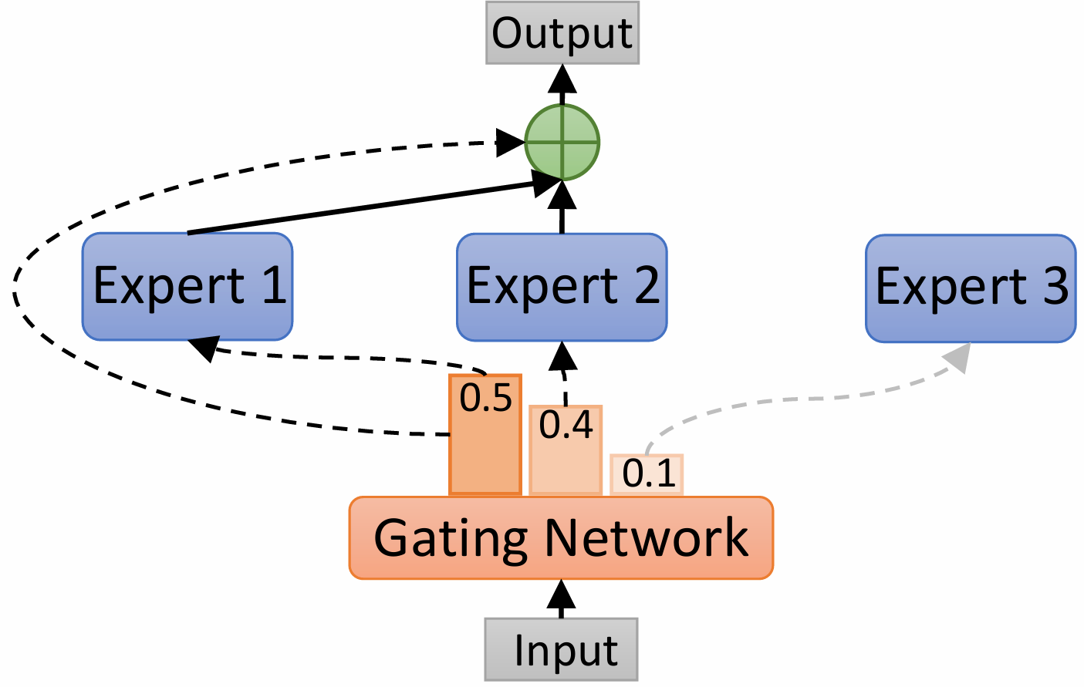
MoE?

Slide 8
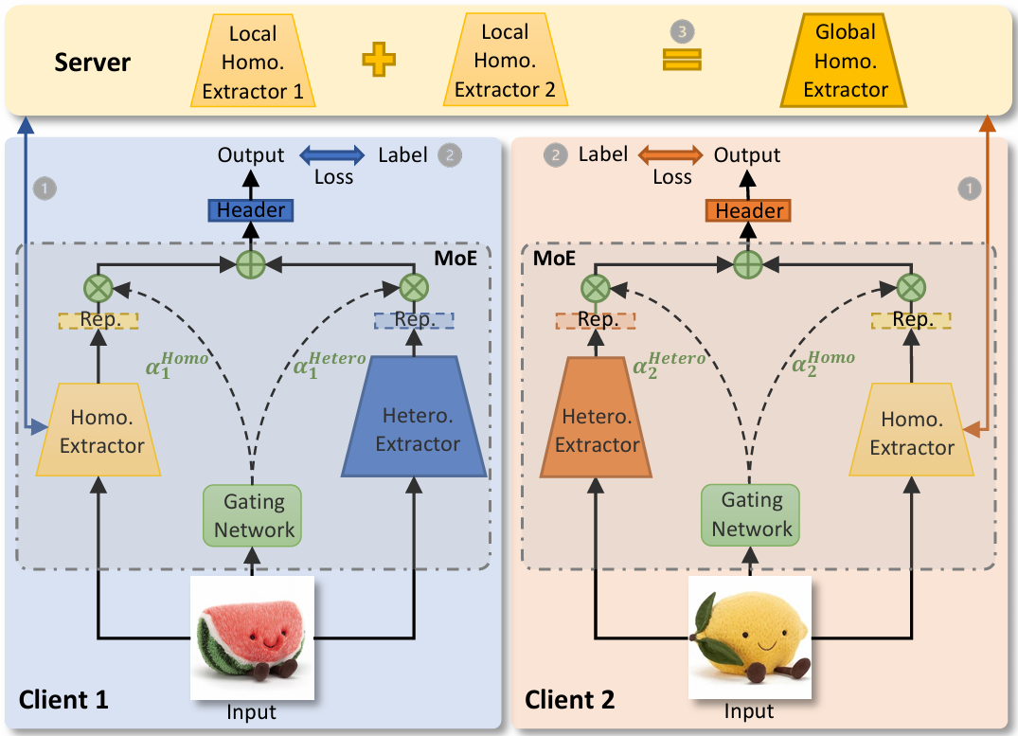
pFedMoE

Slide 9






inference
local header
local header
gating
network
hetero
extracter

Slide 10
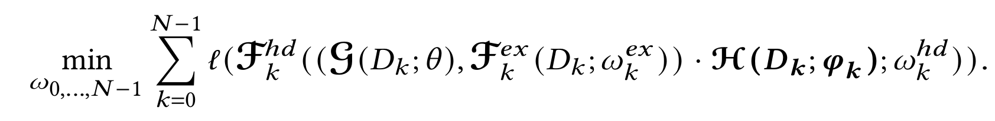
training
homo
extracter
local header
hetero
extracter
gating
network

Slide 11


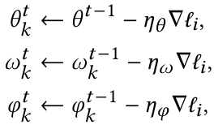
training
local
server
cross entropy
FedAvg
SGD

Slide 12
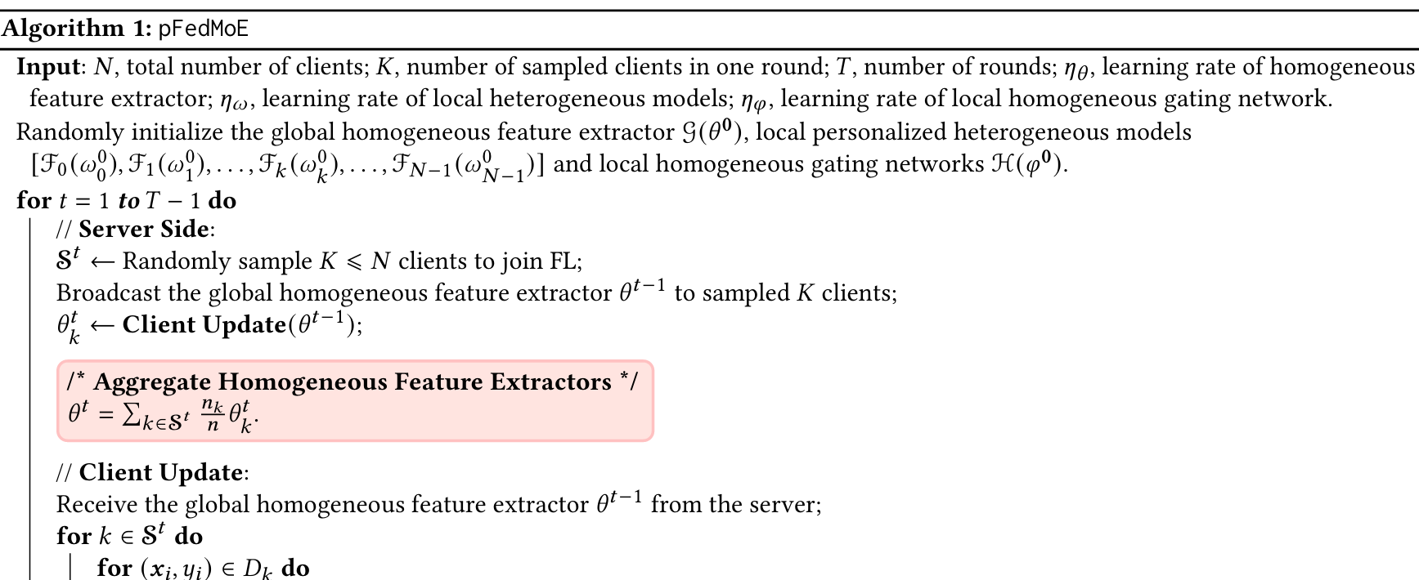
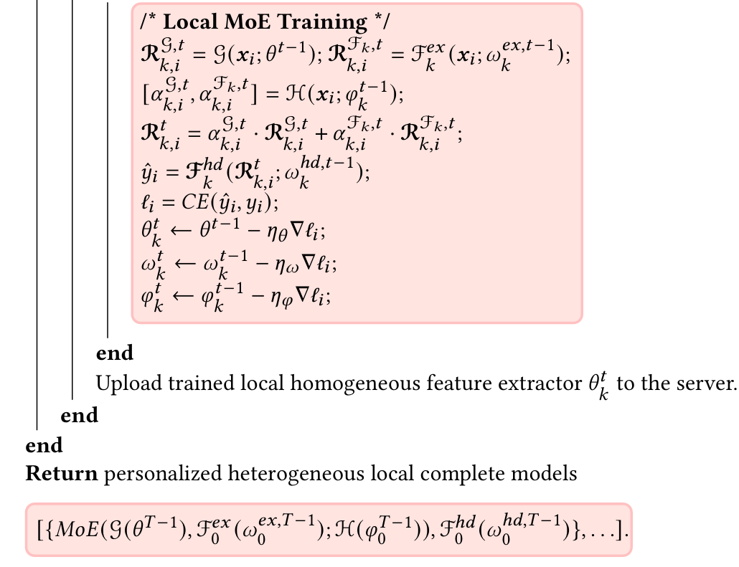

Slide 13
Analysis

Slide 14
Experiment Setup
dataset
CIFAR-10
CIFAR-100

Slide 15
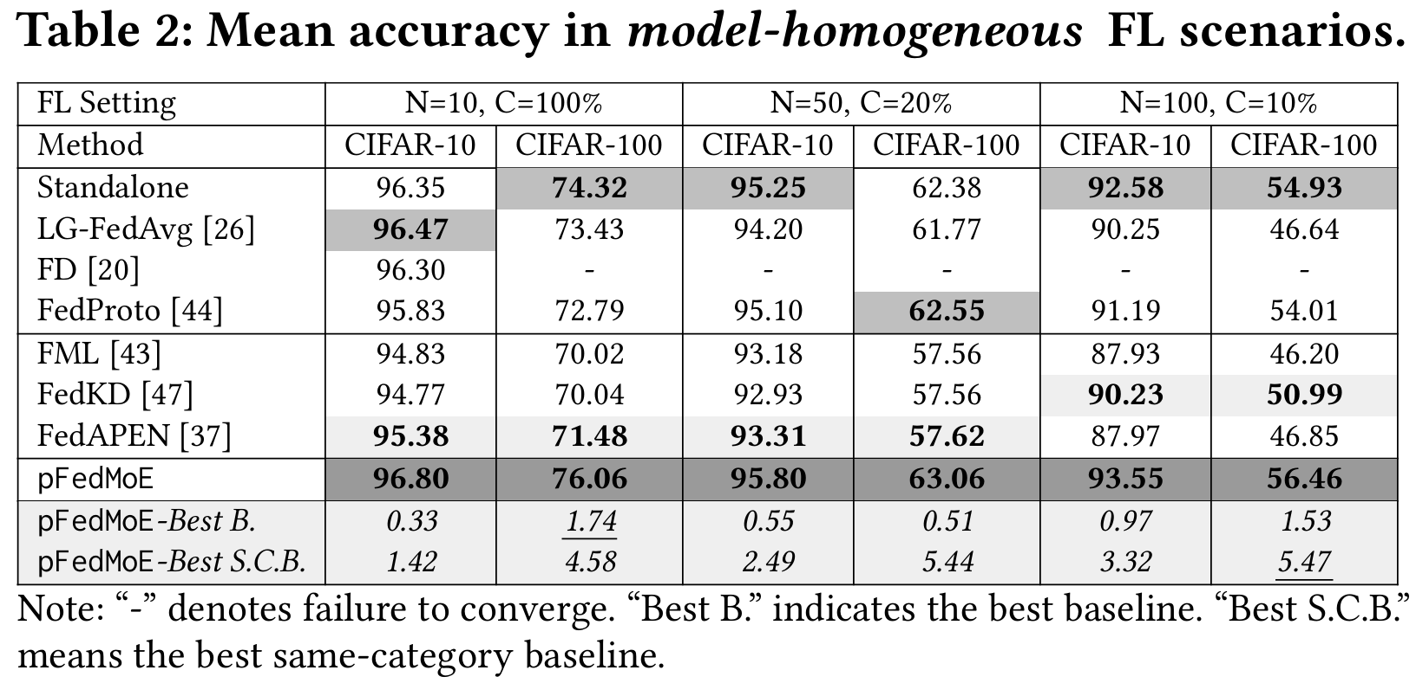
Result

Slide 16
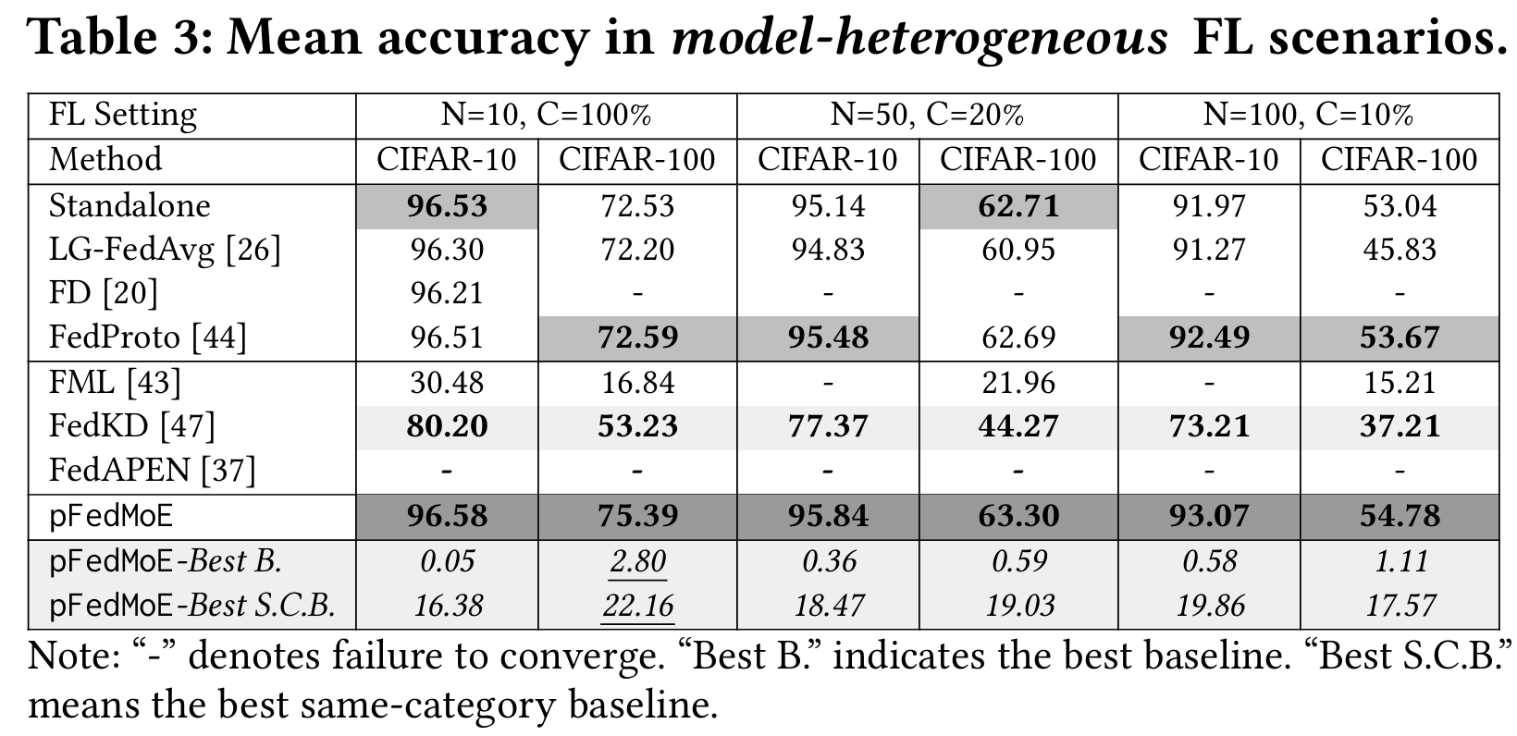
Result

Slide 17
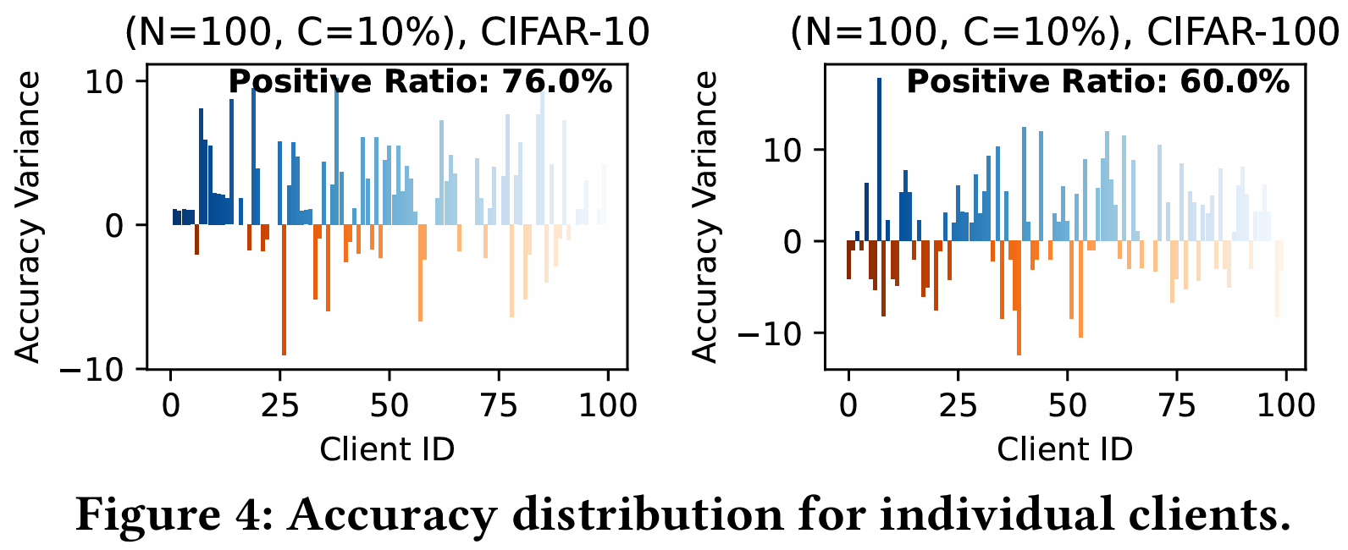
Result

Slide 18
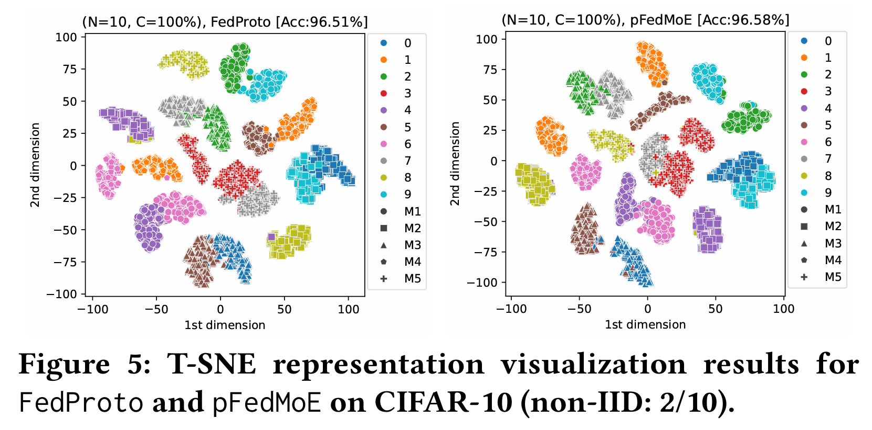
Result

Slide 19
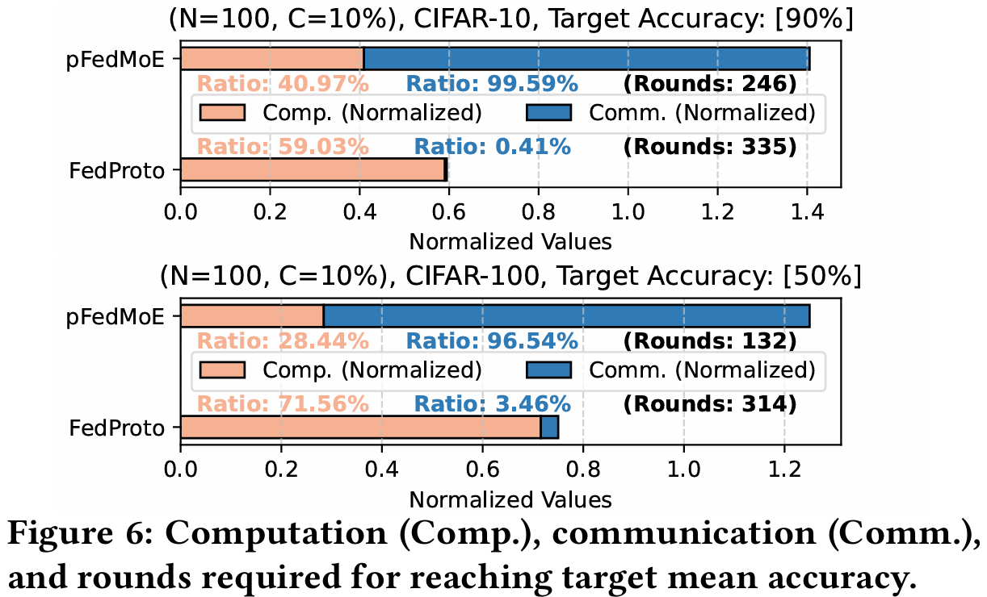
Result

Slide 20
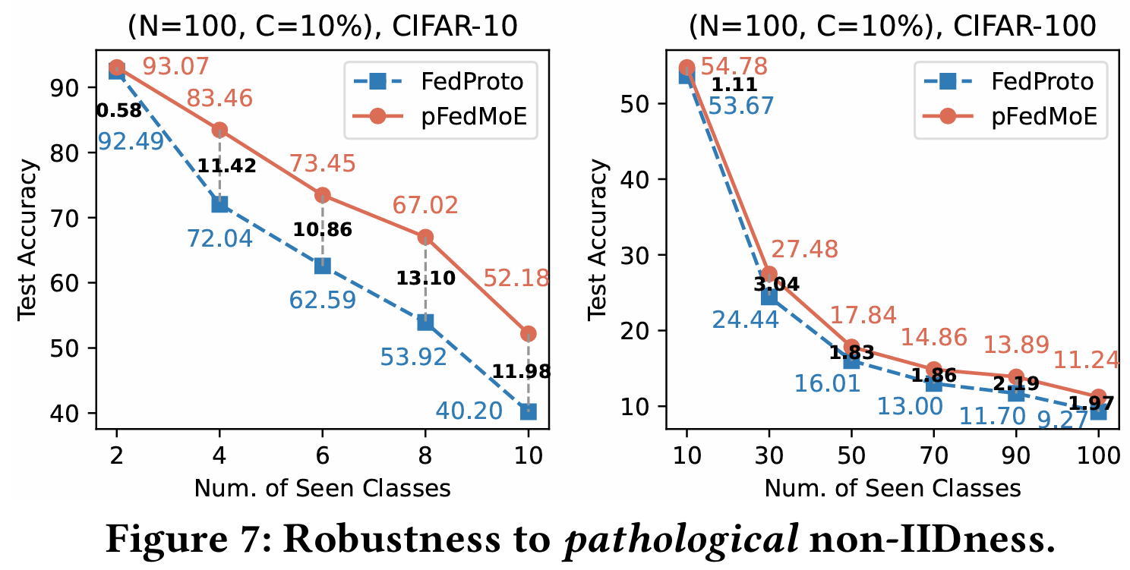
Result

Slide 21
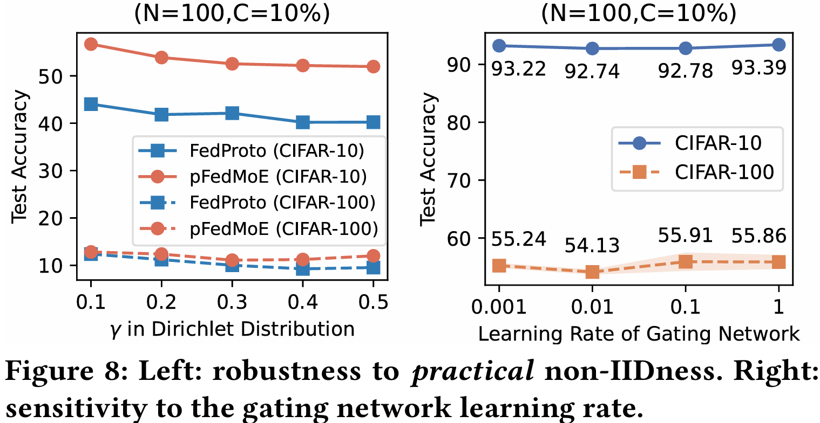
Result

Slide 22
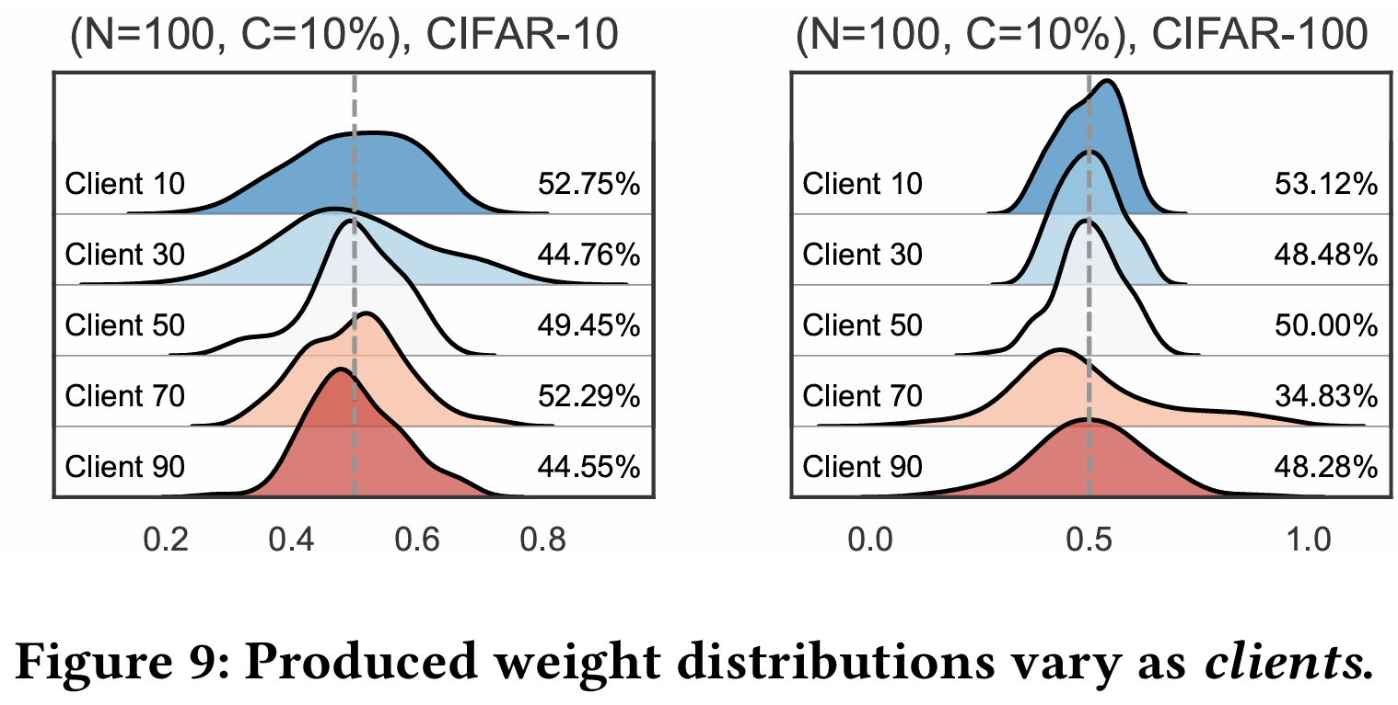
Result

Slide 23
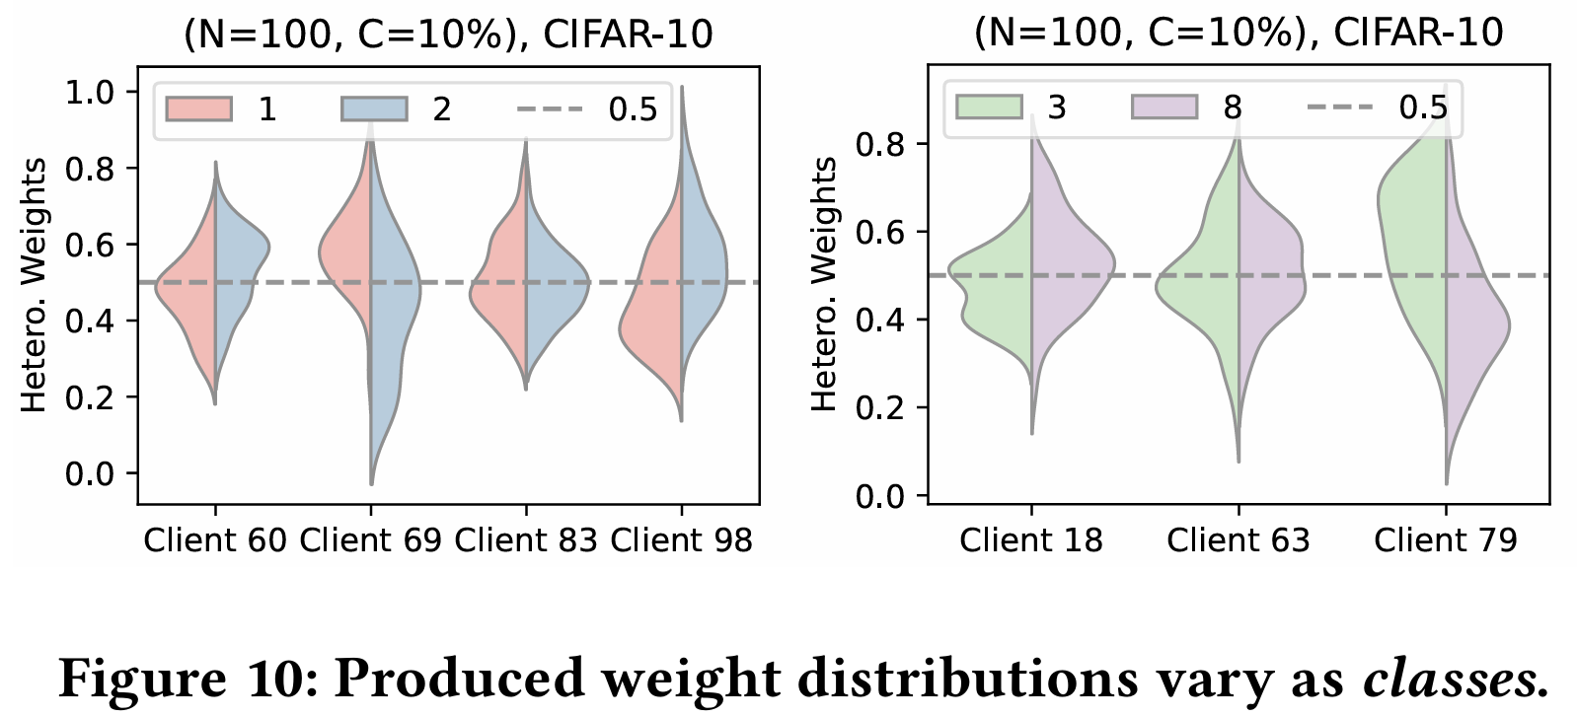
Result

Slide 24
Conclusions

