Slide 1
Results
202212_AMM_Gamma_vs_Derivatives_Gamma

Slide 2
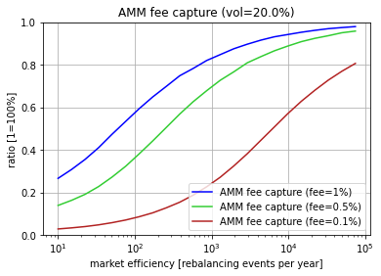
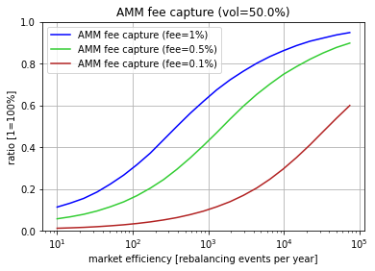

Slide 3
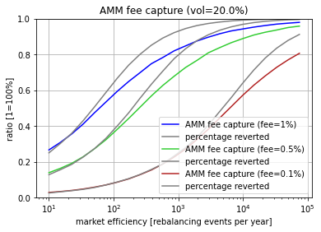
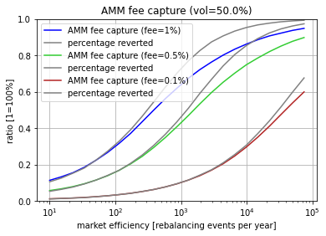
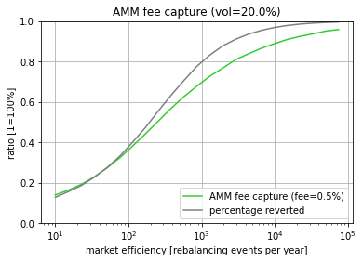
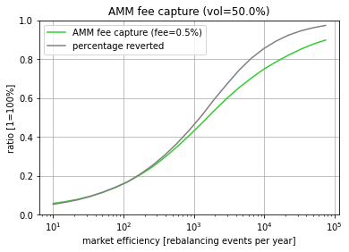

Slide 4
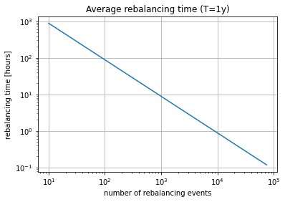

Slide 5
+Gamma Income
+
-
Arbitrageurs
(Market)
Option Buyer (hedging)
The
AMM
Triangle
-
+
+Fee Income
+Option Profile
+
-
Liquidity Provider

Slide 6
PASTE AREA

