Slide 1
THE CUMULATIVE ATTRITION RISK HYPOTHESIS
Strain, Embeddedness, and the Limits of Pay
“Employees rarely leave because of one factor — work-life strain accumulates, and pay only helps up to a point.”
Tzlil Hayne · Oded Shmuely · Amit Shaimen · Topaz Sarid
SISE2601 · Data Analysis Project
Notes:
One-line hook: people don't leave over one thing; strain stacks up, and pay can't fully fix it. State the title and the team. Keep it to ~20 seconds.

Slide 2
Why employee attrition matters
Replacing an employee is costly — and in this dataset, 16.1% of employees left.
An employee
leaves
→
Recruiting &
training a replacement
→
Lost productivity
until ramp-up
Understanding why people leave helps focus retention where it matters.
Notes:
Attrition is expensive: recruiting, training, and lost productivity until the new hire ramps up. So firms want to know WHY people leave. In our data, 16.1% left. ~40 sec.

Slide 3
What we build on
Prior research | Our extension
Pay predicts turnover, but is not the strongest factor (Griffeth et al., 2000) | We test whether pay still helps under high strain
Overtime and heavy demands raise work pressure and turnover (Wong et al., 2024) | We test the accumulation of factors, not each one alone
Embeddedness: workers with more ties leave less (Mitchell et al., 2001) | We use single status as a marker of lower embeddedness
Notes:
Show we know the field. Three strands: (1) pay matters but is secondary; (2) work demands drive turnover; (3) embeddedness explains why singles leave more. Our contribution is the right column — we test accumulation and the limits of pay. ~70 sec. This slide answers the 20-point 'prior work' criterion.

Slide 4
RESEARCH QUESTION
How does the accumulation of overtime, business travel, and single status relate to employee attrition — and does higher pay weaken this link?
Hypothesis: attrition increases as strain markers accumulate, while pay becomes less protective under high strain.
Notes:
Read the question once, clearly. Then the hypothesis: more strain markers → more leaving, and pay helps less as strain rises. ~30 sec.

Slide 5
The data
Dataset | IBM HR Analytics Employee Attrition (synthetic)
Unit of analysis | One employee per row
Employees | 1,470 (no missing values)
Target | Attrition — Yes / No
Key features | Overtime, business travel, marital status, income, job level, age, tenure
16.1%
of employees left
237 of 1,470 · imbalanced classes
Notes:
Quick data tour: 1,470 employees, synthetic IBM dataset, no missing values. Target is leave/stay; only 16.1% left, so the classes are imbalanced. We verified there are no impossible age/experience values. ~40 sec.

Slide 6
How we tested it
1
2
3
Data preparation
Feature construction
Analysis
Clean the dataset, drop non-informative columns, and select the key variables.
Build a strain score (0–3) from overtime + any travel + single, and split income into low / medium / high.
Fit logistic regression, add seniority controls, and run validity checks.
Notes:
Three steps: prepare the data, build the strain score and pay groups, then run logistic regression with seniority controls and validity checks. Emphasize the strain score is just a 0–3 count. ~50 sec.

Slide 7
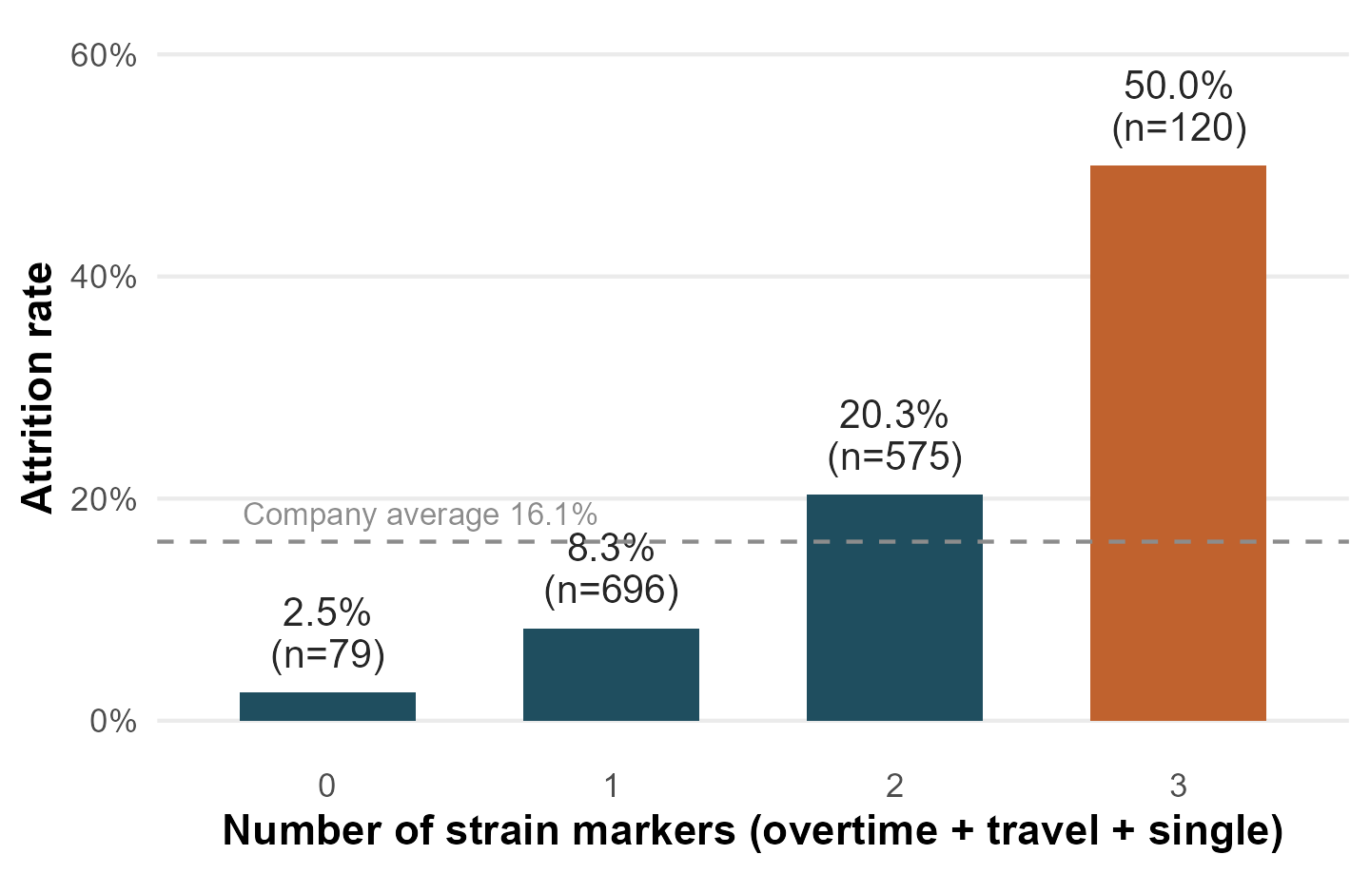
Attrition rises sharply as strain factors accumulate
50%
leave with all three markers
vs. just 2.5% with none — each added marker roughly triples the odds of leaving.
Notes:
Headline finding. As markers stack from 0 to 3, attrition climbs 2.5% → 8.3% → 20.3% → 50%. Each extra marker roughly triples the odds (OR ≈ 3.2), and the trend is significant. This is the core of the project. ~50 sec.

Slide 8
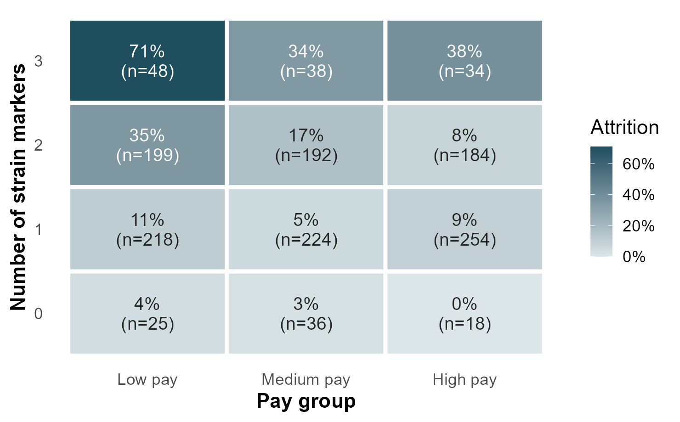
Pay helps under low strain — but cannot offset high strain
At low strain, higher pay clearly lowers attrition. At high strain, attrition stays high even for medium- and high-pay employees — extra pay no longer helps.
Notes:
Reading the heatmap: down each column, pay lowers attrition; but across the top row (high strain) it flattens. Single employees who work overtime stay around 36% even at high pay. Money buys back one factor, not several. Note small cells — read as indicative. ~50 sec.

Slide 9
Validity, limitations & takeaway
Validity
Limitations
Takeaway
Controlled for age, job level, and tenure. Checked whether the income effect is really seniority — it largely is (a Simpson's-paradox pattern).
Dataset is synthetic. Cross-sectional — associations, not causation. The highest-strain pay groups are small, so exact percentages are indicative.
Strain accumulates, and pay is not a complete retention strategy.
To keep people, reduce stacked strain — don't rely on pay alone.
Notes:
Close strong. Validity: we ruled out seniority as the real driver of the pay effect. Limitations: synthetic, cross-sectional, small cells. Takeaway: strain stacks, and pay alone won't retain people. ~50 sec.

Slide 10
Thank you
Questions?
The Cumulative Attrition Risk Hypothesis · Tzlil, Oded, Amit, Topaz
Notes:
Thank the audience and invite questions. Make sure to finish on time.

