Slide 1
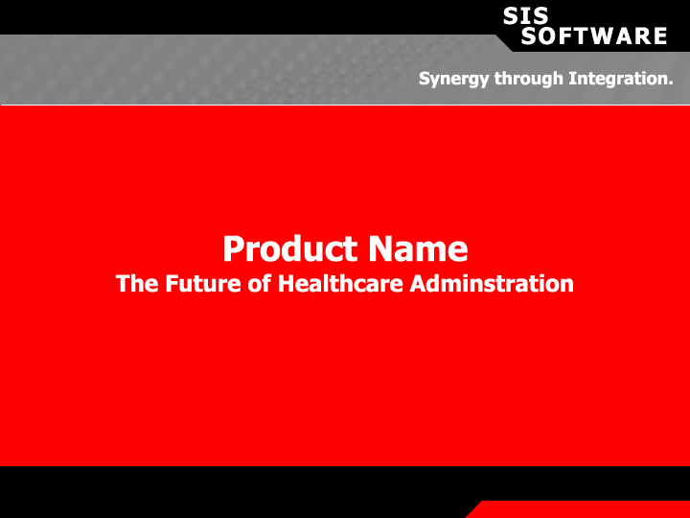

Slide 2
Introduction
.:: Insurance Industry Traditionally has Not Embraced Modern Technology
.:: Health Care Administration Undergoing Technological Revolution
.:: Current Systems Incapable of Delivering Necessary Technical Advances
.:: TopCoder Introduces New Method of Software Development

Slide 3
TopCoder Membership
.:: Community of Highly Talented Software Developers
.:: Developers are Differentiated through a Series of Matches and Tournaments by which they Receive a TopCoder Rating
.:: Rating Used to Rank them Amongst their Peers

Slide 4
TopCoder Software Advantages
.:: Access to Virtually Unlimited Base of Software Developers Differentiated by Talent
.:: Employs Highest Quality Project Managers and Lead Architects
.:: Manages Distributed Development Environment
.:: Delivers Highest Quality Software
: Standardized Distributed Development Methodology
: Performance Based Work Allocation Model
: Reusable Standardized Components

Slide 5
Product Delivery
.:: Application Service Provider
: Economies of Scale over Multiple Customers
: Extensive Industry Data and Reporting
: Service Based Payment

Slide 6
TopCoder Software Competitive Advantage
.:: Higher Quality Software
.:: Lower Software Development Costs
.:: Faster Software Development

Slide 7
What Will the TPA Face in the Next 3 Years?
.:: The competition is getting tougher with more TPA’s merging and only the strong will survive
.:: There will be a lot more government interference and regulation
.:: There will be further refining of the HIPAA electronic regulations with tougher requirements
.:: The employers will require more information not data, as they struggle to find ways to save employee benefit dollars
.:: Employees will make more of the health care decisions and they will demand information to do it

Slide 8
What Will the TPA Face in the Next 3 Years?
.:: There will be tremendous downward pressure on administrative fees as employers look for savings
.:: Technology will have return huge cost savings to keep TPA’s in business
.:: Technology will be the defining characteristic of the best and most successful TPA’s

Slide 9
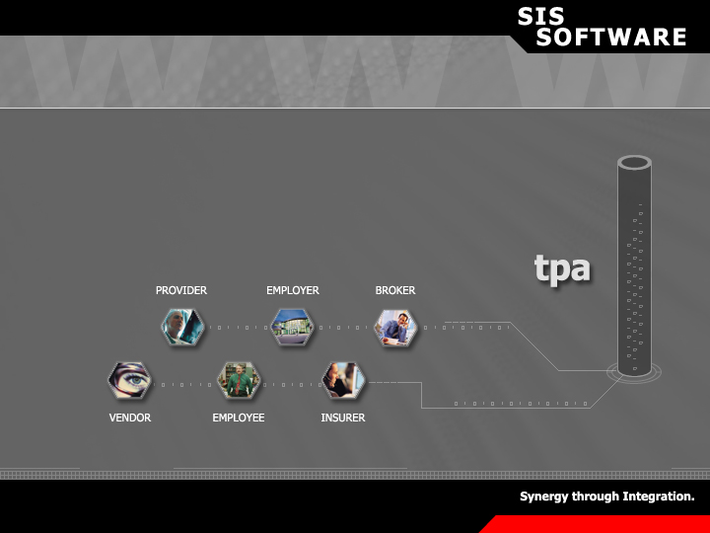
What is Web-based Administration?
.:: It is a Web based ASP offering fully vertically integrated
health care administration with state of the art functionality

Slide 10
What is Web-based Administration Not?
.:: It is not old software updated and strung together with other software to appear web enabled
.:: It is not your current old software attached to a Web site for communications
.:: It is not disparate systems that are Web based for only certain functionality

Slide 11
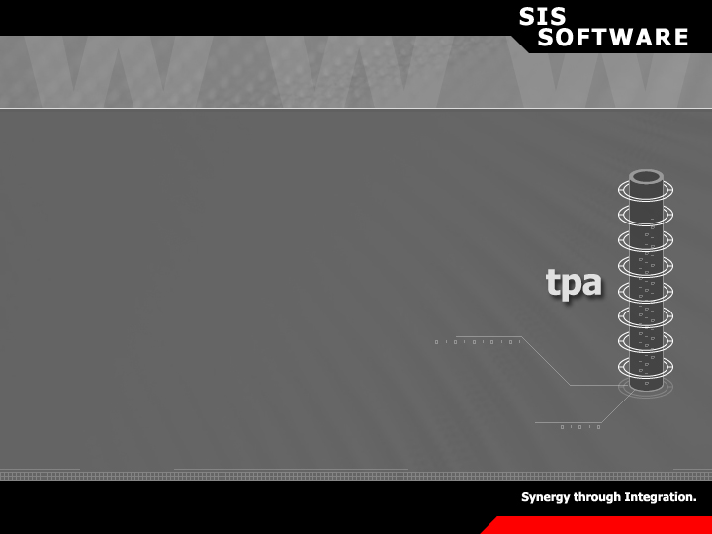
Why PRODUCT NAME
.:: Buying a piece of software (license) and loading it on your hardware is antiquated and very expensive to maintain
.:: ASP’s are the future of most software delivery. They are less costly and much more efficient to use
.:: ASP’s are reliable and secure
.:: {Product Name} will progressively evolve for:
:Technical Enhancements
:Standard Compliance (HIPAA)
:Functional Enhancements

Slide 12
Why PRODUCT NAME
.:: Integrated ASP software can be more readily accessed by a variety of users than traditional “housed” software
.:: Since TPA’s have so many customers/users the ASP environment is a perfect platform

Slide 13
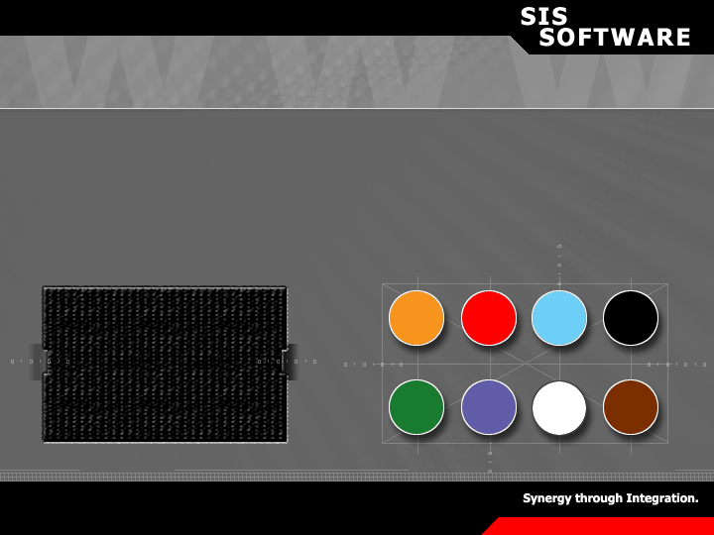
Why PRODUCT NAME
.:: Flexibility is the Key to Success with Customers
Legacy Applications are often monolithic, inflexible and costly to modify
{product name} is a loosely coupled set of integrated components that is flexible and inexpensive to modify

Slide 14
What Will PRODUCT Do for a TPA?
.:: Since all modules are fully integrated there is no loss of information at any point in the client continuum
.:: As a ASP {product name} can cut TPA costs significantly and allow them to provide more to their clients
.:: With lower costs the TPA can gain market share and thus dominate their area or niche
.:: With more information the TPA can offer clients and vendors services not available today

Slide 15
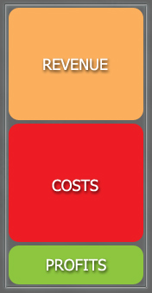
Current Situation
.:: More Competition
.:: Downward Pressure on Pricing
.:: Rising Costs
.:: Smaller Margins

Slide 16
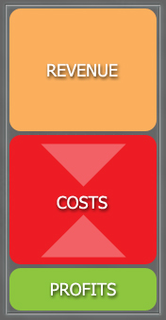
PRODUCT Will Decrease Costs
.:: Performs More Functions Electronically
.:: Push Costs of Receiving Information Back to User
.:: Less Costly Reporting
.:: Faster Return on Receivables
.:: Greater Provider Discounts

Slide 17
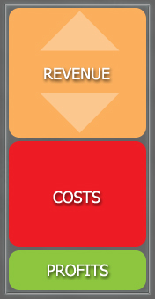
PRODUCT Will Increase Revenue
.:: TPA Can Lower Pricing due to Lower Cost Base
.:: TPA can Offer New Services for Additional Fees
.:: TPA can Increase Market Share

Slide 18
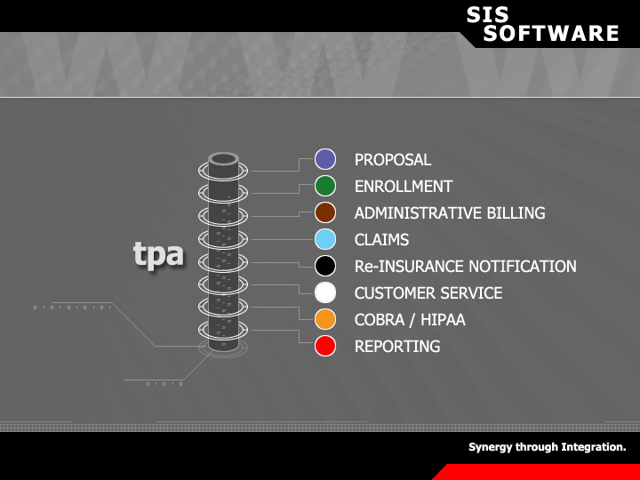
Synergy through Integration.TM

Slide 19
The System Layout
.:: The system is solely based on the administrative functions that a TPA performs
.:: The various modules are all fully integrated for seamless data transfer
.:: The entire system is programmed using JAVA following Sun’s J2EE Standards
.:: The system is designed to function only as a ASP and Web based application
.:: The system will be dynamic continually evolving as only an ASP can

Slide 20
PRODUCT NAME

Slide 21
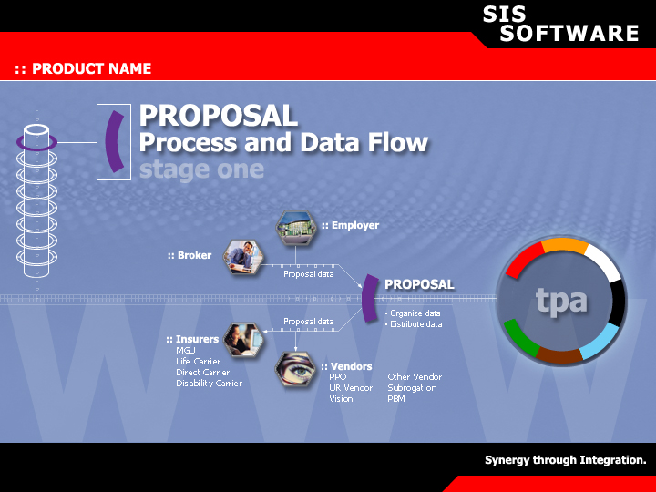

Slide 22


Slide 23
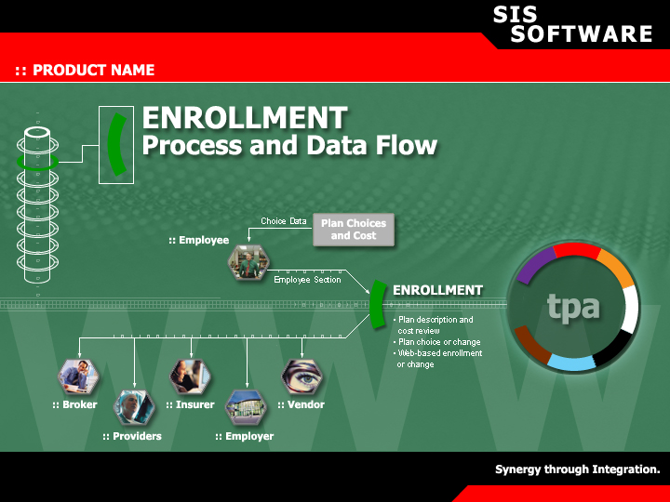

Slide 24
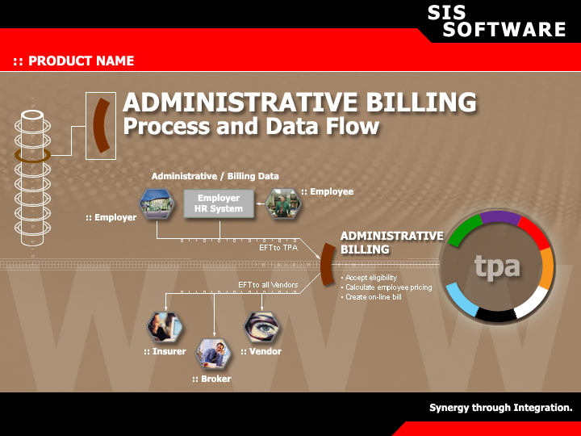

Slide 25
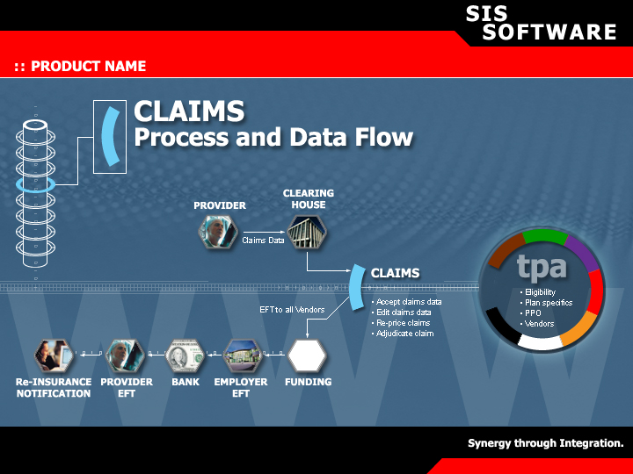

Slide 26
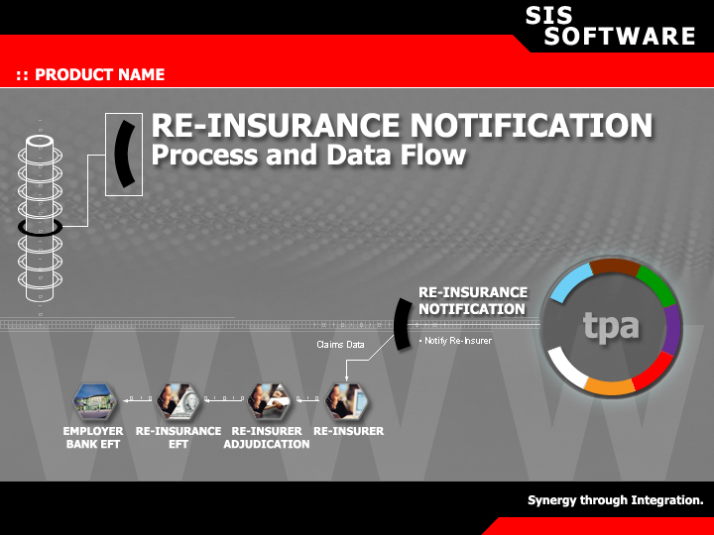

Slide 27
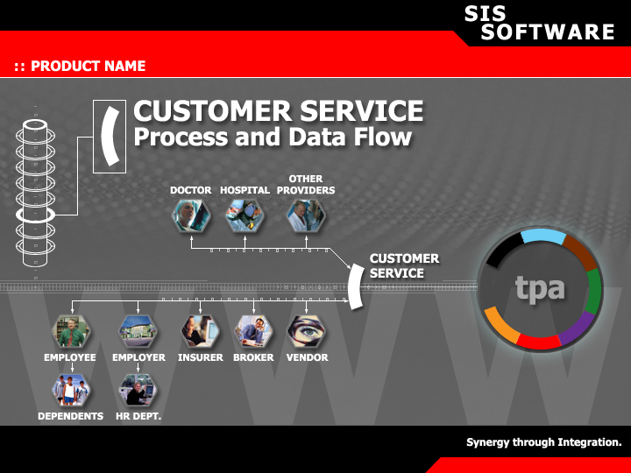

Slide 28
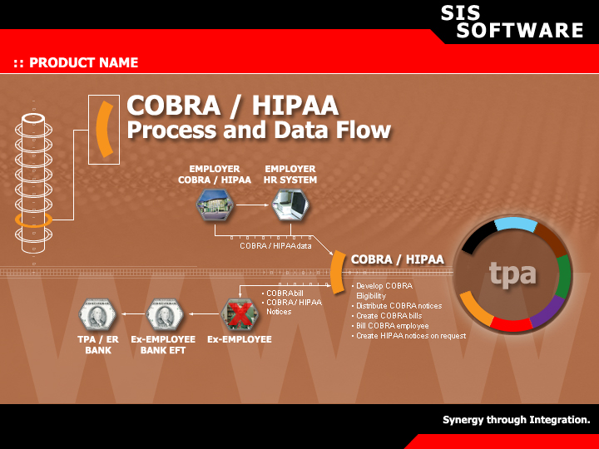

Slide 29
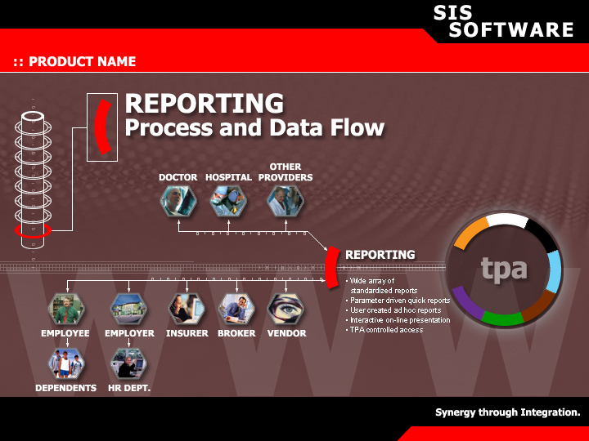

Slide 30
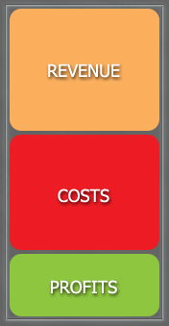
What Can a TPA Save with PRODUCT?
.:: The TPA will save in the following areas:
: Sales
: Enrollment
: Case Administration
: Billing
: Claims
: Customer Service
: Management

Slide 31
How Much Additional Revenue can be Generated?
.:: What will increase revenue?
: New Services Revenue
: Additional Sales Through
- Lower Prices
- Ease of Information Access
- System Flexibility

Slide 32
Profit Analysis
.:: Increase in Profits is 75%
.:: Decrease in Costs is 50%
.:: Total Revenue Increases 10%

Slide 33
Next Steps
.:: SIS SOFTWARE is selecting development partners
.:: Development partner benefits
: TPA Name business specification used to define PRODUCT system requirements
: Partner pricing
: Limited competitive protection
: Advisory Board seat

Slide 34
Next Steps
.:: Development partner responsibilities
: Dedicated resources for system development
: Dedicated resources for system testing
: Dedicated resources for beta testing
: Escrow portion of first payment
: Migrate administrative lives to PRODUCT
: Continue as reference and demonstration customer

