Slide 1

Growing Your Rails App
Dan Cunning
Rails contractor since '08
Cunning Simplicity, Inc.
http://topdan.com

Slide 2


Growing Your Rails App
Photo by Ragesoss
GNU Free Documentation
Photo by Nate Steiner
Creative Commons Attribution

Slide 3
Rails Architecture
Request
Route
Models
Database
Jobs
Controller
Mailers
View
Helpers
Response

Slide 4
Controller Tip #1
Stick to the standard actions
index show new create edit update destroy
Keeps your controllers small
Builds RESTful Resources

Slide 5
Controller Tip #2
Pull logic into services
Services are “Plain Old Ruby Objects” (PORO) that consolidate logic, save models, queue background jobs and emails.
Keeps your controller thin and secure
Simplifies the controller's control flow

Slide 6
Models Tip #1
Treat models like API documentation for your database
ActiveRecord is just a really nice way to access the database.
Keeps your models thin
Builds a solid foundation for your app

Slide 7
Models Tip #2
Only use nouns, avoid verbs
Nouns / Properties:
user.name
user.receives_emails?
post.published?
order.total
Verbs / Methods:
user.unsubscribe!
user.send_welcome_email
post.publish!
order.calculate_total

Slide 8
Jobs Tip #1
Avoid nouns, only use verbs
Jobs and mailers act on models.
Users::Unsubscribe(user).perform_later
UsersMailer.welcome(user).deliver_later
Posts::Publish(post).perform_later
Orders::CalculateTotal(order).perform_now

Slide 9
Jobs Tip #2
Break jobs into smaller jobs
Processes in parallel
Avoids interruptions during restart
Minimizes side-effects of exceptions

Slide 10
Mailers Tip #1
Never use deliver_now
SMTP and HTTP requests will eventually fail
Why is this code a support nightmare?
User.receives_newsletter.find_each do |user|
UsersMailer.newsletter(user).deliver_now
end

Slide 11
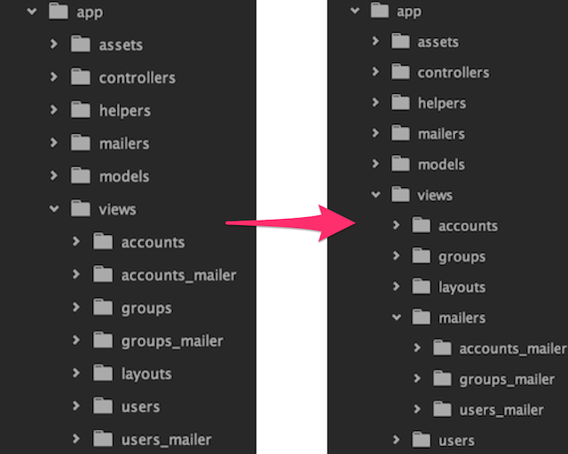
Mailers Tip #2
Group views inside app/views/mailers

Slide 12
Views Tip #1
Avoid most logic
Limit yourself to simple loops and if statements
Place all other logic inside helpers

Slide 13
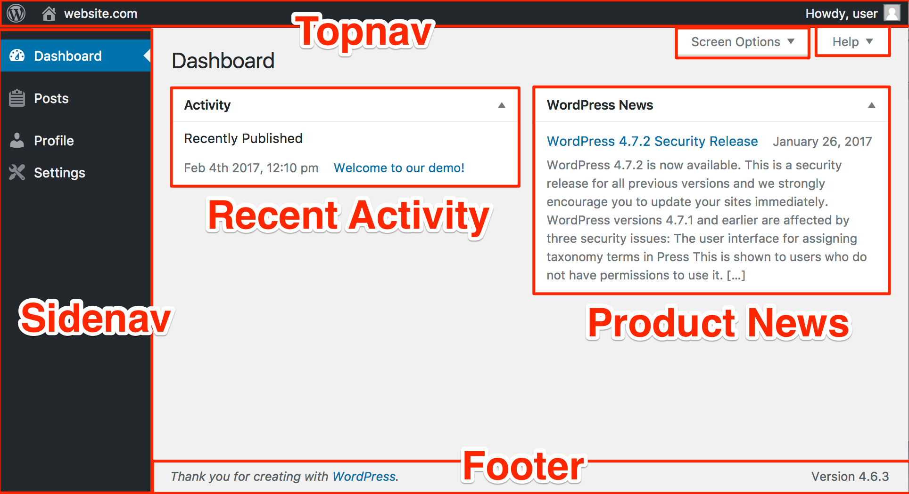
Views Tip #2
Break them into visual pieces

Slide 14
Helpers Tip #1
Break helpers into
view components
View components are “Plain Old Ruby Objects” (PORO) that fill in the details of rendering a visual element.
Keeps your helper modules small
Allows benefits of OO design

Slide 15
Helpers Tip #2
Do not include all helpers
Helps you create a solid foundation of shared modules
Ensures most helpers only help certain views, so the method names can be shorter
config.action_controller.include_all_helpers = false

Slide 16
Application Architecture
Request
Route
Models
Database
Jobs
Controller
Service
Mailers
View
Helpers
View
Components
Response

Slide 17
Major Point
Plan your Rails architecture,
set its convention, and
never compromise
Avoids the broken window theory
Keeps your greenfield project feeling green

Slide 18
Growing Your Rails App
Dan Cunning
http://topdan.com
Photo by Ragesoss
GNU Free Documentation

