Slide 1
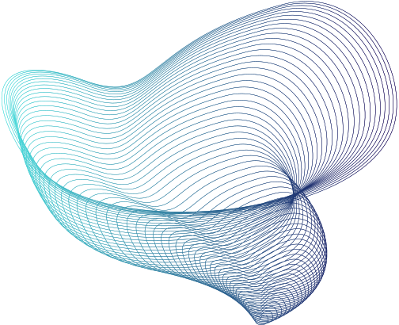
Home
Service
About Us
Contact
DESIGN IN WEB DIGITAL MEDIA
Web System Technologies 7

Slide 2

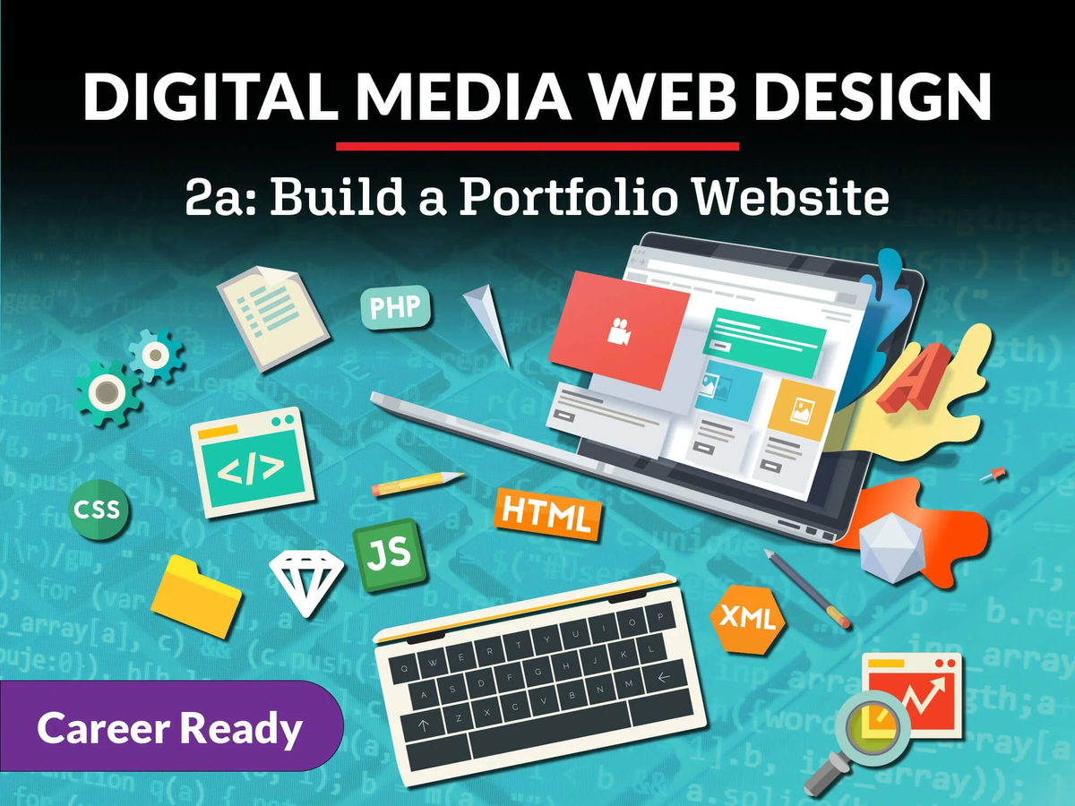

DESIGN IN WEB DIGITAL MEDIA
Home
Service
About Us
Contact
DIGITAL MEDIA DESIGN FOR THE WEB
Digital media has had a far-reaching and multifaceted impact on society and culture. Digital media has created disruptive innovation in publishing, journalism, public relations, entertainment, education, business, and politics due to the Internet and personal computers. Functionality is crucial when a developer designs a website. Developers rely on a deep understanding of coding languages to create websites that respond to various devices and browsers. Furthermore, they consider the site's enduser experience; it should result in a positive experience.

Slide 3
DESIGN IN WEB DIGITAL MEDIA
Home
Service
About Us
Contact
FORM FOLLOWS FUNCTION
Today, Web, mobile app, user interfaces, and game designers and developers lead the pack in determining how the public interacts with text and visuals. The list could go on, but the point is you live with the design. Despite its variety, all design is related through the expression, "Form follows function." Good design results from a partnership between form as art and function as a utility.

Slide 4
DESIGN IN WEB DIGITAL MEDIA
Home
Service
About Us
Contact
FORM
refers to material artistry—what something looks like. Design, triggered by the industrial revolution and mass production capitalism (function), grew out of and continues to be inspired by the visual and even performing arts (form). Most designers have some background or training in art. Knowing something about art can improve your eye for design. But what people consider aesthetically beautiful, or even interesting changes across history, cultures, and individuals.

Slide 5
DESIGN IN WEB DIGITAL MEDIA
Home
Service
About Us
Contact
AESTHETICS
a branch of philosophy, deals with the expression and perception of beauty—your aesthetic dictates what you like in terms of style. Unlike fine artists, however, designers don't have the luxury of creating art for art's sake or wholly yielding to personal taste. Design always has a job to do, and that job influences the design's form. The design has to be practical. The function in "form follows function" refers to the usefulness of the design, whether it's an ergonomic mechanical keyboard in your desktop computer or your keyboard manufacturer's website

Slide 6
DESIGN IN WEB DIGITAL MEDIA
Home
Service
About Us
Contact
PLANNING A GRAPHIC DESIGN
Technically, "graphic design" refers to a plan for organizing visual objects in space. Generally, that space is a two-dimensional plane, meaning a flat surface such as paper or an electronic screen. The key ideas are "plan" and "organize" for "communication." If you were writing a speech or research report, you would organize your thoughts logically and practically. In graphic design, you manage all your elements from copy (text) to visuals (pictures) logically and effectively.

Slide 7
DESIGN IN WEB DIGITAL MEDIA
Home
Service
About Us
Contact
GOOD GRAPHIC DESIGN DOES FOUR THINGS:
1. It captures attention,
2. Controls the eye's movement across the screen or page,
3. Conveys information
4. Evokes emotion.
Graphic design refers to your plan for capturing the audience's attention from among everything else competing for its interest. Once you have the audience looking at your design, its arrangement or layout should control the audience's eyes to move in a particular sequence from one thing to the next on the screen or page. The whole point of guiding the eye is to convey information. Think eye-catching, flowing, interesting, and evocative. Now you need some building blocks for capturing, controlling, conveying, and evoking. In the simplest sense, effective design and layout team-up pictures and words to communicate a unified message, regardless of the visual medium or vehicle. At the risk of oversimplifying, you have only three building blocks: visuals, typography, and space.

Slide 8
DESIGN IN WEB DIGITAL MEDIA
Home
Service
About Us
Contact
VISUALS
Symbols, icons, drawings, illustrations, photographs, film, and video, etc

Slide 9
DESIGN IN WEB DIGITAL MEDIA
Home
Service
About Us
Contact
TYPOGRAPHY
We represent copy graphically with typography, a visual form of language. But words may be defined with handwriting, such as calligraphy or even pictures. And type treatments can make beautiful visuals. Additionally, some kinds of visuals, such as logos and infographics, require text.

Slide 10
DESIGN IN WEB DIGITAL MEDIA
Home
Service
About Us
Contact
SPACE
This is the sandbox that encourages visuals and typography to play well together. Beginners often make the mistake of forgetting to account for space. Too much space and visuals and type get lost or don't talk to each other. Not enough space and they start to fight with each other

Slide 11
DESIGN IN WEB DIGITAL MEDIA
Home
Service
About Us
Contact
The idea is to arrange visuals and type harmoniously in space. Don't think of space as immaterial or invisible. Nor is space a vacuum to be filled. Space is real, even when we call it white space, or more appropriately, negative space. Negative space always has weight and structure in graphic design. Amateurs tend to pack every part of the space with visuals and type.

Slide 12
Home
Service
About Us
Contact
LAYOUT DESIGN
Web System Technologies 7

Slide 13
LAYOUT DESIGN
Home
Service
About Us
Contact
THE IMPORTANCE OF LAYOUT
As readers, we enter a layout in the upper-left corner and exit in the lower-right corner. A layout is essential since one of the functions of good design is to control the eye’s movement across the layout; the direction and order in which we read dictates the order of things on a compelling layout. A good layout works because of how Westerners read: from left to right and from top to bottom.

Slide 14
LAYOUT DESIGN
Home
Service
About Us
Contact
PARTS OF A LAYOUT
1. Outer boundaries and margins
2. Columns
3. Visual + optional cutline
4. Headline
5. Copy
6. Tags

Slide 15
LAYOUT DESIGN
Home
Service
About Us
Contact
STEP 1: OUTER BOUNDARIES & MARGINS
First, set up your layout in the desired size. This creates your outer boundaries. Next, before you do anything else, lay margins inside those boundaries—on all four sides. Think of your margins as a frame that ensures the vital content inside is both readable and visible. Be generous with your margins. Use a minimum of half-inch margins on a small ad or flyer, for example. In print layouts, the size of your margins should grow in proportion to the size of your layout.

Slide 16
LAYOUT DESIGN
Home
Service
About Us
Contact
STEP 2: COLUMN
Now, inside your margins, divide your layout into vertical columns. People will avoid reading long horizontal lines of type and big chunks of text. Because type presented in columns means shorter lines and narrower pieces, columns become a kind of trick of the eye that says, “Come on, reading this won’t take long.” If your layout is a smaller ad or flyer, two columns are probably adequate. You may need more columns if your layout is more prominent, and you have more copy—thread copies from one column to the next. Or use one column for a copy. And the other for images, tags, or sidebar content. Columns are similarly used in Web layouts where it’s common to place a copy in one column and sidebar content (banner ads, widgets, etc.) in the other. In all types of columnar layouts, make sure the alley of negative space separating your columns isn’t too small or too big. Your goal is enough space to keep columns visually separate but still cohesive. Bottom line, unless your layout is very narrow, don’t make your copy span the entire width of your layout.

Slide 17
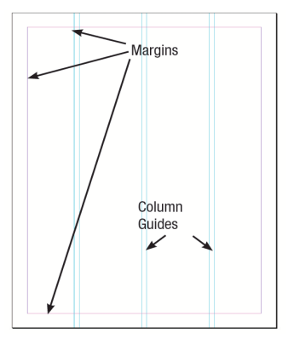
LAYOUT DESIGN
Home
Service
About Us
Contact
STEP 2: COLUMN
Columns and Margins: An 8.5 x 11- inch flyer with a -inch margin on all four sides. Black lines indicate the document boundary. Pink and purple lines indicate margin lines. Blue lines delineate the columns and the alleys.
02

Slide 18
LAYOUT DESIGN
Home
Service
About Us
Contact
STEP 3: VISUAL + OPTIONAL CAPTION NEXT, POSITION THE VISUAL.
The visual is your tool for capturing the audience’s attention. On the layout, the visual goes at the top of the layout. The visual becomes the eye entry point into your layout and is the starting point of a viewing flow that takes the audience from top to bottom. In Web layouts, the upper left corner of the screen is an essential visual hotspot, and your logo or site name should fill this spot. Position your key visual below the logo.
If your layout is for print, hang your visual from the top of the page, the top margin, or the top of your story. Caption/cutline option. Depending on the purpose of your layout, your visuals may not need captions. If you have to explain your visual with a caption, then your visual probably is not the best choice for advertising. For most editorial visuals, including those for print news, broadcast news, magazines, and some websites, a caption, or “cutline,” is required. If you do need a cutline, set it directly underneath the visual. Make your cutline span the width of your visual, and style it flush left, ragged right

Slide 19
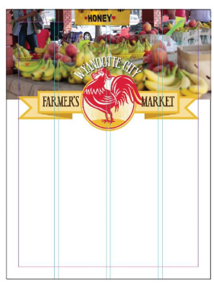
LAYOUT DESIGN
Home
Service
About Us
Contact
STEP 3: VISUAL + OPTIONAL CAPTION NEXT, POSITION THE VISUAL.
Visuals. Position your visual at the top to give your audience an eye entry point at the start of your layout. In this example, the photo and logo work together as one large visual
02

Slide 20
LAYOUT DESIGN
Home
Service
About Us
Contact
STEP 4: HEADLINE
After visuals, headlines have the most significant impact on your layout. Research shows that readers scan before choosing to read. Big, bold headlines provide content information at a glance, and when executed well, encourage readers to dive in. Bold headings and subheadings provide eye entry points to your content. They also help break long copy into bite-sized pieces, which you already know are reader-friendly. In Web design, the reader’s eye may search for navigation and headline before going to the visual. That’s why it’s essential to make Web headlines visually significant. Make your headlines count.
Returning to typographic decisions, you only get to use two fonts on a works-everytime layout. You get one font for the headline and a second font for the body copy. For your headline, choose a font that symbolically goes with your design concept. For example, if you want to communicate streetwise, don’t choose a script-style font that screams traditional wedding invitation.

Slide 21
LAYOUT DESIGN
Home
Service
About Us
Contact
A CAUTION ABOUT HEADLINES:
If you can’t get the whole headline onto one line, then you’ll need to decide where to break the line. Read the copy. The ends of thoughts, clauses, and phrases are good places to break a line. But also consider visual balance. Line lengths should be similar, though not necessarily perfectly even. If breaking after a clause gives you one very long and concise line, rewrite your headline. Finally, never allow hyphenated words to break headlines into two lines. Never strand a single word all by itself in an additional line of a headline, either

Slide 22
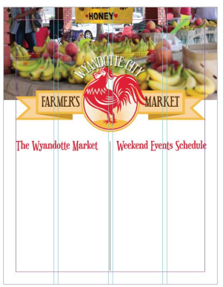
LAYOUT DESIGN
Home
Service
About Us
Contact
STEP 4: HEADLINE
Headlines. Headlines should jump off the page. Make them contrast via a large point size, an interesting font and/or an eye-catching color. Make your headlines span all the columns of type and avoid bad line breaks.
02

Slide 23
LAYOUT DESIGN
Home
Service
About Us
Contact
STEP 5: COPY
Here are some things to remember when creating an excellent typesetting copy to go with your layout.
Keep the headline and the lead together. A lead is the first paragraph of the body copy. Never let anything except a byline come between a headline and its lead. That means don’t let anything physically separate the headline and lead. The eye should finish scanning the headline and flow directly into the lead.
Fit your copy into the column guides created in step 2. A column of copy is called a “leg,” so two columns are two legs. You can entice people to read several short legs of copy when they skip reading exactly the same thing in one very long leg. Don’t go too short, however. Columns that are too short make for choppy reading. Aim for legs somewhere between 2 and 10 inches long. If your copy is too short to fill every column, then fill a column with negative space. It’s okay to leave a column empty.

Slide 24
LAYOUT DESIGN
Home
Service
About Us
Contact
STEP 5: COPY
Here are some things to remember when creating an excellent typesetting copy to go with your layout.
Short paragraphs are just as inviting as shorter legs of a copy. Be concise.
Set your copy in a transparent font. Transparent fonts are easy to read (not seethrough). The eye can focus on reading for content without being distracted with thoughts such as, “Hey, this is an interesting font,” or “Wow, this font is giving me a headache.” Times New Roman (print) and Arial (Web) are today’s ubiquitous transparent fonts. For that very reason, we’re not endorsing them. But do choose a readable font for your body copy, even if that seems uninteresting. Also, make sure your body copy font doesn’t fight with your headline font. Let your headline font be the showoff. For print body copy, start with a font size of 9–11 points. For Web, size varies. Start with 1em and adjust accordingly.

Slide 25
LAYOUT DESIGN
Home
Service
About Us
Contact
STEP 5: COPY
Here are some things to remember when creating an excellent typesetting copy to go with your layout.
Don’t fully justify your text. Flush left, ragged right is your best bet. Next, the width of your column and the size of your type will determine how many words fit on one line. If you’re only getting three to five words per line—and you’re getting a heap of hyphenated words jettisoned to the following line—then you have options: Reduce your font size or make your columns wider, or both. Shoot for six to 12 words per line.
Break paragraphs properly. Regarding sections, don’t indent the lead under a headline. Beyond the lead, if you plan to use indents to mark paragraph breaks, then size your automatic indents at roughly the equivalent of four to five letter spaces of your body copy’s font size. A ½-inch tab, for example, is probably too much. If you plan to use extra spacing between paragraphs as your breaks, don’t indent at all. This approach, by the way, is best for the Web.
Create elegant columns. Really. Look at them. Do the bottoms of your legs break sentences or paragraphs awkwardly? Do the tops of your legs begin with the last word of the previous sentence? In both cases, try not to. Each leg of type does not have to be the same length

Slide 26
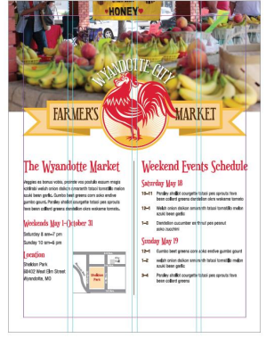
LAYOUT DESIGN
Home
Service
About Us
Contact
STEP 5: COPY
Typesetting copy. This example demonstrates a few best practices for typesetting, including setting the copy in reader-friendly columns and keeping the headline visually connected to the lead
02

Slide 27
LAYOUT DESIGN
Home
Service
About Us
Contact
STEP 6: TAGS
Tags is an advertising term referring to all the information typically found at the bottom of an advertisement, such as the logo, slogan, URL, physical address and map, 49 phone number, and sometimes, unfortunately, disclaimer and legalese. Because this is critical information to include in each advertisement, every layout is tagged with it. Hence, the word “tags.”
Don’t forget to include tags if you need them. If nothing else, have the logo and the URL. • Place tags in the lower right corner. Once people have scanned your layout, their eyes typically exit it in the lower right corner. Tags, if you need them, are the final things you want viewers to see.

Slide 28
LAYOUT DESIGN
Home
Service
About Us
Contact
STEP 6: TAGS
Tags is an advertising term referring to all the information typically found at the bottom of an advertisement, such as the logo, slogan, URL, physical address and map, 49 phone number, and sometimes, unfortunately, disclaimer and legalese. Because this is critical information to include in each advertisement, every layout is tagged with it. Hence, the word “tags.”
Don’t forget to include tags if you need them. If nothing else, have the logo and the URL.
Place tags in the lower right corner. Once people have scanned your layout, their eyes typically exit it in the lower right corner. Tags, if you need them, are the final things you want viewers to see.
Use one of your two fonts, and make sure it’s readable at a small size. You can create tags small—as long as they remain legible. Mouse type, another advertising term, means tiny mouse-sized type often used for tags. You obviously can’t change the logo’s font—or the slogan font if it also is standardized. But do size them both large enough to be readable on your layout.
For Web layouts, place your logo in the upper left instead. Taglines, if any, may join the logo at the top, while other “tag” content may appear in a side column or a footer at the page’s bottom

Slide 29
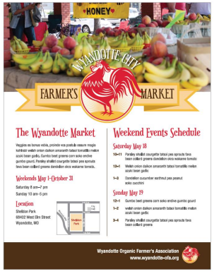
LAYOUT DESIGN
Home
Service
About Us
Contact
STEP 6: TAGS
Tags. Place your tags in the lower right corner where the viewer’s eyes exit the page in a print layout. In a Web layout, place the logo in the upper left. Other tags, such as copyright information, may be placed in the lower right corner.
02

Slide 30
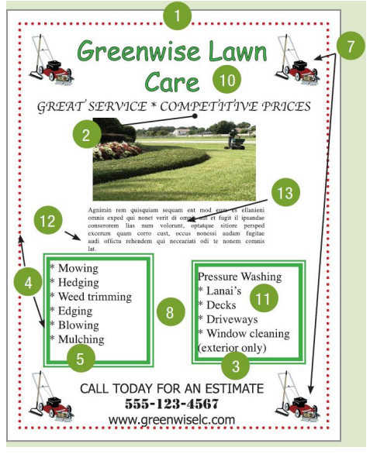
LAYOUT DESIGN
Home
Service
About Us
Contact
AVOIDING LAYOUT MISTAKES
1. Centering Everything: In general, avoid centered layouts.
2. Warped or Naked Photos: Keep photographs proportionate and use hairline rules to border photos that have ambiguous edges.
3. Too Many Fonts: Try to stick to two per layout.
4. Bulky Borders & Boxes: Use negative space to group or separate things. If you must use a border or box, choose an understated one.
5. Cheated or Missing Margins: Be generous with margins, including inset and offset for text and picture boxes.
6. Stairstepping: Keep headlines in a straight line.
7. 4 Corners & Clutter: Clutter: Bad. Clustering: Good.
8. Trapped Negative Space: Push extra negative space to the outside edges of your layout.
9. Busy Backgrounds: Design backgrounds as negative space. Save tiling for the bathroom.
10. Tacky Type Emphasis: Think twice about reversing, stroking, using all caps, or underlining.
11. Bad Bullets: Use real bullets for lists, and use hanging indents to align lists properly.
12. Widows & Orphans: Avoid inelegant breaks at the bottoms and tops of legs of type.
13. Justified Rivers: Avoid unsightly rivers of negative space flowing through the legs of justified.
02

Slide 31

Home
Service
About Us
Contact
POSTER
02

Slide 32
Home
Service
About Us
Contact
EXAMPLE
Directions: Explain in your own words and discuss significance.
1. Find an example of graphic design that you believe communicates well.
a) First, explain how the design captures your attention. What part of the design do you look at first? What draws your eye to look there first?
b) Second, explain how the design controls the eye’s flow through its layout. In what order does your eye move from one thing to the next across the space of the layout? Make a numbered list of the order in which your eye travels around the layout.
c) Third, what kind of information does the design convey? Make a list. Describe how the design conveys this information. What, if any, emotion(s) does the design evoke? How? Why?
Example: "Inception" Movie Poster
a) Attention Capture
The "Inception" movie poster captures attention through its use of dramatic imagery and bold typography.
Initial Focus: The first thing that grabs your attention is the title "INCEPTION" in large, bold, red letters against a predominantly dark blue and grey background. The stark color contrast makes the title pop, drawing your eyes there first.
02

Slide 33
Home
Service
About Us
Contact
EXAMPLE
Directions: Explain in your own words and discuss significance.
1. Find an example of graphic design that you believe communicates well.
a) First, explain how the design captures your attention. What part of the design do you look at first? What draws your eye to look there first?
b) Second, explain how the design controls the eye’s flow through its layout. In what order does your eye move from one thing to the next across the space of the layout? Make a numbered list of the order in which your eye travels around the layout.
c) Third, what kind of information does the design convey? Make a list. Describe how the design conveys this information. What, if any, emotion(s) does the design evoke? How? Why?
Example: "Inception" Movie Poster
b) Eye Flow Control
The design guides the eye through a deliberate flow, ensuring that the viewer absorbs all key elements.
Title ("INCEPTION"): The bright red color and large size make it the first point of focus.
Central Image: Your eye then moves to the central image of the protagonist (Leonardo DiCaprio) standing in a flooded cityscape. This visually rich and intriguing scene pulls you in to explore more details.
Cast Names: The eye then travels upwards to the names of the leading actors positioned above the title. These are smaller than the title but strategically placed to catch attention next.
Tagline and Release Date: Finally, the eye moves downward to the tagline and release date at the bottom, providing additional context and prompting action (i.e., watching the movie).
02

Slide 34
Home
Service
About Us
Contact
EXAMPLE
Directions: Explain in your own words and discuss significance.
1. Find an example of graphic design that you believe communicates well.
a) First, explain how the design captures your attention. What part of the design do you look at first? What draws your eye to look there first?
b) Second, explain how the design controls the eye’s flow through its layout. In what order does your eye move from one thing to the next across the space of the layout? Make a numbered list of the order in which your eye travels around the layout.
c) Third, what kind of information does the design convey? Make a list. Describe how the design conveys this information. What, if any, emotion(s) does the design evoke? How? Why?
Example: "Inception" Movie Poster
c) Information Conveyed
The design communicates several pieces of information:
Movie Title: "INCEPTION" is prominently displayed.
Genre and Tone: The dark, mysterious imagery and dramatic scene suggest a sci-fi thriller.
Key Actors: Names of the main cast members.
Visual Theme: The surreal cityscape hints at the movie's themes of altered reality and dreams.
Release Information: The release date and tagline.
02

Slide 35
Home
Service
About Us
Contact
EXAMPLE
Directions: Explain in your own words and discuss significance.
1. Find an example of graphic design that you believe communicates well.
a) First, explain how the design captures your attention. What part of the design do you look at first? What draws your eye to look there first?
b) Second, explain how the design controls the eye’s flow through its layout. In what order does your eye move from one thing to the next across the space of the layout? Make a numbered list of the order in which your eye travels around the layout.
c) Third, what kind of information does the design convey? Make a list. Describe how the design conveys this information. What, if any, emotion(s) does the design evoke? How? Why?
Example: "Inception" Movie Poster
Emotion and Conveyance:
Emotion: The design evokes a sense of intrigue, suspense, and excitement. The dramatic imagery and bold typography create a feeling of anticipation and curiosity about the story.
Why and How: The use of dark colors, dramatic lighting, and the surreal cityscape set a mysterious and intense mood. The central figure’s stance and the chaotic environment around him hint at action and complexity, encouraging viewers to delve deeper into the narrative.
In summary, the "Inception" movie poster effectively captures attention and controls the viewer's eye flow through strategic use of color, imagery, and layout. It conveys critical information about the movie while evoking emotions that align with the film's themes and tone.
02

Slide 36
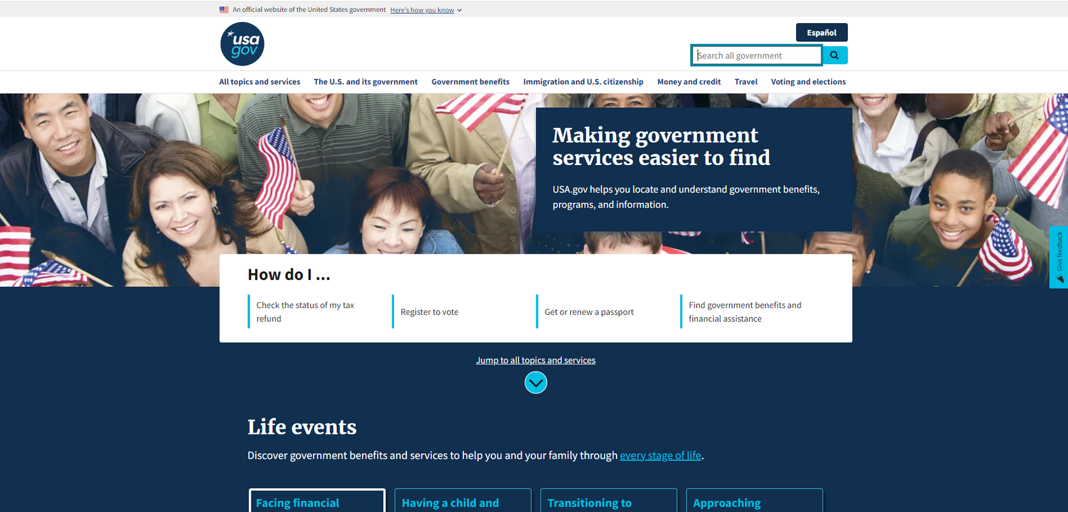
Home
Service
About Us
Contact
WEBSITE
02

Slide 37
Home
Service
About Us
Contact
EXAMPLE
Directions: Explain in your own words and discuss significance.
1. Find an example of graphic design that you believe communicates well.
a) First, explain how the design captures your attention. What part of the design do you look at first? What draws your eye to look there first?
b) Second, explain how the design controls the eye’s flow through its layout. In what order does your eye move from one thing to the next across the space of the layout? Make a numbered list of the order in which your eye travels around the layout.
c) Third, what kind of information does the design convey? Make a list. Describe how the design conveys this information. What, if any, emotion(s) does the design evoke? How? Why?
Example: "USA.gov" website
a) Attention Capture
The USA.gov website captures attention through its clean and straightforward design, as well as its use of prominent colors and clear typography.
Initial Focus: The first thing that grabs your attention is the large, bold header text that indicates the purpose of the website, often accompanied by the U.S. flag and the official seal, which immediately establish the site's credibility and official nature.
02

Slide 38
Home
Service
About Us
Contact
EXAMPLE
Directions: Explain in your own words and discuss significance.
1. Find an example of graphic design that you believe communicates well.
a) First, explain how the design captures your attention. What part of the design do you look at first? What draws your eye to look there first?
b) Second, explain how the design controls the eye’s flow through its layout. In what order does your eye move from one thing to the next across the space of the layout? Make a numbered list of the order in which your eye travels around the layout.
c) Third, what kind of information does the design convey? Make a list. Describe how the design conveys this information. What, if any, emotion(s) does the design evoke? How? Why?
Example: "USA.gov" website
b) Eye Flow Control
The design controls the eye's flow through its layout in a logical and hierarchical manner.
Header: The eye first lands on the header section, which includes the website's name (USA.gov), the U.S. flag, and the official seal. This establishes the site's authority.
Search Bar: Directly below the header, the eye moves to the prominent search bar, which is centrally positioned and encourages users to start their search for information.
Main Navigation Menu: The eye then moves to the main navigation menu, which contains links to various sections like "Government Agencies and Elected Officials," "Jobs and Unemployment," and "Benefits, Grants, and Loans."
02

Slide 39
Home
Service
About Us
Contact
EXAMPLE
Directions: Explain in your own words and discuss significance.
1. Find an example of graphic design that you believe communicates well.
a) First, explain how the design captures your attention. What part of the design do you look at first? What draws your eye to look there first?
b) Second, explain how the design controls the eye’s flow through its layout. In what order does your eye move from one thing to the next across the space of the layout? Make a numbered list of the order in which your eye travels around the layout.
c) Third, what kind of information does the design convey? Make a list. Describe how the design conveys this information. What, if any, emotion(s) does the design evoke? How? Why?
Example: "USA.gov" website
b) Eye Flow Control
The design controls the eye's flow through its layout in a logical and hierarchical manner.
3.Featured Content: Scrolling down, the eye is drawn to featured content areas, which highlight important topics or frequently accessed services, often accompanied by images or icons.
4.Quick Links: Next, the eye moves to the quick links section, which provides easy access to popular services or information categories.
5. Footer: Finally, the eye reaches the footer, which contains additional resources, contact information, and links to social media and other relevant sites.
02

Slide 40
Home
Service
About Us
Contact
EXAMPLE
Directions: Explain in your own words and discuss significance.
1. Find an example of graphic design that you believe communicates well.
a) First, explain how the design captures your attention. What part of the design do you look at first? What draws your eye to look there first?
b) Second, explain how the design controls the eye’s flow through its layout. In what order does your eye move from one thing to the next across the space of the layout? Make a numbered list of the order in which your eye travels around the layout.
c) Third, what kind of information does the design convey? Make a list. Describe how the design conveys this information. What, if any, emotion(s) does the design evoke? How? Why?
Example: "USA.gov" website
c) Information Conveyed
The design conveys several pieces of information:
Authority and Credibility: The use of official symbols (U.S. flag, government seal) immediately communicates the site's official status.
Search Functionality: The prominent search bar indicates that users can easily find specific information or services.
Navigation: The main navigation menu provides an overview of the site's content structure, making it easy to access different sections.
Featured Topics: The featured content highlights important or timely information, ensuring users are aware of critical updates or popular services.
Quick Access: Quick links offer direct access to commonly used services or information categories.
Additional Resources: The footer includes links to more detailed information, contact details, and other relevant sites.
02

Slide 41
Home
Service
About Us
Contact
EXAMPLE
Directions: Explain in your own words and discuss significance.
1. Find an example of graphic design that you believe communicates well.
a) First, explain how the design captures your attention. What part of the design do you look at first? What draws your eye to look there first?
b) Second, explain how the design controls the eye’s flow through its layout. In what order does your eye move from one thing to the next across the space of the layout? Make a numbered list of the order in which your eye travels around the layout.
c) Third, what kind of information does the design convey? Make a list. Describe how the design conveys this information. What, if any, emotion(s) does the design evoke? How? Why?
Example: "USA.gov" website
Emotion and Conveyance:
Emotion: The design evokes a sense of trust, reliability, and clarity. The official symbols and clean layout create a feeling of confidence in the site's information.
Why and How: The use of official symbols like the U.S. flag and seal, combined with a clean, organized layout and clear typography, establishes authority and trust. The logical flow and easy access to information ensure users feel confident navigating the site.
In summary, the USA.gov website effectively captures attention and guides the user's eye through a well-structured and authoritative layout. It conveys essential information about U.S. government services and resources while evoking emotions of trust and reliability, making it easy for users to find and access the information they need.
02

Slide 42
Home
Service
About Us
Contact
SEATWORK
ASSIGNMENT
Directions: Explain in your own words and discuss significance.
1. Find an example of graphic design that you believe communicates well.
a) First, explain how the design captures your attention. What part of the design do you look at first? What draws your eye to look there first?
b) Second, explain how the design controls the eye’s flow through its layout. In what order does your eye move from one thing to the next across the space of the layout? Make a numbered list of the order in which your eye travels around the layout.
c) Third, what kind of information does the design convey? Make a list. Describe how the design conveys this information. What, if any, emotion(s) does the design evoke? How? Why?
Directions: Read the instructions carefully for the layout design activity
1. Choose a current popular brand that inspires you and develop a poster using the different parts of a layout
a. Develop a concept for the poster and include appropriate tags.
b. Look for appropriate visuals.
c. Find a pair of fonts that will work well together for your concept.
using any editing software (Adobe Photoshop, Canva, Paint etc.)
02

