Slide 1
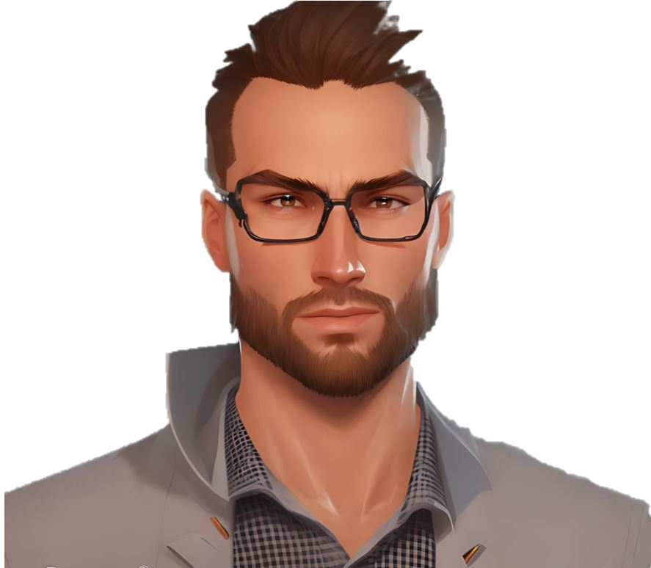

Slide 3


Slide 4
ias
P
i
To
ngel

Slide 5
ias
To
p
b
i
ngel

Slide 6
Tobias
Tobias
i
i
P ngel
P ngel

Slide 7
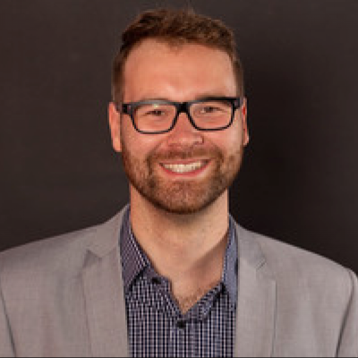

Slide 8
About me v1
Hello! I'm Tobias Pingel, a Software Engineer specializing in Renewable Energy Systems and a Frontend Web Developer. With a strong background in C programming for inverter applications in the wind energy and hydrogen sectors, I bring a unique skill set to my work.
Since March 2023, I have been working part-time as a Frontend Web Developer for two days a week, honing my expertise in HTML, CSS, JavaScript, React, and NodeJS. I have also recently created my own portfolio website using these technologies to showcase my projects and skills.
One of my recent projects includes building a webshop using React and CSS for the frontend, and utilizing Sanity for product management and Stripe as the payment system for the backend. Both my portfolio website and the webshop are deployed on Vercel, demonstrating my proficiency in modern web development tools and technologies.
I am a self-learner, and I have utilized various online resources such as W3Schools, Stack Overflow, and other websites to continuously improve my skills and gain practical experience in web development.
When I'm not coding, I enjoy spending time outdoors, engaging in activities such as running, biking, hiking, and swimming. I am also passionate about music, both listening and occasionally playing. If you'd like to get in touch with me, feel free to reach out to my contact email.
I am currently seeking partnerships and clients who need assistance with their Frontend Website Projects. I am excited to collaborate and bring my expertise to create exceptional web experiences. Let's work together to bring your ideas to life!

Slide 9
About me v2
Hi, I'm Tobias Pingel, a software engineer and a frontend web developer. I have a passion for creating clean and user-friendly websites that showcase your products or services.
I have been working as a software engineer since 2015 being in the renewable energy sector since 2008 and now developing applications in C for inverters in wind energy and hydrogen systems. Since March 2023, I have also been working part-time as a frontend web developer, learning new skills and technologies along the way.
I am proficient in HTML, CSS, JavaScript, React and Node.js. I have built two projects using these tools: this portfolio website and a webshop. For the portfolio website, I used HTML, JavaScript and CSS to create a simple and elegant design. For the webshop, I used React and CSS for the frontend and Sanity and Stripe for the backend. Both sites are deployed on Vercel, check them out both.
I am a self-taught Web Developer who loves to learn new things and solve problems. I have used various online resources such as tutorials, blogs, forums and documentation to expand my knowledge and improve my skills. I am always open to feedback and suggestions to make my work better.
When I'm not coding, I enjoy being outdoors and doing activities like running, biking, hiking and swimming. I also love listening to music and playing some instruments from time to time.
I am looking for partners to work with and clients who need expertise for their frontend website projects. If you are interested in collaborating with me or hiring me for your next project, please feel free to contact me at webdev.pingel@gmail.com.
I would love to hear from you!

Slide 10
About me v3
Hello! My name is Tobias Pingel and I am a Software Engineer for Renewable Energy Systems and a Frontend Web Developer. I have experience working with C for inverter application in wind energy and hydrogen. Since March 2023, I have been working part-time as a Frontend Web Developer for two days a week.
I am proficient in HTML, CSS, JavaScript, React, and NodeJS. For my portfolio website, I used HTML, JavaScript, and CSS. For my webshop, I used React and CSS for Frontend and Sanity for product management and Stripe as a payment system for Backend. Both sites are deployed on Vercel.
I have taught myself how to code by using tutorials and several websites such as W3Schools and Stack Overflow. As a private person, I enjoy being outside in nature and doing activities like running, biking, hiking, swimming. Another passion of mine is listening to music and sometimes playing.
If you would like to get in touch with me regarding potential partnerships or clients that I can help with their Frontend Website Project, please feel free to contact me.

