Slide 1
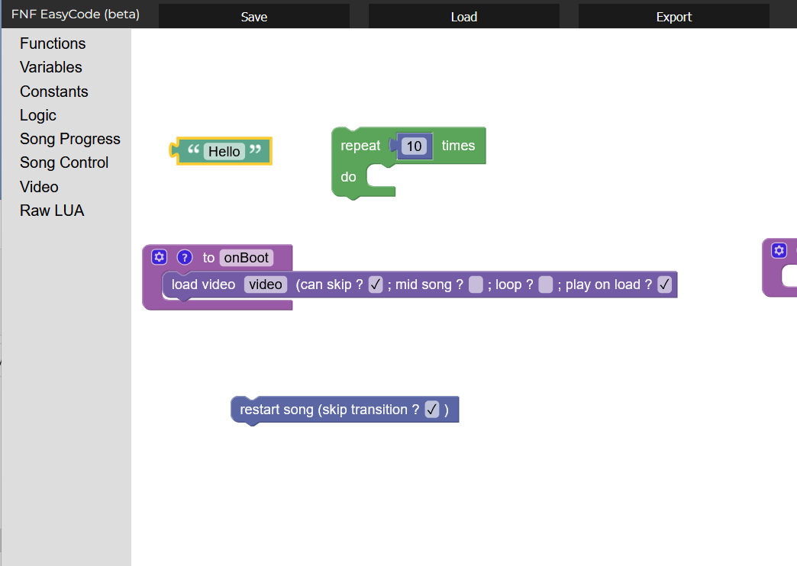
Easycode
FNF modding. Even easier than before.

Slide 2

7 functions out of 212 mapped.
Other engines coming soon!

