Slide 1
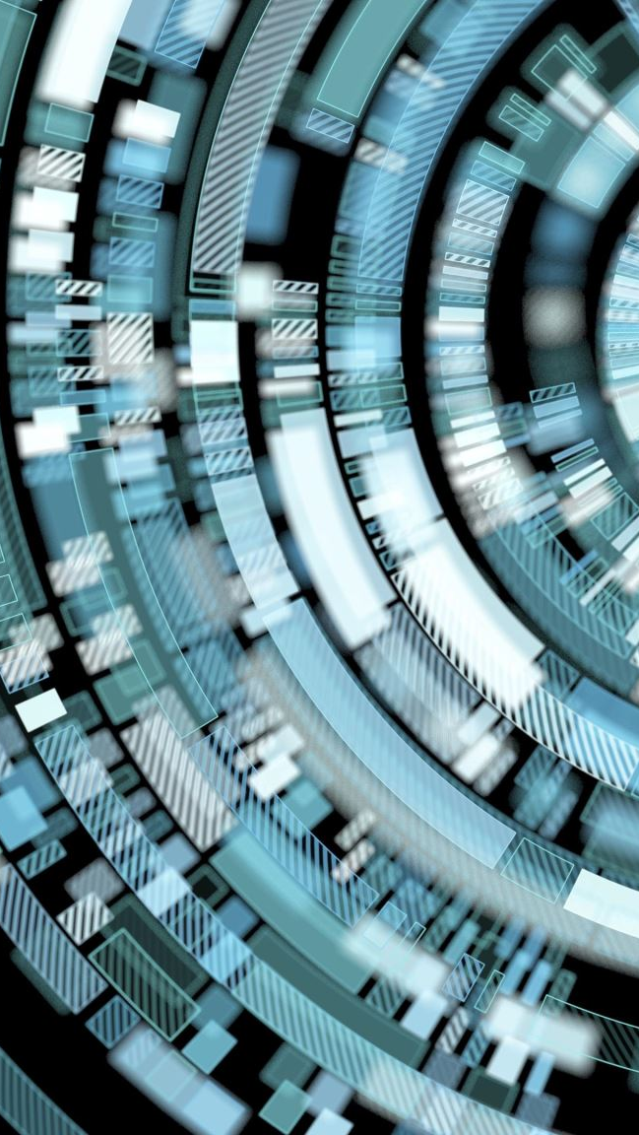
Understanding Deepfakes with Convolutional GANs Using drone: Focused on eye blinking
Maryam Taeb

Slide 2
Outline
Introduction
Scenario
The Acquisition Process and Advantages
Examination & Analysis
Lab Tasks
Conclusion & Improvements

Slide 3
Introduction
Deepfake and Fake news → utilizing tampered images/videos
Global epidemic → massive adop
Quality of public discourse and the safeguarding of human right
Manipulation, harassment, and persuasion
Identifying manipulated media is a technically demanding and rapidly evolving challenge. This hands-on lab introduces a deep neural architecture for image forgery detection.
Notes:
Deepfake and Fake news, often utilizing tampered images/videos, has lately become a global epidemic, especially with the massive adoption of social media as a contemporary alternative to classic news outlets.
These content generation and modification technologies may affect the quality of public discourse and the safeguarding of human rights—especially given that deepfakes may be used maliciously as a source of misinformation, manipulation, harassment, and persuasion. Identifying manipulated media is a technically demanding and rapidly evolving challenge. This hands-on lab introduces a deep neural architecture for image forgery detection.

Slide 4
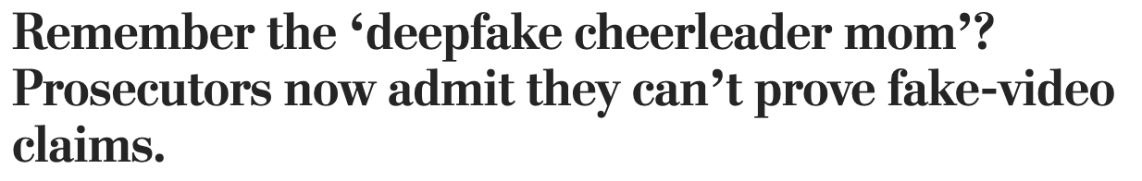
Scenario
The suburban Pennsylvania cheer mom was alleged to have created a “deepfake” video to secretly attack the other girls on her daughter’s cheerleading squad.
While investigators originally believed at least one video showed evidence of the use of so-called Deep Fake face replacement technology, police are at this point unable to confirm the video evidence was falsified
It’s your job as a Forensic investigator to develop an algorithm or leverage proper tools to identify whether the obtained media was fake or real
The Mother of All Deepfakes!

Slide 5
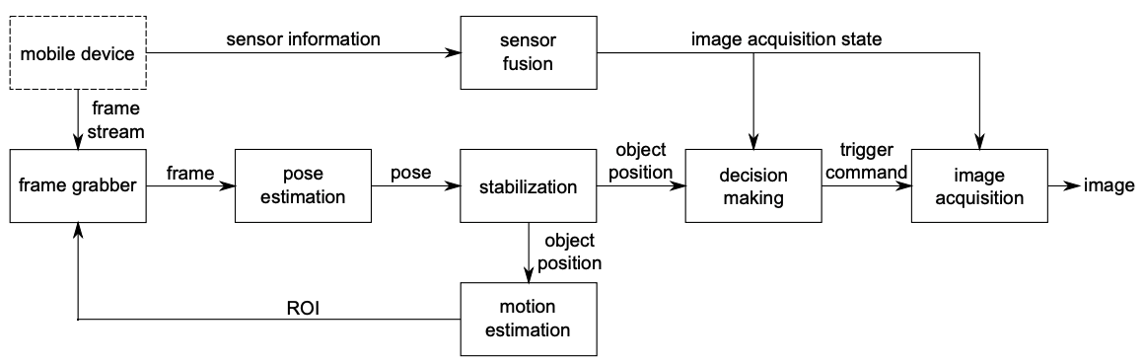
The Acquisition process
It was assumed in the lab that you have been handed with the result of following acquisition process

Slide 6
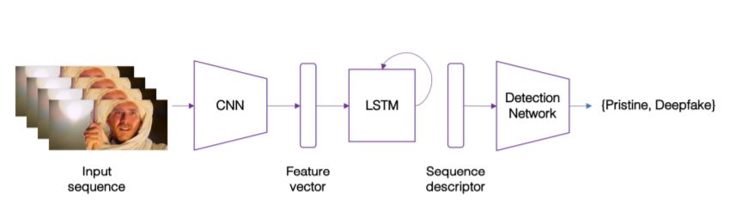
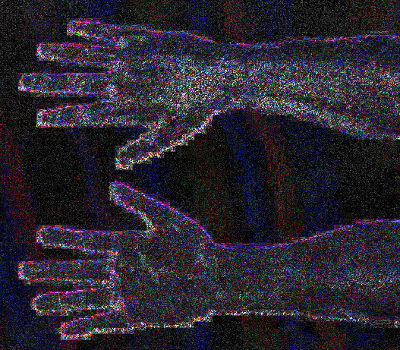
Examination & Analysis
Assembling different trained Convolutional Neural Network (CNN) models
Generate Fake images using First Order Model and test model to analyze its performance
Error Level Analysis (ELA) and FotoForensics to relate forgery analysis & CNN
Leveraging Deepfake-O-Meter to identify fake media and compare performance of MesoNet & CNN architectures
Double Compression method of video forgery detection
Frame Integrity score analysis

Slide 7
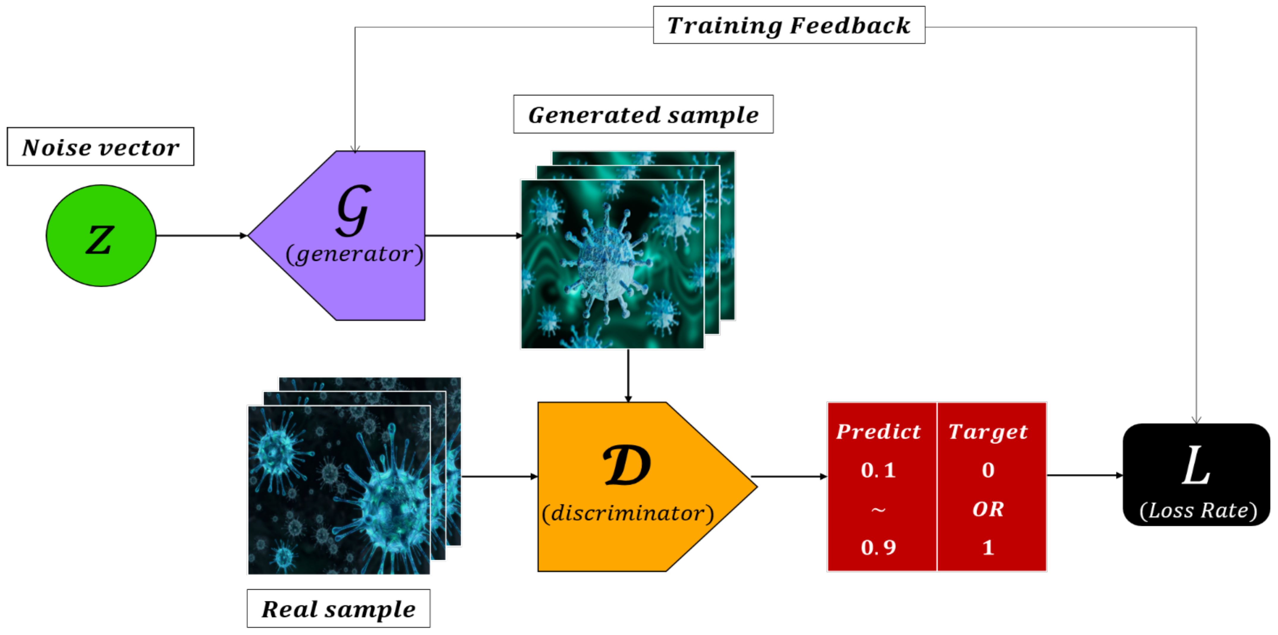
EXAMINATION & analysis (GAN)

Slide 8
Objective
Introduce deepfake media generation and detection using Generative Adversarial networks (GAN), and DenseNet-121
Educate students on:
Replace pooling layers with strided convolutions (discriminator) and fractional-strided convolutions (generator)
Use batch norm in both the generator and the discriminator.
Remove fully connected hidden layers for deeper architectures.
Use ReLU activation in generator for all layers except for the output, which uses Tanh.
Use LeakyReLU activation in the discriminator for all layers.
learn how to measure to verify an anomaly based on the period, repeated number, and elapsed eye blink time when eye blinks were continuously repeated within a very short period of time.

Slide 9
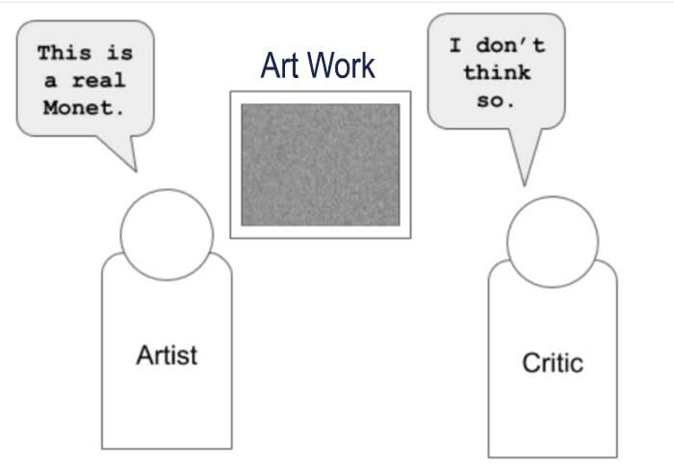
Task 1 (Importing libraries and performing Data Augmentation )
Importing libraries and performing Data Augmentation
Learning the differences between Keras, Tensorflow and scikit-learn
Learning about GAN Generator and discriminator
Learning about MNIST Database and Deepfake MNIST+
Learning the relation between First Order Model and Deepfake MNIST+
Learning the animated actions of interest in deepfake detection
Notes:
TensorFlow (TF) is an end-to-end machine learning framework from Google that allows you to perform an extremely wide range of downstream tasks. With TF2.0 and newer versions, more efficiency and convenience was brought to the game.
Keras is built on top of TensorFlow, which makes it a wrapper for deep learning purposes. It is incredibly user-friendly and easy to pick up. A solid asset is its neural network block modularity and the fact that it is written in Python, which makes it easy to debug.
MNIST+
Various Deepfake detection methods and datasets are proposed for detecting such data, especially for face-swapping. However, recent researches less consider facial animation, which is also important in the Deepfake attack side. Experiments show that the existed datasets are not sufficient to develop reliable detection methods. While the current liveness detector cannot defend such videos as the attack. As a response, a new human face animation dataset, called Deepfake MNIST+ was generated by a SOTA image animation generator. It includes 10,000 facial animation videos in ten different actions, which can spoof the recent liveness detectors.
It contains video animation data generated by First Order Motion Model for Image Animation
The dataset contains 10,000 real videos selected from VoxCeleb1 and 10,000 animation videos generated by First Order Motion Model for Image Animation using these 10,000 real videos as sources

Slide 10
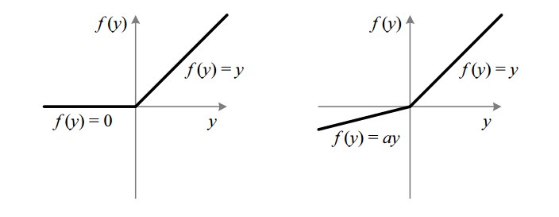
Task 2 (Building Generator and Discriminators )
Learning the mechanism and architecture behind Discriminator and Generator
Understanding RELU and Leaky RELU activation functions, their differences and issues/applications
Getting the generator to generate a fake handwritten digit and observe its performance
Use batch normalization in both the generator and the discriminator.
Remove fully connected hidden layers for deeper architectures.
Use ReLU activation in generator for all layers except for the output, which uses Tanh.
Use LeakyReLU activation in the discriminator for all layers.
Notes:
Leaky ReLU activation function was developed to overcome one of the major shortcomings of ReLU activation function. The formula for ReLU activation function is: R(x) = max(0, x)
You can conclude from the above formula that the ReLU activation function gives the derivate as 1 when the value is positive. In case when the value is negative, the derivative becomes 0 during the backpropagation.
This means that when the value is negative, no learning happens as the new weight remains equal to the old weight since the value of the derivative is 0. This is called the “Dead ReLU” issue.

Slide 11
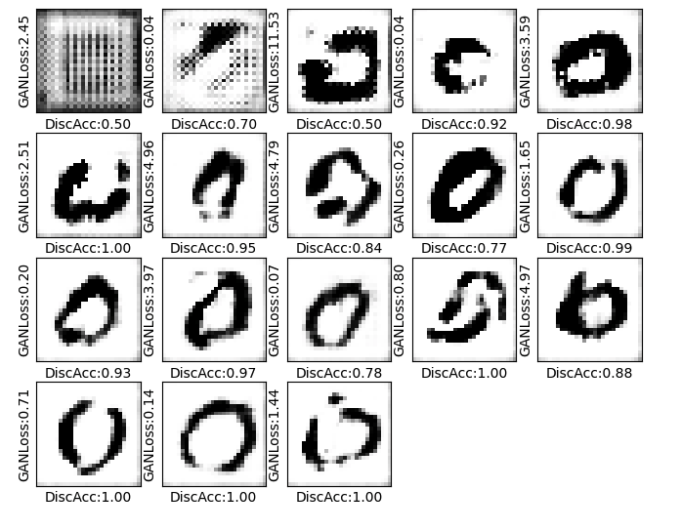
Task 3 (Creating a Generative Adversarial Network (GAN))
Creating a Generative Adversarial Network (GAN) model using the knowledge gained in the previous tasks
Learning about Weights and Non trainable parameters
Calculating the steps that models will run per epoch
Understanding the loss and accuracy values from generator and discriminator

Slide 12
Conclusion & improvements
The hands-on lab tackled the problem of face manipulation detection in image sequences targeting modern facial manipulation techniques
Data Acquisition process could be added to cover the whole forensics investigation process
Other types of deepfake media (audio, video) could be analyzed
Other investigation methods and tools (steganalysis and header file level analysis) could be added

Slide 13

Questions?

