Slide 1

A Quick Overview of
Tooling and Testing for
Android
Tom Opgenorth
@topgenorth
tom@opgenorth.net
http://www.opgenorth.net

Slide 2
About Me
Independent Consultant
  Developing professionally for 18 years
.NET Focused – but keenly interested in mobile
Started with Android as a Hobby in early 2009
Not a professional tester.

Slide 3
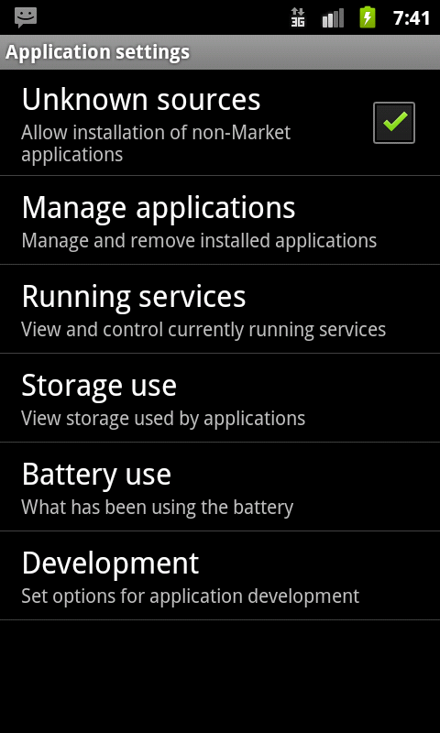
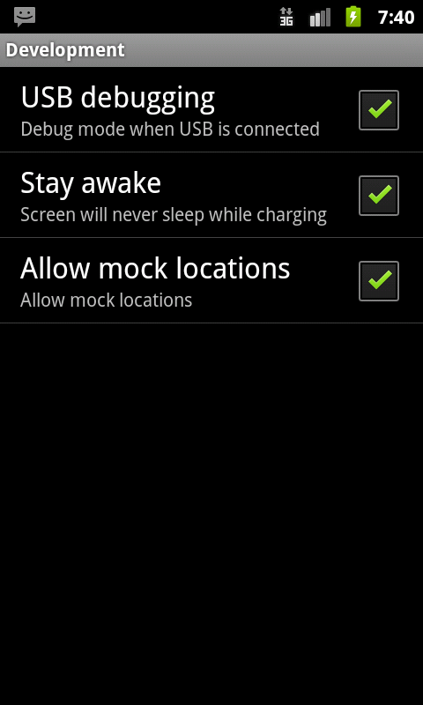
Setting Up
Settings → Applications → Application Settings → Development

Slide 4
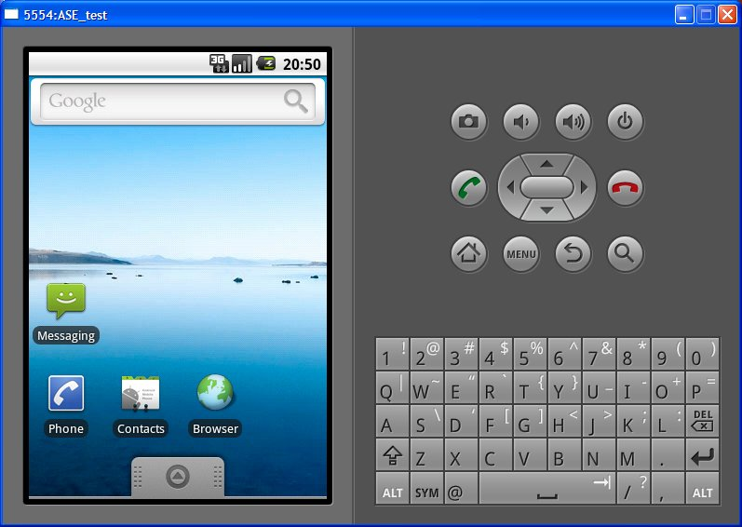

Emulator

Slide 5
Android Debug Bridge
Runs as client, server and daemon
Command line Control of Device

Slide 6
Monkey Runner
Write programs that control a device from OUTSIDE Android code
Python / Jython
Not to be confused with monkey.

Slide 7
DDMS
Dalvik Debug Monitor Server
Kitchen Sink : provides a lot of services
Screen capture
Logcat
Thread & Heap info
Location spoofing

Slide 8
JVM vs Dalvik
JVM based:
Faster
More tooling – and it’s more mature
Dalvik
Slower
Only way for instrumentation

Slide 9

Robolectric

Slide 10

Robotium

Slide 11
Fin
Thanks for coming
@topgenorth
tom@opgenorth.net

