Slide 1
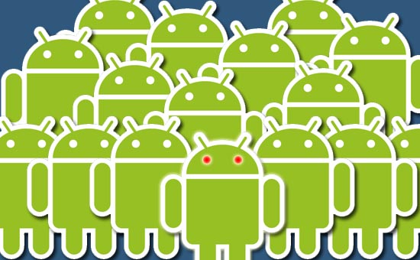

Induction Into the Android Army
Tom Opgenorth
@topgenorth
tom@opgenorth.net
http://www.opgenorth.net

Slide 2
About Me
Independent Consultant
.NET Focused – but keenly interested in mobile
Started with Android as a Hobby in early 2009

Slide 3

Why Android?

Slide 4
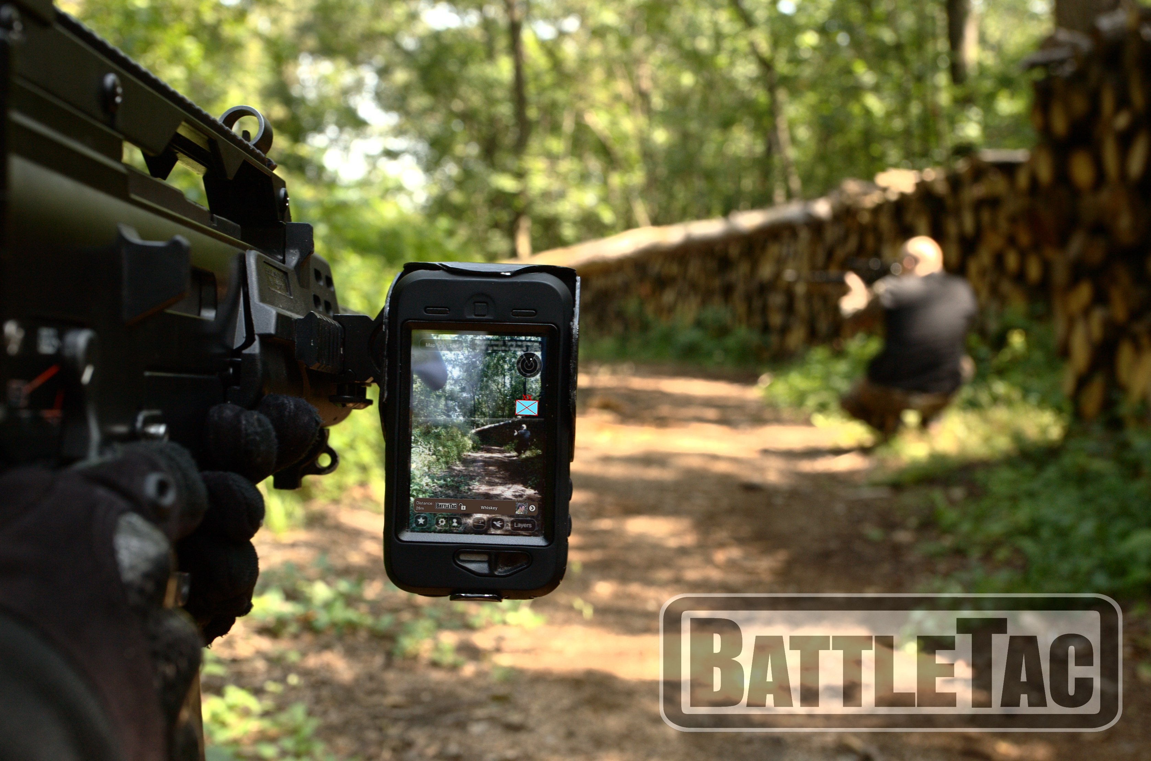
About Me

Slide 5

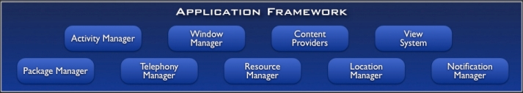
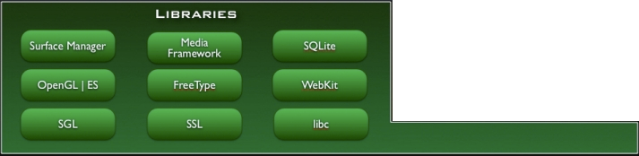
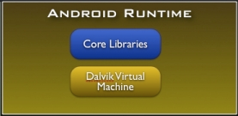
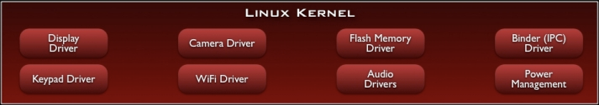
Notes:
Applications
Built in applications that come with android
.. As well as the applications that developer build for the platform.
Application Framework
Activity Manager:
Window Manager:
Package Manager:
Telephony Manager: Responsible for telephone based operations.
Resource Manager: All embedded bitmaps, audio, video, strings, and layouts are rendered to a class the name of “R”. The resource manager handles working with them.
Location manager: Responsible for handling GPS updates and location based information.
Notification Manager: Responsible for placing notifications into the status bar. Allows the developer to provide a rich interface for the users to view information about applications and/or background services.
View system: Handles the views in the system. Each item on the screen is a view. A button is a view, a textbox is a view, a list is a view. The view system manages the view components.
Content Providers: Allows access to various pieces of data across the android system.
Android Runtime
Core libraries such as file, network, drawing, etc.
DalVik virtual machine that runs compiled .dex files. The code is compled into .dex intermediate code files and DalVik runs this.
Libraries: All written in C, C++ and this is where the core power of android comes from.
- Surface Manager: Responsible for composing diff drawing surfaces onto the screen. From views, to maps, images, different applications, its responsibility is figuring out how to get the pixels to the screen.
OpenGL | ES & SGL: Core graphics libraries. OpenGL|ES is the 3d library and SGL is the 2D platform. The majority of drawing uses the SGL model.
Can combine 2d and 3d in the same application
SQL Lite for data storage (its also important to note that object databases such as db40 can also be used in android)
WebKit is the foundation of the browser, which is also what Safari runs on.
-----------------------
Linux Kernel as the HAL
Based on the linux 2.6 kernel
Reason: Proven Driver Model, Process mgmt, Mem mgmt, Networking, Security Model , and it is a proven robust OS that provides a vast array of core OS features.

Slide 6
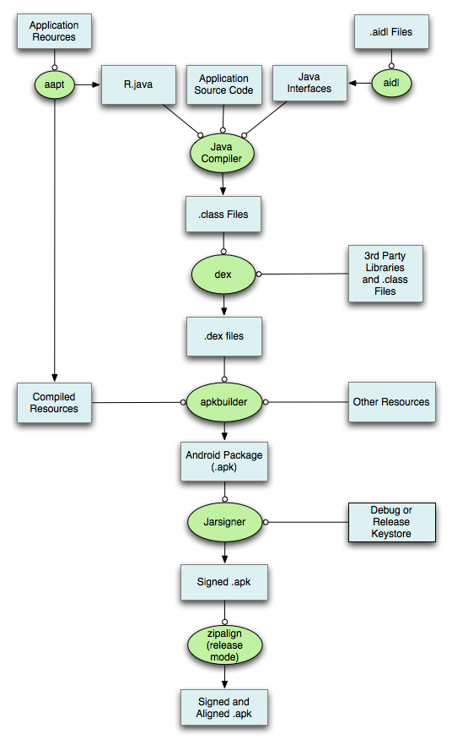
Compiling
Activity
Broadcast Receiver
Service
ContentProvider

Slide 7


Slide 8
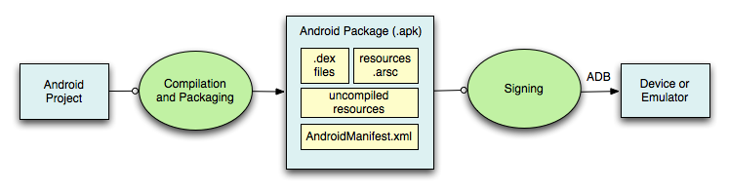
Compiling
Activity
Broadcast Receiver
Service
ContentProvider

Slide 9
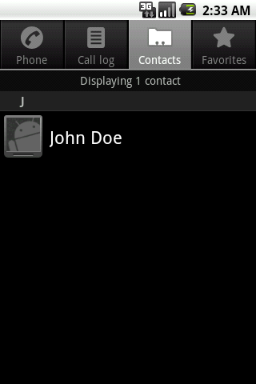
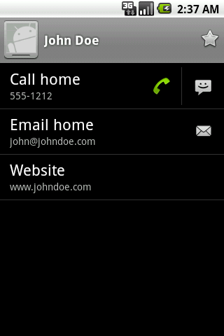
Activities
One Activity == One Screen
Can start other activities
Typically defined with XML

Slide 10
Activity Lifecycle
Activity Starts
onCreate()
onStart()
onResume()
onRestart()
User navigates back
to the activity
Activity is running
User navigates back
to the activity
Another activity comes in front
Process killed
Other apps need memory
onPause()
User navigates back
to the activity
This activity is no longer visible
onStop()
onDestroy()
Activity is shut down

Slide 11
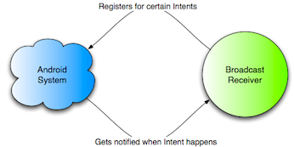
Broadcast Receivers
No UI
Can start activity
Listen for intents

Slide 12
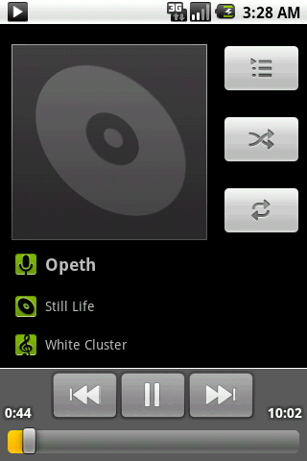
Services
Runs in background – no UI
Stays running
Can be accessed by many

Slide 13
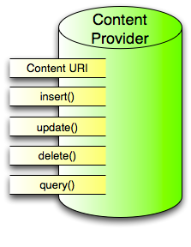
Content Providers
Applications
  Content Providers
    Contacts
    Music
    Videos
    Pictures
    …
Share data with applications
Data can reside anywhere: SQLite, Internet, Files, etc

Slide 14
Intents
View Map
Edit Contact
Send Email
Call Mom
Send Tweet
Play Song
Capture Video
Edit Calendar
Pick Photo
Browse Market
Capture Photo
View Video
Get GPS Location
Start App
View Web Page

Slide 16

Questions?

Slide 17
Fin
Tom Opgenorth
@topgenorth
tom@opgenorth.net
http://www.opgenorth.net

