Slide 1
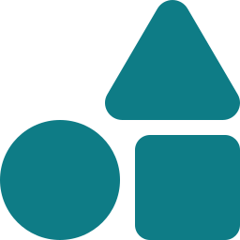
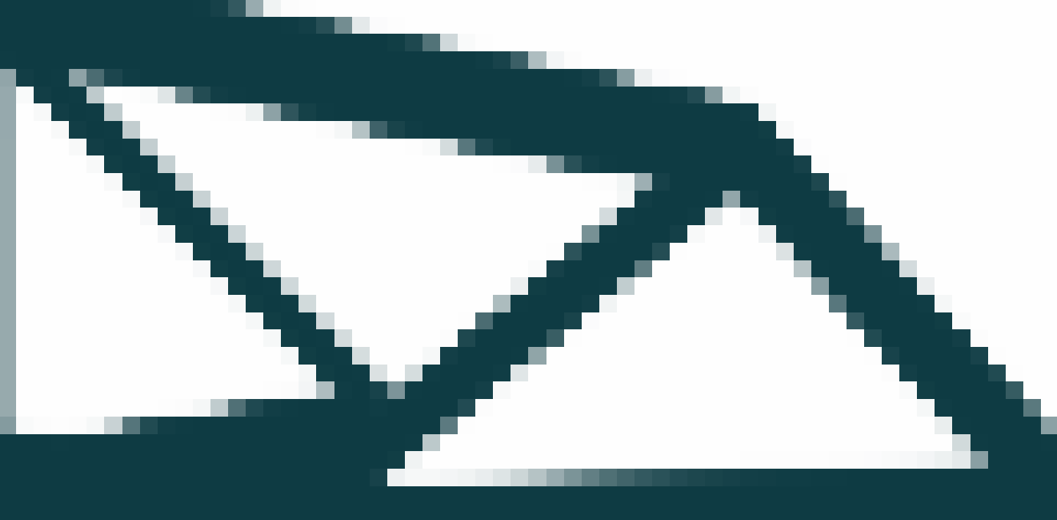

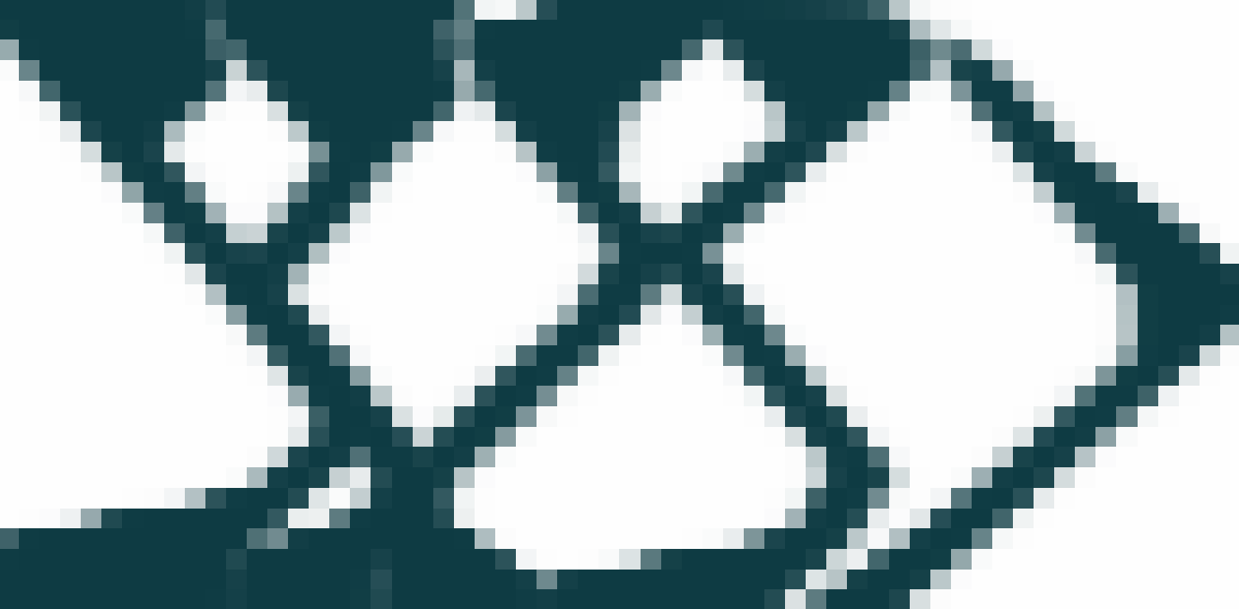
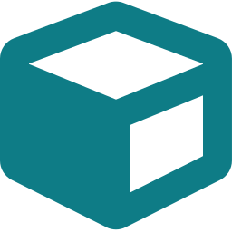

GGP-Topo
Feature-based structural topology optimization for additive manufacturing — Python · FEniCS · GEMSEO
What it does
How it works
Results
Geometric features, not pixels
Bars & plates are projected onto the mesh (GGP) — crisp, CAD-ready layouts
ProblemSpec
YAML preset or config
Printable by design
ALM formulation: layer-by-layer parameters + overhang-angle constraints
Geometry projection
Features → element densities ρ
MBB beam — Free 2D
design update + analytic gradients
2D & 3D, Free & ALM
Four pure-NumPy mappers with analytic Jacobians; iterative AMG for large 3D
FEniCS elasticity
SIMP stiffness, MUMPS / CG+AMG
Config-driven & extensible
Frozen ProblemSpec from YAML; registries for readers & mappers
GEMSEO MDF optimizer
MMA · SLP · CONLIN
Cantilever — ALM 2D, overhang-constrained
4 projection formulations
3 gradient optimizers
5 built-in benchmark presets
>80% test coverage
Try it: ggp optimize --preset alm_cantilever · Coniglio et al., Generalized Geometry Projection, Arch. Comput. Methods Eng. 27 (2020)
Notes:
GGP-Topo re-implements and extends the GGP-Matlab framework in Python. Key message: geometric features are projected onto a FEniCS mesh, optimized with GEMSEO, and the ALM formulation adds layer-wise and overhang constraints for printable designs.

