Slide 1

PHOTO ALBUM
Riyadh
Deion
Topgyal
Wei

Slide 2

DESCRIPTION- Photo album Website
lets user make photo albums.
User needs provide username, password, email.
Can upload photos and put them into photo album.
Database to store user information, photo albums and photos

Slide 3
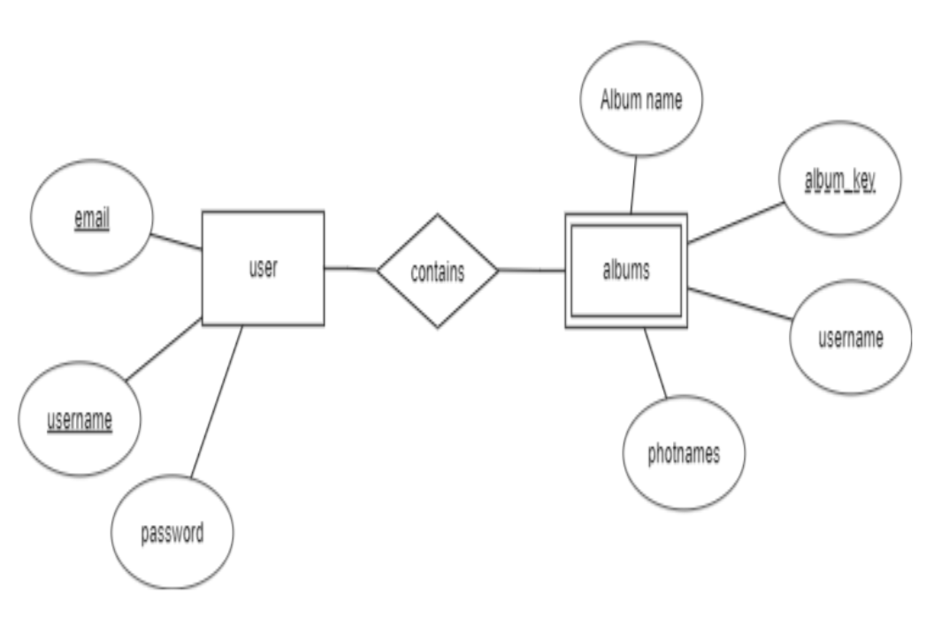
E-R DIAGRAM

Slide 4
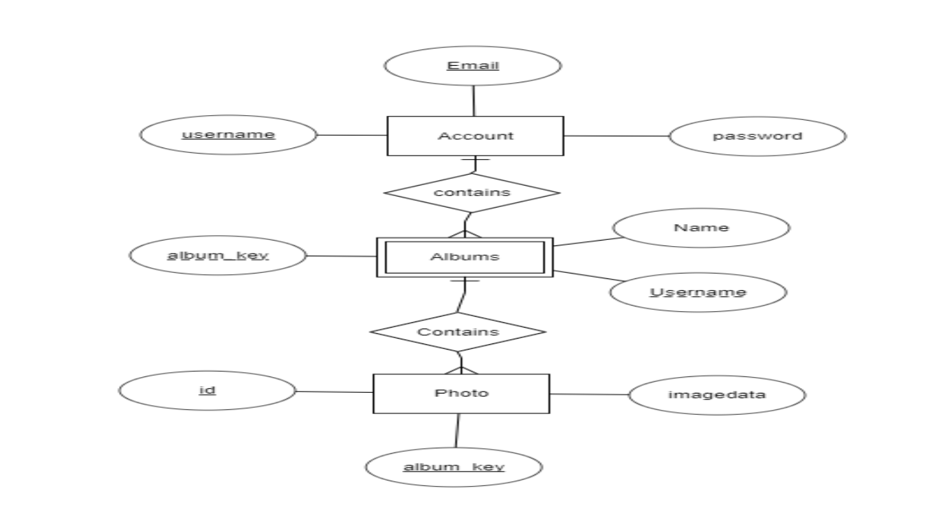
NORMALIZED E-R DIAGRAM

Slide 5
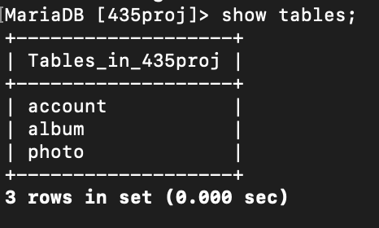
Database: 435proj

Slide 6
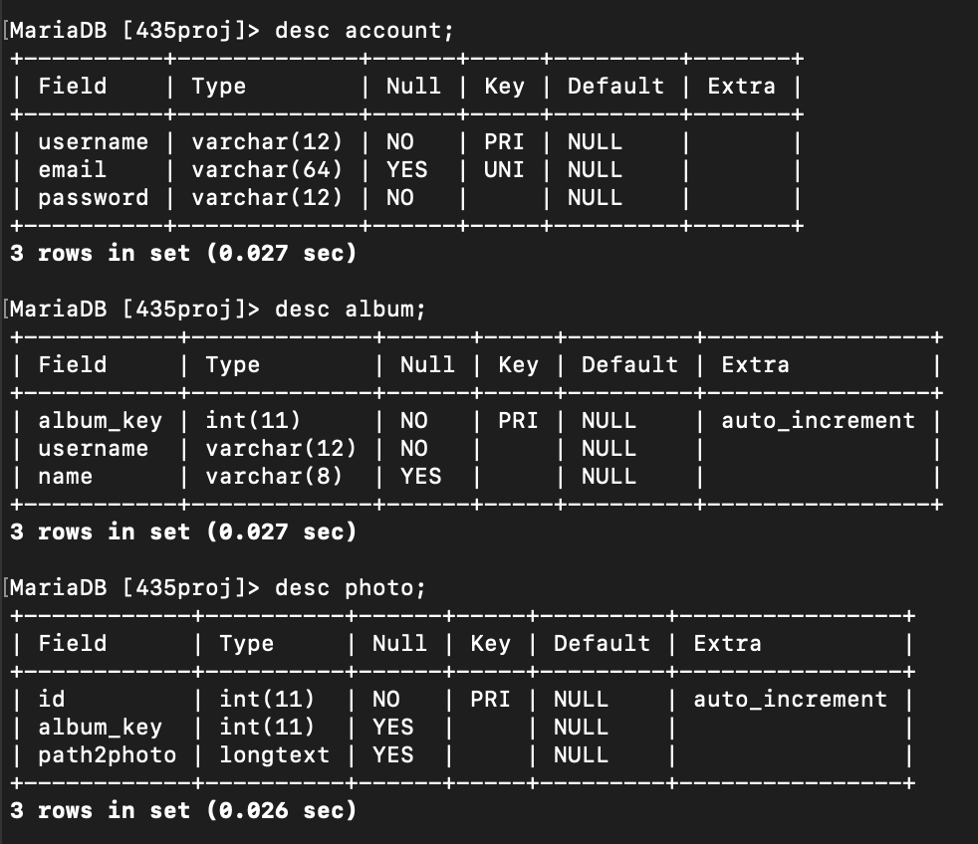
Tables and their entities

Slide 7
Web based application
Technology:WAMP/ XAMPP
Apache HTTP Server, MariaDB database, and interpreters for scripts written in the PHP
Support CRUD (Create, read, update and delete) operations

Slide 8
Queries in PHP
Signup.php: $sql="INSERT INTO account (username, email, password) VALUES ('$username', '$email', '$password’)”;
Login.php: $result = mysqli_query($connect, "select username,password from account where username='$username' and password='$password’”);
Index.php: $result = mysqli_query($connect, "select username,password from account where username='$username' and password='$password'");

Slide 9
ALBUMS.PHP functions
createAlbum(): $sql = "INSERT INTO album (username, name) VALUES ('" . $_SESSION['user_id'] . "', '" . $_GET['name'] . "')";
addPhoto(): $sql = "INSERT INTO photo (album_key, path2photo) VALUES ('" . $_GET['album_key'] . "', '" . $_POST['data'] . "')";
deletePhoto(): $sql = "DELETE FROM photos WHERE id = " . $_GET['id’];
getPhoto(): $sql = "SELECT id, path2photo FROM photo WHERE album_key = '" . $_GET['album_key'] . ”’”;
getAlbums(): $sql = "SELECT * FROM album where username = '" . $_SESSION['user_id'] . "'";

