Slide 1
Economics
The word comes from the Greek, meaning one who manages a household.

Slide 2
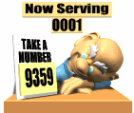
The study of Economics
The study of how people use their limited resources to satisfy their unlimited wants.
What are the categories of resources?

Slide 3

Natural

Slide 4
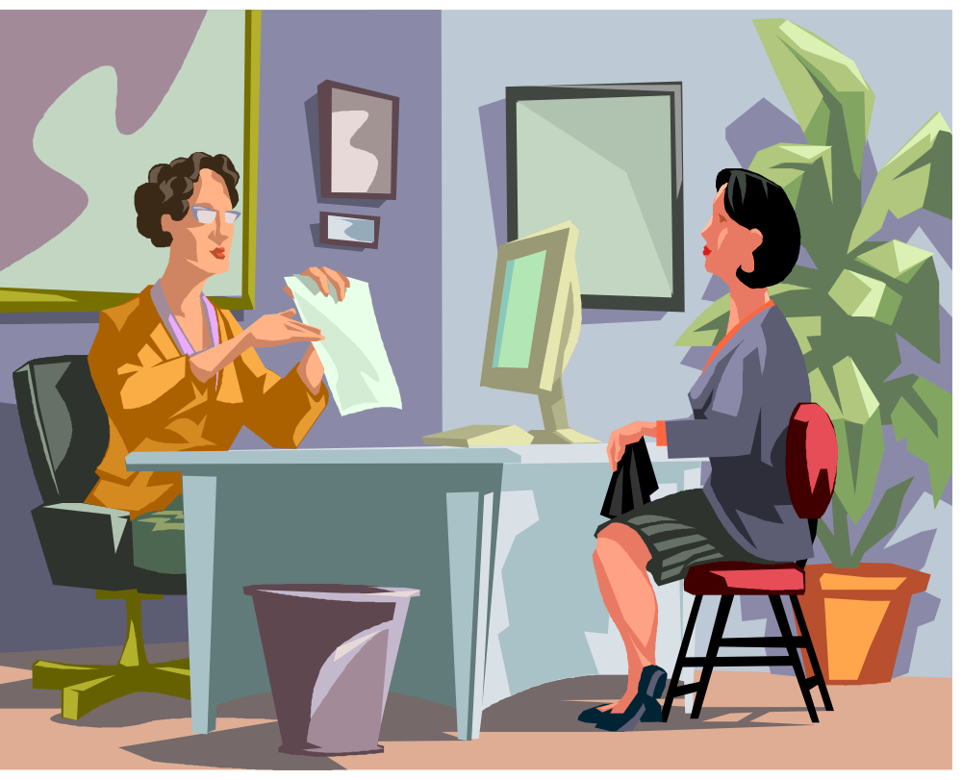
Human

Slide 5

Capital

Slide 6
So…what’s a want?
What people would buy if their incomes were unlimited.
What people would accept if it was given away free.

Slide 7
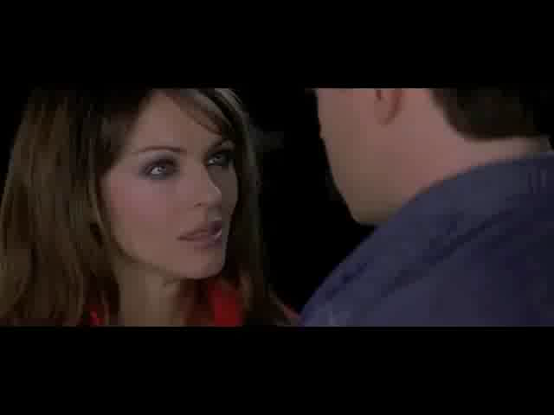
No such thing as a free lunch!

Slide 8
We have unlimited wants, we can’t all get what we want in unlimited amounts at the same time.
The condition of SCARCITY exists because of those unlimited wants and limited resources!

Slide 9
Scarcity
Simply not enough to go around.
Use scarcity videos from Mr. Clifford and star Wars

Slide 10
Society
Has a job to do…
It must decide…

Slide 11

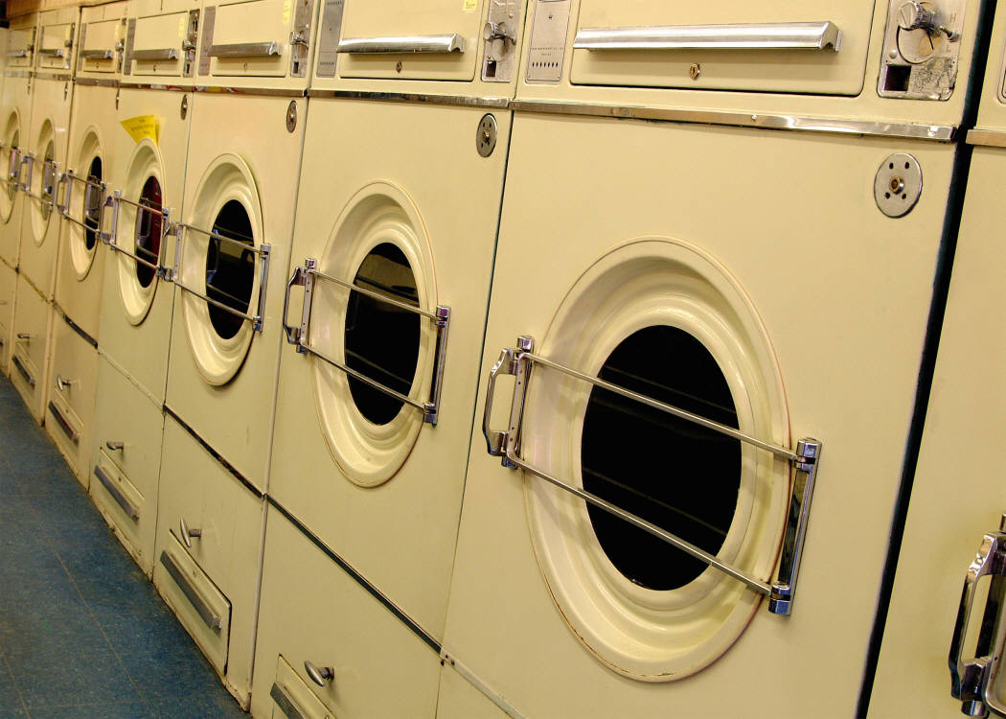




1. What to produce.

Slide 12
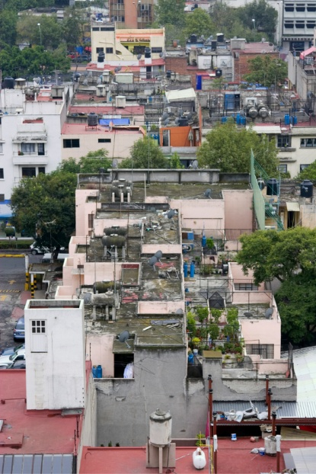
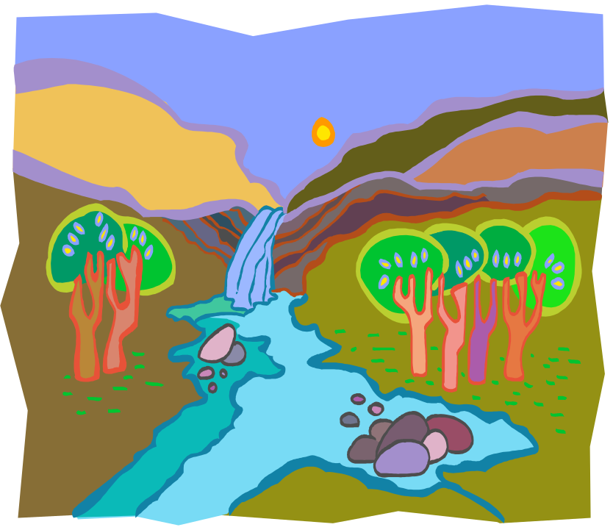
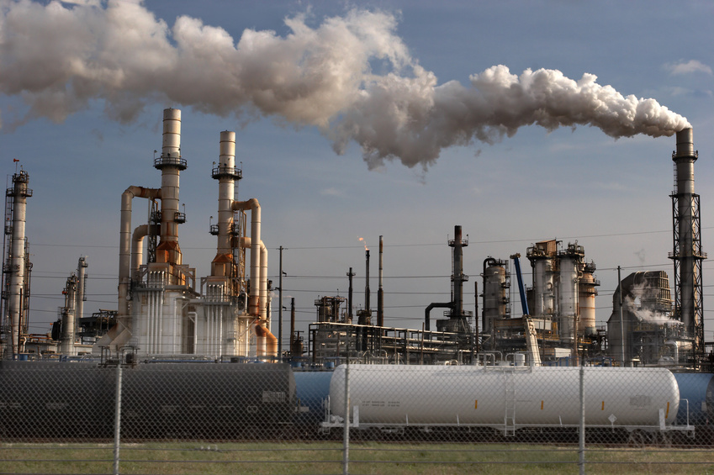
2. How it will get produced.

Slide 13

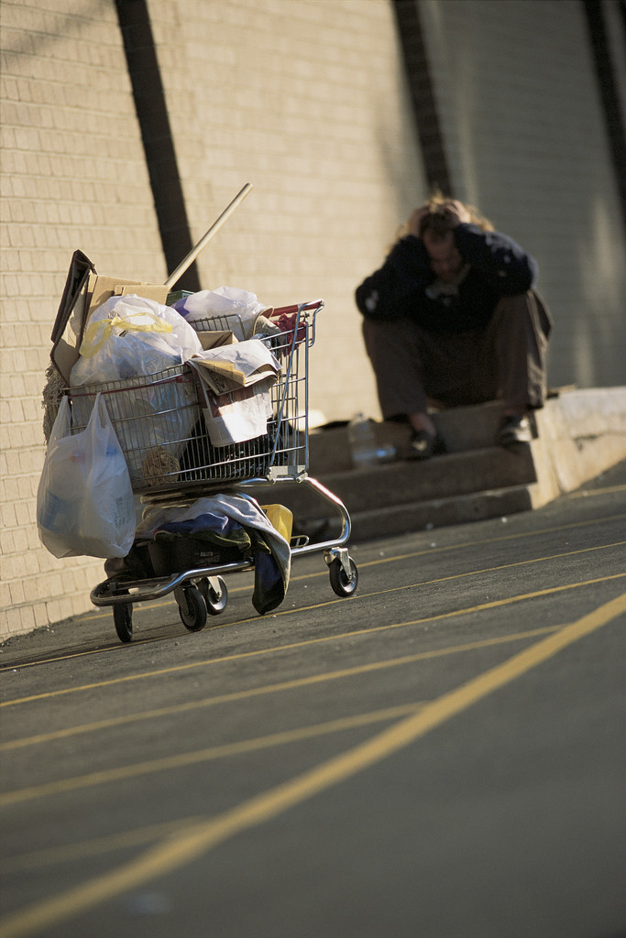




3. Who will reap the benefits of production.

Slide 14
Vocabulary
Economics has its own vocabulary…if you master that you will master the course.

Slide 15

Based on scientific reasoning
1. Identify the question.
2. Specify assumptions.
3. Formulate a hypothesis.
4. Test the hypothesis.
5. Verify or refute the theory.
But economics also involves people!

Slide 16

Data

Slide 17
Economic Models
Based on the gathered data
Simplified diagrams and graphs
Generalizations
Show how the world works, starting with the most simple steps.
3 pm wed

Slide 18
Our theories are based on rational self-interest!
We try to do the things that will ultimately benefit ourselves and our families.
We avoid pain and seek out pleasure.
To say this another way…
We maximize our expected benefits from any action, and minimize our expected costs.

Slide 19
Let’s take a look at Adam Smith 1723-1790
Scottish Economist
Wrote The Theory of Moral Sentiments
Wrote the Wealth of Nations
Developed self-interest in the economic sense
You have probably heard about the “Invisible Hand”

Slide 20
John Stossell

Slide 21
Economics is about Choice
Tradeoffs
Opportunity Cost
Information involves costs
Marginal!

Slide 22
Microeconomics
Snapshot of the economy at a point in time!
Called the theory of the firm
Shows how markets, prices, supply and demand and different market structures all interact.
Study of how households and firms make decisions in the marketplace.

Slide 23
Macroeconomics
It’s the big picture.
In our global economy we have to see how the world interacts!
We look at supply and demand, but we also see how the economy interacts with our households, firms and governments!

Slide 24
Jobs for Economists!
Positive Statements are descriptive, they describe how the world is.
So you could work for the BLS or any job that deals with statistics or demographics, or any job where they need someone to pay attention to the details.

Slide 25
There are times however when economists make normative statements. These are prescriptive, they say how the world should be!
The economists that work for the President’s Economic Advisory Council, propose changes in policy that are normative.

Slide 26
THE END

