Slide 1




Build websites using HTML5 and CSS3
Create a compelling web experience with transitions and animations
Design responsive websites that adapt to the user’s screen size

Slide 2
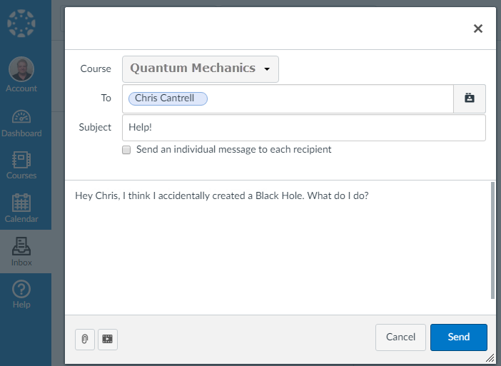

topherCantrell@gmail.com

