Slide 1
Day 1
Memory Forensics
Problems with Forensics
Evidence Acquisition
Memory Forensics

Slide 2
CS 407 Computer Forensics III
Incident Response & Memory Analysis
Introduction

Slide 3
Live System Forensics
Incident Response
Course: CS 407
Times: MW 3:30 – 5:20
    Texts: The Art of Memory Forensics, Michael Hale Ligh, Andrew Case, Jamie Levy.
    Windows Internals 6th Edition Volume 1 & 2, David Solomon and Mark Russinovich
Web sites: webpages.sou.edu/~ackler/ AND www.tophertimzen.com/cs407/
Instructors: Lynn Ackler, Topher Timzen and a guest lecturer Week 8, Ryan Allen.
Syllabus: http://www.tophertimzen.com/cs407/syllabus.html
    Office: CSC 222
    ackler@sou.edu timzenc@sou.edu
    552-6974
    821-2561

Slide 4

Our Main Text

Slide 5
CF III Outline
Live System Analysis
Introduction to Memory and Acquisition
Windows Objects, Pools, Processes, Handles & Tokens
Process Memory Internals & Malware
Event Logs, Networking and Registry
Rootkits
Windows GUI
Disk Artifacts in Memory
Time Lining / EOF

Slide 6
Ethical Issues
Evidence
  All of it
  Emphasis on exculpatory
Respect for suspects privacy and rights
Beware of collateral damage
Proper use of dual use technology
  All tools can be used to commit crime
  All procedures can be used to hide crime

Slide 7
Order of volatility of data
RFC 3227
Collecting information from a system
  Balance between
    Altering memory or physical media
    Information disappearing
The current scenario is important
  Is this a networking incident case
  Or a criminal case involving possession/conduct

Slide 8
Volatile Data
Registers, cache
Memory and temporary tables
    Routing, arp tables
    Open ports and connections
    Process table
    Kernel statistics
    Memory
Temporary file systems
    pagefile.sys
    hiberfil.sys

Slide 9
Incident Response
Plan, Planning, Strategy

Slide 10
Computer/Network Incident
Theft – IP
Embezzlement
Extortion
Business interruption
Computer/network intrusion
Malicious or unlawful action
Unauthorized consumption of resources
Should be SOP for any digital acquisition

Slide 11
Goals of Incident Response
Confirm the occurrence of an incident
Minimize business interruption
Provide rapid containment
Minimize exposure of business property
Determine damage
Restore data
Restore operations
Restore business presence

Slide 12
Methodology
Detection of incident
Initial response
Formulate response strategy
Investigate the incident
    Collect data
    Data analysis
Resolution
    Recovery
    Improve security
Report

Slide 13
Incident Detection
Firewall report
IDS report
System alerts
Anomalous behavior
Network congestion
Internal complaints
External complaints

Slide 14
Initial Response
Review logs
Enable logging on all possibly affected systems
Interview IT people
Interview administrators
Review access control lists
Review network topology

Slide 15
Formulate Response Strategy
How critical are the affected systems
Sensitivity of compromised data
Potential perpetrators
PR
Apparent skill of the attacker
Downtime
$ loss

Slide 16
Collect Data
Network activity capture and analysis
Live system acquisition of all affected systems
Image relevant computers
Capture all relevant logs
    Firewalls
    Routers
    Servers
      Authentication
      DNS
    IDS
    Storage devices

Slide 17
Analysis
Network activity timeline
Forensic analysis of captured data
    Time lines
    Malware artifacts
      Initial infection vector
      Propagation mechanism
      Persistence mechanism
    File signature analysis
    Executable analysis
    Log file analysis

Slide 18
Resolution
Recovery
    Scrub/reimage all infected systems
    Restore backups
    Notify affected users/owners
Improve security
    Lessons learned
    Organizations top priorities
    More protection

Slide 19
Incident Response
Collection List

Slide 20
Stuff
General steps during an Incident Response for a forensic examiner include:
Identify host(s) that may be involved, infected and/or compromised
Perform live response on those machines, keeping in mind the order of volatility:
Acquire physical memory (RAM capture)
Acquire system information
System date and time
System information
Volume information
Logged on users
Encryption detection
Auto-start persistence
Scheduled tasks
Acquire network data
IP(F)CONFIG -all
Arp table
Routing table
NetBIOS cache
Network connections
Files opened on the system remotely

Slide 21
More Stuff
Acquire processes and drivers
List of processes
process list with full path name
List of services
Loaded dlls
Process handles
Drivers
From the host, consider collecting the following information:
Hibernation file
Page file
Registry hives (specially HKEY_LOCAL_MACHINE) from RAM
Eventlogs
$MFT
File listing with MD5 hash codes
Analyze contents of memory for IOC's (indicators of compromise)
including processes, network connections, encryption keys,
and other informatin in memory
Force a malware scan on host (this can significantly alter memory)
Analyze $MFT, registry, event logs, and memory dumps for
evidence of intrusion and/or lateral movement within the environment
Attempt to identify method of intrusion and any exfiltration of data

Slide 22
And More Stuff
Identify other potentially involved hosts, update spreadsheet of affected hosts as indicated
Conduct static and dynamic analysis of malware, if located
Identify strategies for containment and eradication
Keep CIRT team aware of findings

Slide 23
2.2 – Memory
A Not So Gentle Introduction

Slide 24
Memory Formats
Virtual
    What the OS and the process sees
Physical
    Raw
    Crash dump
    Hibernation File
    Pagefile

Slide 25
Physical Memory Allocation
Physical memory is divided into 4Kbyte blocks
    Sometimes 2Mbyte or 4Mbyte
This is the memory a process uses
The OS resides here
Most drivers for physical devices reside here

Slide 26
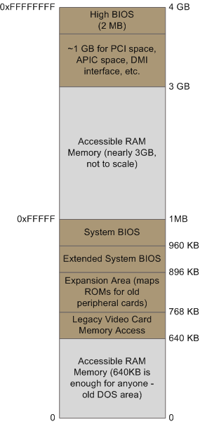
Physical Memory (4Gb)
APIC – Advanced Programmable Interrupt Controller

Slide 27
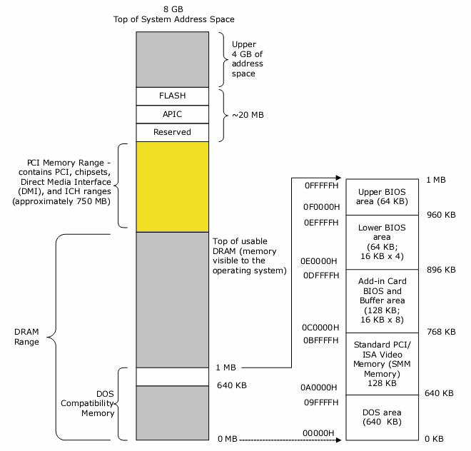
Physical Memory (8Gb)
APIC – Advanced Programmable Interrupt Controller

Slide 28
Physical Memory Utilization another view
BIOS data
0x1000
Kernel code/data
0xB8000
Video memory
MEM_START
(0x100000)
page0
page1
page2
.
.
.
next_free_page
pageN
free page frames
MAX_PHY_MEM

Slide 29
Virtual Memory
HW & SW
Mapping of HW addresses to Virtual addresses
Manages memory resources for applications
Manages shared memory space
MMU – CPU
    Auto address translation

Slide 30
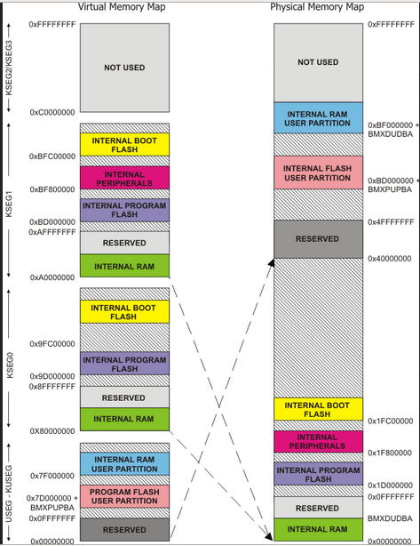
Memory Utilization

Slide 31
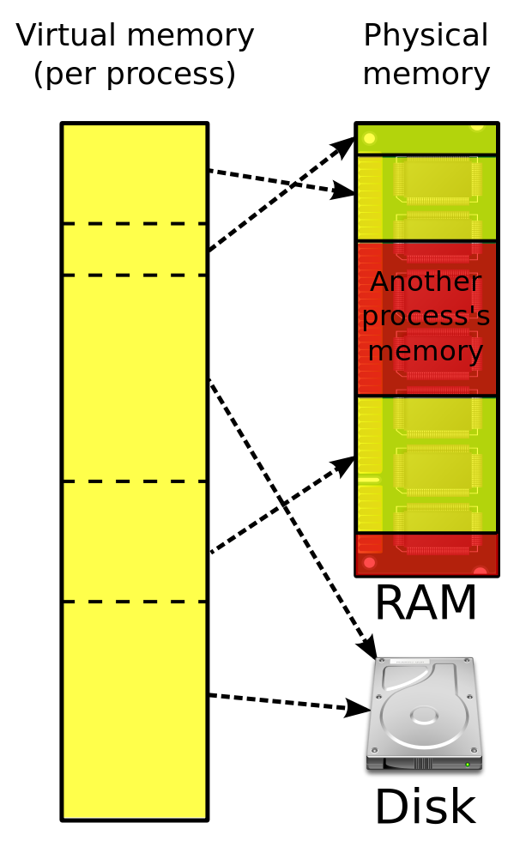
Virtual
Memory
Management
Pagefile

Slide 32
Virtual Memory Layout per process
0x0
Kernel code/data,
Kernel stacks, etc
Kernel address space
MAX_PHY_MEM
PROCESS_LOCATION
(0x1000000)
Process code/data
User address space
Process user stack
(one page, pinned in mem)
MAX_VIRTUAL_MEM
(0xFFFFFFFF)

Slide 33
Pages
Memory divided into pages
    Usually 4k per page
    When acquiring memory always use 4k block size
Page tables
    Stores virtual vs physical addresses
    Used to convert virtual addresses to physical addresses

Slide 34
Classic x86 Addressing
Has 32 bit addresses
Allows a process to address 4 Gbytes
Has a 2 level virtual addressing scheme
Each process has a 4 Gbyte virtual address space

Slide 35
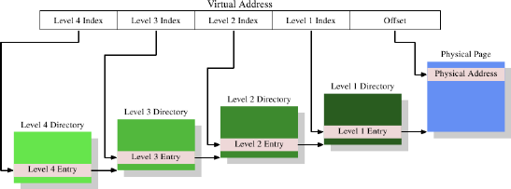
MultiLevel Page Indexing

Slide 36
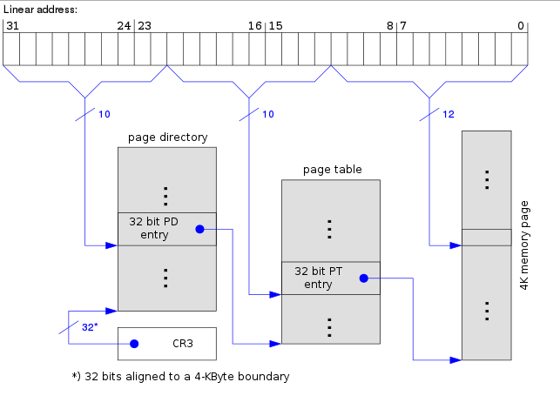
X86–64
2-Level Paging without PAE
Wikipedia

Slide 37
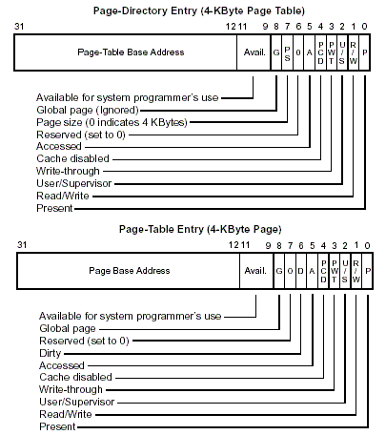
PTE/PDE x86-64

Slide 38
PAE
Physical Address Extensions
Permits the OS to address up to 64 Gbytes of physical RAM
Each process can address up 4 Gbytes of virtual address space
Enables each process to have up to 4 Page directories

Slide 39
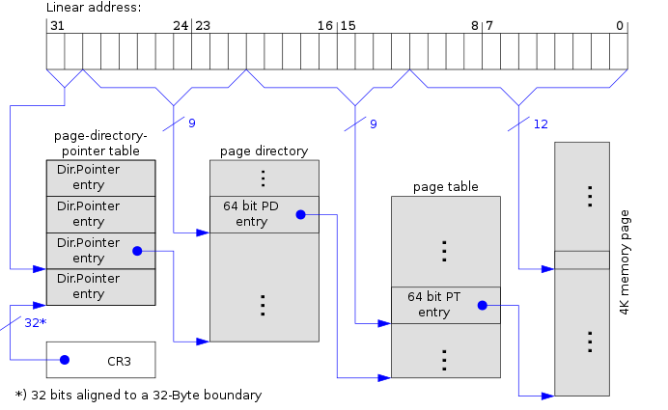
X86–64
3-Level Paging with PAE
Wikipedia

Slide 40
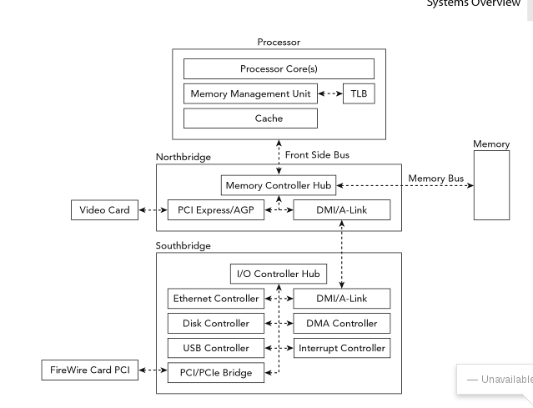
Computer Architecture

Slide 41
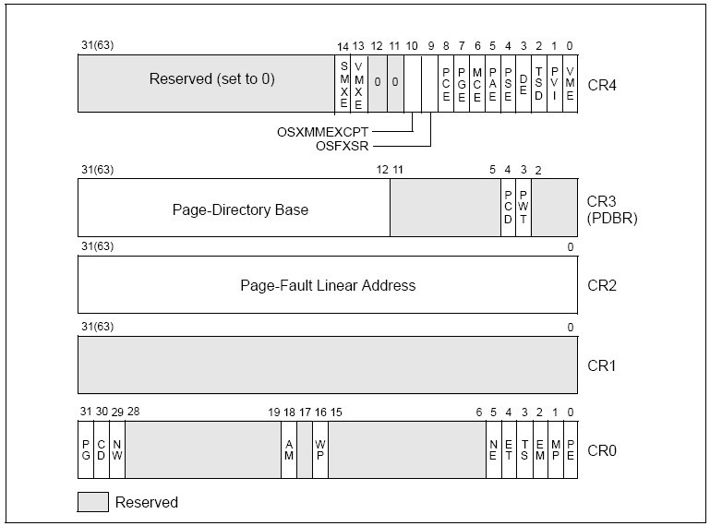
Control Registers x86-64
PCD Page-level Cache Disable
PWT Page-level Writes Transparent
PG bit enables paging
http://blog.csdn.net/songzheng1986/article/details/4437492

Slide 42
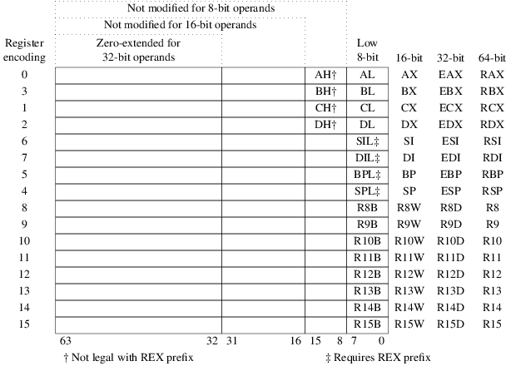
General Purpose Registers x86-64
Accumulator
Base
Counter
Data
Source
Destination
Stack Base Pointer
Stack Pointer
www.tortal.net

Slide 43
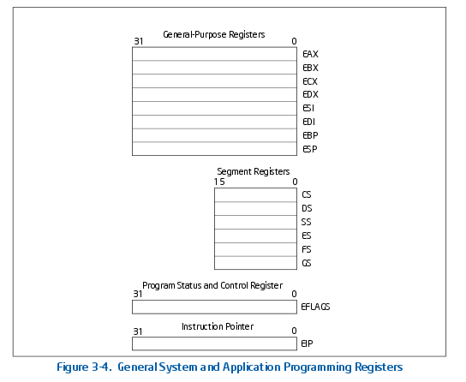
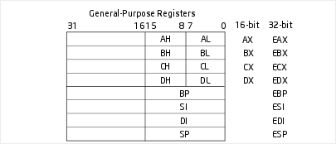
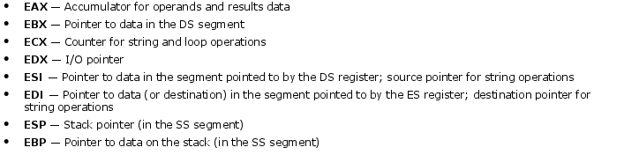
General Purpose Registers

Slide 44
Page Directory Base Register
If paging is enabled
    Bit 31 (PG bit) is set in CR0
Upper 20 bits of CR3 contains the address of the page directory
    Page Directory Base Register
    The physical address of the first page directory entry.

Slide 45
Memory Image Formats
Virtual
    What the OS and the process sees
Physical
    Raw
    Crash dump
    Hibernation File

Slide 46
Raw Memory Dump
Just an image of physical memory
You will not get the full addressable memory
    Only what the hardware has
You have to find the virtual structure
Each process has its own memory allocation

Slide 47
Crash Dump
32-bit crash dumps
Crash dumps from 32-bit systems begin with a _DMP_HEADER structure. The Signature field must be "PAGEDUMP" for volatility to consider it valid.
>>> dt("_DMP_HEADER")
'_DMP_HEADER' (4096 bytes)
0x0 : Signature ['array', 4, ['unsigned char']]
0x4 : ValidDump ['array', 4, ['unsigned char']]
0x8 : MajorVersion ['unsigned long']
0xc : MinorVersion ['unsigned long']
0x10 : DirectoryTableBase ['unsigned long']
0x14 : PfnDataBase ['unsigned long']
0x18 : PsLoadedModuleList ['unsigned long']
0x1c : PsActiveProcessHead ['unsigned long']
0x20 : MachineImageType ['unsigned long']
0x24 : NumberProcessors ['unsigned long']
0x28 : BugCheckCode ['unsigned long']
0x2c : BugCheckCodeParameter ['array', 4, ['unsigned long']]
0x3c : VersionUser ['array', 32, ['unsigned char']]
0x5c : PaeEnabled ['unsigned char']
0x5d : KdSecondaryVersion ['unsigned char']
0x5e : VersionUser2 ['array', 2, ['unsigned char']]
0x60 : KdDebuggerDataBlock ['unsigned long']
0x64 : PhysicalMemoryBlockBuffer ['_PHYSICAL_MEMORY_DESCRIPTOR']
0x320 : ContextRecord ['array', 1200, ['unsigned char']]
0x7d0 : Exception ['_EXCEPTION_RECORD32']
0x820 : Comment ['array', 128, ['unsigned char']]
0xf88 : DumpType ['unsigned long']
0xf8c : MiniDumpFields ['unsigned long']
0xf90 : SecondaryDataState ['unsigned long']
0xf94 : ProductType ['unsigned long']
0xf98 : SuiteMask ['unsigned long']
0xf9c : WriterStatus ['unsigned long']
0xfa0 : RequiredDumpSpace ['unsigned long long']
0xfb8 : SystemUpTime ['unsigned long long']
0xfc0 : SystemTime ['unsigned long long']
0xfc8 : reserved3 ['array', 56, ['unsigned char']]
http://computer.forensikblog.de/en/2006/03/dmp-file-structure.html

Slide 48
Crash Dump
64-bit crash dumps
Crash dumps from 64-bit systems begin with a _DMP_HEADER64 structure. The Signature field must be "PAGEDU64" for volatility to consider it valid.
>>> dt("_DMP_HEADER64")
'_DMP_HEADER64' (8192 bytes)
0x0 : Signature ['array', 4, ['unsigned char']]
0x4 : ValidDump ['array', 4, ['unsigned char']]
0x8 : MajorVersion ['unsigned long']
0xc : MinorVersion ['unsigned long']
0x10 : DirectoryTableBase ['unsigned long long']
0x18 : PfnDataBase ['unsigned long long']
0x20 : PsLoadedModuleList ['unsigned long long']
0x28 : PsActiveProcessHead ['unsigned long long']
0x30 : MachineImageType ['unsigned long']
0x34 : NumberProcessors ['unsigned long']
0x38 : BugCheckCode ['unsigned long']
0x40 : BugCheckCodeParameter ['array', 4, ['unsigned long long']]
0x80 : KdDebuggerDataBlock ['unsigned long long']
0x88 : PhysicalMemoryBlockBuffer ['_PHYSICAL_MEMORY_DESCRIPTOR']
0x348 : ContextRecord ['array', 3000, ['unsigned char']]
0xf00 : Exception ['_EXCEPTION_RECORD64']
0xf98 : DumpType ['unsigned long']
0xfa0 : RequiredDumpSpace ['unsigned long long']
0xfa8 : SystemTime ['unsigned long long']
0xfb0 : Comment ['array', 128, ['unsigned char']]
0x1030: SystemUpTime ['unsigned long long']
0x1038: MiniDumpFields ['unsigned long']
0x103c: SecondaryDataState ['unsigned long']
0x1040: ProductType ['unsigned long']
0x1044: SuiteMask ['unsigned long']
0x1048: WriterStatus ['unsigned long']
0x104c: Unused1 ['unsigned char']
0x104d: KdSecondaryVersion ['unsigned char']
0x104e: Unused ['array', 2, ['unsigned char']]
0x1050: _reserved0 ['array', 4016, ['unsigned char']]

Slide 49
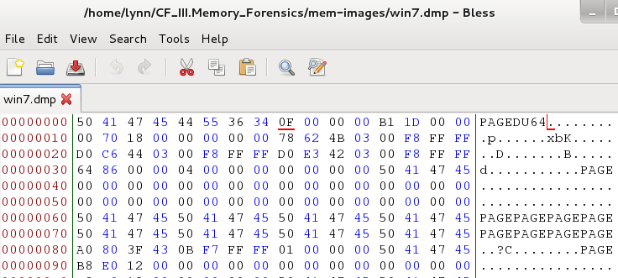
Crash Dump Header

Slide 50
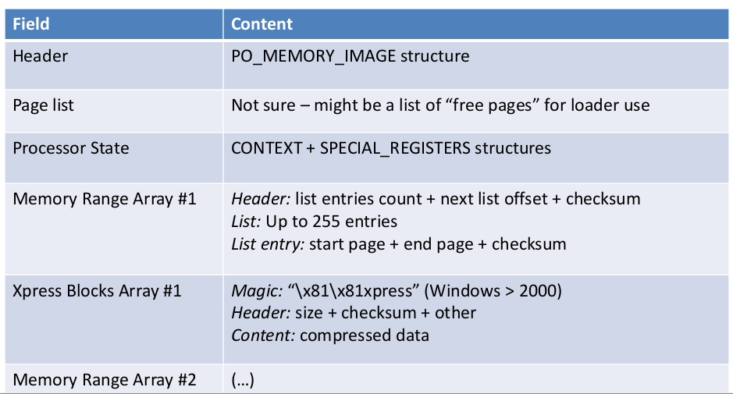
Hibernation File
http://www.msuiche.net/pres/PacSec07-slides-0.4.pdf

Slide 51
Hibernation File
typedef struct
{
ULONG Signature; 'hibr'
ULONG ImageType;
ULONG CheckSum;
ULONG LengthSelf;
ULONG PageSelf;
ULONG PageSize;
LARGE_INTEGER SystemTime;
UINT64 InterruptTime;
ULONG FeatureFlags;
UCHAR HiberFlags;
UCHAR spare[3];
ULONG NoHiberPtes;
ULONG HiberVa;
LARGE_INTEGER HiberPte;
ULONG NoFreePages;
ULONG FreeMapCheck;
ULONG WakeCheck;
ULONG TotalPages;
ULONG FirstTablePage;
ULONG LastFilePage;
PO_HIBER_PERF PerfInfo;
ULONG NoBootLoaderLogPages;
ULONG BootLoaderLogPages[8];
ULONG TotalPhysicalMemoryCount;
} PO_MEMORY_IMAGE, *PPO_MEMORY_IMAGE;

Slide 52
2.1 - RAM Acquisition Procedures

Slide 53
Tools
Know your tools
    How do they work?
    What's the output
    Command line
RAM footprint
System dlls used
What's to worry?

Slide 54
Windows Problems
Access to certain files
Access to memory
Must have admin rights
We are always in a friendly and permissive setting
Do not do this stuff subversively

Slide 55
dd
Originally written for very early Unix systems
Used mainly for system maintenance
Syntax comes from IBM JCL
Makes a bit for bit copy
Can also convert the data
An old standby

Slide 56
Windows dd Versions
Most used is Garner’s Version 3.16
    56 KB
New version 5.3 is greatly expanded
    856 KB
    http://gmgsystemsinc.com/fau/
    Many more options
Use the one with the smallest footprint
You will need getopt.dll
Test

Slide 57
dd Syntax
dd if=input of=output options
Defaults
input is STDIN (the keyboard)
output is STDOUT (the screen)
Usually a file or device
Unix - /dev/sda, image.dd
Windows - \\.\PhysicalDevice0, image.dd

Slide 58
Important Devices
Unix
  /dev/mem
  /dev/zero
  /dev/random
  /dev/null
Windows
  \\.\PhysicalMemory

Slide 59
dd - Options
bs=blocksize
count=number of blocks to copy
seek=blocks-to-skip-at-start-of-output
skip=blocks-to-skip-at-start-of-input
conv=noerror – continue after read errors
    Important in memory reads
    Windows memory is not contiguous

Slide 60
dd with nc
dd Examples
dd if=\\.\PhysicalMemory of=E\:RAM.dd conv=noerror - Physical memory
dd if=\\.\PhysicalDrive0 of=E:\Drive0.dd – The whole drive (Physical copy)
dd if=C: of=E:\C_Partition.dd – Main patition (Logical copy)
dd if=C:\Pagefile.sys of=E:\pagefile.dd – Failed file in use
  Have to image entire hard drive and then extract
Collection device
  nc –l –p 8080 > physical-memory.dd
Compromised device
  dd if=\\.\PhysicalMemory bs=4096 count=1 | nc 192.168.1.1 8080 –w 3

Slide 61
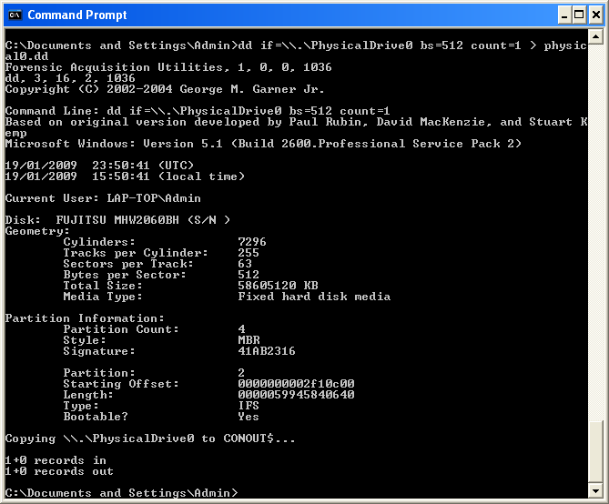
dd Output for a hard drive

Slide 62
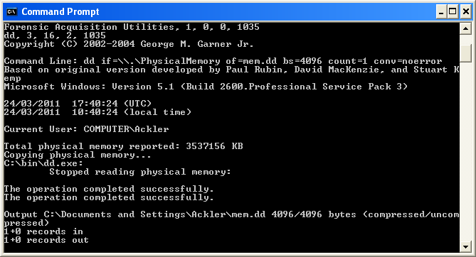
dd Output for a memory dump

Slide 63
win32dd & win64dd
Authored by Matthieu Suiche
    http://www.moonsols.com/products/
Kernel level acquisition
    \\Device\\PhysicalMemory
Syntax
    win32dd [path to output file]
    May need path to .exe
Appears to be very robust
Scripting is questionable

Slide 64
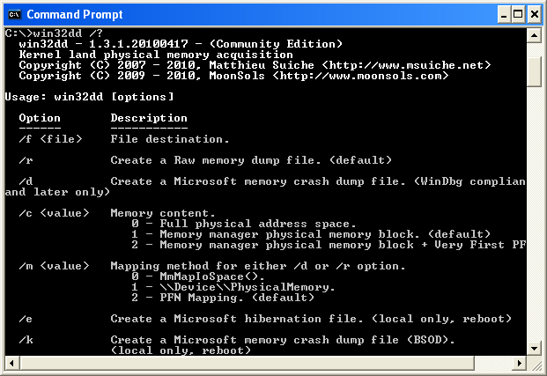
win32(64)dd /?

Slide 65
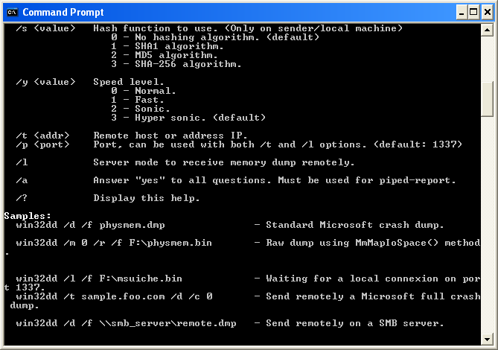
win32(64)dd /?

Slide 66
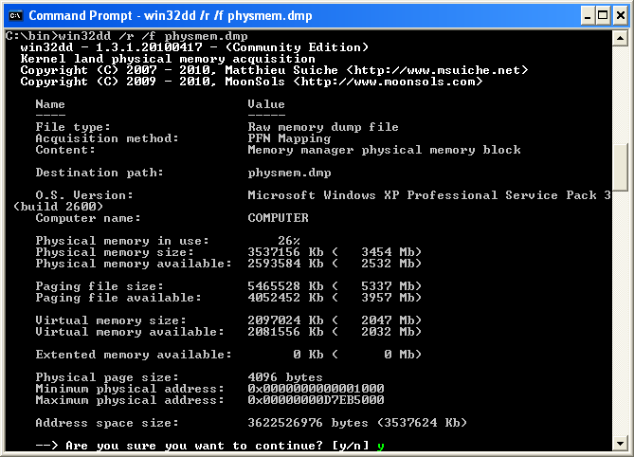
win32dd Output

Slide 67
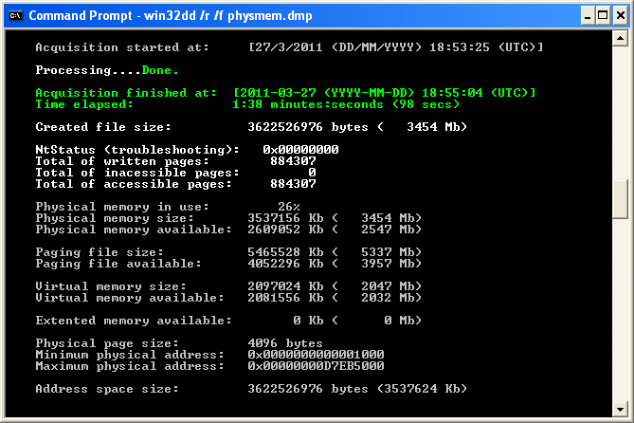
win32dd Output

Slide 68
winpmem
Excellent memory capture binary
Very robust
Free
Open source
Small footprint

Slide 69
winpmem
Derivative of win64dd
Reads memory
Can write to a file or a socket
Run as a python module or a binary
    The binaries are signed so they can run in Win7
If a driver is loaded, volatility can use live memory
You can read the source

Slide 70
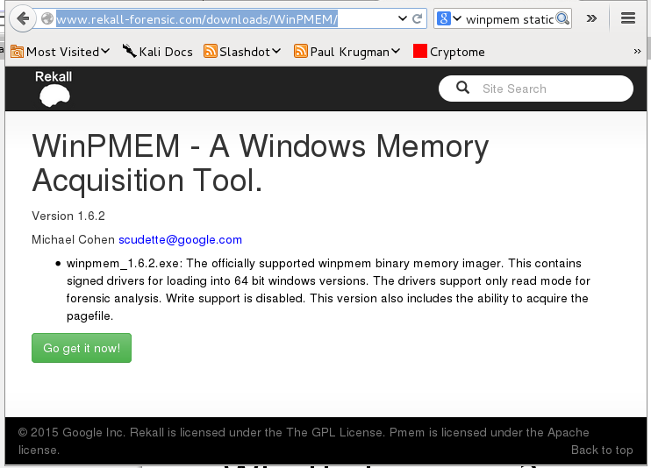
Get winpmem

Slide 71

Source Code is Available

Slide 72
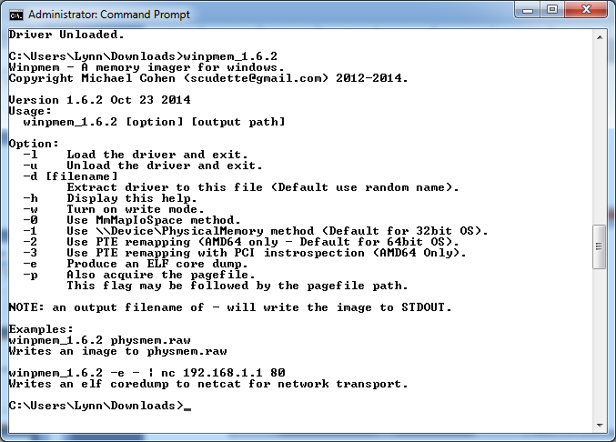
winpmem
Usage

Slide 73
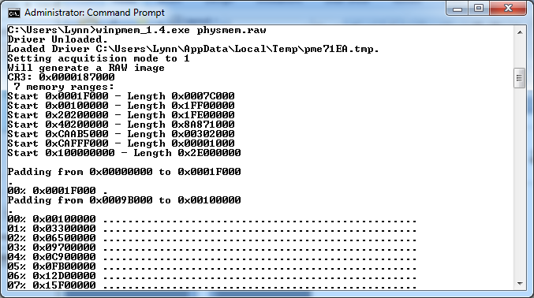
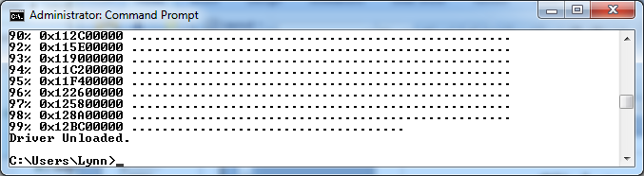
In Action

Slide 74
You don't get it all
Certain areas of memory hold HW device drivers
Often it is active
Acquisition can corrupt
Use KnTTools from James Garner
    $$$

Slide 75
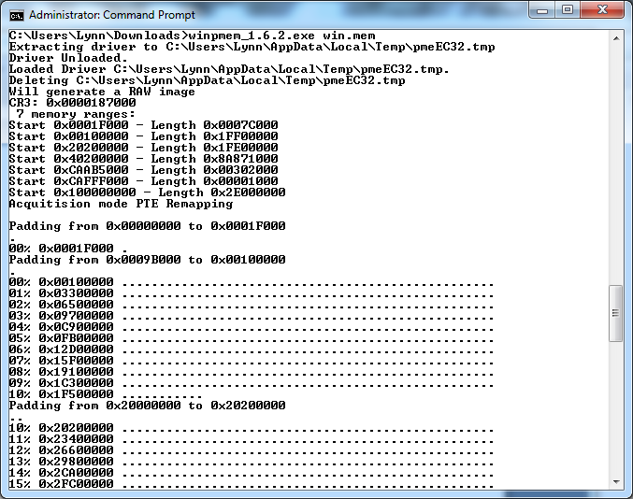

Slide 76
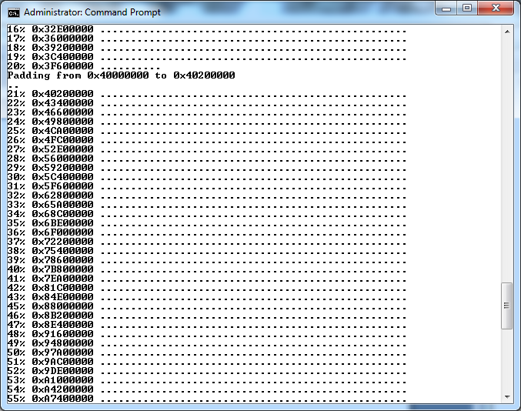

Slide 77
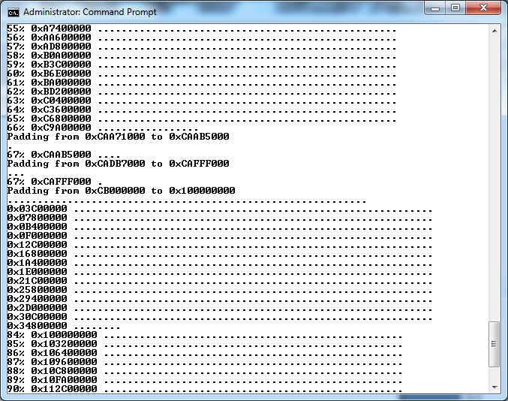

Slide 78
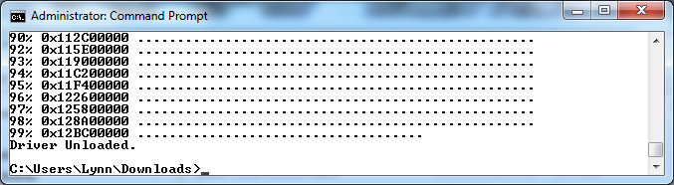

Slide 79
Memory Ranges
Extracting driver to C:\Users\Lynn\AppData\Local\Temp\pmeFADC.tmp
Driver Unloaded.
Loaded Driver C:\Users\Lynn\AppData\Local\Temp\pmeFADC.tmp.
Deleting C:\Users\Lynn\AppData\Local\Temp\pmeFADC.tmp
Will generate a RAW image
CR3: 0x0000187000
7 memory ranges:
Device 0x00000000 to 0x0001F000 - Length 0x0001F000
1 Start 0x0001F000 to 0x0009B000 - Length 0x0007C000
Device 0x0009B000 to 0x00100000 - Length 0x00065000
2 Start 0x00100000 to 0x20000000 - Length 0x1FF00000
Device 0x20000000 to 0x20200000 - Length 0x00200000
3 Start 0x20200000 to 0x40000000 - Length 0x1FE00000
Device 0x40000000 to 0x40200000 - Length 0x00200000
4 Start 0x40200000 to 0xCAA71000 - Length 0x8A871000
Device 0xCAA71000 to 0xCAAB5000 - Length 0x00044000
5 Start 0xCAAB5000 to 0xCADB7000 - Length 0x00302000
Device 0xCADB7000 to 0xCAFFF000 - Length 0x00248000
6 Start 0xCAFFF000 to 0xCB000000 - Length 0x00001000
Device 0xCB000000 to 0x100000000 - Length 0x35000000
7 Start 0x100000000 to 0x12E000000 - Length 0x2E000000

Slide 80
Recommendations
Use winpmem to acquire Windows memory image
    It is relatively small
    It runs natively on Windows
Run dcfldd on Linux and generate your hash logs, etc.
    Very flexible
Linux memory acquisition
    http://www.rekall-forensic.com/downloads.html

Slide 81
Process Footprint
Size
System dlls it uses
Process Explorer
Process Monitor
Regshot
Dependency Walker

Slide 82
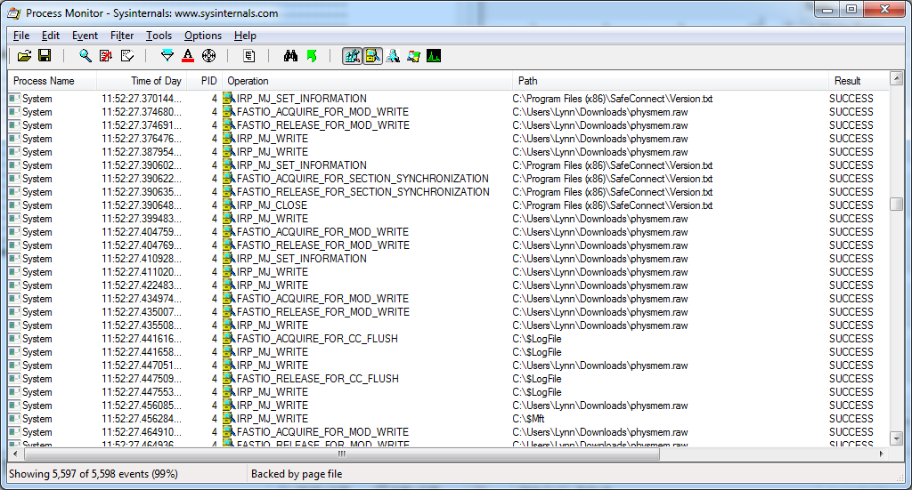
Process Monitor (procmon)
Sysinternals

Slide 83
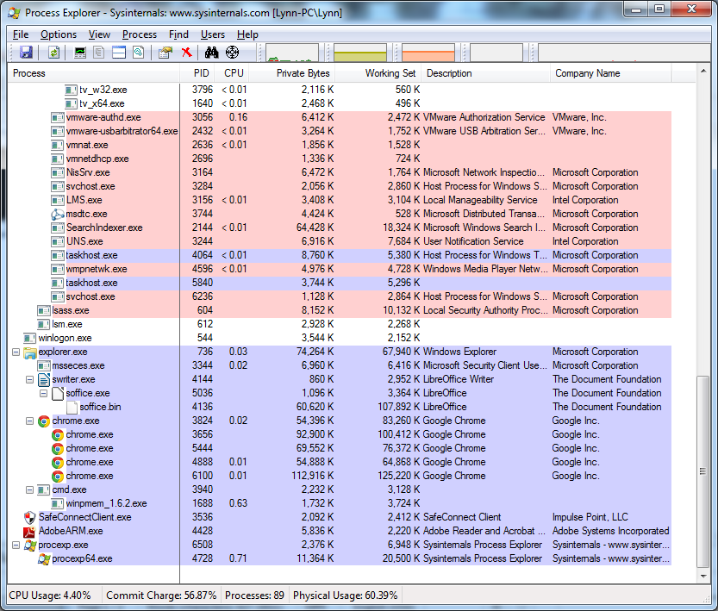
Process Explorer (procexp) MS

Slide 84
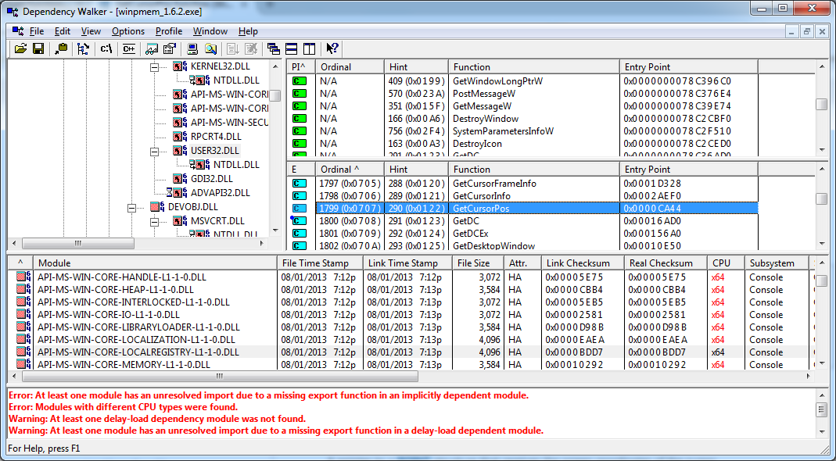
winpmem_1.6.2 Dependencies
Microsoft

Slide 85
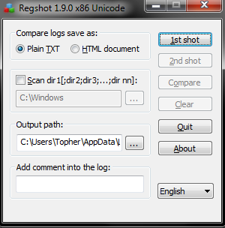
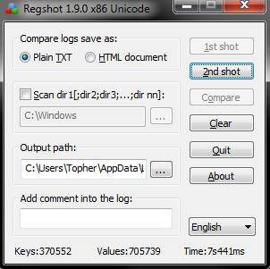
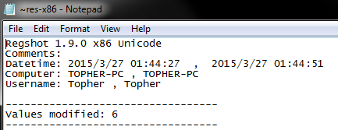
Regshot
Registry before and after using a snapshot.

Slide 86
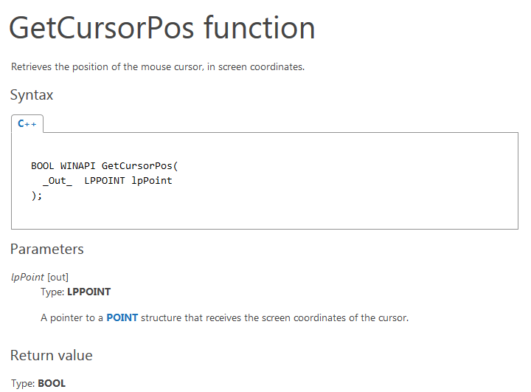
Double Click on Function for Full Description

