Slide 1
Memory Analysis Tools

Slide 2
Volatility Installation
Windows
This installation follows:
  http://www.secarma.co.uk/blog/2013/04/03/how-to-installing-volatility-on-windows-7-64-bit/
First have to get the install packages
Python 2.6 or greater, we used 2.6.6 for the purposes of writing this document: http://www.python.org/ftp/python/2.6.6/python-2.6.6.amd64.msi
Distorm (Malware Plugins, Volshell): https://code.google.com/p/distorm/downloads/detail?name=distorm3-3.win-amd64.exe
Yara (Malware Plugins): https://code.google.com/p/yara-project/downloads/detail?name=yara-python-1.6.win-amd64-py2.6.exe
PyCrypto (Core): http://www.voidspace.org.uk/downloads/pycrypto26/pycrypto-2.6.win-amd64-py2.6.exe
Subversion Client – TortoiseSVN for example.: http://switch.dl.sourceforge.net/project/tortoisesvn/1.7.11/Application/TortoiseSVN-1.7.11.23600-x64-svn-1.7.8.msi
PIL (Adds imaging capabilities for viewing screenshots): http://www.mediafire.com/?20h3zeimnke
Be sure you get the latest. Python is up to 2.7.3. I think everything is current.

Slide 3
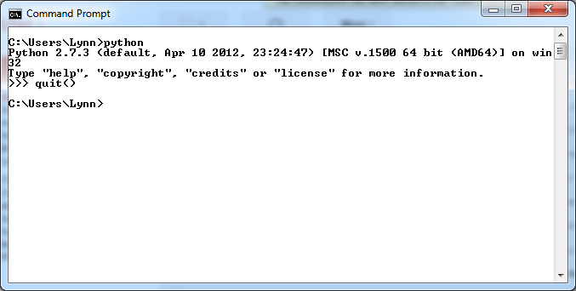
Python Install
Double click the python install package
Take defaults
Check the Environment Variale making sure c:\python is at the end.
    Control Panel > System
    Advanced settings, Environment Variables
Check it out:
    C:\python

Slide 4
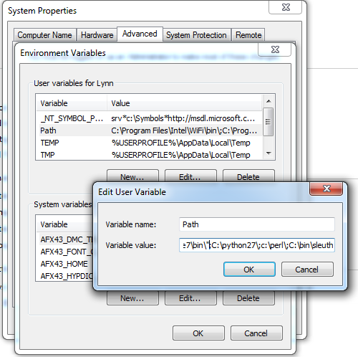
Environment Variable

Slide 5
Install Dependencies
The following should be completed in the order outlined here:
Pycrypto – Using the pycrypto-2.6.win-amd64-py2.6.exe package,
run through the installation selecting the default options.
Distorm3 – Using the distorm3-3.win-amd64.exe package,
run through the installation selecting the default options.
Yara-Python 1.6 – Using the yara-python-1.6.win-amd64-py2.6.exe package,
run through the installation selecting the default options.
TortoiseSVN – Using the TortoiseSVN-1.7.11.23600-x64-svn-1.7.8.msi package,
run through the installation selecting the default options.
PIL – Using the PIL-1.1.6.win-amd64-py2.6.exe package,
run through the installation selecting the default options.

Slide 6
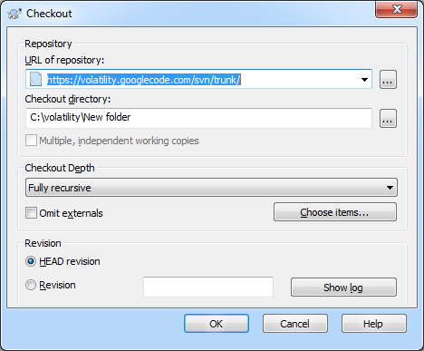
Volatility Installation
Create c:\volatility
In c:\volatility right click
Select “SVN Checkout”
Enter URL

Slide 7
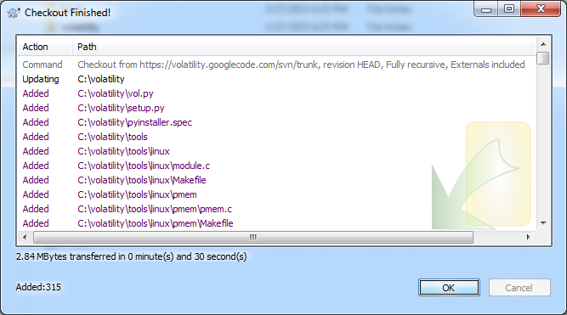
Voila Volatility Installed

Slide 8
Check it out
C:\python c:\volatility\vol.py -h
Volatility Foundation Volatility Framework 2.3.1
Usage: Volatility - A memory forensics analysis platform.
Options:
-h, --help list all available options and their default values.
Default values may be set in the configuration file
(/etc/volatilityrc)
--conf-file=.volatilityrc
User based configuration file
-d, --debug Debug volatility
--plugins=PLUGINS Additional plugin directories to use (semi-colon
separated)
--info Print information about all registered objects
--cache-directory=C:\Users\Lynn/.cache\volatility
Directory where cache files are stored
--cache Use caching
--tz=TZ Sets the timezone for displaying timestamps
-f FILENAME, --filename=FILENAME
Filename to use when opening an image
--profile=WinXPSP2x86
Name of the profile to load
-l LOCATION, --location=LOCATION
A URN location from which to load an address space
-w, --write Enable write support
--dtb=DTB DTB Address
--output=text Output in this format (format support is module
specific)
--output-file=OUTPUT_FILE
write output in this file
-v, --verbose Verbose information
--shift=SHIFT Mac KASLR shift address
-g KDBG, --kdbg=KDBG Specify a specific KDBG virtual address
-k KPCR, --kpcr=KPCR Specify a specific KPCR address

Slide 9
Supported Plugin Commands:
apihooks Detect API hooks in process and kernel memory
atoms Print session and window station atom tables
atomscan Pool scanner for _RTL_ATOM_TABLE
bioskbd Reads the keyboard buffer from Real Mode memory
callbacks Print system-wide notification routines
clipboard Extract the contents of the windows clipboard
cmdscan Extract command history by scanning for _COMMAND_HISTORY
connections Print list of open connections [Windows XP and 2003 Only]
connscan Scan Physical memory for _TCPT_OBJECT objects (tcp connections)
consoles Extract command history by scanning for _CONSOLE_INFORMATION
crashinfo Dump crash-dump information
deskscan Poolscaner for tagDESKTOP (desktops)
devicetree Show device tree
dlldump Dump DLLs from a process address space
dlllist Print list of loaded dlls for each process
driverirp Driver IRP hook detection
driverscan Scan for driver objects _DRIVER_OBJECT
dumpcerts Dump RSA private and public SSL keys
dumpfiles Extract memory mapped and cached files
envars Display process environment variables
eventhooks Print details on windows event hooks
filescan Scan Physical memory for _FILE_OBJECT pool allocations
gahti Dump the USER handle type information
gditimers Print installed GDI timers and callbacks
gdt Display Global Descriptor Table
getsids Print the SIDs owning each process
handles Print list of open handles for each process
hibinfo Dump hibernation file information
hivedump Prints out a hive
hivelist Print list of registry hives.
hivescan Scan Physical memory for _CMHIVE objects (registry hives)
hpakextract Extract physical memory from an HPAK file
hpakinfo Info on an HPAK file
idt Display Interrupt Descriptor Table
iehistory Reconstruct Internet Explorer cache / history
imagecopy Copies a physical address space out as a raw DD image
imageinfo Identify information for the image
impscan Scan for calls to imported functions
kdbgscan Search for and dump potential KDBG values
kpcrscan Search for and dump potential KPCR values
ldrmodules Detect unlinked DLLs

Slide 10
machoinfo Dump Mach-O file format information
malfind Find hidden and injected code
mbrparser Scans for and parses potential Master Boot Records (MBRs)
memdump Dump the addressable memory for a process
memmap Print the memory map
messagehooks List desktop and thread window message hooks
mftparser Scans for and parses potential MFT entries
moddump Dump a kernel driver to an executable file sample
modscan Scan Physical memory for _LDR_DATA_TABLE_ENTRY objects
modules Print list of loaded modules
mutantscan Scan for mutant objects _KMUTANT
patcher Patches memory based on page scans
printkey Print a registry key, and its subkeys and values
privs Display process privileges
procexedump Dump a process to an executable file sample
procmemdump Dump a process to an executable memory sample
pslist Print all running processes by following the EPROCESS lists
psscan Scan Physical memory for _EPROCESS pool allocations
pstree Print process list as a tree
psxview Find hidden processes with various process listings
raw2dmp Converts a physical memory sample to a windbg crash dump
screenshot Save a pseudo-screenshot based on GDI windows
sessions List details on _MM_SESSION_SPACE (user logon sessions)
sockets Print list of open sockets
sockscan Scan Physical memory for _ADDRESS_OBJECT objects (tcp sockets)
ssdt Display SSDT entries
strings Match physical offsets to virtual addresses (may take a while, VERY verbose)
symlinkscan Scan for symbolic link objects
thrdscan Scan physical memory for _ETHREAD objects
threads Investigate _ETHREAD and _KTHREADs
timers Print kernel timers and associated module DPCs
unloadedmodules Print list of unloaded modules
userassist Print userassist registry keys and information
userhandles Dump the USER handle tables
vaddump Dumps out the vad sections to a file
vadinfo Dump the VAD info
vadtree Walk the VAD tree and display in tree format
vadwalk Walk the VAD tree
vboxinfo Dump virtualbox information
vmwareinfo Dump VMware VMSS/VMSN information
volshell Shell in the memory image
windows Print Desktop Windows (verbose details)
wintree Print Z-Order Desktop Windows Tree
wndscan Pool scanner for tagWINDOWSTATION (window stations)
yarascan Scan process or kernel memory with Yara signatures

Slide 11
Volatility Usage
Python
Vol.py
Image file name
Profile
Plugin name
python vol.py -f c:\case-2015\win7.memdmp --profile=Win7SP0x86 pslist

Slide 12
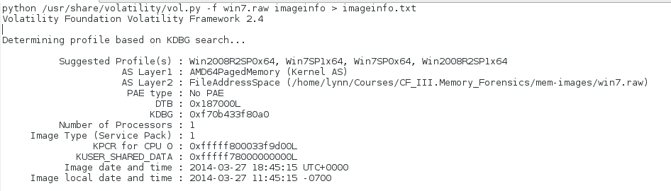
We have to Discover the Right Profile

Slide 13
Volatility Installation
Linux
This installation follows:
  https://code.google.com/p/volatility/wiki/FullInstallation
Luckily installation is a bit easier for Linux. You will need to install Subversion (probably already installed) and libpcre in addition to the dependencies listed above. These should be available in your distribution's repository. For example on Ubuntu (as root):
  # apt-get install subversion pcregrep libpcre++-dev python-dev -y

Slide 14
pycrypto
$ wget https://gitweb.pycrypto.org/\?p=crypto/pycrypto-2.0.x.git\;a=snapshot\;h=9e9641d0a9b88f09683b5f26d3b99c4a2e148da5\;sf=tgz -O pycrypto.tgz
# tar -xzvf pycrypto.tgz
# cd pycrypto-2.0.x/
# python setup.py build
# python setup.py build install

Slide 15
distorm
wget https://distorm.googlecode.com/files/distorm3-1.0.zip
# unzip distorm3-1.0.zip
# cd distorm3-1.0
# python setup.py build

Slide 16
Memory Parsing
Memory Forensics
Identify Rogue Processes
Analyze Process DLLs and Handles
Network Artifacts
Signs of Code Injection
Look for Rootkits
Dump Suspicious Processes and Drivers

Slide 17
Some Data Storage Models
Basic Data Types
Abstract Data Types
  Arrays
  Bitmaps
  Records
  Strings
  Linked Lists
  Hash Tables
  Trees

Slide 18
Records
Usual C type structs
For example
struct Connection {
short id;
short port;
unsigned long addr;
char hostname[32];
};

Slide 19
Arrays
Consecutive memory locations holding the same data type
Usually addressed in 'c' as A[n]
Knowing the base address of the array the n^{th} element of the array can be addressed as base+n*sizeof(data type)

Slide 20
Strings
Array of chars
Last entry is 0x00 the null character
Poses many problems for 'c' programmers

Slide 21
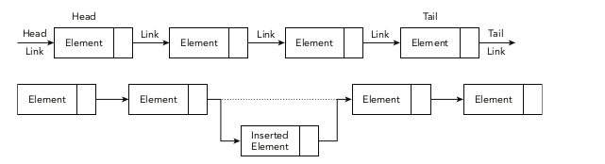
Linked Lists

Slide 22

Circular Linked Lists

Slide 23

Doubly Linked Circular List

Slide 24
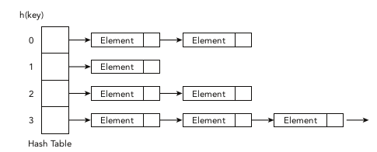
Hash Table

Slide 25
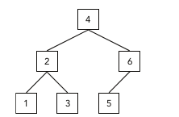
Hierarchical Trees

Slide 27
Virtual to Physical x86
Determining profile based on KDBG search...
Suggested Profile(s) : WinXPSP2x86, WinXPSP3x86 (Instantiated with WinXPSP2x86)
AS Layer1 : IA32PagedMemory (Kernel AS)
AS Layer2 : FileAddressSpace (mem-images/xp.img)
PAE type : No PAE
DTB : 0x39000L
KDBG : 0x8054c060
Number of Processors : 1
Image Type (Service Pack) : 2
KPCR for CPU 0 : 0xffdff000
KUSER_SHARED_DATA : 0xffdf0000
Image date and time : 2005-07-04 18:30:32 UTC+0000
Image local date and time : 2005-07-04 14:30:32 -0400

Slide 28
Find the executable
Offset(V) Name PID PPID Thds Hnds Sess Wow64 Start
---------- -------------------- ------ ------ ------ -------- ------ ------ ----------------------------
0x823c87c0 System 4 0 62 1133 ------ 0
0x8214b020 smss.exe 400 4 3 21 ------ 0 2005-07-04 18:17:26 UTC+0000
0x821c11a8 csrss.exe 456 400 11 551 0 0 2005-07-04 18:17:29 UTC+0000
0x814dc020 winlogon.exe 480 400 18 522 0 0 2005-07-04 18:17:29 UTC+0000
0x815221c8 services.exe 524 480 17 321 0 0 2005-07-04 18:17:30 UTC+0000
.........
0x81f7fb98 taskmgr.exe 3192 2392 3 65 ------ 0 2005-07-04 18:19:33 UTC+0000
0x8153f480 cmd.exe 3256 2392 1 29 ------ 0 2005-07-04 18:20:58 UTC+0000
0x8133d810 firefox.exe 3276 2392 7 189 ------ 0 2005-07-04 18:21:11 UTC+0000
0xff96b860 PluckSvr.exe 3352 680 6 206 0 0 2005-07-04 18:21:42 UTC+0000
0x813383b0 PluckTray.exe 3612 3352 3 -------- 0 0 2005-07-04 18:24:00 UTC+0000
0x81488350 PluckUpdater.ex 368 3352 0 -------- 0 0 2005-07-04 18:24:30 UTC+0000
0x81543870 dd.exe 3300 3256 1 22 0 0 2005-07-04 18:30:32 UTC+0000
cmd.exe virtual address 0x8153f480

Slide 29
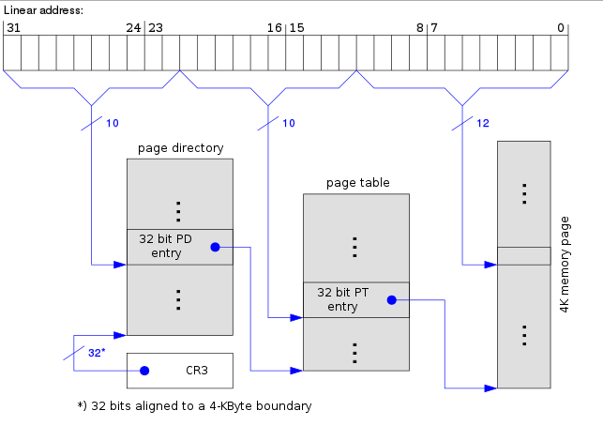
Virtual Address
0x8153f480
8 1 5 3 f 4 8 0
1000 0001 0101 0011 1111 0100 1000 0000
1000000101 0100111111 010010000000
0X205 0x13F 0x480

Slide 30
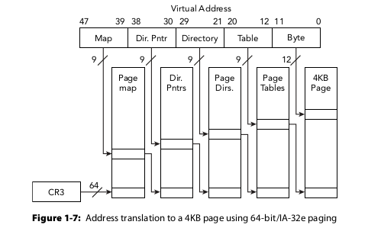
Virtual to Physical
64-bit/IA-32e

Slide 31
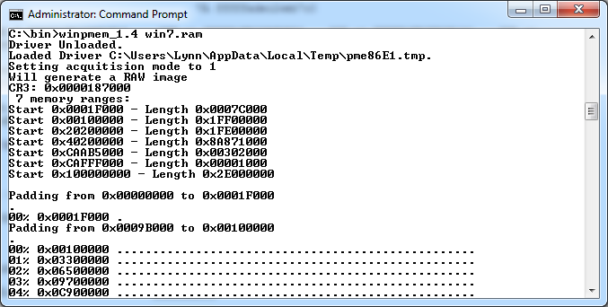
Find CR3
There it is!

Slide 32
And Again
Determining profile based on KDBG search...
Suggested Profile(s) : Win2008R2SP0x64, Win7SP1x64, Win7SP0x64, Win2008R2SP1x64
AS Layer1 : AMD64PagedMemory (Kernel AS)
AS Layer2 : FileAddressSpace (/home/lynn/Courses/CF_III.Memory_Forensics/mem-images/win7.ram)
PAE type : No PAE
DTB : 0x187000L
KDBG : 0xf707434530a0
Number of Processors : 1
Image Type (Service Pack) : 1
KPCR for CPU 0 : 0xfffff80003454d00L
KUSER_SHARED_DATA : 0xfffff78000000000L
Image date and time : 2015-04-01 03:11:11 UTC+0000
Image local date and time : 2015-03-31 20:11:11 -0700
Directory Table Base

Slide 33
Virtual Address from pslist
0xfffffa800396d6f0 System
| | | | | |
| PML4E | PDPTE | PDE | PTE | Page Offset |
| | | | | |
| 1f5 | 0 | 1c | 16e | 6f0 |
| | | | | | |1111|1010|1000|0000|0000|0011|1001|0110|1110|0110|1111|0000|
| | | | | | | | | | | | |
| f | a | 8 | 0 | 0 | 3 | 9 | 6 | d | 6 | f | 0 |

