Slide 1
The Technology Value Stream
Christopher Villarreal
CSD380 – DevOps
Module 1 Assignment 2
June 7, 2026

Slide 2
What is the Technology Value Stream?
Definition
The Technology Value Stream is the process used to transform a business idea or objective into a technology-enabled service that delivers value to customers. (Kim et al., 2021)
Begins when work enters the development backlog and continues through development, testing, deployment, and operations.
Goal
To create value quickly, reliably, and with minimal disruption.
Key Stages
Business Objective
Development
Version Control
Testing
Deployment
Production Operations

Slide 3
Focus on Deployment Lead Time
What is Deployment Lead Time?
Deployment Lead Time measures how long it takes for a code change to move from version control to production.
Why It Matters?
Measures delivery speed
Reflects customer value delivery
Provides feedback to development teams
Helps identify bottlenecks

Slide 4
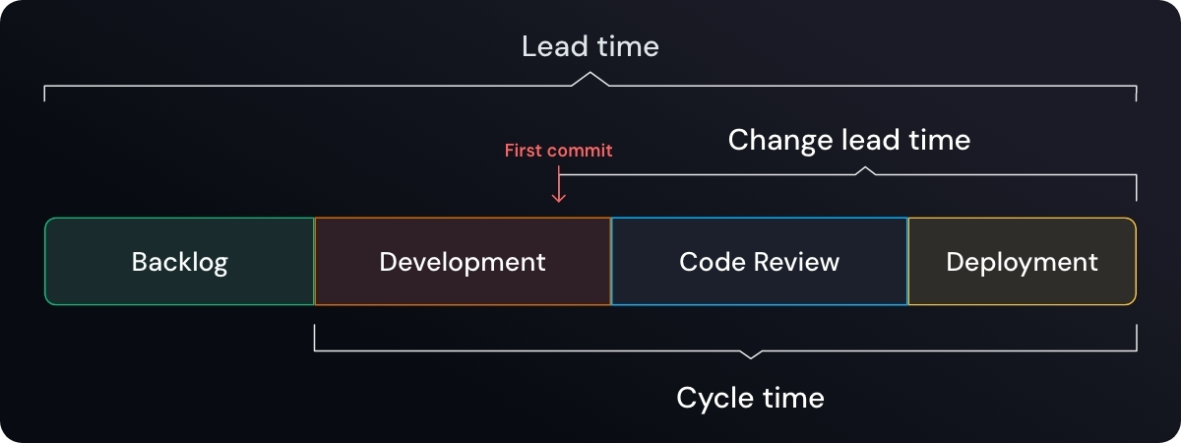
Lead Time vs. Processing Time
Lead Time
Starts when a request is made
Ends when the request is completed
Includes waiting periods, approvals, queues, and processing
Processing Time
Begins when work actually stars
Ends when work is completed
Excludes waiting and queue time
The Difference? Does it Matter?
The customers experience lead time
Organizations improve performance by reducing waiting time

Slide 5
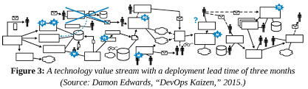
Deployment Lead Times Requiring Months
Characteristics
Large monolithic systems
Long testing cycles
Scarce integration environments
Heavy reliance on manual testing
Multiple approval processes
Problems Created
Slow customer value delivery
Frequent integration issues
Delayed feedback
Increased troubleshooting efforts

Slide 6
Deployment Lead Times of Minutes
DevOps Goals
Continous integration
Small code changes
Frequent testing
Rapid deployment
Fast feedback loops
Benefits
Faster delivery
Reduced risk
Higher confidence
Quicker problem resolution

Slide 7
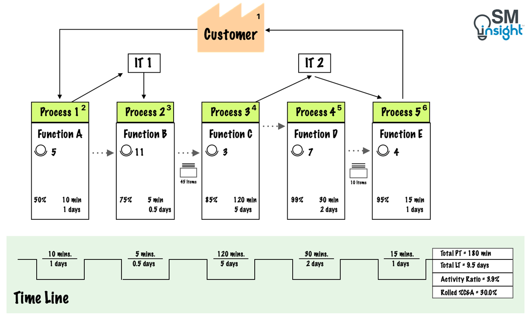
Example of a Minutes-Based Value Stream
Example Workflow
Commit Stage
Automated Testing
Exploratory Testing
Production Deployment
Traits
Small batches
Automated validation
Fast aprpovals
Continous feedback

Slide 8
Wrap Up
Key Revists
The Technology Value Stream measure how work flows from idea to customer value.
Lead time includes waiting and processing time
Long deployment lead times create delays, risks, and inefficiencies
DevOps seeks to reduce deployment lead time from months to minutes
Automation, continuous integration, and small batches enable faster and more reliability.

Slide 9
References
Jurevicius, O. (2025, April 4). Value Stream Mapping (VSM) explained in depth. Strategic Management Insight. https://strategicmanagementinsight.com/tools/value-stream-mapping-vsm/
Kim, G., Humble, J., Debois, P., Willis, J., & Forsgren, N. (2021). The DevOps Handbook: How to Create World-Class Agility, Reliability, & Security in Technology Organizations. IT Revolution.

