Slide 1
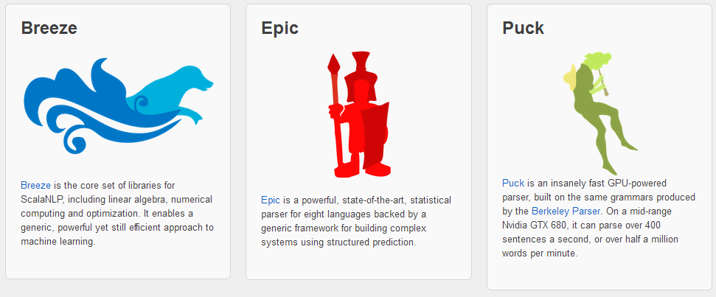
Spark机器学习案例实战—04

Slide 2
Spark MLlib矩阵向量
Spark MLlib底层的向量、矩阵运算使用了Breeze库，Breeze库提供了Vector/Matrix的实现以及相应计算的接口（Linalg）。但是在MLlib里面同时也提供了Vector和Linalg等的实现。

Slide 3
Breeze创建函数
在使用Breeze 库时，需要导入相关包：
import breeze.linalg._
import breeze.numerics._
API：
http://www.scalanlp.org/api/breeze/index.html#breeze.linalg.package

Slide 4
Breeze创建函数
操作名称 | Breeze函数 | 对应Matlab函数 | 对应Numpy函数
全0矩阵 | DenseMatrix.zeros[Double](n,m) | zeros(n,m) | zeros((n,m))
全0向量 | DenseVector.zeros[Double](n) | zeros(n) | zeros(n)
全1向量 | DenseVector.ones[Double](n) | ones(n) | ones(n)
按数值填充向量 | DenseVector.fill(n){5.0} | ones(n) * 5 | ones(n) * 5
生成随机向量 | DenseVector.range(start,stop,step) orVector.rangeD(start,stop,step)
线性等分向量（用于产生start,stop之间的N点行矢量） | DenseVector.linspace(start,stop,numvals) | linspace(0,20,15)
单位矩阵 | DenseMatrix.eye[Double](n) | eye(n) | eye(n)
对角矩阵 | diag(DenseVector(1.0,2.0,3.0)) | diag([1 2 3]) | diag((1,2,3))
按照行创建矩阵 | DenseMatrix((1.0,2.0), (3.0,4.0)) | [1 2; 3 4] | array([ [1,2], [3,4] ])
按照行创建向量 | DenseVector(1,2,3,4) | [1 2 3 4] | array([1,2,3,4])
向量转置 | DenseVector(1,2,3,4).t | [1 2 3 4]' | array([1,2,3]). reshape(-1,1)
从函数创建向量 | DenseVector.tabulate(3){i => 2*i}
从函数创建矩阵 | DenseMatrix.tabulate(3, 2){case (i, j) => i+j}
从数组创建向量 | new DenseVector(Array(1, 2, 3, 4))
从数组创建矩阵 | new DenseMatrix(2, 3, Array(11, 12, 13, 21, 22, 23))
0 到 1的随机向量 | DenseVector.rand(4)
0 到 1的随机矩阵 | DenseMatrix.rand(2, 3)

Slide 5
Breeze创建函数
scala> val m1 = DenseMatrix.zeros[Double](2,3)
m1: breeze.linalg.DenseMatrix[Double] =
0.0 0.0 0.0
0.0 0.0 0.0
scala> val v1 = DenseVector.zeros[Double](3)
v1: breeze.linalg.DenseVector[Double] = DenseVector(0.0, 0.0, 0.0)
scala> val v2 = DenseVector.ones[Double](3)
v2: breeze.linalg.DenseVector[Double] = DenseVector(1.0, 1.0, 1.0)
scala> val v3 = DenseVector.fill(3){5.0}
v3: breeze.linalg.DenseVector[Double] = DenseVector(5.0, 5.0, 5.0)

Slide 6
Breeze创建函数
scala> val v4 = DenseVector.range(1,10,2)
v4: breeze.linalg.DenseVector[Int] = DenseVector(1, 3, 5, 7, 9)
scala> val m2 = DenseMatrix.eye[Double](3)
m2: breeze.linalg.DenseMatrix[Double] =
1.0 0.0 0.0
0.0 1.0 0.0
0.0 0.0 1.0
scala> val v6 = diag(DenseVector(1.0,2.0,3.0))
v6: breeze.linalg.DenseMatrix[Double] =
1.0 0.0 0.0
0.0 2.0 0.0
0.0 0.0 3.0

Slide 7
Breeze创建函数
scala> val v8 = DenseVector(1,2,3,4)
v8: breeze.linalg.DenseVector[Int] = DenseVector(1, 2, 3, 4)
scala> val v9 = DenseVector(1,2,3,4).t
v9: breeze.linalg.Transpose[breeze.linalg.DenseVector[Int]] = Transpose(DenseVector(1, 2, 3, 4))
scala> val v10 = DenseVector.tabulate(3){i => 2*i}
v10: breeze.linalg.DenseVector[Int] = DenseVector(0, 2, 4)
scala> val m4 = DenseMatrix.tabulate(3, 2){case (i, j) => i+j}
m4: breeze.linalg.DenseMatrix[Int] =
0 1
1 2
2 3

Slide 8
Breeze创建函数
scala> val v11 = new DenseVector(Array(1, 2, 3, 4))
v11: breeze.linalg.DenseVector[Int] = DenseVector(1, 2, 3, 4)
scala> val m5 = new DenseMatrix(2, 3, Array(11, 12, 13, 21, 22, 23))
m5: breeze.linalg.DenseMatrix[Int] =
11 13 22
12 21 23
scala> val v12 = DenseVector.rand(4)
v12: breeze.linalg.DenseVector[Double] = DenseVector(0.7517657487447951, 0.8171495400874123, 0.8923542318540489, 0.174311259949119)
scala> val m6 = DenseMatrix.rand(2, 3)
m6: breeze.linalg.DenseMatrix[Double] =
0.5349430131148125 0.8822136832272578 0.7946323804433382
0.41097756311601086 0.3181490074596882 0.34195102205697414

Slide 9
Breeze元素访问
操作名称 | Breeze函数 | 对应Matlab函数 | 对应Numpy函数
指定位置 | a(0,1) | a(1,2) | a[0,1]
向量子集 | a(1 to 4) or a(1 until 5) ora.slice(1,5) | a(2:5) | a[1:5]
按照指定步长取子集 | a(5 to 0 by -1) | a(6:-1:1) | a[5:0:-1]
指定开始位置至结尾 | a(1 to -1) | a(2:end) | a[1:]
最后一个元素 | a( -1 ) | a(end) | a[-1]
矩阵指定列 | a(::, 2) | a(:,3) | a[:,2]

Slide 10
Breeze元素访问
scala> val a = DenseVector(1,2,3,4,5,6,7,8,9,10)
a: breeze.linalg.DenseVector[Int] = DenseVector(1, 2, 3, 4, 5, 6, 7, 8, 9, 10)
scala> a(0)
res2: Int = 1
scala> a(1 to 4)
res4: breeze.linalg.DenseVector[Int] = DenseVector(2, 3, 4, 5)
scala> a(5 to 0 by -1)
res5: breeze.linalg.DenseVector[Int] = DenseVector(6, 5, 4, 3, 2, 1)
scala> a(1 to -1)
res6: breeze.linalg.DenseVector[Int] = DenseVector(2, 3, 4, 5, 6, 7, 8, 9, 10)

Slide 11
Breeze元素访问
scala> a( -1 )
res7: Int = 10
scala> val m = DenseMatrix((1.0,2.0,3.0), (3.0,4.0,5.0))
m: breeze.linalg.DenseMatrix[Double] =
1.0 2.0 3.0
3.0 4.0 5.0
scala> m(0,1)
res8: Double = 2.0
scala> m(::,1)
res9: breeze.linalg.DenseVector[Double] = DenseVector(2.0, 4.0)

Slide 12
Breeze元素操作
操作名称 | Breeze函数 | 对应Matlab函数 | 对应Numpy函数
调整矩阵形状 | a.reshape(3, 2) | reshape(a, 3, 2) | a.reshape(3,2)
矩阵转成向量 | a.toDenseVector (Makes copy) | a(:) | a.flatten()
复制下三角 | lowerTriangular(a) | tril(a) | tril(a)
复制上三角 | upperTriangular(a) | triu(a) | triu(a)
矩阵复制 | a.copy |  | np.copy(a)
取对象线元素 | diag(a) | NA | diagonal(a)(Numpy >= 1.9)
子集赋数值 | a(1 to 4) := 5.0 | a(2:5) = 5 | a[1:4] = 5
子集赋向量 | a(1 to 4) := DenseVector(1.0,2.0,3.0) | a(2:5) = [1 2 3] | a[1:4] = array([1,2,3])
矩阵赋值 | a(1 to 3,1 to 3) := 5.0 | a(2:4,2:4) = 5 | a[1:3,1:3] = 5
矩阵列赋值 | a(::, 2) := 5.0 | a(:,3) = 5 | a[:,2] = 5
垂直连接矩阵 | DenseMatrix.vertcat(a,b) | [a ; b] | vstack((a,b))
横向连接矩阵 | DenseMatrix.horzcat(d,e) | [a , b] | hstack((a,b))
向量连接 | DenseVector.vertcat(a,b) | [a b] | concatenate((a,b))

Slide 13
Breeze元素操作
scala> val m = DenseMatrix((1.0,2.0,3.0), (3.0,4.0,5.0))
m: breeze.linalg.DenseMatrix[Double] =
1.0 2.0 3.0
3.0 4.0 5.0
scala> m.reshape(3, 2)
res11: breeze.linalg.DenseMatrix[Double] =
1.0 4.0
3.0 3.0
2.0 5.0
scala>m.toDenseVector
res12: breeze.linalg.DenseVector[Double] = DenseVector(1.0, 3.0, 2.0, 4.0, 3.0, 5.0)

Slide 14
Breeze元素操作
scala> val m = DenseMatrix((1.0,2.0,3.0), (4.0,5.0,6.0) , (7.0,8.0,9.0))
m: breeze.linalg.DenseMatrix[Double] =
1.0 2.0 3.0
4.0 5.0 6.0
7.0 8.0 9.0
scala> val m = DenseMatrix((1.0,2.0,3.0), (4.0,5.0,6.0) , (7.0,8.0,9.0))
m: breeze.linalg.DenseMatrix[Double] =
1.0 2.0 3.0
4.0 5.0 6.0
7.0 8.0 9.0

Slide 15
Breeze元素操作
scala> lowerTriangular(m)
res19: breeze.linalg.DenseMatrix[Double] =
1.0 0.0 0.0
4.0 5.0 0.0
7.0 8.0 9.0
scala> upperTriangular(m)
res20: breeze.linalg.DenseMatrix[Double] =
1.0 2.0 3.0
0.0 5.0 6.0
0.0 0.0 9.0

Slide 16
Breeze元素操作
scala> m.copy
res21: breeze.linalg.DenseMatrix[Double] =
1.0 2.0 3.0
4.0 5.0 6.0
7.0 8.0 9.0
scala> diag(m)
res22: breeze.linalg.DenseVector[Double] = DenseVector(1.0, 5.0, 9.0)
scala> m(::, 2) := 5.0
res23: breeze.linalg.DenseVector[Double] = DenseVector(5.0, 5.0, 5.0)

Slide 17
Breeze元素操作
scala> m
res24: breeze.linalg.DenseMatrix[Double] =
1.0 2.0 5.0
4.0 5.0 5.0
7.0 8.0 5.0
scala> m(1 to 2,1 to 2) := 5.0
res32: breeze.linalg.DenseMatrix[Double] =
5.0 5.0
5.0 5.0
scala> m
res33: breeze.linalg.DenseMatrix[Double] =
1.0 2.0 5.0
4.0 5.0 5.0
7.0 5.0 5.0

Slide 18
Breeze元素操作
scala> val a = DenseVector(1,2,3,4,5,6,7,8,9,10)
a: breeze.linalg.DenseVector[Int] = DenseVector(1, 2, 3, 4, 5, 6, 7, 8, 9, 10)
scala> a(1 to 4) := 5
res27: breeze.linalg.DenseVector[Int] = DenseVector(5, 5, 5, 5)
scala> a(1 to 4) := DenseVector(1,2,3,4)
res29: breeze.linalg.DenseVector[Int] = DenseVector(1, 2, 3, 4)
scala> a
res30: breeze.linalg.DenseVector[Int] = DenseVector(1, 1, 2, 3, 4, 6, 7, 8, 9, 10)
scala> val a1 = DenseMatrix((1.0,2.0,3.0), (4.0,5.0,6.0))
a1: breeze.linalg.DenseMatrix[Double] =
1.0 2.0 3.0
4.0 5.0 6.0

Slide 19
Breeze元素操作
scala> val a2 = DenseMatrix((1.0,1.0,1.0), (2.0,2.0,2.0))
a2: breeze.linalg.DenseMatrix[Double] =
1.0 1.0 1.0
2.0 2.0 2.0
scala> DenseMatrix.vertcat(a1,a2)
res34: breeze.linalg.DenseMatrix[Double] =
1.0 2.0 3.0
4.0 5.0 6.0
1.0 1.0 1.0
2.0 2.0 2.0
scala> DenseMatrix.horzcat(a1,a2)
res35: breeze.linalg.DenseMatrix[Double] =
1.0 2.0 3.0 1.0 1.0 1.0
4.0 5.0 6.0 2.0 2.0 2.0

Slide 20
Breeze元素操作
scala> val b1 = DenseVector(1,2,3,4)
b1: breeze.linalg.DenseVector[Int] = DenseVector(1, 2, 3, 4)
scala> val b2 = DenseVector(1,1,1,1)
b2: breeze.linalg.DenseVector[Int] = DenseVector(1, 1, 1, 1)
scala> DenseVector.vertcat(b1,b2)
res36: breeze.linalg.DenseVector[Int] = DenseVector(1, 2, 3, 4, 1, 1, 1, 1)

Slide 21
Breeze数值计算函数
操作名称 | Breeze函数 | 对应Matlab函数 | 对应Numpy函数
元素加法 | a + b | a + b | a + b
元素乘法 | a :* b | a .* b | a * b
元素除法 | a :/ b | a ./ b | a / b
元素比较 | a :< b | a < b | a < b
元素相等 | a :== b | a == b | a == b
元素追加 | a :+= 1.0 | a += 1 | a += 1
元素追乘 | a :*= 2.0 | a *= 2 | a *= 2
向量点积 | a dot b,a.t * b† | dot(a,b) | dot(a,b)
元素最大值 | max(a) | max(a) | a.max()
元素最大值及位置 | argmax(a) | [v i] = max(a); i | a.argmax()

Slide 22
Breeze数值计算函数
scala> val a = DenseMatrix((1.0,2.0,3.0), (4.0,5.0,6.0))
a: breeze.linalg.DenseMatrix[Double] =
1.0 2.0 3.0
4.0 5.0 6.0
scala> val b = DenseMatrix((1.0,1.0,1.0), (2.0,2.0,2.0))
b: breeze.linalg.DenseMatrix[Double] =
1.0 1.0 1.0
2.0 2.0 2.0
scala> a + b
res37: breeze.linalg.DenseMatrix[Double] =
2.0 3.0 4.0
6.0 7.0 8.0

Slide 23
Breeze数值计算函数
scala> a :* b
res38: breeze.linalg.DenseMatrix[Double] =
1.0 2.0 3.0
8.0 10.0 12.0
scala> a :/ b
res39: breeze.linalg.DenseMatrix[Double] =
1.0 2.0 3.0
2.0 2.5 3.0
scala> a :< b
res40: breeze.linalg.DenseMatrix[Boolean] =
false false false
false false false

Slide 24
Breeze数值计算函数
scala> a :== b
res41: breeze.linalg.DenseMatrix[Boolean] =
true false false
false false false
scala> a :+= 1.0
res42: breeze.linalg.DenseMatrix[Double] =
2.0 3.0 4.0
5.0 6.0 7.0
scala> a :*= 2.0
res43: breeze.linalg.DenseMatrix[Double] =
4.0 6.0 8.0
10.0 12.0 14.0

Slide 25
Breeze数值计算函数
scala> max(a)
res47: Double = 14.0
scala> argmax(a)
res48: (Int, Int) = (1,2)
scala> DenseVector(1, 2, 3, 4) dot DenseVector(1, 1, 1, 1)
res50: Int = 10

Slide 26
Breeze求和函数
操作名称 | Breeze函数 | 对应Matlab函数 | 对应Numpy函数
元素求和 | sum(a) | sum(sum(a)) | a.sum()
每一列求和 | sum(a, Axis._0) orsum(a(::, *)) | sum(a) | sum(a,0)
每一行求和 | sum(a, Axis._1) orsum(a(*, ::)) | sum(a') | sum(a,1)
对角线元素和 | trace(a) | trace(a) | a.trace()
累积和 | accumulate(a) | cumsum(a) | a.cumsum()

Slide 27
Breeze求和函数
scala> val a = DenseMatrix((1.0,2.0,3.0), (4.0,5.0,6.0) , (7.0,8.0,9.0))
a: breeze.linalg.DenseMatrix[Double] =
1.0 2.0 3.0
4.0 5.0 6.0
7.0 8.0 9.0
scala> sum(a)
res51: Double = 45.0
scala> sum(a, Axis._0)
res52: breeze.linalg.DenseMatrix[Double] = 12.0 15.0 18.0

Slide 28
Breeze求和函数
scala> sum(a, Axis._1)
res53: breeze.linalg.DenseVector[Double] = DenseVector(6.0, 15.0, 24.0)
scala> trace(a)
res54: Double = 15.0
scala> accumulate(DenseVector(1, 2, 3, 4))
res56: breeze.linalg.DenseVector[Int] = DenseVector(1, 3, 6, 10)

Slide 29
Breeze布尔函数
操作名称 | Breeze函数 | 对应Matlab函数 | 对应Numpy函数
元素与操作 | a :& b | a && b | a & b
元素或操作 | a :| b | a || b | a | b
元素非操作 | !a | ~a | ~a
任意元素非零 | any(a) | any(a) | any(a)
所有元素非零 | all(a) | all(a) | all(a)

Slide 30
Breeze布尔函数
scala> val a = DenseVector(true, false, true)
a: breeze.linalg.DenseVector[Boolean] = DenseVector(true, false, true)
scala> val b = DenseVector(false, true, true)
b: breeze.linalg.DenseVector[Boolean] = DenseVector(false, true, true)
scala> a :& b
res57: breeze.linalg.DenseVector[Boolean] = DenseVector(false, false, true)
scala> a :| b
res58: breeze.linalg.DenseVector[Boolean] = DenseVector(true, true, true)
scala> !a
res59: breeze.linalg.DenseVector[Boolean] = DenseVector(false, true, false)

Slide 31
Breeze布尔函数
scala> val a = DenseVector(1.0, 0.0, -2.0)
a: breeze.linalg.DenseVector[Double] = DenseVector(1.0, 0.0, -2.0)
scala> any(a)
res60: Boolean = true
scala> all(a)
res61: Boolean = false

Slide 32
Breeze线性代数函数
操作名称 | Breeze函数 | 对应Matlab函数 | 对应Numpy函数
线性求解 | a \ b | a \ b | linalg.solve(a,b)
转置 | a.t | a' | a.conj.transpose()
求特征值 | det(a) | det(a) | linalg.det(a)
求逆 | inv(a) | inv(a) | linalg.inv(a)
求伪逆 | pinv(a) | pinv(a) | linalg.pinv(a)
求范数 | norm(a) | norm(a) | norm(a)
特征值和特征向量 | eigSym(a) | [v,l] = eig(a) | linalg.eig(a)[0]
特征值 | val (er, ei, _) = eig(a) (实部与虚部分开) | eig(a) | linalg.eig(a)[0]
特征向量 | eig(a)._3 | [v,l] = eig(a) | linalg.eig(a)[1]
奇异值分解 | val svd.SVD(u,s,v) = svd(a) | svd(a) | linalg.svd(a)
求矩阵的秩 | rank(a) | rank(a) | rank(a)
矩阵长度 | a.length | size(a) | a.size
矩阵行数 | a.rows | size(a,1) | a.shape[0]
矩阵列数 | a.cols | size(a,2) | a.shape[1]

Slide 33
Breeze线性代数函数
scala> val a = DenseMatrix((1.0,2.0,3.0), (4.0,5.0,6.0) , (7.0,8.0,9.0))
a: breeze.linalg.DenseMatrix[Double] =
1.0 2.0 3.0
4.0 5.0 6.0
7.0 8.0 9.0
scala> val b = DenseMatrix((1.0,1.0,1.0), (1.0,1.0,1.0) , (1.0,1.0,1.0))
b: breeze.linalg.DenseMatrix[Double] =
1.0 1.0 1.0
1.0 1.0 1.0
1.0 1.0 1.0

Slide 34
Breeze线性代数函数
scala> a \ b
res74: breeze.linalg.DenseMatrix[Double] =
-2.5 -2.5 -2.5
4.0 4.0 4.0
-1.5 -1.5 -1.5
scala> a.t
res63: breeze.linalg.DenseMatrix[Double] =
1.0 4.0 7.0
2.0 5.0 8.0
3.0 6.0 9.0
scala> det(a)
res64: Double = 6.661338147750939E-16

Slide 35
Breeze线性代数函数
scala> a \ b
res74: breeze.linalg.DenseMatrix[Double] =
-2.5 -2.5 -2.5
4.0 4.0 4.0
-1.5 -1.5 -1.5
scala> a.t
res63: breeze.linalg.DenseMatrix[Double] =
1.0 4.0 7.0
2.0 5.0 8.0
3.0 6.0 9.0
scala> det(a)
res64: Double = 6.661338147750939E-16

Slide 36
Breeze取整函数
操作名称 | Breeze函数 | 对应Matlab函数 | 对应Numpy函数
四舍五入 | round(a) | round(a) | around(a)
最小整数 | ceil(a) | ceil(a) | ceil(a)
最大整数 | floor(a) | floor(a) | floor(a)
符号函数 | signum(a) | sign(a) | sign(a)
取正数 | abs(a) | abs(a) | abs(a)

Slide 37
Breeze取整函数
scala> val a = DenseVector(1.2, 0.6, -2.3)
a: breeze.linalg.DenseVector[Double] = DenseVector(1.2, 0.6, -2.3)
scala> round(a)
res75: breeze.linalg.DenseVector[Long] = DenseVector(1, 1, -2)
scala> ceil(a)
res76: breeze.linalg.DenseVector[Double] = DenseVector(2.0, 1.0, -2.0)
scala> floor(a)
res77: breeze.linalg.DenseVector[Double] = DenseVector(1.0, 0.0, -3.0)
scala> signum(a)
res78: breeze.linalg.DenseVector[Double] = DenseVector(1.0, 1.0, -1.0)
scala> abs(a)
res79: breeze.linalg.DenseVector[Double] = DenseVector(1.2, 0.6, 2.3)

Slide 38
Breeze其它函数
Breeze三角函数
Breeze三角函数包括：
sin, sinh, asin, asinh
cos, cosh, acos, acosh
tan, tanh, atan, atanh
atan2
sinc(x) ，即sin(x)/x
sincpi(x) ，即 sinc(x * Pi)
Breeze对数和指数函数
Breeze对数和指数函数包括：
log, exp log10
log1p, expm1
sqrt, sbrt
pow

Slide 39
BLAS介绍
BLAS按照功能被分为三个级别：
Level 1：矢量-矢量运算，比如点积（ddot)，加法和数乘 (daxpy)， 绝对值的和（dasum)，等等；
Level 2：矩阵-矢量运算，最重要的函数是一般的矩阵向量乘法(dgemv)；
Level 3：矩阵-矩阵运算，最重要的函数是一般的矩阵乘法 (dgemm)；
每一种函数操作都区分不同数据类型（单精度、双精度、复数）

Slide 40
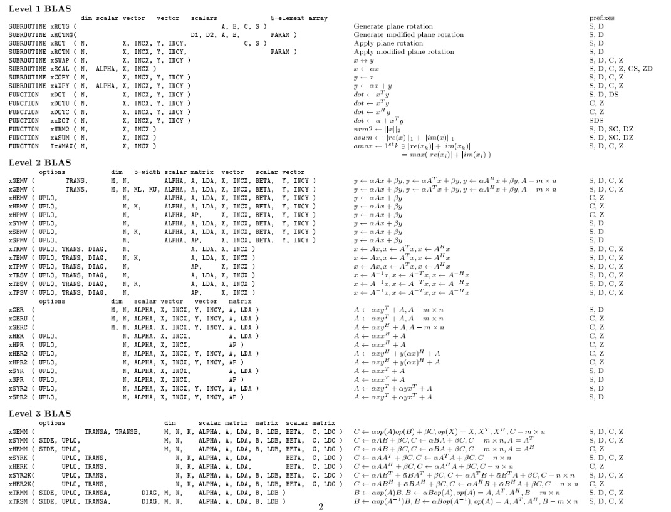
BLAS介绍
API
http://www.netlib.org/blas/

Slide 41
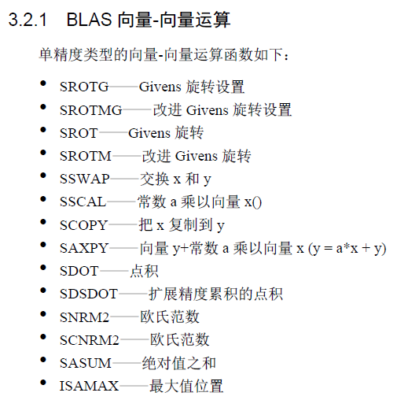
BLAS介绍

Slide 42
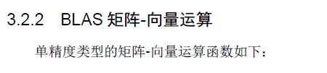
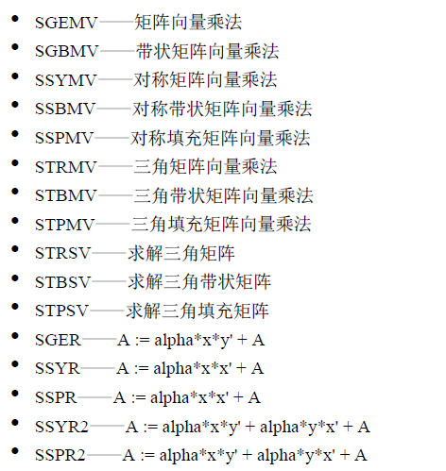
BLAS介绍

Slide 43
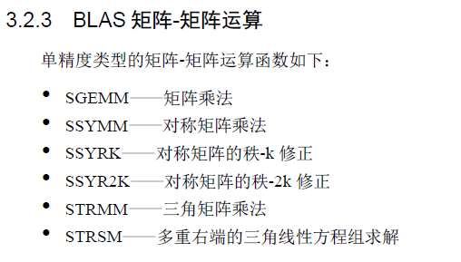
BLAS介绍

