Slide 1

Your Data Career Starts Here: Workshop 5.0 Kickoff
Oyelaran Paul
Business Data Analyst

Slide 2
Ground Rules
Punctuality
Have an
Open Mind
One Class
Participation
Ask Questions
Respect
Mute your mic always
Raise your hand before you speak
Notes:
When I ask a question, they should raise up their hand.

Slide 3

Oyelaran Paul
Business Data Analyst
Professional Experience
4+ years of active work experience
Worked in the supply chain sector and currently in a manufacturing company
A recent MBA graduate
A graduate of Tekedia Institute
A YIL Fellow
Deployed 3+ of business automation solutions
Led a team to organise a tech bootcamp for secondary schools in Oyo State with approval from the Ministry of Education
Led a team to organise a 3-month data analytics bootcamp for business professionals for free
Trained over 4000 participants globally.
Graduate of the YF and DBO mentorship program
Passionate about impacting lives and helping others scale
Dec 26 is always a great day to reach out to homes in Oyo State

Slide 4
A BEGINNER'S COURSE
Introduction to SQL JOIN & Window Functions
From relational database fundamentals to advanced querying — everything you need to start writing SQL with confidence.
Oyelaran Paul Temitope

Slide 5
COMBINING TABLES
SQL Joins: The Big Picture
1
Why joins matter
2
Four main types
3
The key idea
In a relational database, data lives across many tables. Joins pull related rows together into one meaningful result set.
INNER, LEFT, RIGHT, and FULL OUTER — each controls which unmatched rows to keep or drop.
Every join connects tables using a shared column — usually a primary key in one table and a matching foreign key in another.

Slide 6
MATCHING ROWS ONLY
INNER JOIN
Returns only the rows that have a match in both tables.
SELECT product_name, category_name, brand_name, list_price
FROM production.products p
INNER JOIN production.categories c ON c.category_id = p.category_id
INNER JOIN production.brands b ON b.brand_id = p.brand_id
ORDER BY product_name DESC;

Slide 7
KEEPING UNMATCHED ROWS
LEFT JOIN vs RIGHT JOIN
LEFT JOIN
RIGHT JOIN
• Keeps all rows from the left table
• Matches rows from the right where they exist
• Unmatched right-side columns become NULL
• 'OUTER' is optional: LEFT (OUTER) JOIN
• Keeps all rows from the right table
• Matches rows from the left where they exist
• Unmatched left-side columns become NULL
• The mirror image of a LEFT JOIN

Slide 8
KEEPING EVERYTHING
FULL OUTER JOIN
Returns all rows from both tables. Where there's no match on either side, the missing columns are filled with NULL.
SELECT columns
FROM first_table
FULL JOIN second_table
ON first_table.id = second_table.id;
Tip: add WHERE first_table.id IS NULL OR second_table.id IS NULL to find only the unmatched rows.

Slide 9
SET OPERATIONS
UNION, UNION ALL & INTERSECT
1
UNION
2
UNION ALL
Combines the results of two SELECT statements into one result set and removes duplicate rows. Both queries need the same number and type of columns.
Same as UNION, but keeps every duplicate row instead of removing them.
3
INTERSECT
4
UNION vs JOIN
Returns only the distinct rows that appear in both queries' results.
A JOIN combines columns from two tables side by side (horizontally). A UNION stacks rows from two queries on top of each other (vertically).

Slide 10
SECTION 2 / 2
Window Functions in SQL Server
Calculations across a set of related rows — without collapsing them into a single result, the way GROUP BY does.

Slide 11
GETTING STARTED
What is a Window Function?
A window function performs a calculation across a set of rows related to the current row — its 'window' — while returning a value for every individual row, not just one row per group. It performs calculations (e.g. aggregation)on a specific subset of data, without losing the level of detail of rows.

Slide 12
Key Terms in Window Function
A PARTITION: in a SQL window function is a subset of rows divided from the main result set using the PARTITION BY clause
An OVER: clause is the keyword that transforms a standard function into a window function
An ORDER BY: A clause inside OVER() that sorts the rows inside each partition
ROWS: Tells the database to define the window frame using physical row counts rather than logical values.
BETWEEN ... AND ...: Specifies the starting and ending boundaries of the window frame.
UNBOUNDED PRECEDING: Means the frame starts at the very first row of the partition.
UNBOUNDED FOLLOWING: Means the frame ends at the very last row of the partition. [1, 2]

Slide 13
A COMMON POINT OF CONFUSION
Window Function vs. GROUP BY
GROUP BY
Window Function
• Collapses rows into one row per group
• Detail rows are lost from the output
• Aggregate goes in SELECT or HAVING
• SELECT dept, AVG(salary) ... GROUP BY dept
• Keeps every original row intact
• Calculation sits alongside the detail
• Uses OVER() instead of GROUP BY
• SELECT *, AVG(salary) OVER (PARTITION BY dept)

Slide 14

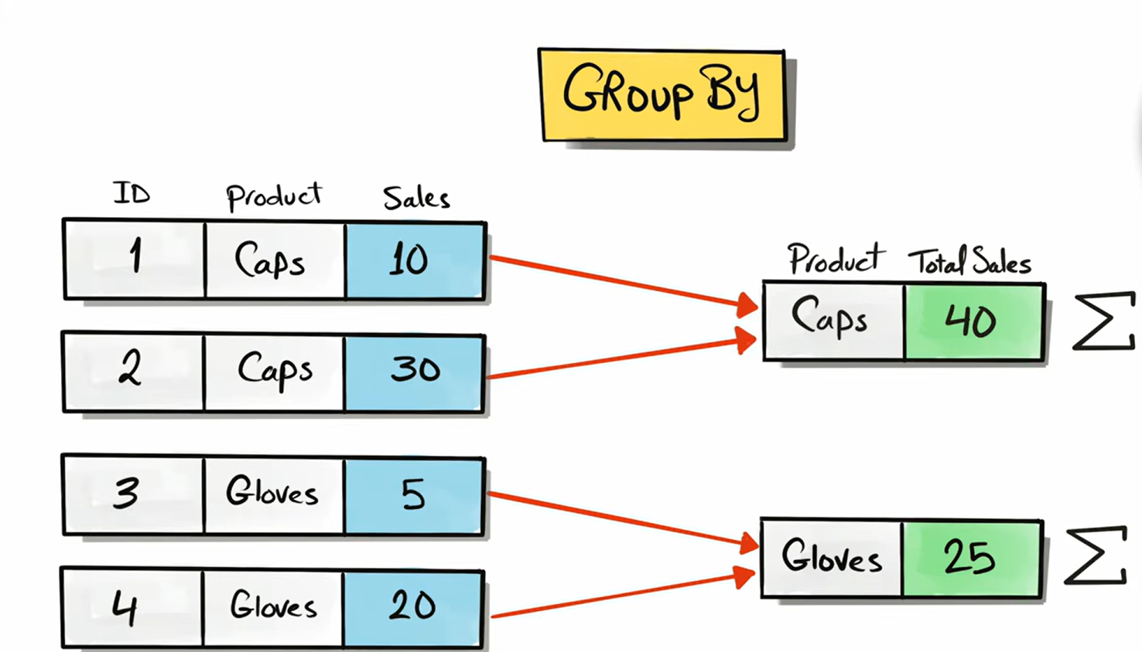
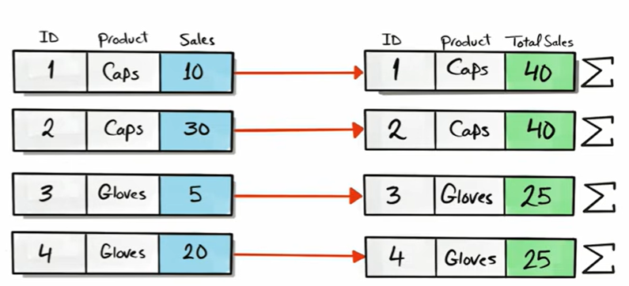

Slide 15
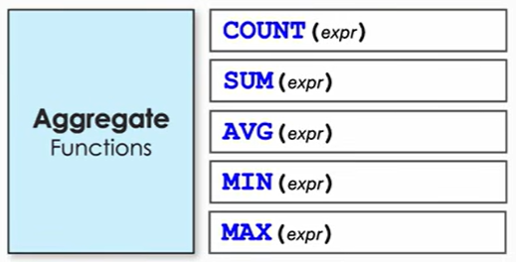
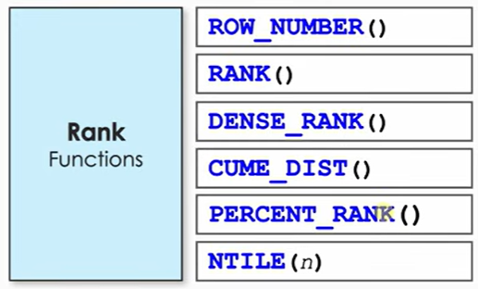
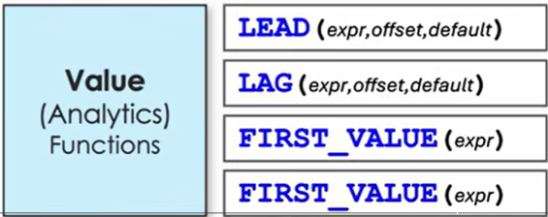
WINDOW FUNCTION CATEGORIES
LAST

Slide 16
CATEGORY 1
Aggregate Window Functions
SUM() · AVG() · COUNT() · MAX() · MIN()
1
The same functions, new powers
2
What makes them 'window' functions
3
Common uses
The same aggregate functions you already know from GROUP BY — now calculating over a window while every row stays visible.
Paired with OVER(), they compute totals, averages, or counts across a window of rows, without collapsing the result set.
Running totals, a category's average shown next to each product, or a percentage of a group total.

Slide 17
AGGREGATE WINDOW FUNCTIONS
SUM() & AVG()
SUM() — running total of sales, ordered by date
SELECT order_date, order_amount,
SUM(order_amount) OVER (ORDER BY order_date) AS running_total
FROM orders;
AVG() — average price within each product category
SELECT product_name, category, list_price,
AVG(list_price) OVER (PARTITION BY category) AS category_avg
FROM products;

Slide 18
AGGREGATE WINDOW FUNCTIONS
COUNT(), MAX() & MIN()
All three follow the same pattern — the aggregate is computed over the window, but every row of detail is preserved.
SELECT product_name, category, list_price,
COUNT(*) OVER (PARTITION BY category) AS products_in_category,
MAX(list_price) OVER (PARTITION BY category) AS highest_price,
MIN(list_price) OVER (PARTITION BY category) AS lowest_price
FROM products;

Slide 19
CATEGORY 2
Ranking Window Functions
1
RANK()
2
DENSE_RANK()
Assigns ranks to rows, skipping rank numbers after a tie.
Assigns ranks to rows without skipping numbers after a tie.
3
ROW_NUMBER()
4
PERCENT_RANK()
Assigns a unique, ever-increasing number to each row — never repeats.
Shows a row's relative rank as a percentage, between 0 and 1.

Slide 20
ORDERING ROWS
RANK(), DENSE_RANK() & ROW_NUMBER()
All three number rows in order — they differ only in how they handle ties.
SELECT name, score,
ROW_NUMBER() OVER (ORDER BY score DESC) AS row_num,
RANK() OVER (ORDER BY score DESC) AS rank_num,
DENSE_RANK() OVER (ORDER BY score DESC) AS dense_rank_num
FROM scores;

Slide 21
SAME DATA, THREE ANSWERS
How Ties Are Handled
Name | Score | ROW_NUMBER() | RANK() | DENSE_RANK()
Alice | 95 | 1 | 1 | 1
Bob | 90 | 2 | 2 | 2
Carol | 90 | 3 | 2 | 2
Dave | 85 | 4 | 4 | 3

Slide 22
RELATIVE STANDING
PERCENT_RANK()
PERCENT_RANK calculates (rank - 1) / (total rows - 1), giving each row's position as a percentage. The top row is always 0; the bottom row is always 1.
SELECT name, score,
PERCENT_RANK() OVER (ORDER BY score DESC) AS pct_rank
FROM scores;
A pct_rank of 0.25 means that row scores better than 75% of the group.

Slide 23
CUMULATIVE STANDING
CUME_DIST()
CUME_DIST returns the proportion of rows with a value less than or equal to the current row's — always a number between 0 (exclusive) and 1.
CUME_DIST = Number of rows ≤ current row / Total number of rows
SELECT name, score,
CUME_DIST() OVER (ORDER BY score) AS cume_dist
FROM scores;
A CUME_DIST of 0.8 means 80% of rows score at or below this one.
The BIG difference
PERCENT_RANK()
What is my position in the ranking?
CUME_DIST()
What percentage of the data is at or below me?
proportion of rows reached.

Slide 24
THE BUILDING BLOCKS
The OVER() Clause & PARTITION BY
OVER() is what turns an ordinary function into a window function. PARTITION BY splits rows into independent groups the calculation restarts for each group. Without it, the whole result set is one window.
Rank employees by salary, separately within each department
SELECT employee_name, department, salary,
RANK() OVER (
PARTITION BY department
ORDER BY salary DESC
) AS dept_rank
FROM employees;
PARTITION BY department means the ranking restarts at 1 for every new department.

Slide 25
DEFINING THE WINDOW'S EDGES
Frame Clause: UNBOUNDED PRECEDING
A frame clause narrows the window further, row by row. ROWS BETWEEN UNBOUNDED PRECEDING AND CURRENT ROW says: 'everything from the very first row up to the current one' — the classic running-total frame.
SELECT order_date, order_amount,
SUM(order_amount) OVER (
ORDER BY order_date
ROWS BETWEEN UNBOUNDED PRECEDING AND CURRENT ROW
) AS running_total
FROM orders;
This is actually the default frame whenever ORDER BY is used without an explicit frame clause.

Slide 26
DEFINING THE WINDOW'S EDGES
Frame Clause: Custom ROWS BETWEEN
ROWS BETWEEN lower_bound AND upper_bound defines a custom frame that moves with the current row — useful for moving averages and other fixed-size windows.
3-row moving average: 1 row before, current row, 1 row after
SELECT order_date, revenue,
AVG(revenue) OVER (
ORDER BY order_date
ROWS BETWEEN 1 PRECEDING AND 1 FOLLOWING
) AS moving_avg_3day
FROM daily_sales;

Slide 27
DEFINING THE WINDOW'S EDGES
Frame Clause: RANGE BETWEEN
RANGE BETWEEN lower_bound AND upper_bound works like ROWS, but groups by the value in the ORDER BY column rather than physical row position — rows with an equal value are treated as part of the same point in the frame.
SELECT order_date, order_amount,
SUM(order_amount) OVER (
ORDER BY order_date
RANGE BETWEEN UNBOUNDED PRECEDING AND CURRENT ROW
) AS running_total
FROM orders;
ROWS counts physical rows; RANGE counts logical values — they can give different results when the ORDER BY column has duplicates.

Slide 28
CATEGORY 3
Value Window Functions
1
LAG()
2
LEAD()
3
FIRST_VALUE()
Retrieves a value from a row before the current row.
Retrieves a value from a row after the current row.
Returns the first value in an ordered partition.
4
LAST_VALUE()
5
NTH_VALUE()
6
CUME_DIST()
Returns the last value in an ordered partition.
Returns the value of the nth row in the ordered set.
Returns the cumulative distribution — the share of rows at or below this one.

Slide 29
COMPARING NEIGHBORING ROWS
LAG() & LEAD()
LAG looks back at a previous row; LEAD looks ahead to a following row — both within the ordering you specify. Useful for day-over-day or month-over-month comparisons.
SELECT order_date, revenue,
LAG(revenue, 1) OVER (ORDER BY order_date) AS prev_day_revenue,
LEAD(revenue, 1) OVER (ORDER BY order_date) AS next_day_revenue
FROM daily_sales;
The second argument (1) sets how many rows back or forward to look — it defaults to 1 if omitted.

Slide 30
THE EDGES OF A PARTITION
FIRST_VALUE() & LAST_VALUE()
These return the first or last value in an ordered partition — handy for comparing every row to its group's starting or ending point.
SELECT employee_name, department, salary,
FIRST_VALUE(employee_name) OVER (
PARTITION BY department ORDER BY salary DESC
) AS top_earner,
LAST_VALUE(employee_name) OVER (
PARTITION BY department ORDER BY salary DESC
ROWS BETWEEN UNBOUNDED PRECEDING AND UNBOUNDED FOLLOWING
) AS lowest_earner
FROM employees;
LAST_VALUE needs an explicit full-partition frame — otherwise the default frame stops at the current row.

Slide 31
PICKING A SPECIFIC POSITION
NTH_VALUE()
NTH_VALUE returns the value from a specific position within the ordered window — for example, the second-highest earner in each department.
SELECT employee_name, department, salary,
NTH_VALUE(employee_name, 2) OVER (
PARTITION BY department ORDER BY salary DESC
ROWS BETWEEN UNBOUNDED PRECEDING AND UNBOUNDED FOLLOWING
) AS second_highest_earner
FROM employees;

Slide 32
Rules – what we should know
Window functions can be used ONLY in SELECT and ORDER BY Clauses
WINDOW Functions can't be used to filter Data
SQL executes window functions after the WHERE Clause
Nesting Window Functions is not allowed!
Window Function can be used together with GROUP BY

Slide 33




Thank you
Oyelaran Paul
Twitter: @iamtopinfiniti
Youtube: Analyticswithpaul
Linkedin: www.linkedin.com/in/oyelaran-paul

