Slide 1
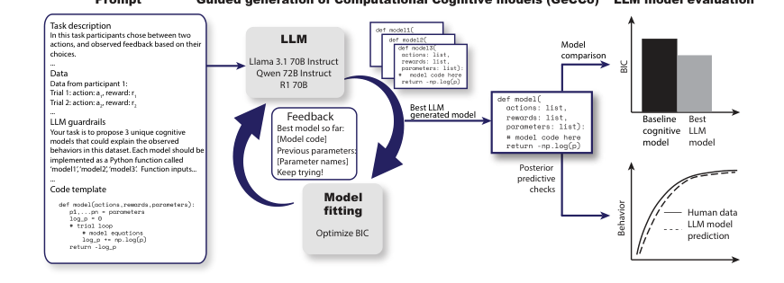
Generating computational cognitive models using LLMs
Seminar presentation · Yingzhu Chen & Christian Block
Core message
LLMs can accelerate cognitive model discovery, but better fit is not automatically better cognitive explanation.
Rmus et al. (2025) · NeurIPS 2025
opening
Rmus et al. (2025) · GeCCo
Notes:
开场提示：不要说这是完整 summary，而是 argument-driven reading。
核心句：GeCCo can speed up cognitive model discovery, but better fit is not automatically better explanation.
过渡：To understand why this matters, we first need to see why cognitive modeling is difficult.

Slide 2
Why cognitive modeling needs help
The paper starts from a bottleneck in traditional model discovery.
Theory
Code
Fit data
Revise
Traditional modeling is slow and expert-dependent.
The risk: a narrow model space.
Researchers must read literature, formalize theory, implement code, fit models, and repeat.
We may only test theories we already know how to write down.
problem
Rmus et al. (2025) · GeCCo
Notes:
讲法提示：这里讲 motivation，不要讲技术。
传统 cognitive modeling 很慢：理论要变成代码，再 fit data，再修改。
重点：瓶颈不只是速度，而是 model space 会受研究者已有知识限制。
过渡：So what exactly counts as a cognitive model in this paper?

Slide 3
What is a computational cognitive model?
A psychological explanation written as equations or executable code.
Psychological idea
"people learn from rewards"
Executable model
Python function
Predictions
choice probabilities
def model(actions, rewards, params):
learning_rate, beta = params
...
return -log_likelihood
Models are compared because different mechanisms can fit the same behavior.
concept
Rmus et al. (2025) · GeCCo
Notes:
讲法提示：慢一点，听众可能不熟 cognitive modeling。
用一句话解释：a cognitive model is a psychological theory translated into code that predicts behavior.
强调：不同心理机制可能产生相似行为，所以需要比较模型。
过渡：GeCCo tries to automate part of this model-building process.

Slide 4
GeCCo in one loop
LLM proposes; data evaluates; feedback improves the next proposal.
Prompt
task + data
LLM writes
3 model codes
Fit on
held-out data
Select by
BIC
Feedback
best so far
This is guided code generation, not one-shot prompting.
method
Rmus et al. (2025) · GeCCo
Notes:
讲法提示：这是核心方法页，要讲清楚 loop。
LLM does not replace evaluation: it proposes model code.
Data and BIC select among generated candidates, then feedback guides the next iteration.
关键词：guided code generation, not one-shot prompting.
过渡：The prompt itself is therefore part of the experimental setup.

Slide 5
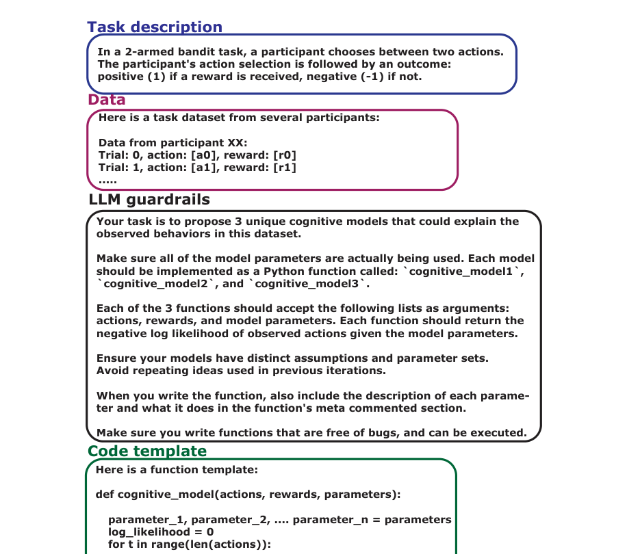
The prompt is part of the method
GeCCo constrains the LLM so outputs are executable and comparable.
PROMPT INGREDIENTS
1
Task description
What participants do
2
Behavioral data
Trial-by-trial examples
3
Guardrails
Function names, inputs, outputs
4
Code template
Syntactic scaffold
5
Feedback
Best model so far
Design choice: more control means less free-form creativity, but better reproducibility.
method
Rmus et al. (2025) · GeCCo
Notes:
讲法提示：不要逐项解释太久。
核心点：prompting is not just asking ChatGPT; it constrains the search space.
好处：outputs become executable and comparable.
代价：more constraints may reduce creativity and introduce template bias.
过渡：Once models are generated, how does the paper decide which one is better?

Slide 6
How does the paper decide a model is good?
Predictive evaluation, theoretical interpretation.
NLL
How surprised is the model by real choices?
BIC
Good fit, with a penalty for complexity.
PPC
Can the fitted model simulate human-like behavior?
Key point: lower BIC compares models; it does not prove psychological truth.
Details and formulas → backup slides.
evaluation
Rmus et al. (2025) · GeCCo
Notes:
讲法提示：只讲直觉，不讲公式。
NLL: how surprised the model is by observed choices; lower is better.
BIC: good fit plus penalty for extra parameters; lower is better for comparison.
PPC: whether simulated behavior looks human-like.
强调：these are comparison tools, not proof of psychological truth. Formula details are backup.

Slide 7
Evidence across four cognitive domains
The paper tests whether GeCCo generalizes beyond one task.
Decision making
Planning
baseline: pWADD
Llama/R1 lower BIC
baseline: Hybrid
R1 favored by EXP
Learning
Working memory
baseline: RW4α
Llama favored
baseline: RL-WM
Llama favored
Across all four: LLM-generated models matched or outperformed literature baselines.
evidence
Rmus et al. (2025) · GeCCo
Notes:
讲法提示：这是 breadth overview，不要四个都深入。
一句话：GeCCo was tested across decision making, learning, planning, and working memory.
核心结果：LLM-generated models matched or outperformed literature baselines across domains.
过渡：I will use decision making and learning as representative examples, then summarize the others briefly.

Slide 8
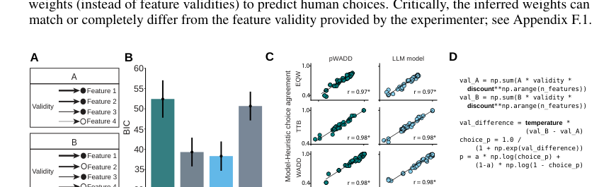
Experiment 1: decision making
A representative case for parsimony.
MAIN RESULT
One discount factor links several classic heuristics.
Compared with pWADD, the LLM model is simpler and more flexible across strategies.
Why it matters: BIC rewards fit, but also penalizes extra parameters.
experiment 1
Rmus et al. (2025) · GeCCo
Notes:
讲法提示：这是代表性实验之一。
不要讲代码细节。讲 scientific insight：a simple discount factor can connect several classic heuristics.
为什么重要：GeCCo did not only find a better-fitting model; it found a more parsimonious way to describe strategies.
小心表达：BIC favors this partly because it penalizes unnecessary parameters.

Slide 9
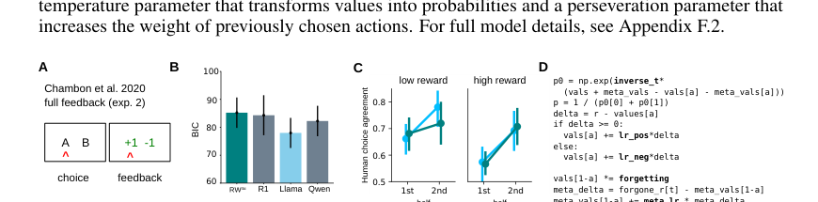
Experiment 2: learning
Full feedback lets people learn from both outcomes and missed outcomes.
LLM INSIGHT
chosen outcome
experienced value
forgone outcome
fictive trace
forgetting
old values decay
The model does not only fit better; it suggests a theory about counterfactual learning.
experiment 2
Rmus et al. (2025) · GeCCo
Notes:
讲法提示：用直观语言讲 chosen vs forgone。
Full feedback means participants see not only what they chose, but also what they missed.
LLM model separates experienced value and fictive/counterfactual value, plus forgetting.
核心：this becomes a psychological hypothesis, not just a numerical improvement.

Slide 10
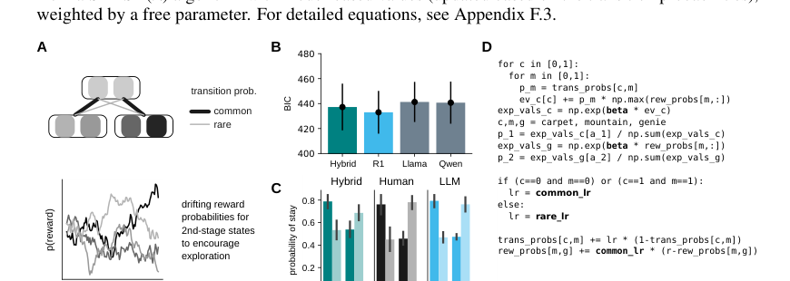
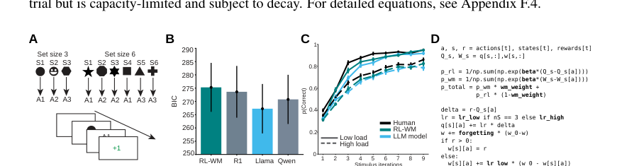
Two more cases: planning and working memory
Use these as high-level evidence, not technical deep dives.
Planning
Working memory
Transition learning can look model-based without explicitly splitting MB/MF systems.
Cognitive load may slow RL learning, not only reduce working-memory weight.
Takeaway: GeCCo generates alternative hypotheses, not just better predictions.
experiments 3-4
Rmus et al. (2025) · GeCCo
Notes:
讲法提示：高层概述，不要深挖 planning / working memory 细节。
Planning takeaway：transition learning can mimic model-based-looking behavior.
Working memory takeaway：load may slow RL learning, not only reduce WM contribution.
核心：GeCCo can generate alternative explanations, but these still require human interpretation.

Slide 11
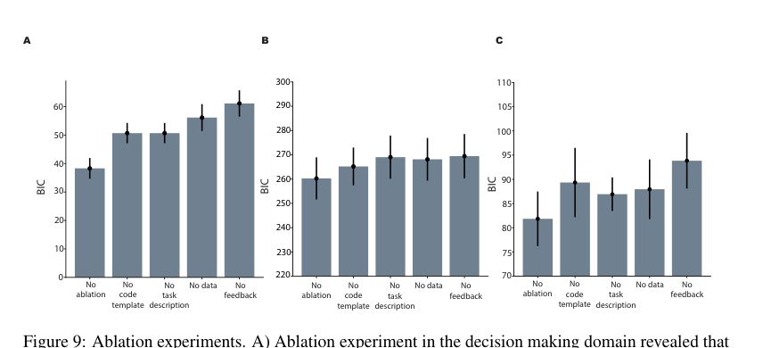
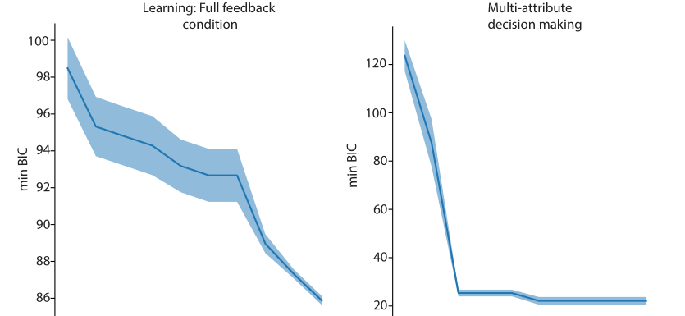
The feedback loop is the core mechanism
The control experiments show that iteration matters.
Remove feedback -> worse BIC
More iterations -> lower BIC
Interpretation: GeCCo works because it creates a search-and-selection loop.
control
Rmus et al. (2025) · GeCCo
Notes:
讲法提示：这是 control 的核心，讲短但要强调。
如果没有 feedback loop，BIC 变差；更多 iterations 通常改善 BIC。
结论：GeCCo works through iterative search and selection, not because the LLM magically knows the answer.
过渡：The authors also check whether this is just memorization or luck.

Slide 12
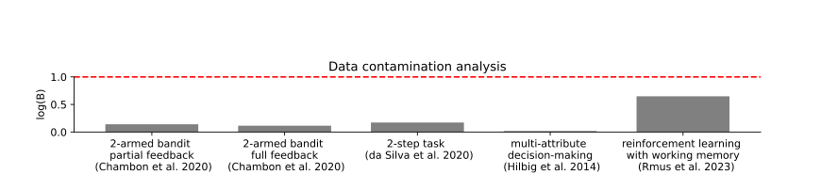
Robustness checks: not just memorization
The authors test whether performance could come from leakage or luck.
Synthetic data
known ground truth
Data contamination
GeCCo recovers
key mechanisms
LogProber scores stay below the contamination threshold. This weakens the memorization explanation.
But: synthetic success is a sanity check, not proof that all human behavior is captured.
control
Rmus et al. (2025) · GeCCo
Notes:
讲法提示：保持 balanced。
Data contamination check weakens the memorization explanation.
Synthetic data shows GeCCo can recover known mechanisms in controlled settings.
但不要夸大：synthetic recovery is a sanity check, not proof that human behavior is fully captured.

Slide 13
Critical question: model fit or cognitive explanation?
The main claim needs interpretation, not just scores.
Better BIC ≠ better theory
LLM proposes
Data selects
Why this matters
A model can predict well without capturing the true psychological process.
Humans interpret
GeCCo is a proposal engine, not an automatic theory machine.
critical evaluation
Rmus et al. (2025) · GeCCo
Notes:
讲法提示：这是你们的 critical lens，可以讲得有力一点。
核心句：better BIC does not automatically mean better cognitive theory.
LLM proposes, data selects, but humans still interpret.
重点：GeCCo is best understood as a proposal engine / hypothesis generator, not an automatic theory machine.

Slide 14
What is still not solved?
Scope and judgment still matter.
Template bias
Prompt sensitivity
The scaffold shapes what the LLM can easily propose.
Small wording changes can alter generated models.
Four lab tasks
Scaling
Evidence comes from controlled lab tasks, not naturalistic behavior.
Richer tasks may require more complex evaluation.
The method helps scientists search; humans still judge explanation.
limitations
Rmus et al. (2025) · GeCCo
Notes:
讲法提示：limitations 要 constructive，不要像在否定 paper。
Template bias：scaffold shapes what can be generated.
Prompt sensitivity：wording may change outputs.
Four lab tasks：scope is controlled, not naturalistic behavior.
Scaling：richer tasks need richer evaluation.
收束：the method expands search, but judgment remains human.

Slide 15
Thank you
Questions？
Rmus et al. (2025) · GeCCo
Notes:
结束提示：简短收尾，不要突然停。
可以说：To conclude, GeCCo is exciting because it expands the search for cognitive models. But its outputs should be treated as candidate explanations that need evaluation and interpretation.
然后邀请问题：We are happy to take questions.

Slide 16
Backup: evaluation metrics
Use only if asked for technical detail.
NLL
BIC
How well the model predicts observed choices.
Compares fit while penalizing extra parameters.
PPC
Interpretation
Checks whether simulations look human-like.
Metrics compare models; they do not prove mechanisms.
In the main talk: explain the intuition, not the formula.
backup
Rmus et al. (2025) · GeCCo
Notes:
Backup slide：只有被问到指标细节时才用。
解释顺序：NLL predicts choices; BIC balances fit and complexity; PPC checks simulated behavior.
不要主动讲公式。重点仍然是：metrics compare models, they do not prove mechanisms.

Slide 17
Backup: acronym glossary
For quick clarification during Q&A.
RW / RL
MB / MF
Rescorla-Wagner / reinforcement learning.
Model-based / model-free learning systems.
pWADD
RL-WM
A literature baseline for decision heuristics.
Reinforcement learning + working memory.
Use only the acronyms needed for the main argument.
backup
Rmus et al. (2025) · GeCCo
Notes:
Backup slide：只有有人问缩写时用。
快速解释需要的缩写，不要全部念。
如果被问 MB/MF：MB uses an internal model of transitions; MF learns cached action values.
如果被问 RL-WM：combines reinforcement learning and working memory components.

Slide 18
Backup: experiment strategy
Why not explain all four experiments equally?
Main deck
Deep dive
Use four domains as breadth evidence.
Explain 1–2 representative cases in more detail.
Selection rule
Professor’s point
Choose cases that support or challenge the main claim.
Details matter only when they serve the claim.
Goal: compact story, not a full technical reconstruction.
backup
Rmus et al. (2025) · GeCCo
Notes:
Backup slide：如果有人问为什么不详细讲四个实验，用这页回答。
教授建议的原则：details matter only when they serve the claim.
正式演讲目标是 compact story，不是 technical reconstruction.
选择 1–2 个代表性案例深入，其余作为 breadth evidence.

