Slide 1
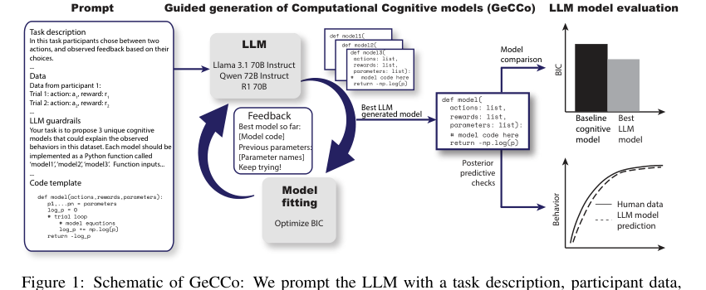
Generating Computational Cognitive Models
using Large Language Models
Presentation Yingzhu Chen & Christian Block
The core idea: LLMs do not just chat. They can propose executable cognitive model code, and the models can be tested against human behavioral data.
NeurIPS 2025 · Rmus et al.
Rmus et al. 2025
1

Slide 2
The paper in one sentence
LLMs generate cognitive models and improve them through data-driven feedback.
Traditional cognitive science: humans propose a theory → humans write a model → fit it to human behavior → compare models.
This paper: the LLM reads the task and data → writes candidate model code → tests it on held-out data → receives feedback about the best model → keeps improving.
Key terms
• Computational cognitive model: a psychological theory written as equations or code
• LLM-generated model: a model proposed by a large language model
• BIC: a model comparison score; lower is better
• Posterior predictive check: test whether a model can simulate human-like behavior
Think of GeCCo as a cognitive-model generator plus an automatic evaluation loop.
BIG PICTURE
2

Slide 3
Why does this paper matter?
It tackles the problem that hand-built modeling is slow, narrow, and heavily dependent on experts.
Traditional modeling is slow
1
2
3
LLMs can expand the model space
Expert bias can narrow the search space
Researchers need to review literature, form theories, write code, fit data, and repeat the process.
Researchers may only test models they already know or believe in.
LLMs can read task descriptions and data, propose multiple executable models, and let data decide which ones work best.
The point is not “LLMs replace scientists.” The point is that LLMs can help scientists explore more cognitive models faster.
MOTIVATION
3

Slide 4
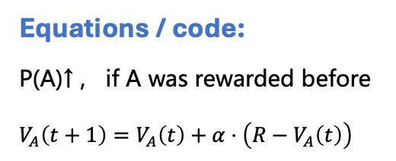
What is a computational cognitive model?
It turns an idea about “how people think” into a runnable and comparable model.
Psychological theory
What does the model output?
Why compare models?
• The probability of choosing each action on every trial
• The negative log-likelihood of the full behavior sequence
• Fitted parameters such as learning rate, temperature, or forgetting
Because different theories can explain the same behavior. Model comparison asks which explanation predicts the data best, while staying simple.
For example: people update choices from rewards; people repeat a previous successful action; working-memory load affects learning.
↓
Equations / code:
P(A)↑ , if A was rewarded before
$$V_{A}\left(t+1\right)=V_{A}\left(t\right)+α⋅\left(R−V_{A}\left(t\right)\right)$$
CONCEPT
4

Slide 5
The overall GeCCo pipeline
The LLM proposes models, a traditional optimizer evaluates them, and the feedback goes back to the LLM.
• The prompt contains the task description, some participant data, a code template, and output rules.
• In each round, the LLM generates 3 different Python cognitive models.
• Each model is fitted on held-out validation data and evaluated with BIC.
• The current best model and previously used parameters are fed back into the next prompt.
METHOD
5

Slide 6
What exactly goes into the GeCCo prompt?
This step determines whether the LLM output is executable and comparable.
1
2
3
4
5
Task description
Behavioral data
Guardrails
Code template
Feedback
A natural-language explanation of what participants do, what they see, and how they choose.
Trial-by-trial participant behavior written as text.
Rules such as function names, inputs, outputs, parameter constraints, and “bug-free Python.”
A simple model skeleton that helps the LLM follow the right structure.
From the second iteration onward: the best model so far and already-used parameters.
In simple words: the prompt gives the LLM both the scientific task and the programming format.
METHOD
6

Slide 7
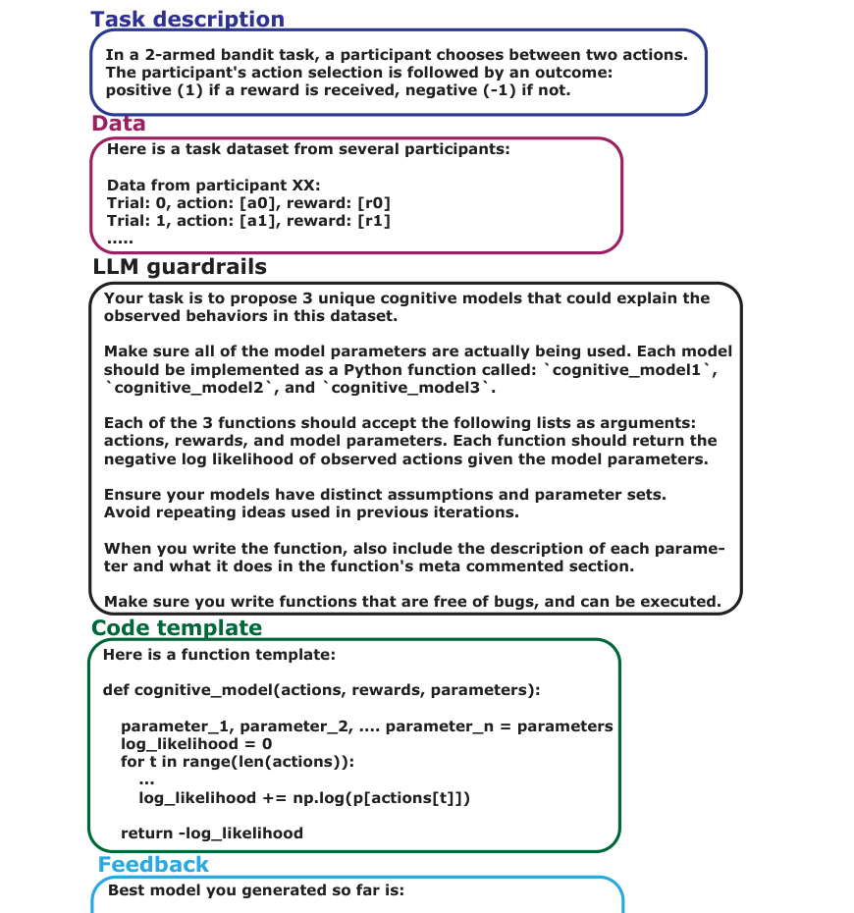
Prompt structure: the full version in the appendix
The paper makes the prompt very explicit, so the experiment is reproducible.
How to read this figure
• Top left: task description, so the LLM understands the experiment.
• Middle left: participant data in text form.
• Top right: guardrails, forcing Python functions as output.
• Bottom right: feedback, so the next round avoids repeating old models.
• Center: template, keeping the function structure stable.
This is why GeCCo is guided code generation with feedback, not a one-shot prompt.
APPENDIX A
Appendix · Figure 6 on page 14
7

Slide 8
How does the paper judge whether a model is good?
It does not ask whether the model sounds nice. It asks whether the model predicts behavior.
NLL
BIC
EXP
Negative log-likelihood: the higher the probability the model assigns to real choices, the lower the NLL.
A fit score that also penalizes the number of parameters; lower is better and simpler is rewarded.
Exceedance probability: the probability that one model explains the data better than the competitors.
One more important check is the posterior predictive check: simulate behavior from the model and see whether the simulated behavior looks like real human behavior.
EVALUATION
8
8

Slide 9
Four experiments across four cognitive domains
Decision making, learning, planning, and working memory.
Experiment
Task
Literature baseline
GeCCo key result
1 Decision making
Multi-feature choice
pWADD
R1 / Llama beat the baseline
2 Learning
Two-armed bandit
RW4α
Llama performs better
3 Planning
Two-step task
Hybrid model
R1 is favored by EXP
4 Working memory
RL-WM task
RL-WM
Llama performs better
The authors chose these tasks because they have well-established baselines and cover different types of cognition.
EXPERIMENTS
9

Slide 10
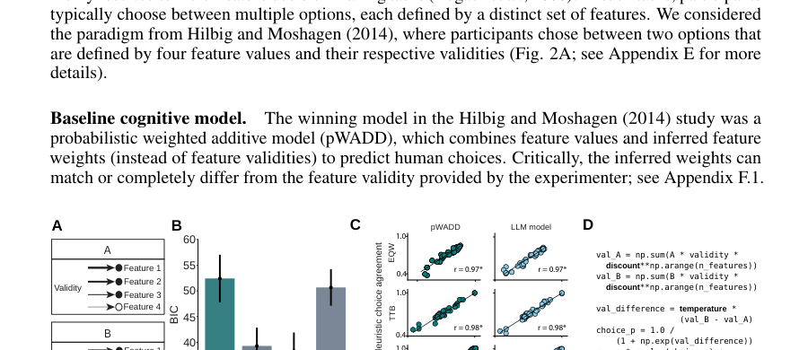
Experiment 1: Decision making
How do people weigh different cues in a multi-feature choice?
What is the task?
• Participants choose between product A and product B.
• Each product has 4 binary features.
• Each feature has a different validity, meaning reliability.
• The question: do people use only the most reliable cue, or do they combine all cues?
Literature baseline: pWADD
A probabilistic weighted additive model that predicts choices with multiple feature weights.
EXPERIMENT 1
Experiment 1 · Figure 2 on page 4
10

Slide 11
Experiment 1 result: the LLM found a simpler explanation
It uses one discount factor to move between classic heuristics.
R1 / Llama
1 parameter
PPC passed
Lower BIC than pWADD
More parsimonious than pWADD’s 4 feature weights
Simulated choices closely match human behavior
Scientific insight: the LLM-generated model is not random code. It proposes a continuous mechanism that can move from Take-the-Best to Weighted Additive to Equal Weighting.
Experiment 1
EXPERIMENT 1
11
11

Slide 12
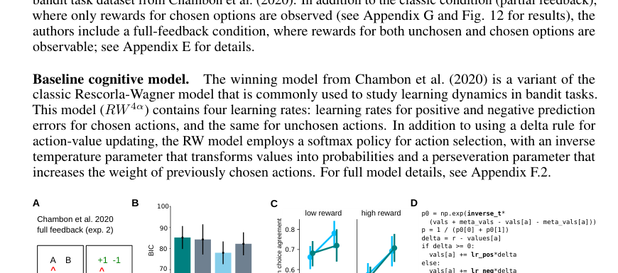
Experiment 2: Learning
How do people learn from rewards and from missed rewards in a bandit task?
What is the task?
• There are two options, and participants choose one each trial.
• They observe the reward for the chosen action.
• In the full-feedback condition, they also see the reward of the unchosen action.
• The question: people may learn not only from what they got, but also from what they missed.
Literature baseline: RW4α
A Rescorla-Wagner variant with chosen / unchosen × positive / negative prediction-error learning rates.
EXPERIMENT 2
Experiment 2 · Figure 3 on page 5
12

Slide 13
Experiment 2 result: the LLM added two interesting mechanisms
Forgetting plus a counterfactual trace.
Asymmetric learning
Forgetting
Fictive trace
Positive and negative prediction errors use different learning rates.
The value of the unchosen option decays, possibly capturing working-memory limits.
The model separately learns from forgone outcomes, like regret or relief signals.
Result: the Llama-generated model has a lower average BIC, and EXP = 0.97, which strongly favors the LLM model at the group level.
Experiment 2
EXPERIMENT 2
13
13

Slide 14
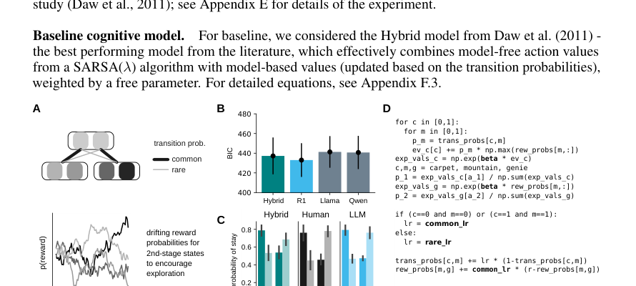
Experiment 3: Planning
In a two-step task, do people rely on habits or use the structure of the environment?
The task in plain language
• First, choose a magic carpet.
• It usually takes you to one mountain, but sometimes there is a rare transition.
• Then choose a genie, which may give a reward.
• Model-free: repeat what was rewarded.
• Model-based: consider the transition structure; after a rare rewarded transition, switching may be better.
EXPERIMENT 3
Experiment 3 · Figure 4 on page 6
14

Slide 15
Experiment 3 result: the LLM generated a simpler planning model
It does not force behavior into separate model-based and model-free systems.
Literature model: Hybrid
LLM model: transition learning
• Combines model-free SARSA(λ)
• Combines model-based transition values
• Uses a weight parameter w to mix them
• Learns common and rare transitions
• Uses expected future value for choice
• No explicit reward-discount parameter
• Behavior still looks model-based
Scientific insight: planning behavior may not need a strict MB/MF split. It can also come from more general transition learning plus value updating.
EXPERIMENT 3
Experiment 3
15

Slide 16
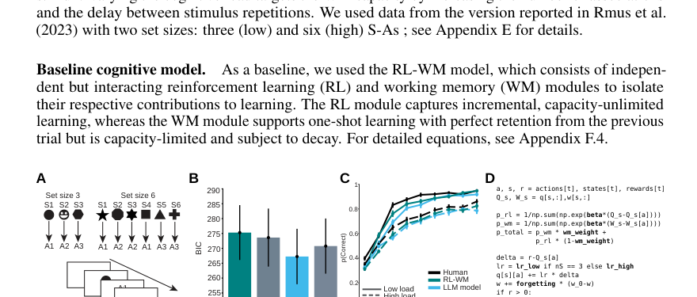
Experiment 4: Working memory
How much do reinforcement learning and working memory each contribute to learning?
What is the task?
• Participants learn stimulus-action associations.
• Each block has set size 3 or 6.
• Set size 3 = low load, so working memory should help more.
• Set size 6 = high load, so learning should be slower and more incremental.
• Goal: separate the roles of RL and WM.
EXPERIMENT 4
Experiment 4 · Figure 5 on page 7
16

Slide 17
Experiment 4 result: the LLM gives a different explanation of cognitive load
The effect is not only on WM weight; it may also affect the RL learning rate.
Llama
EXP 0.99
Load effect
Lower BIC than the RL-WM baseline
Group-level comparison strongly favors the LLM model
Low load shows fast learning; high load shows slower learning.
The interesting part: the classic RL-WM model treats set size mainly as a change in WM weight. The LLM model places the load effect in RL learning rate instead.
EXPERIMENT 4
17
17

Slide 18
CONTROL EXPERIMENTS
Control experiments: how do the authors show this is not a fluke?
They run five robustness checks.
1
Model features
Compare the contributions of reasoning ability, model family, and model size.
2
Prompt ablation
Remove prompt components and test how much performance drops.
3
Data contamination
Check whether the LLM may have memorized the datasets.
4
Synthetic recovery
Use simulated data with known ground truth and see whether GeCCo can recover it.
5
Explainable variance
Compare with a foundation model of human cognition to estimate explainable variance.
The control experiments test whether GeCCo is genuinely modeling behavior, not just getting lucky.
CONTROL EXPERIMENTS
Control experiments
18

Slide 19
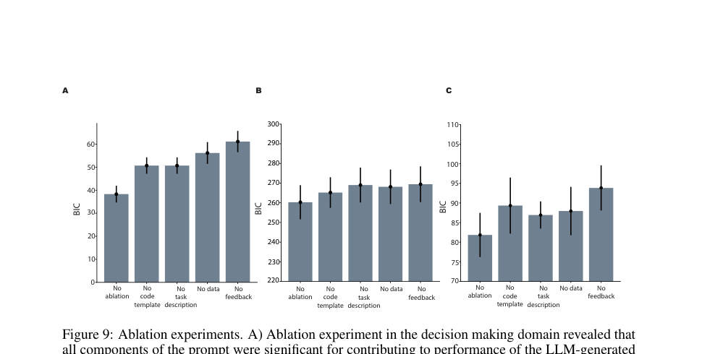
Prompt ablation: which part matters most?
Answer: feedback matters the most, followed by data and task description.
How to read the figure
• “No ablation” means the full prompt.
• Removing a component makes BIC increase = worse models.
• Removing feedback has the biggest effect, so iterative feedback is the core of GeCCo.
Conclusion: GeCCo is not a one-shot burst of LLM inspiration. It improves through generate → test → feedback → generate again.
CONTROL
Control · Figure 9 on page 24
19

Slide 20
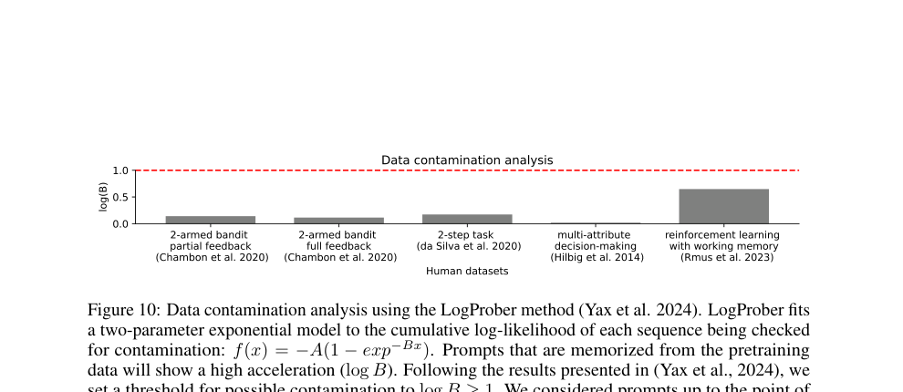
Data contamination: did the LLM already see the data?
The authors use LogProber and find no clear evidence of contamination.
Why does this matter?
• If the LLM saw the data during training, the result might not reflect modeling ability.
• LogProber checks whether sequence log-likelihood looks suspiciously memorized.
• The threshold for possible contamination is log(B) ≥ 1.
• All tasks are clearly below 1.
In simple terms: the authors try to rule out the possibility that the LLM is just recalling answers.
CONTROL
Control · Figure 10 on page 24
20

Slide 21
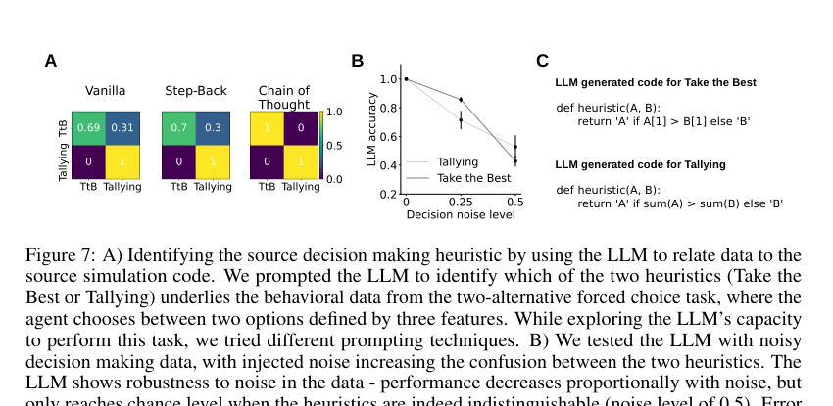
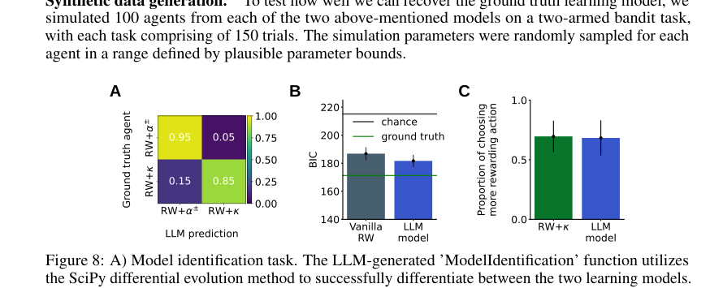
Synthetic recovery: if the truth is known, can GeCCo find it?
Simulated data gives the authors ground truth, so this is a sanity check.
• Decision making: the LLM identifies Take-the-Best and Tallying; as noise increases, the task becomes harder, which is exactly what we expect.
• Learning: the LLM recovers RW with two learning rates; for RW with stickiness, it proposes a value-decay alternative.
CONTROL
Control · Figures 7–8 on pages 21–22
21

Slide 22
Comparison with CENTAUR: how much behavior does the LLM model capture?
CENTAUR is a foundation model for predicting human behavior, used here as a high bar.
How to read the result
Key point
• Decision making: LLM and CENTAUR are close.
• Learning: LLM has much lower NLL.
• Planning: CENTAUR is slightly better, but the difference is not significant.
• Memory: LLM has lower NLL.
CENTAUR is strong at prediction; GeCCo is strong because it stays interpretable.
If a simple LLM-generated model can match or beat CENTAUR, it means the model predicts well and also gives a readable cognitive mechanism.
One sentence: GeCCo captures much of the explainable variation in human behavior while keeping the model interpretable.
CONTROL
Control · Table 1 on page 8
22

Slide 23
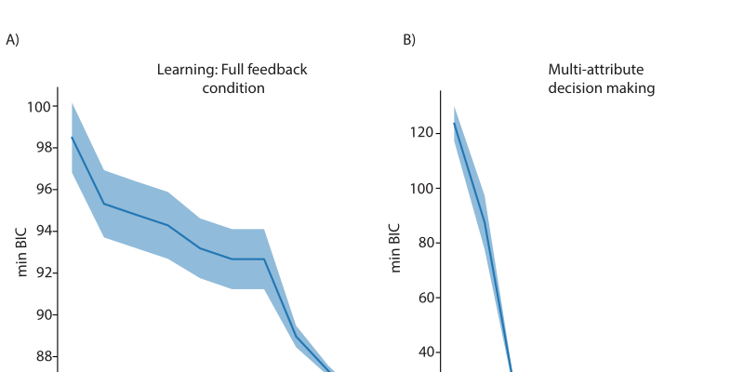
Does iteration really help?
BIC decreases across iterations, which means the feedback loop improves the models.
How to read it
• x-axis: sampling iteration.
• y-axis: minimum BIC.
• Later iterations have lower BIC, meaning better models.
• This supports the claim that feedback is a key driver.
MECHANISM
Mechanism · Figure 11 on page 25
23

Slide 24
DISCUSSION
Main conclusion: what does GeCCo show?
LLMs can quickly generate interpretable cognitive models that compete with literature models.
1
It works across four domains
Decision making, learning, planning, and memory.
2
The models are not black boxes
The output is Python functions with parameters, mechanisms, and interpretable assumptions.
3
The loop is data-driven
The LLM proposes candidates, but held-out data and BIC decide which models survive.
4
The models can inspire new theory
Some LLM-generated mechanisms challenge classic interpretations, such as MB/MF splitting or where load effects occur.
Key message: LLMs can act as proposal engines for scientific models, while data-driven evaluation keeps the process grounded.
DISCUSSION
24

Slide 25
What makes this paper strong?
It combines LLM generation with traditional model fitting instead of simply asking AI to “guess.”
Open-source LLMs
No fine-tuning
Hybrid loop
The paper uses models such as Llama, Qwen, and R1, which lowers the reproducibility barrier.
All experiments are in-context, so no model retraining is needed.
The LLM generates candidates; the optimizer and BIC select the best ones.
The most important design idea: do not let the LLM be the judge. Let the LLM propose models, and let data plus statistics decide which model is better.
STRENGTHS
25

Slide 26
Limitations: what is still not solved?
The results are strong, but the method is not universal yet.
Limited domains
Prompt sensitivity
Template dependence
Only four cognitive domains are tested, so this does not cover all cognitive modeling.
Different prompts may generate different models, so standardization and reproducibility matter.
The template has the smallest effect, but it can still guide the model space.
High-dimensional data is harder
Human oversight is still needed
Vision, language, and richer real-world behavior may require more complex models.
Generated code and mechanisms need to be checked for plausibility and bugs.
LIMITATIONS
26

Slide 27
Three things that make this paper hard to read
Do not be scared by the formulas. First understand the structure.
BIC
Softmax / temperature
Posterior predictive check
Not an absolute score. It is for relative comparison. Lower BIC means a better balance between fit and simplicity.
Turns values into choice probabilities. Temperature or inverse temperature controls how deterministic the choices are.
Not another fitting step. The model generates behavior, and we check whether that behavior looks human-like.
Suggested reading order: task → baseline → what mechanism the LLM model adds → BIC/PPC results.
HOW TO READ
27

Slide 28
References used in this learning deck
Mainly based on Rmus et al. 2025.
• Rmus, M., Jagadish, A. K., Mathony, M., Ludwig, T., & Schulz, E. (2025). Generating Computational Cognitive Models using Large Language Models.
• Hilbig & Moshagen (2014): multi-attribute decision-making baseline.
• Chambon et al. (2020): learning / two-armed bandit data.
• Feher da Silva & Hare (2020): two-step planning data.
• Rmus et al. (2023): RL-WM / working memory data.
• Binz et al. (2024): CENTAUR, a foundation model of human cognition.
Suggested learning order: Abstract + Figure 1 first, then the four experiments, and finally the control experiments and limitations.
REFERENCES
30

