Slide 1
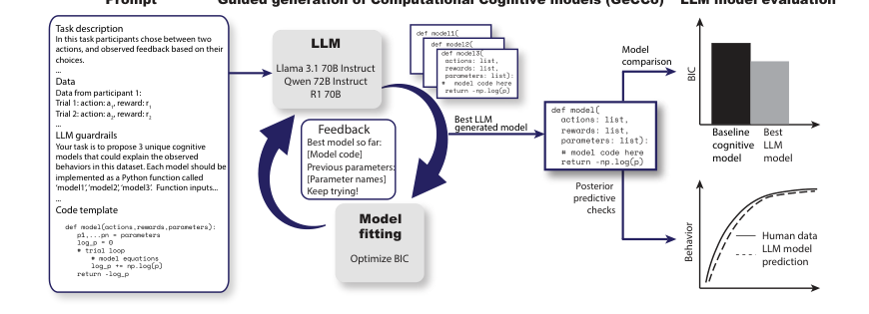
Generating computational cognitive models using LLMs
Seminar presentation · Yingzhu Chen & Christian Block
Core message
LLMs can accelerate cognitive model discovery, but better fit is not automatically better cognitive explanation.
Rmus et al. (2025) · NeurIPS 2025
opening
Rmus et al. (2025) · GeCCo
Notes:
Open with the main message. Emphasize that the presentation is not a full summary, but an argument-driven reading of GeCCo.

Slide 2
Why cognitive modeling needs help
The paper starts from a bottleneck in traditional model discovery.
Theory
Code
Fit data
Revise
Traditional modeling is slow and expert-dependent.
The risk: a narrow model space.
Researchers must read literature, formalize theory, implement code, fit models, and repeat.
We may only test theories we already know how to write down.
problem
Rmus et al. (2025) · GeCCo
Notes:
Frame the problem: GeCCo is not just about speed; it is about expanding model search beyond the researcher’s familiar hypotheses.

Slide 3
What is a computational cognitive model?
A psychological explanation written as equations or executable code.
Psychological idea
"people learn from rewards"
Executable model
Python function
Predictions
choice probabilities
def model(actions, rewards, params):
learning_rate, beta = params
...
return -log_likelihood
Models are compared because different mechanisms can fit the same behavior.
concept
Rmus et al. (2025) · GeCCo
Notes:
Explain this slide slowly. The audience may not know cognitive modeling. Keep it intuitive: theory becomes code; code assigns probabilities to behavior.

Slide 4
GeCCo in one loop
LLM proposes; data evaluates; feedback improves the next proposal.
Prompt
task + data
LLM writes
3 model codes
Fit on
held-out data
Select by
BIC
Feedback
best so far
This is guided code generation, not one-shot prompting.
method
Rmus et al. (2025) · GeCCo
Notes:
This is the central method slide. Stress the hybrid design: LLM is the proposal engine; BIC and held-out data are the selection mechanism.

Slide 5
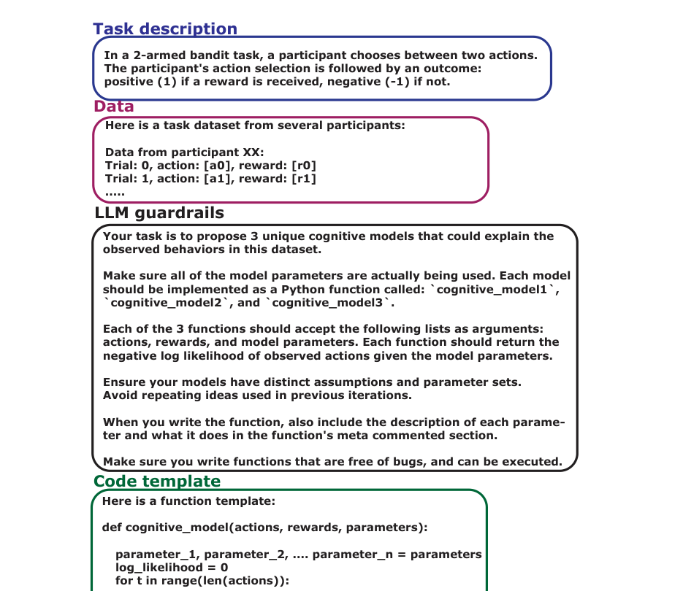
The prompt is part of the method
GeCCo constrains the LLM so outputs are executable and comparable.
PROMPT INGREDIENTS
1
Task description
What participants do
2
Behavioral data
Trial-by-trial examples
3
Guardrails
Function names, inputs, outputs
4
Code template
Syntactic scaffold
5
Feedback
Best model so far
Design choice: more control means less free-form creativity, but better reproducibility.
method
Rmus et al. (2025) · GeCCo
Notes:
Use this slide to connect to the professor’s advice: every figure has a message. Here the message is that prompting is an experimental design choice.

Slide 6
How does the paper decide a model is good?
The evaluation is predictive, but the interpretation is still theoretical.
NLL
Did the model assign high probability to real choices?
BIC
Good fit, but penalize extra parameters
PPC
Can the model simulate human-like behavior?
Lower BIC means better model comparison, not automatic psychological truth.
This distinction is the critical lens for the presentation.
evaluation
Rmus et al. (2025) · GeCCo
Notes:
Set up the later critique: their metrics are strong for comparison and prediction, but a psychological explanation requires more than a score.

Slide 7
Evidence across four cognitive domains
The paper tests whether GeCCo generalizes beyond one task.
Decision making
Planning
baseline: pWADD
Llama/R1 lower BIC
baseline: Hybrid
R1 favored by EXP
Learning
Working memory
baseline: RW4α
Llama favored
baseline: RL-WM
Llama favored
Across all four: LLM-generated models matched or outperformed literature baselines.
evidence
Rmus et al. (2025) · GeCCo
Notes:
This is a transition slide. Do not explain every experiment in detail yet. The goal is to show breadth.

Slide 8
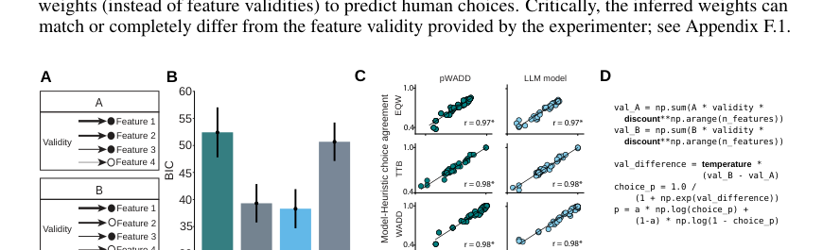
Experiment 1: decision making
Can one simple mechanism explain different choice heuristics?
MAIN RESULT
One discount factor spans several classic heuristics.
The best LLM model is more parsimonious than pWADD: it can move between Take-the-Best, Weighted Additive, and Equal Weighting.
Critical point: simplicity is a real advantage here because BIC rewards fewer parameters.
experiment 1
Rmus et al. (2025) · GeCCo
Notes:
Do not get stuck in the code. Explain the insight: a compact model can interpolate between well-known heuristics.

Slide 9
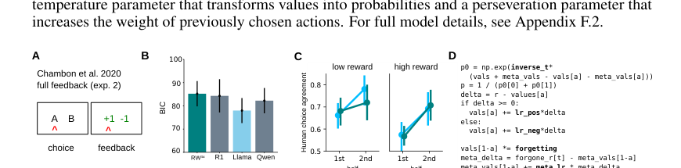
Experiment 2: learning
Full feedback lets people learn from both outcomes and missed outcomes.
LLM INSIGHT
chosen outcome
experienced value
forgone outcome
fictive trace
forgetting
old values decay
The model does not only fit better; it suggests a theory about counterfactual learning.
experiment 2
Rmus et al. (2025) · GeCCo
Notes:
Focus on the scientific interpretation: the LLM keeps chosen and counterfactual values distinct, rather than merging everything into one value system.

Slide 10
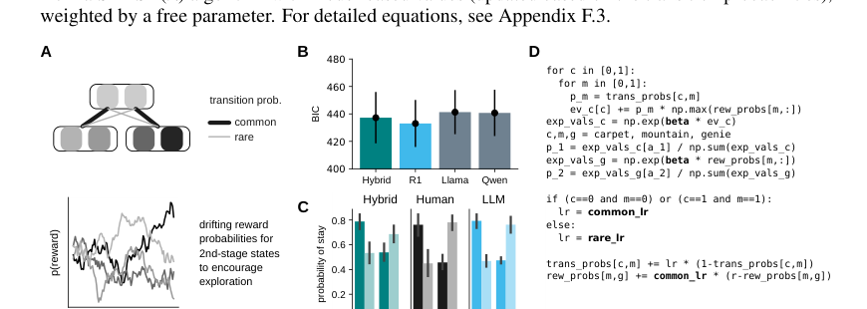
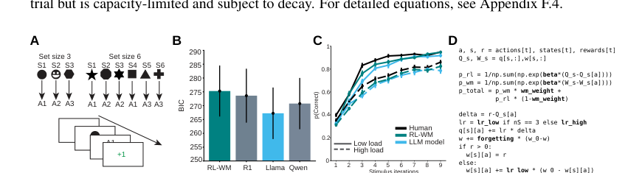
Two more cases: planning and working memory
The interesting results are not only better scores, but alternative explanations.
Planning
Working memory
Transition learning can produce model-based-looking behavior without explicitly splitting MB and MF systems.
Cognitive load may slow the RL learning rate, not only reduce working-memory weight.
Both cases show why GeCCo may generate hypotheses, not just predictions.
experiments 3-4
Rmus et al. (2025) · GeCCo
Notes:
Summarize experiments 3 and 4 without too much detail. The audience should remember the alternative interpretations.

Slide 11
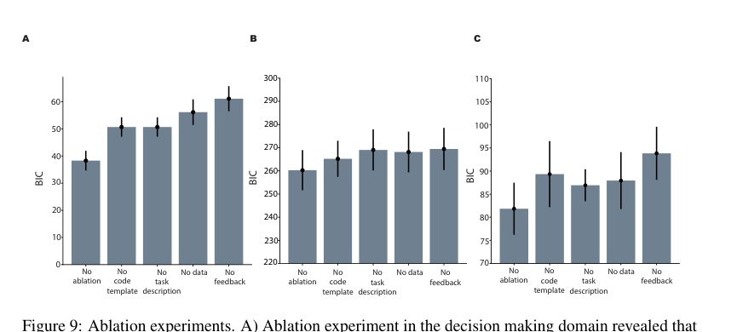
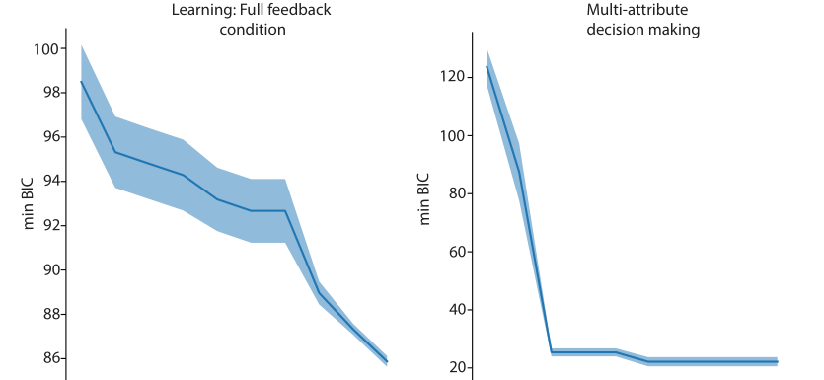
The feedback loop is the core mechanism
The control experiments show that iteration matters.
Remove feedback -> worse BIC
More iterations -> lower BIC
Interpretation: GeCCo works because it creates a search-and-selection loop.
control
Rmus et al. (2025) · GeCCo
Notes:
This is one of the strongest control slides. Use it to argue that GeCCo is not simply asking an LLM once.

Slide 12
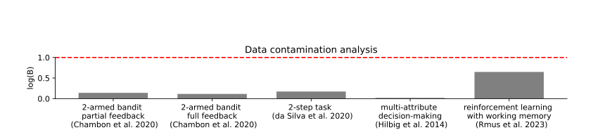
Robustness checks: not just memorization
The authors test whether performance could come from leakage or luck.
Synthetic data
known ground truth
Data contamination
GeCCo recovers
key mechanisms
LogProber scores stay below the contamination threshold. This weakens the memorization explanation.
But: synthetic success is a sanity check, not proof that all human behavior is captured.
control
Rmus et al. (2025) · GeCCo
Notes:
This slide should be balanced. The authors do important controls, but we should not overstate what controls can prove.

Slide 13
Critical question: model fit or cognitive explanation?
This is the main evaluation lens for our presentation.
Better BIC ≠ better theory
LLM proposes
Data selects
Why this matters
A model can predict behavior well without capturing the true psychological process. It may be a useful approximation rather than a causal explanation.
Humans interpret
GeCCo should be understood as a proposal engine, not an automatic theory machine.
critical evaluation
Rmus et al. (2025) · GeCCo
Notes:
This is the core critical slide. It shows that we understand the paper but are not just accepting the claim without evaluation.

Slide 14
What is still not solved?
GeCCo is promising, but not universal.
Template bias
Prompt sensitivity
The scaffold may shape what models the LLM can easily propose.
Different wording can change model generation.
Four lab tasks
Scaling
The domains are standard and controlled, not naturalistic behavior.
Language, vision, or richer tasks may require many more parameters.
The method helps scientists search; it does not remove the need for scientific judgment.
limitations
Rmus et al. (2025) · GeCCo
Notes:
Make the limitations constructive. The point is not that the paper is weak; the point is that the claims have a scope.

Slide 15
Thank you
Questions？
Rmus et al. (2025) · GeCCo
Notes:
End by inviting questions. These discussion questions align with the seminar’s focus on critical reading and AI in neuroscience.

