Slide 1
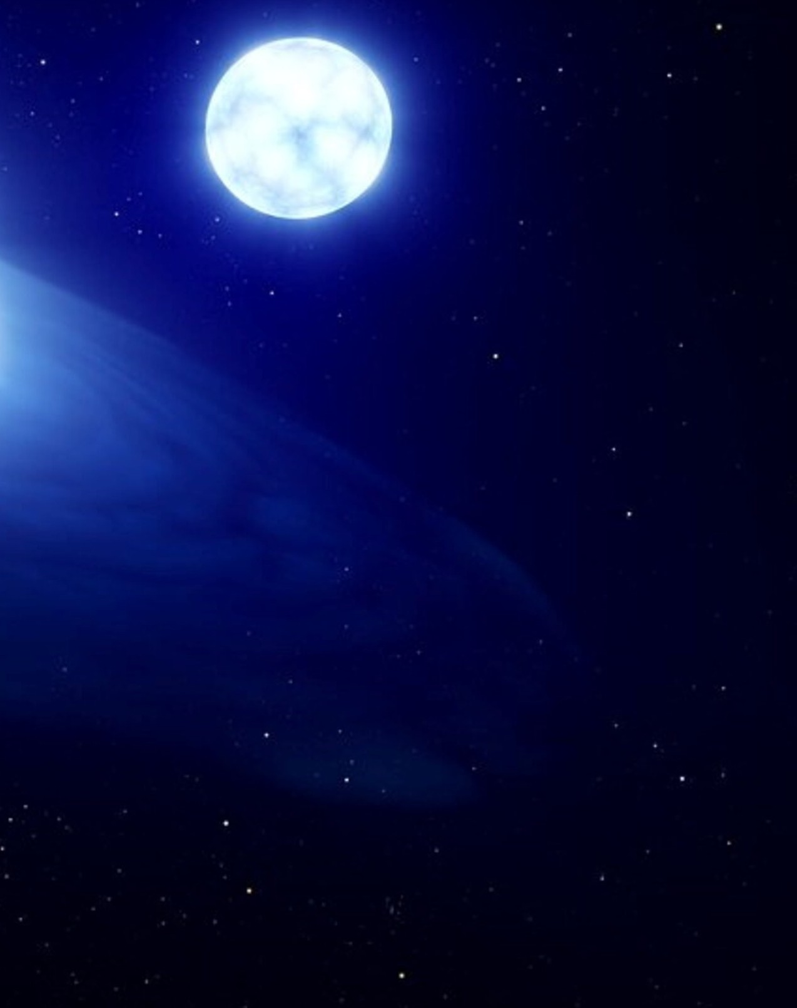
Introduction to MESA

Slide 2
Outline

Slide 3
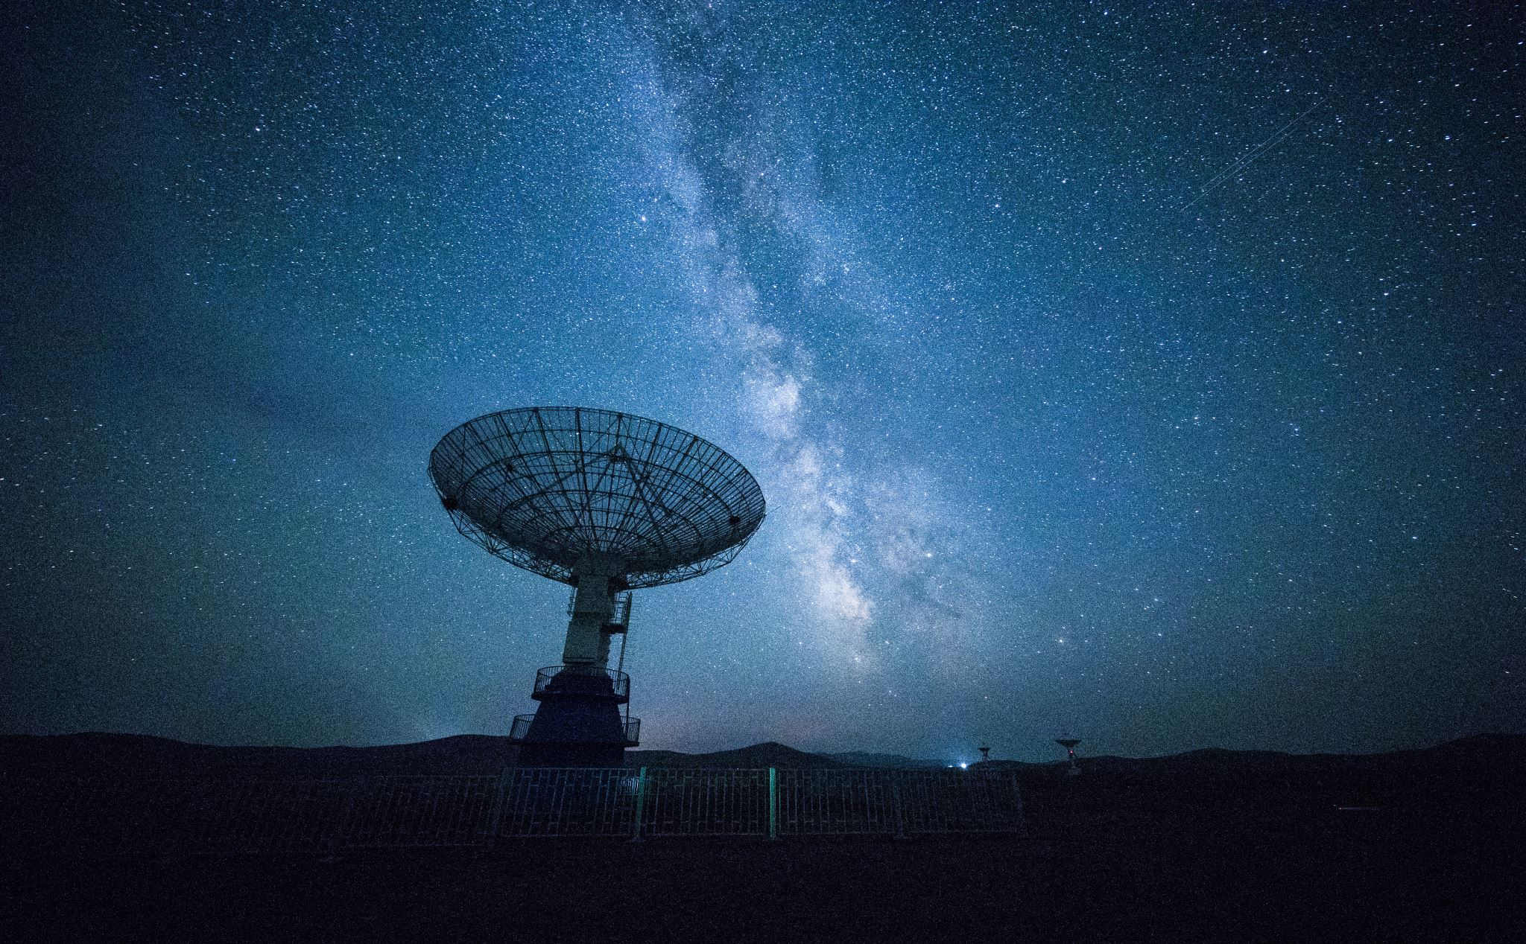
Stars

