Slide 1

Wiener Linien
Deleja-Hotko Julian, Topor Karol

Slide 2
Concept
Use historic data on disruptions in the public transit system in Vienna
Combine with weather data and geographic data
Try to recognize patterns

Slide 3
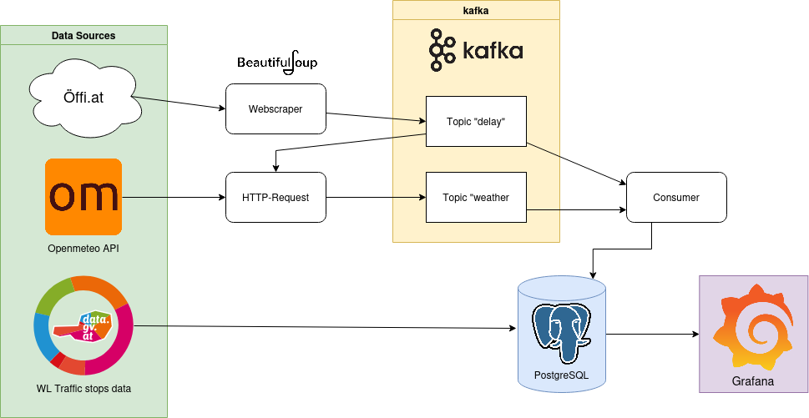
Data Pipeline

Slide 4
DATA SOURCES
Öffi.at: Web-based historic archive of disruptions in the public transit system
Openmeteo: API for real-time and historic weather data
Data.gv.at: publicly available datasets from Austrian open government data

Slide 5
Data collection
Data from Öffi.at is scraped using BeautifulSoup
Weather data is collected via calls to Openmeteo's API for the timestamps collected from Öffi.at
All of this is streamed to kafka
Geographic information is imported from a csv file from Data.gv.at directly into the database

Slide 6
Data processing
Delay data and Weather data are streamed to two kafka topics
Delay data is consumed to get timestamps for weather data
Then both are consumed and written to the database
In addition, the number of delays for a given day or at a given station is added to the respective table

Slide 7

Data Storage
Delays:
Title
Fixed
Affected Lines
Affected Station
Timestamps (start, end)
Weather:
Timestamp
WMO classification Code
Temperature
Precipitation
Relative humidity
Wind speed
Number of disruptions on said day
Traffic stops:
Name
Longitude
Latitude
Number of disruptions affecting said station
All Data is stored in a postgreSQL database
3 Tables:

Slide 8
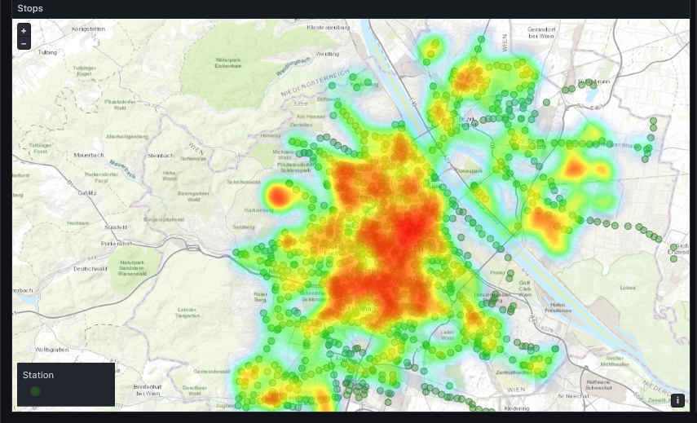
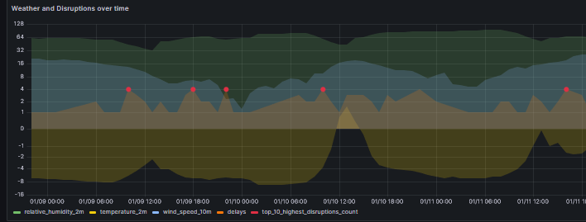
Data Visualization
Data is analyzed using Grafana
We can analyze:
Heatmaps for disruptions
Time-series graphs of different weather metrics and disruptions
Total and relative numbers of delays
Detailed information on all tables
In addition, we can filter for:
Specific stations
Specific timeframes

Slide 9

Containers
dsi_kafka_producer_weather: Container running custom Python script for fetching weather data
dsi_kafka_producer_delays: Container running custom Python script for fetching disruption data
dsi_init_kafka: Used to create required topics in Kafka on startup
dsi_kafka_00: This container hosts the Apache Kafka
dsi_kafka_consumer: Container running custom Python script to handle reading from Kafka and writing to PostgreSQL
Every part of the system is containerized
Docker is used here
In total, there are 10 containers:

Slide 10
Containers Pt. 2
dsi_psotgres_setup_table: Container for creating and setting up tables in postgreSQL
dsi_postgres: The postgreSQL database used to store our final data
dsi_grafana: Contains the visualization tool we use to get our results
dsi_prometheus: Used to store metrics
dsi_exporter_postgres: Used to gather postgres metrics (just for fun)
Remaining 5 containers:

Slide 11
Live Demonstration

