Slide 1

Wiener Linien
Deleja-Hotko Julian, Topor Karol

Slide 2
Concept
Use historic data on disruptions in the public transit system in Vienna
Combine with weather data and geographic data
Try to recognize patterns

Slide 3
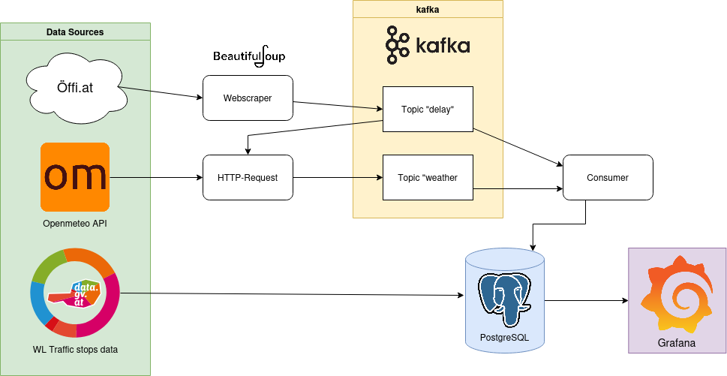
Data flow

Slide 4
DATA SOURCES
Öffi.at: Web-based historic archive of disruptions in the public transit system
Openmeteo: API for real-time and historic weather data
Data.gv.at: publicly available datasets from Austrian open government data

Slide 5
Use historic data on disruptions in the public transit system in Vienna
Combine with weather data and geographic data
Try to recognize patterns

Slide 6
Concept
Use historic data on disruptions in the public transit system in Vienna
Combine with weather data and geographic data
Try to recognize patterns

Slide 7
Concept
Use historic data on disruptions in the public transit system in Vienna
Combine with weather data and geographic data
Try to recognize patterns

