Slide 1




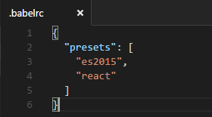
transpile
Presets used

