Slide 1

HOG and Gabor Filter based Pedestrian Detection using Convolutional Neural Network
Fahim Ahmed
Student ID: 140217
Badhon Ahmed Topu
Student ID: 140229

Slide 2
Contents
Introduction
Related Works
Objectives
Proposed System
Conclusion and Future Work
References

Slide 3
Introduction
Pedestrian detection is one of the most important tasks in Computer Vision and in the last few decades, many research has been done in this.
There are many application of pedestrian detection like autonomous car, traffic control and it is useful technique which provides safety for both road drivers and also pedestrians themselves.
According to a study by the Accident Research Centre (ARC) of BUET, road accidents claim on average 12,000 lives and lead to about 35,000 injuries per year in Bangladesh [1].
[1] “Road Accidents in Bangladesh: An Alarming Issue” [Online Available] : http://blogs.worldbank.org/endpovertyinsouthasia/road-accidents-Bangladesh-alarming-issue
[Accessed : 15 Jul, 2018]

Slide 4
Related Works
Pedestrian and Part Position Detection using a Regression-based
Multiple Task Deep Convolutional Neural Network [2]
HOG and SVM-based methods.
Regression-based DCNN.
Pedestrian detection accuracy – 94.5%.
Limitations :
Their work fail to detect pedestrian when there is pose variations.
They used only head and leg to detect the pedestrian that increase their miss rate.
[2] Yamashita, T., Fukui, H., Yamauchi, Y., & Fujiyoshi, H. (2016, December). Pedestrian and part position detection using a regression-based multiple task deep convolutional neural network. In Pattern Recognition (ICPR), 2016 23rd International Conference on (pp. 3500-3505). IEEE.

Slide 5
Related Works (Continued)
Multispectral Deep Neural Networks for Pedestrian Detection[3]
Deep Neural Network.
Color and thermal images.
Pedestrian detection accuracy – 96.5%.
Limitations :
Difficult to eliminate semantic noise.
[3] Liu, J., Zhang, S., Wang, S., & Metaxas, D. N. (2016). Multispectral deep neural networks for pedestrian detection. arXiv preprint arXiv:1611.02644.

Slide 6
Related Works (Continued)
Multi-pedestrian Detection in Crowded Places on Quadrotor's View [4]
Can detect pedestrian in crowded place.
HOG features and SVM classifier is used for pedestrian detection.
Kalman filter is used for getting missing pedestrian.
Precision - 82% and
Recall - 63%
Limitations :
Low accuracy.
Their features are not good enough for showing better result.
[4] Sun, Yang, Zhenghua Liu, and Baoyang Ding. "Multi-pedestrian detection in crowded places on quadrotor's view." Intelligent Robot Systems (ACIRS), 2017 2nd Asia-Pacific Conference on. IEEE, 2017.

Slide 7
Related Works (Continued)
Latent Subcategory Models for Pedestrian Detection with Partial Occlusion Handling [5]
HOG used as feature extractor.
They took K as a number of subcategories in HOG feature.
SVM and LSVM is used for classification.
Accuracy – 96.82%
Limitations:
Larger values of subcategory (K) does affect the time performance.
[5] Martelli, S., San Biagio, M., & Murino, V. (2015, August). Latent subcategory models for pedestrian detection with partial occlusion handling. In Advanced Video and Signal Based Surveillance (AVSS), 2015 12th IEEE International Conference on (pp. 1-6). IEEE.

Slide 8
Objectives
To develop pedestrian detection models and to find a robust model for pedestrian detection.

Slide 9
System Architecture
Training
Testing
Positive Sample
Negative Sample
Testing Sample
Gaussian Filter
Preprocessing
Gaussian Filter
Gabor Filter
Gabor Filter
Feature Extraction
Histogram of Oriented Gradients
Histogram of Oriented Gradients
Loaded Model Parameter and Weights
Prediction Using CNN
Training Set
Validation Set
Model Parameter and Weights Stored in Database
Pedestrian
Or
Not-Pedestrian
Training Using CNN

Slide 10


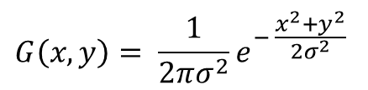
Training Phase (Continued)
Preprocessing Technique
Gaussian Filter [11]
It is used for removing noise.
The Gaussian outputs a weighted average
of each pixel’s neighborhood.
$$G\left(x,y\right)= \frac{1}{2πσ^{2}}e^{− \frac{x^{2}+y^{2}}{2σ^{2}}}$$
Input Image
Gaussian Filtered Image
Where,
x and y = Intensity of the input image
σ = Standard deviation of the Gaussian Distribution.
[11] Deng, G., & Cahill, L. W. (1993, November). An adaptive Gaussian filter for noise reduction and edge detection. In Nuclear Science Symposium and Medical Imaging Conference, 1993., 1993 IEEE Conference Record. (pp. 1615-1619). IEEE.

Slide 11


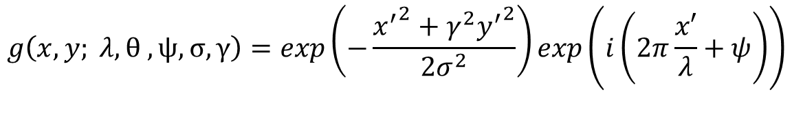
Training Phase (Continued)
Feature Extraction Techniques
Gabor Filter
Gabor filters are special class of bandpass filter.
It is used in edge detection, texture analysis and feature extraction.
$$g\left(x, y; λ, θ , ψ, σ, γ\right)=exp\left(−\frac{{x^{′}}^{2}+γ^{2}{y^{′}}^{2}}{2σ^{2}}\right)exp\left(i\left(2π\frac{x′}{λ}+ψ\right)\right)$$
where,
$$x^{′}=x\cos{θ}+y\sin{θ}$$
and
$$y^{′}=−x\sin{θ+y\cos{θ}}$$
λ = wavelength of the sinusoidal factor
θ = orientation of the normal to the parallel stripes of a Gabor function
ψ = phase offset
σ = standard deviation of the Gaussian envelope
γ = spatial aspect ratio
Notes:
Gabor filters are special class of bandpass filter. They allow a certain band of frequencies and reject the others.

Slide 12
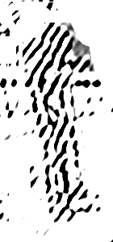
Training Phase (Continued)
Gabor Filter
When the Gabor preprocessing is introduced into other local feature extraction method they achieve a better detection of relevant information by enhancing the human shape [6].
Gaussian Filtered Image
Gabor Filtered Image
[6] Guojuan, F., Bo, L., Wanquan, M., & Xuqing, L. (2016, December). HOGG: Gabor and HOG- Based Human Detection. In Information Technology in Medicine and Education (ITME), 2016 8th International Conference on (pp. 562-566). IEEE.

Slide 13
Training Phase (Continued)
Histogram of Oriented Gradients (HOG)
It is an edge orientation histograms based on the orientation of the gradient in localized region.
It can represent a rough shape of the object, so that it has been used for general object recognition, such as people or cars.
The image is divided into small connected regions called cells, and for the pixels within each cell, a histogram of gradient directions is compiled.

Slide 14
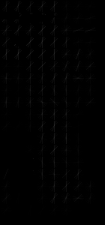
Training Phase (Continued)
HOGG
We have used Histogram of Oriented Gradient (HOG) and Gabor filter together. It performs better than only HOG or only Gabor [6].
Gaussian Filtered Image
Gabor Filtered Image
HOG Image
[6] Guojuan, F., Bo, L., Wanquan, M., & Xuqing, L. (2016, December). HOGG: Gabor and HOG- Based Human Detection. In Information Technology in Medicine and Education (ITME), 2016 8th International Conference on (pp. 562-566). IEEE.

Slide 15
Training Phase (Continued)
Convolutional Neural Networks
They are able to extract visual concepts from the raw image content [10].
Output Layer
Input Layer
Hidden Layer 1
Hidden Layer 2
Hidden Layer 3

Slide 16
Training Phase (Continued)
Model 1
Hidden Layer
Flatten
Convolutional Layer
Conv1
Max Pooling
Output Layer
Conv2
Max Pooling
Conv3
Max Pooling
Pedestrian
Or
Not-Pedestrian
64x64
32x(62x62)
32x(31x31)
32x(29x29)
32x(14x14)
32x(12x12)
32x(6x6)
1152
128
128
128

Slide 17
Training Phase (Continued)
Model 2
Hidden Layer
Flatten
Convolutional Layer
Conv1
Max Pooling
Output Layer
Conv2
Max Pooling
Conv3
Max Pooling
Pedestrian
Or
Not-Pedestrian
64x64
32x(62x62)
32x(31x31)
64x(29x29)
64x(14x14)
128x(12x12)
128x(6x6)
4608
128
128
128

Slide 18
Training Phase (Continued)
Hidden Layer
Model 3
Flatten
Convolutional Layer
Output Layer
Conv1
Max Pooling
Conv2
Max Pooling
Conv3
Conv4
Max Pooling
Max Pooling
Pedestrian
Or
Not-Pedestrian
64x64
32x(62x62)
32x(31x31)
32x(29x29)
32x(14x14)
32x(12x12)
32x(6x6)
32x(4x4)
32x(2x2)
128
128
128
128
128
128
128

Slide 19
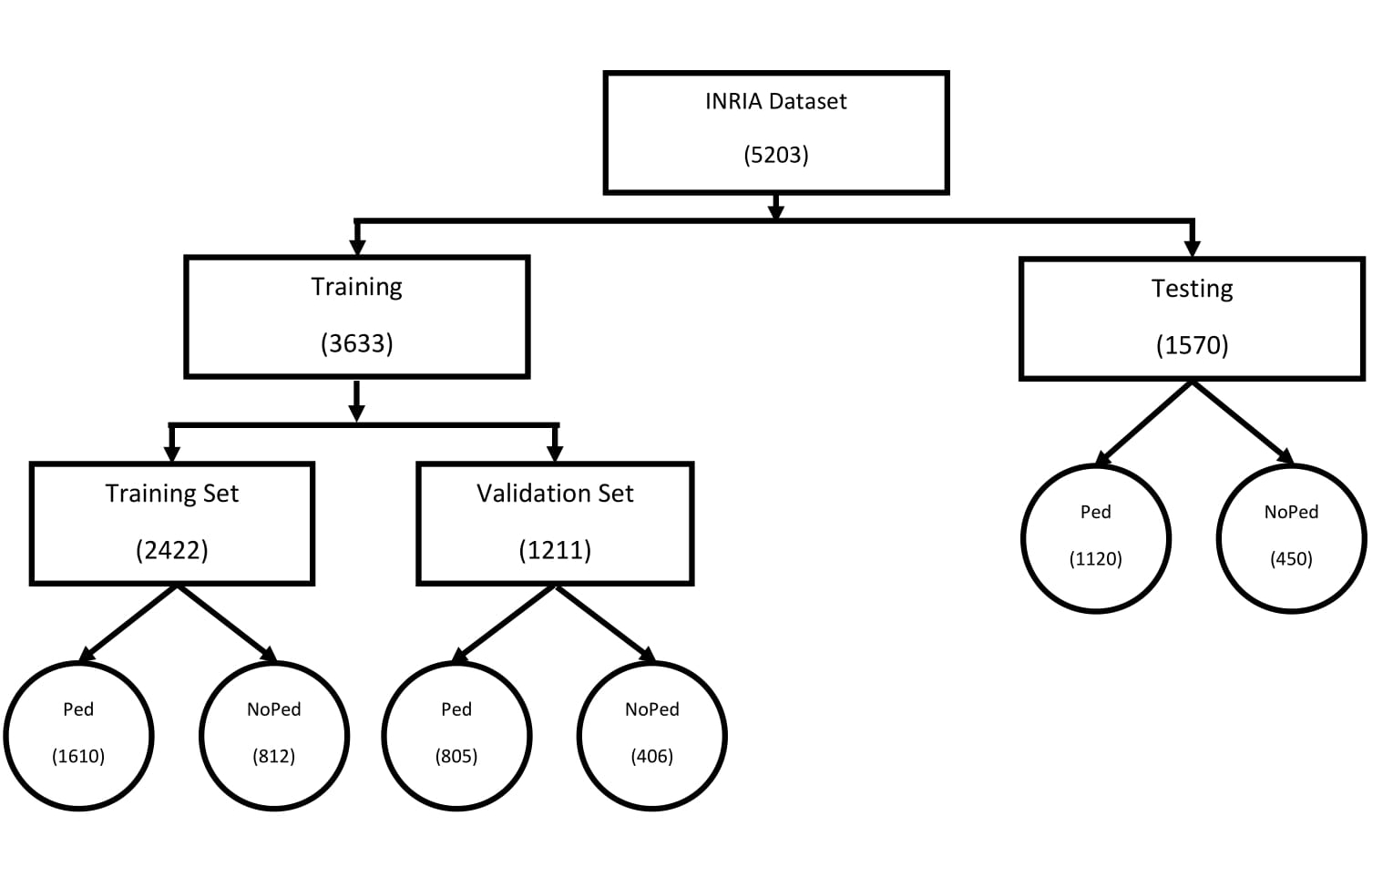
Distribution of Images in INRIA Dataset

Slide 20
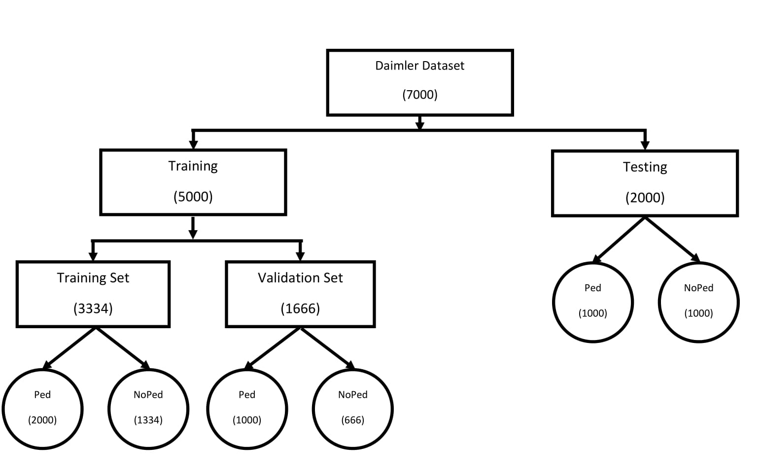
Distribution of Images in Daimler Dataset

Slide 21
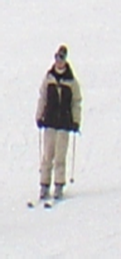
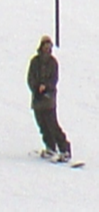
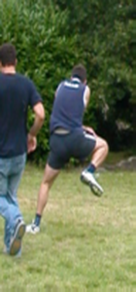
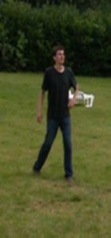

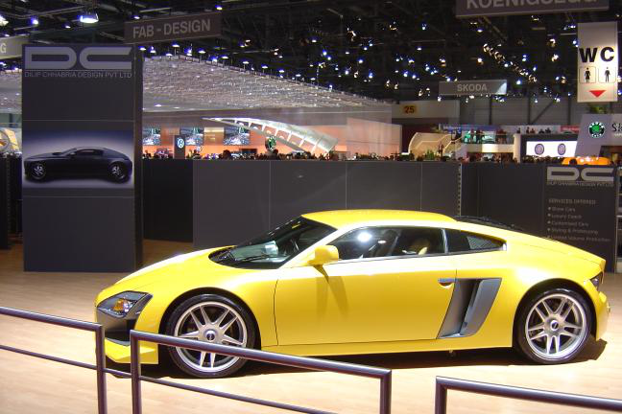
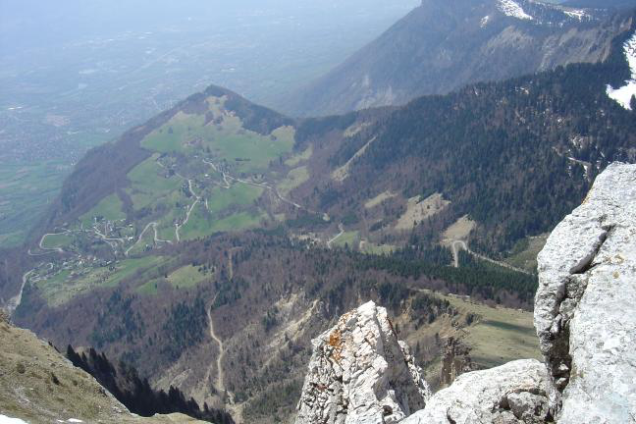
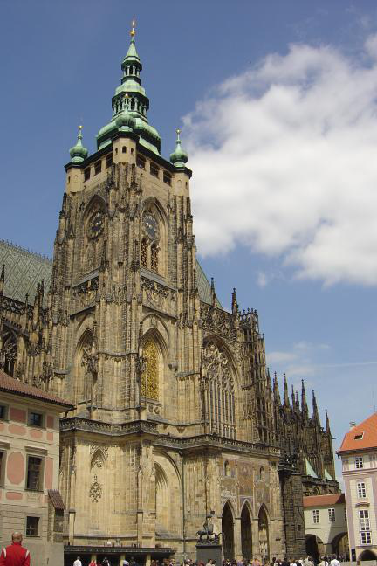
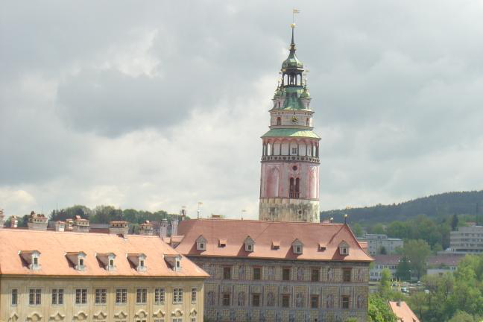
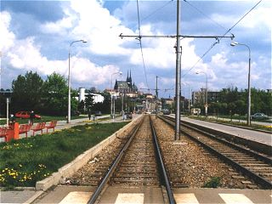
INRIA Dataset
Sample Images

Slide 22
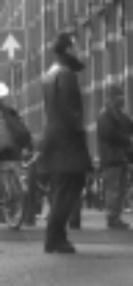
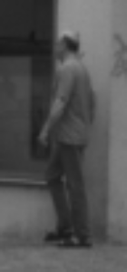
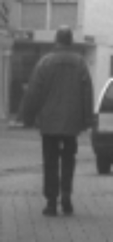
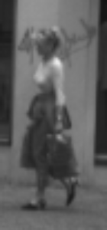
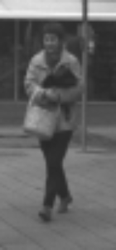
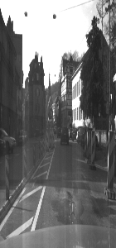
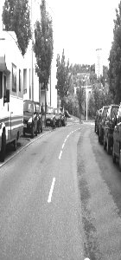
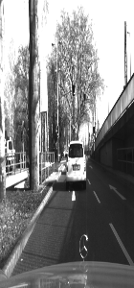
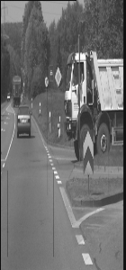
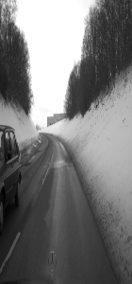
Daimler Dataset
Sample Images

Slide 23
Testing Phase
The preprocessing and the feature extraction method is same as the training phase.
We have loaded the pre-trained model parameter and weights from the database and sent it to the classifier.
Then the classifier predict the result pedestrian or not pedestrian.

Slide 24
Results for INRIA Dataset
Model | Input Shape | Convolutional Layer | Hidden Layer | Precision | Recall | Accuracy
1 | 64x64 | 1 – 32(3x3) 2 – 32 (3x3) 3 – 32(3x3) | 1 – 128 1 - 128 1 - 128 | 99.56% | 100% | 99.68%
2 | 64x64 | 1 – 32(3x3) 2 – 64 (3x3) 3 – 128(3x3) | 1 - 128 1 - 128 1 - 128 | 99.73% | 100% | 99.81%
3 | 64x64 | 1 – 32(3x3) 2 – 32 (3x3) 3 – 32(3x3) 4 – 32(3x3) | 1 - 128 1 - 128 1 - 128 1 - 128 1 - 128 1 - 128 | 98.68% | 100% | 99.04%

Slide 25
Results for Daimler Dataset
Model | Input Shape | Convolutional Layer | Hidden Layer | Precision | Recall | Accuracy
1 | 64x64 | 1 – 32(3x3) 2 – 32 (3x3) 3 – 32(3x3) | 1 – 128 1 - 128 1 - 128 | 81.16% | 89.6% | 84.4%
2 | 64x64 | 1 – 32(3x3) 2 – 64 (3x3) 3 – 128(3x3) | 1 - 128 1 - 128 1 - 128 | 79.35% | 99.5% | 86.8%
3 | 64x64 | 1 – 32(3x3) 2 – 32 (3x3) 3 – 32(3x3) 4 – 32(3x3) | 1 - 128 1 - 128 1 - 128 1 - 128 1 - 128 1 - 128 | 100% | 53.7% | 76.85%

Slide 26
Comparison with Existing Works
Dataset | Work Reference | Approach | Precision | Recall | Accuracy
INRIA | Sun et. al. [4] | HOG and SVM | 82% | 63% | -
 | Yamashita et. al. [2] | DCNN | - | - | 94.5%
 | Li et. al. [7] | R-CNN | - | - | 91.06%
 | Liu et. al. [3] | DNN | - | - | 96.5%
 | Proposed Work | HOGG and CNN | 99.73% | 100% | 99.81%
Daimler | Dominguez et. al. [9] | HOG and ResNet | - | - | 79%
 | Nilsson et. al. [8] | HOG and SVM | - | - | 81%
 | Martelli et. al. [5] | HOG and SVM, LSVM | - | - | 96.82%
 | Proposed Work | HOGG and CNN | 99.5% | 79.35% | 86.8%

Slide 27
Conclusion and Future Work
In our thesis, we have used Gabor filter and Histogram of Oriented Gradient (HOG) for feature extraction.
We have used Convolutional Neural Network as classifier.
INRIA and Daimler Mono Pedestrian datasets is used for training and testing purposes. Limitations:
We have achieved better accuracy than other methods [8][9] but we couldn’t get better accuracy than this method [5] on Daimler Mono Pedestrian dataset.
Future work:
Pedestrian position detection using bounding box.

Slide 28
References
[1] “Road Accidents in Bangladesh: An Alarming Issue ” [Online Available] : http://blogs.worldbank.org/endpovertyinsouthasia/road-accidents-Bangladesh-alarming-issue
[Accessed : 15 Jul, 2018]
[2] Yamashita, T., Fukui, H., Yamauchi, Y., & Fujiyoshi, H. (2016, December). Pedestrian and part position detection using a regression-based multiple task deep convolutional neural network. In Pattern Recognition (ICPR), 2016 23rd International Conference on (pp. 3500-3505). IEEE.
[3] Liu, J., Zhang, S., Wang, S., & Metaxas, D. N. (2016). Multispectral deep neural networks for pedestrian detection. arXiv preprint arXiv:1611.02644.
[4] Sun, Yang, Zhenghua Liu, and Baoyang Ding. "Multi-pedestrian detection in crowded places on quadrotor's
view." Intelligent Robot Systems (ACIRS), 2017 2nd Asia-Pacific Conference on. IEEE, 2017.
[5] Martelli, S., San Biagio, M., & Murino, V. (2015, August). Latent subcategory models for pedestrian detection with partial occlusion handling. In Advanced Video and Signal Based Surveillance (AVSS), 2015 12th IEEE International Conference on (pp. 1-6). IEEE.
[6] Guojuan, F., Bo, L., Wanquan, M., & Xuqing, L. (2016, December). HOGG: Gabor and HOG-Based Human
Detection. In Information Technology in Medicine and Education (ITME), 2016 8th International Conference
on (pp. 562-566). IEEE.

Slide 29
References
[7] Li, J., Liang, X., Shen, S., Xu, T., Feng, J., & Yan, S. (2018). Scale-aware fast R-CNN for pedestrian detection. IEEE Transactions on Multimedia, 20(4), 985-996.
[8] Nilsson, J., Andersson, P., Gu, I. Y., & Fredriksson, J. (2014, August). Pedestrian detection using augmented training data. In Pattern Recognition (ICPR), 2014 22nd International Conference on (pp. 4548-4553). IEEE.
[9] Dominguez-Sanchez, A., Cazorla, M., & Orts-Escolano, S. (2017). Pedestrian movement direction recognition using convolutional neural networks. IEEE Transactions on Intelligent Transportation Systems, 18(12), 3540-3548.
[10] Krizhevsky, A., Sutskever, I., & Hinton, G. E. (2012). Imagenet classification with deep convolutional neural networks. In Advances in neural information processing systems (pp. 1097-1105).
[11] Deng, G., & Cahill, L. W. (1993, November). An adaptive Gaussian filter for noise reduction and edge detection. In Nuclear Science Symposium and Medical Imaging Conference, 1993., 1993 IEEE Conference Record. (pp. 1615-1619). IEEE.

Slide 30
Thank You

