Slide 1

Sentiment Analysis

Slide 2
Overview
Rows (40K)
Binary Classification
Labels
Two Cols : (Label, Text)
2. Negative
1. positive
Balanced Classes

Slide 3
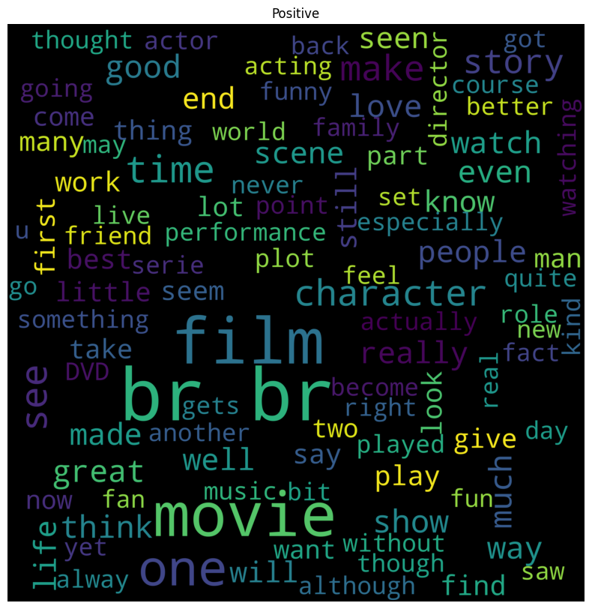
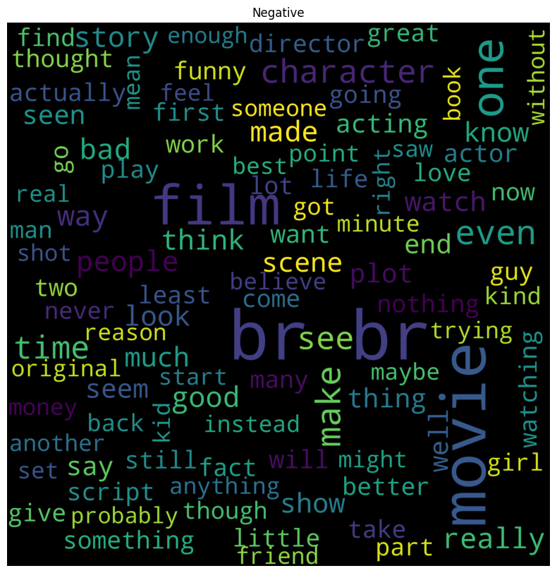
Cloud

Slide 4

PREPROCESSING STEPS
Normalize the data into lowercase.
Remove URLs.
Remove HTML Tags
Remove Emails
Remove Punctuations
Remove emoji
Handle abbreviations
Remove Numbers & Stop words
Lemmatization

Slide 5
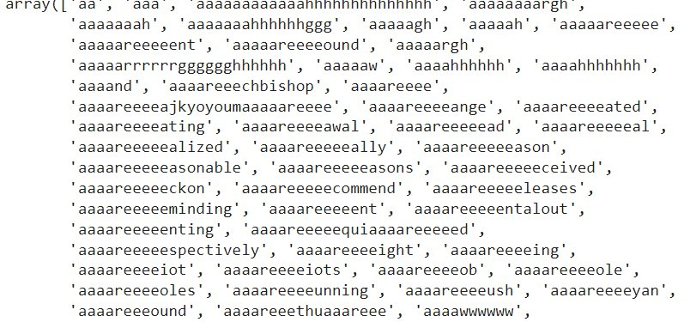
TF-IDF
Result df : (40K, 183K)
A lot of words are unexpressed
Suggested Sol:
-Take only words from dictionary.

Slide 6
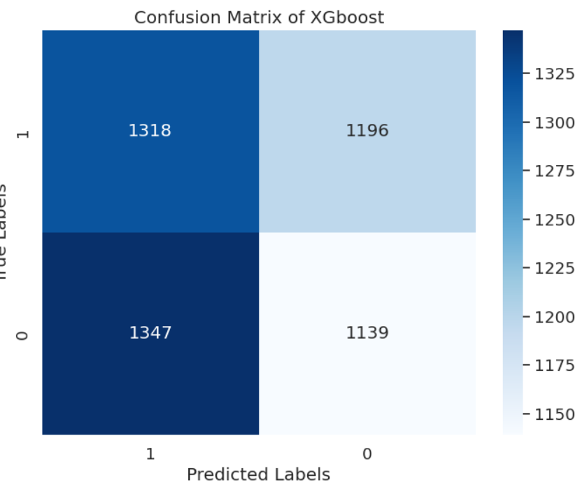

XGboost
Accuracy

Slide 7
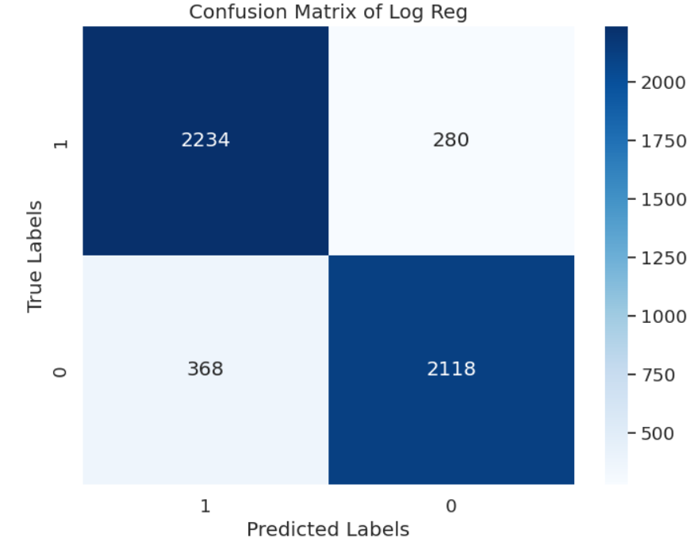
Bernoulli Naive Bayes
Accuracy

Slide 8
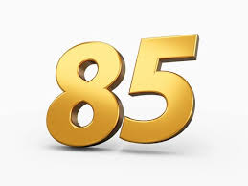
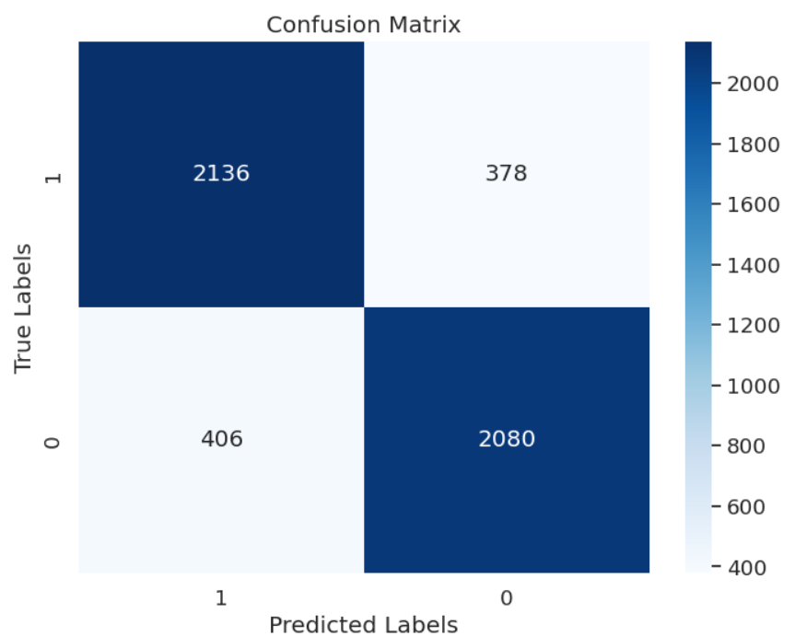
Random Forest
Accuracy

Slide 9
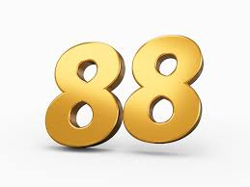
Logistic Regression
Accuracy

Slide 10

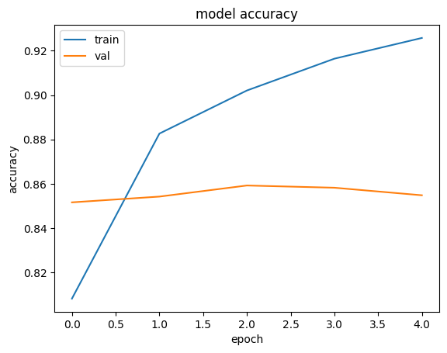
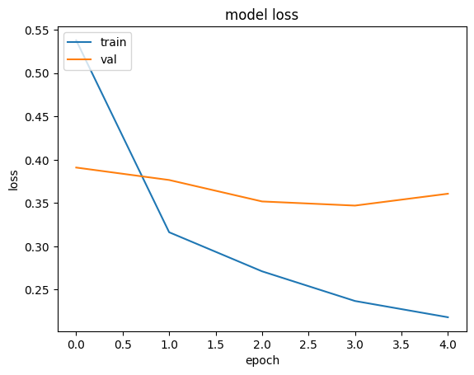
LSTM
Accuracy

Slide 11
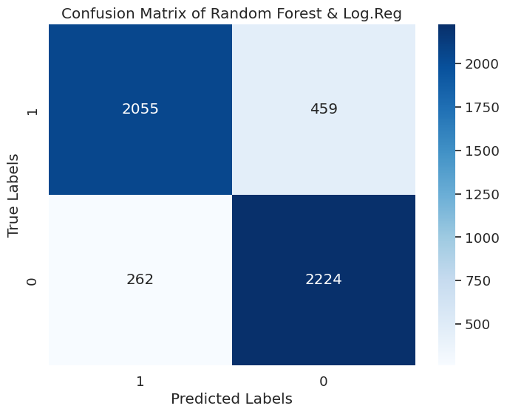
Ensemble approach : Log. Reg & Ran. Forest
Accuracy

Slide 12

Github:

