Slide 1
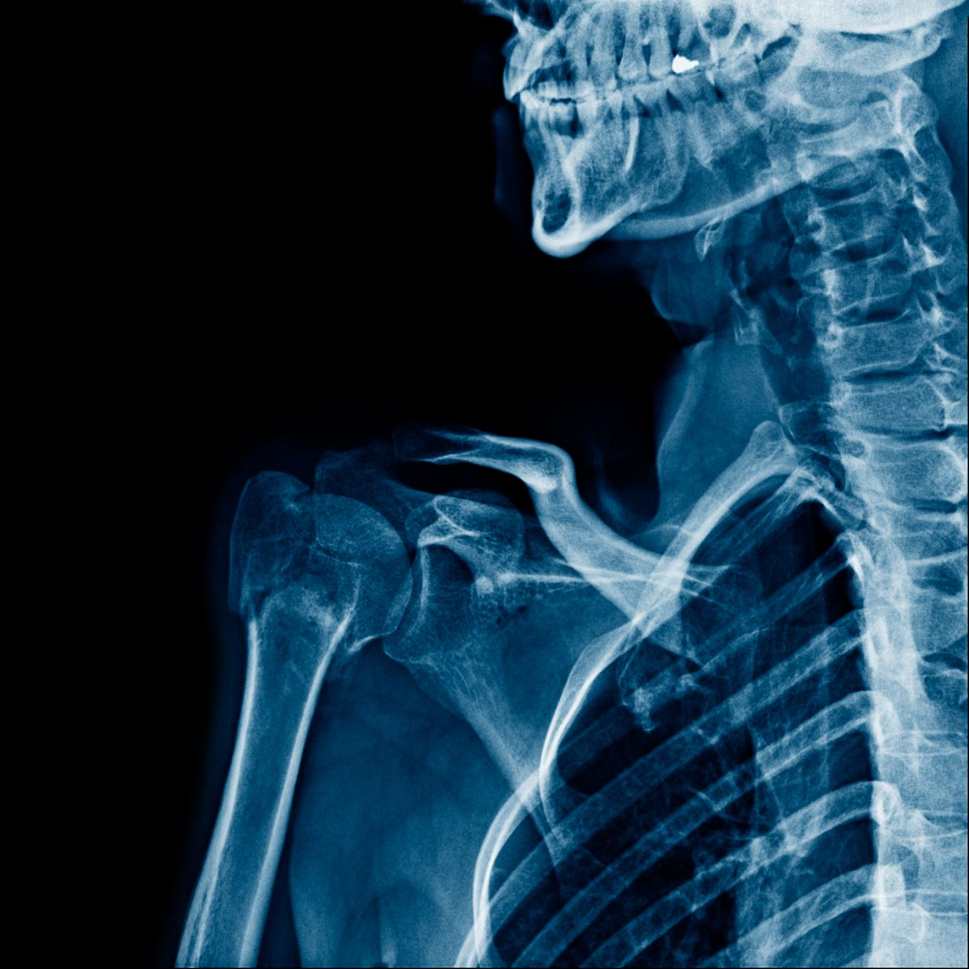

Lung x-ray

Slide 2
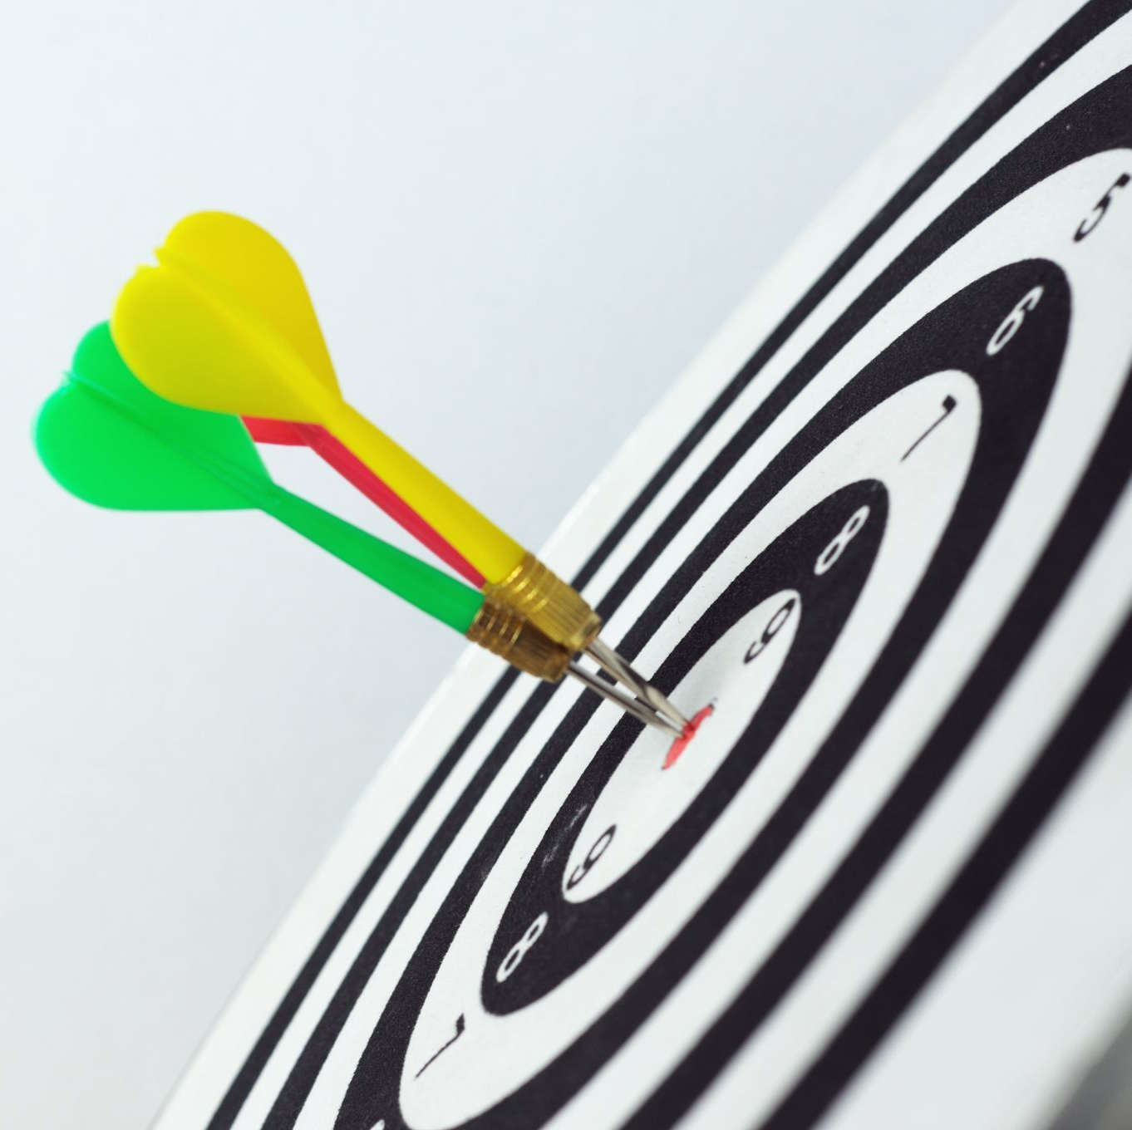
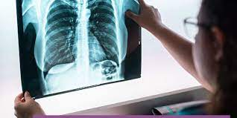
Goal
Image Classification or diagnostic for Lung X_Ray has 3 cases.

Slide 3
Problem Info
Covid : 0.25
Normal : 0.39
Virus : 0.36
Multiclass : 3 Labels
Train cases : 1195
Grayscale & RGB

Slide 4
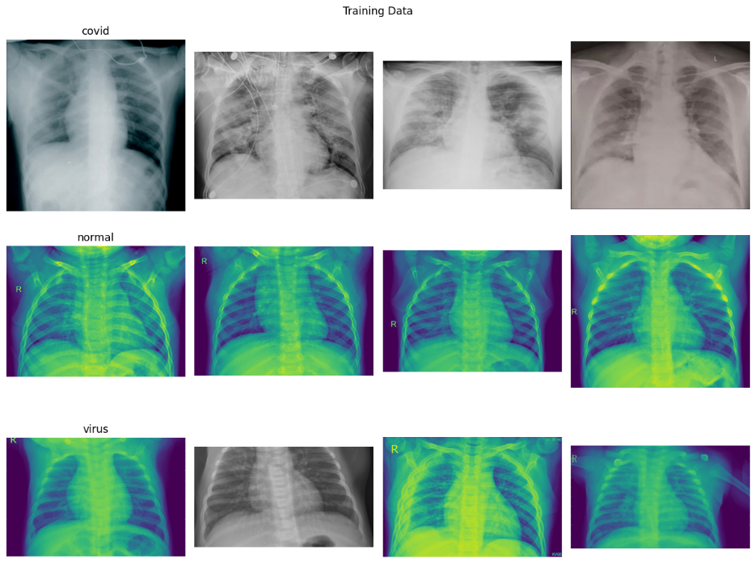
Different Shapes
Resizing the all into (224,224, 3) (RGB)
Categorical classes
Encoding using Label-Encoder
Small Data
Using pretrained model
Augmentation is possible to be good.

Slide 5
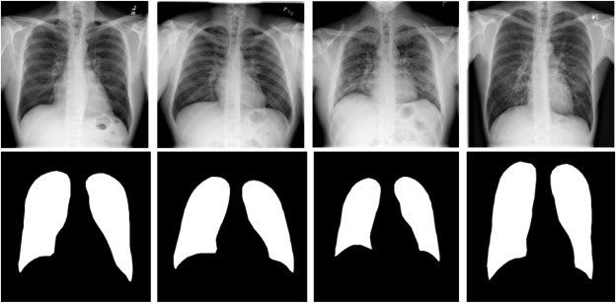
Normalization
WHAT ?
Convert values in range(0, 1)
WHY ?
Helps to learn faster and better

Slide 6
2 con2D 2 Max-Pool 2 Dense 2 Dropout
CNN Model

Slide 7
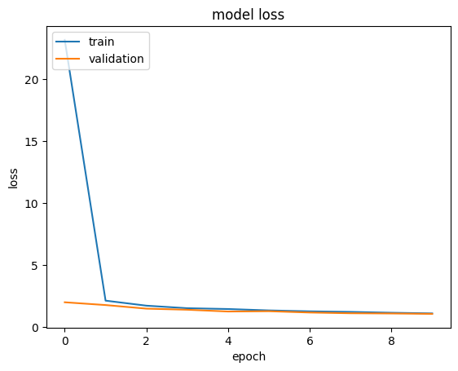
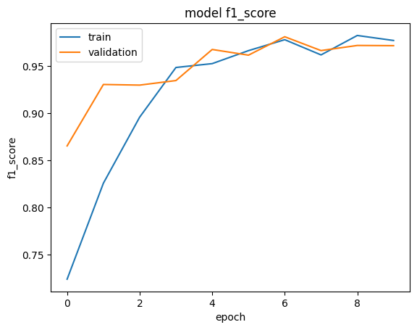
CNN RESULT

Slide 8

Performance

Slide 9

VGG16 algorithm
Freezing of all Layers except the output layer.
Adding Flatten & 1 Dense Layer.
Adding Dropout Layer.

Slide 10
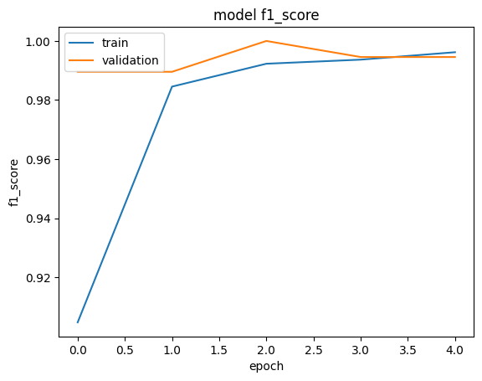
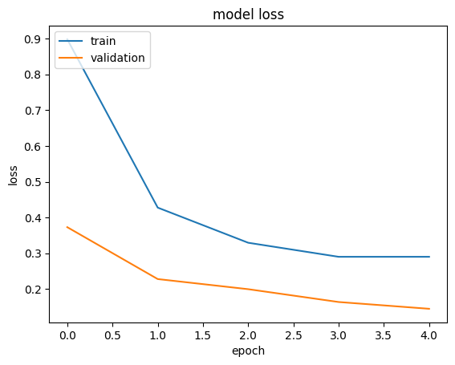
VGG16 Result

Slide 11

93.2%
VGG16

Slide 12

Toqa Ghozlan https://colab.research.google.com/drive/1gHvOHUHYRCLUb3bH8O3JF31E_NAamZfn?usp=sharing

