Slide 1
UBER TRIP INSIGHTS ANALYSIS Hossam Sherif Osama Mohamed

Slide 2
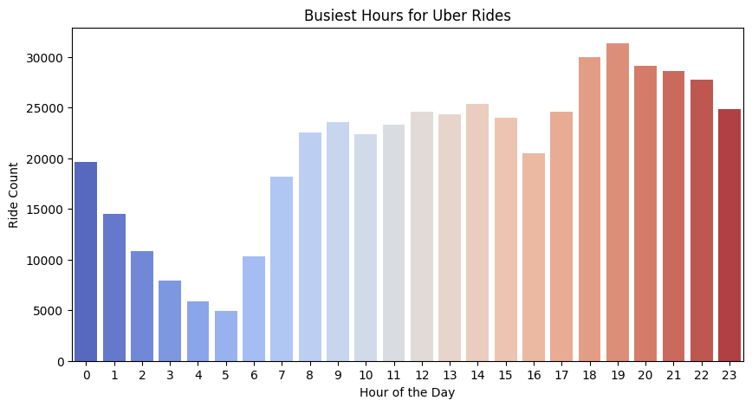
What are the busiest hours for Uber rides?
Busiest hours are typically during morning and evening rush hours.

Slide 3
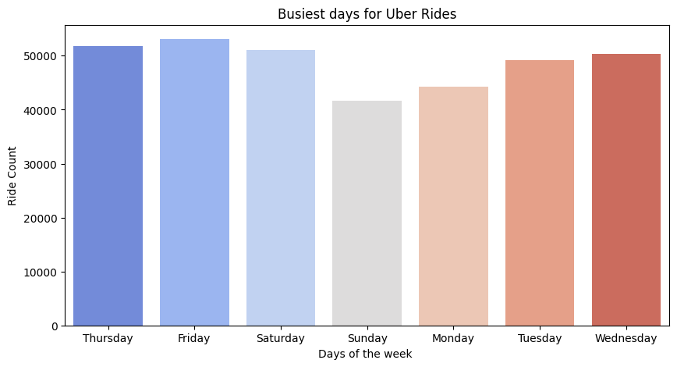
Which days have the highest and lowest ride demand?
Weekends tend to have the highest demand, while mid-week sees lower demand.

Slide 4
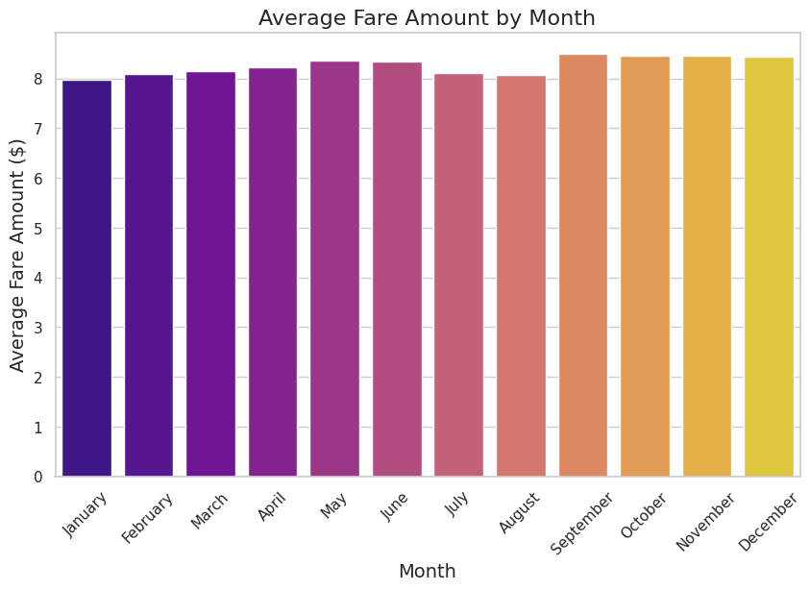
Which Month have the highest and lowest ride demand?

Slide 5
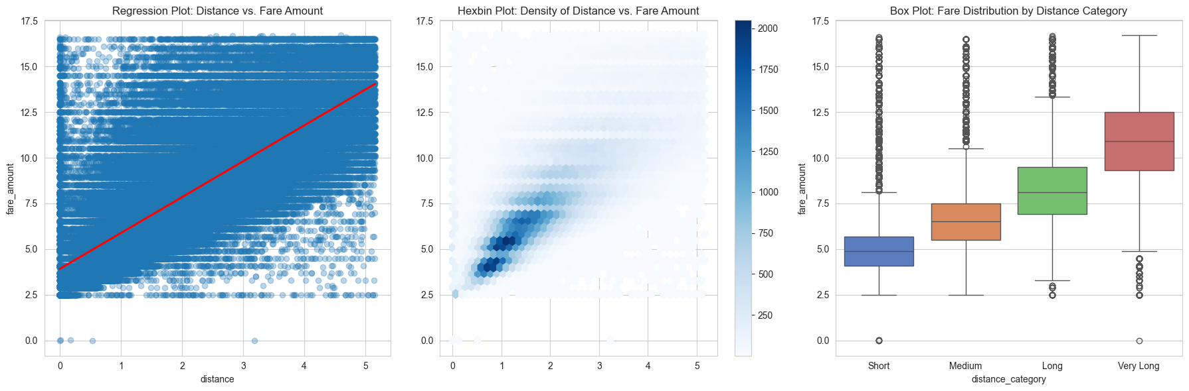
How does trip distance affect fare price?
Fares increase with distance, but surge pricing can introduce variability.

Slide 6
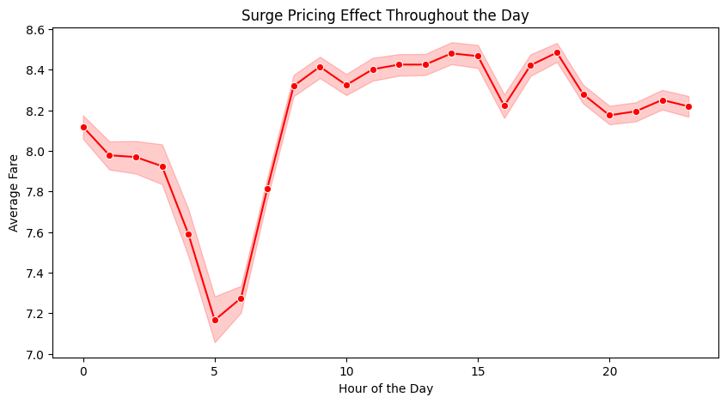
During which hours does Uber apply surge pricing the most?
Surge pricing is most common during peak hours and late-night periods.

Slide 7
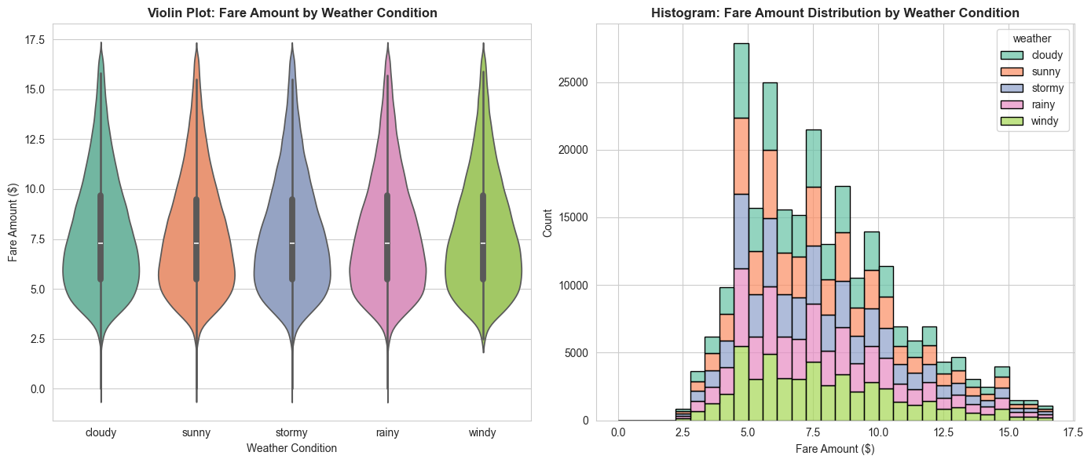
How do fares differ by weather condition
Weekend fares tend to be higher due to increased demand.

Slide 8
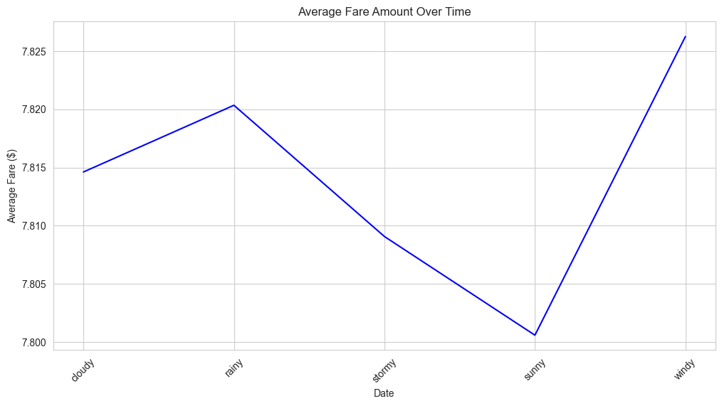
Average fare by weather?
Earnings are higher in windy and rainy days and low in sunny days

Slide 9
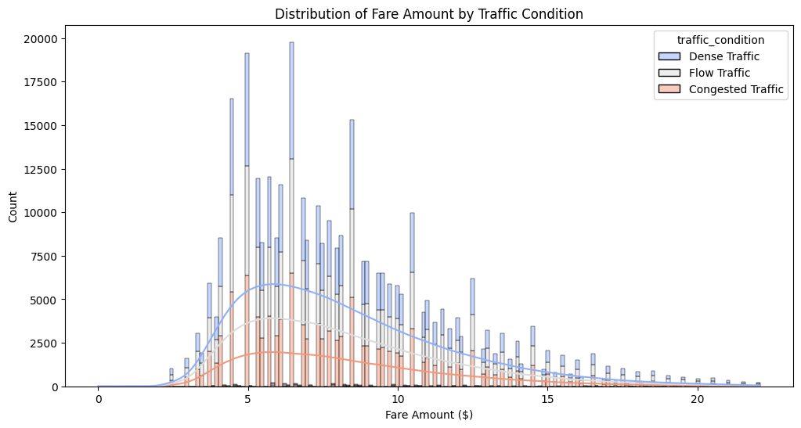
What is the effect of fare by traffic conditions?

Slide 10
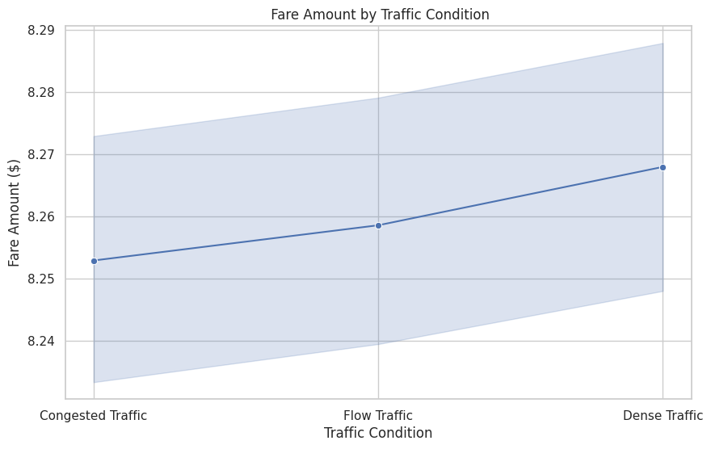

Slide 11

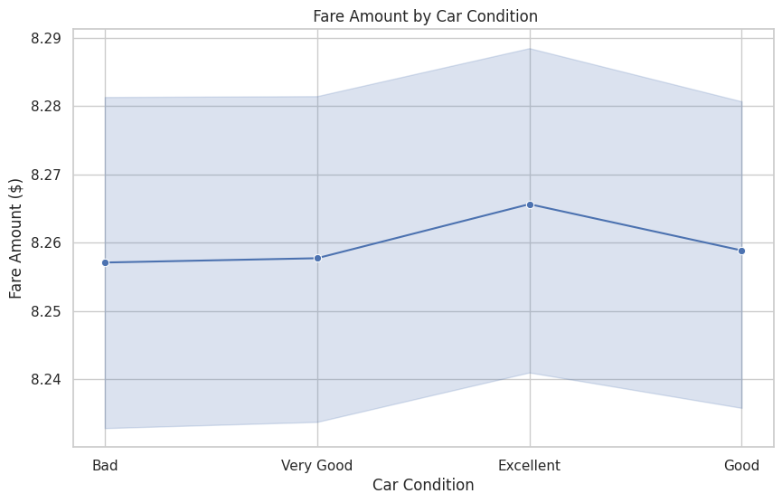



What is the effect of fare by Car conditions?

Slide 12
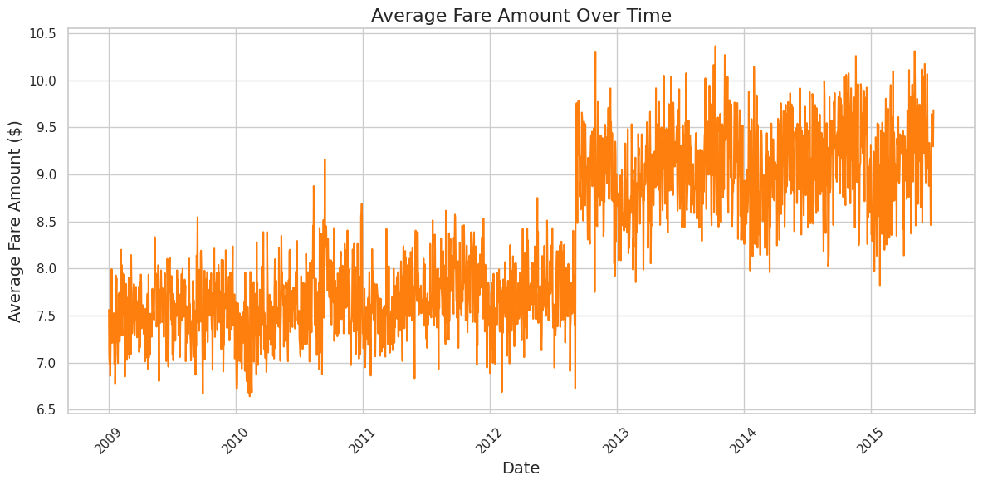
What is the effect of fare by Date?

Slide 13
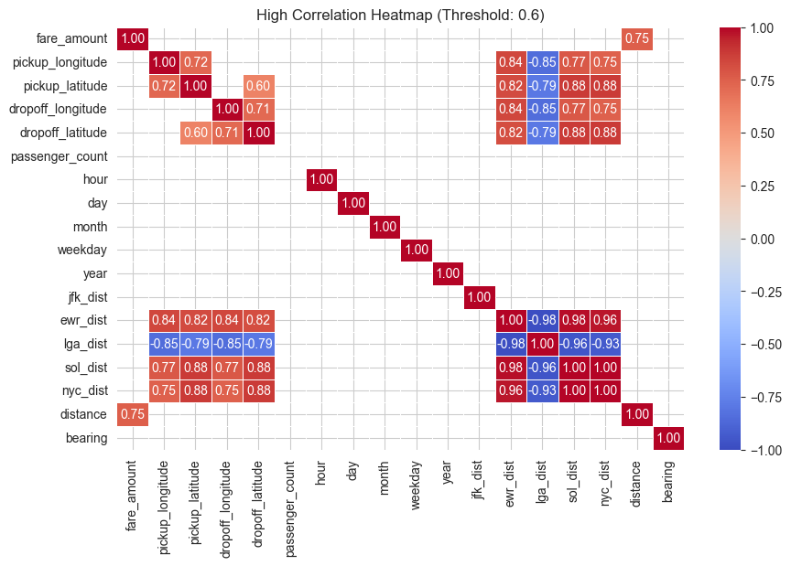
Correlations between data

