Slide 1





Smart Prescription Platform for Error-Free Healthcare

Slide 2
Team Members
Rahaf Ghozlan → Medical Doctor Student
Ala’a Motawe → Data science & AI Student
Dina al-Omari → Data science & AI Student
Aya Marwan → Data science & AI Student
Toqa Ghozlan → Data science & AI Student
Leader
Dr.Zeyad Hailat

Slide 3

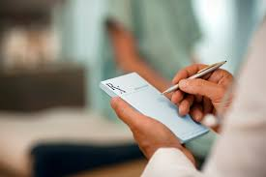
Introduction
Medical prescriptions contain critical information for patient care, but they are often handwritten, unstructured, and difficult to analyze. This project aims to digitize and structure handwritten medical prescriptions using advanced data processing techniques, making them easier to read and analyze. It focuses on recognizing different handwriting styles from doctors and pharmacists, especially to assist beginners

Slide 4
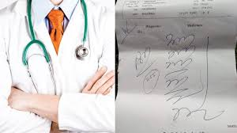
Problem Statement
Pharmacies frequently encounter challenges such as:
Illegible handwriting in prescriptions.
Difficulty in tracking medication trends and patient compliance.
Errors in dosage interpretation leading to potential health risks.
Lack of experience among beginner pharmacists.
Limited knowledge of alternative medications or possible contradictions and sensitivities between medicines.

Slide 5
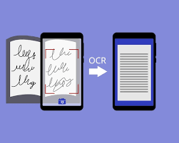
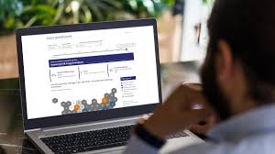
Methodology
1-Natural Language Processing (NLP)
Extract key prescription details such as drug name, dosage, frequency, doctor information, and patient details using NLP algorithms.
Standardize medical terminology to ensure consistency and improve data reliability.
MD-Hand-Written-Drug-Prescription Recognition
2- LLMs & Database Integration
Store structured prescription data in a relational database for efficient retrieval and analysis.
Implement analytical models to monitor prescription trends and predict medication demand.
Employ the power of pretrained Large Language Models (LLMs) to analyze different prescription text. E.g., identify generic names.
3- Visualization & User friendly UI
Provide real-time alerts for potential drug-drug interactions, contradictions, or dosage errors to enhance patient safety.
Desing and implement a mobile application that help patients
Develop interactive dashboards to track prescription patterns and insights.

Slide 6

Our Values
Improved Prescription Legibility and Accuracy
Enhanced clarity in reading prescriptions, reducing interpretation errors.
Enhanced Patient Safety
Whole knowledge of patient record
Detect whether there are contradictions or sensitivity of specific drug
Optimized Pharmacy Operations
Data-driven inventory management based on prescription trends.
Foundation for AI-Driven Medical Insights
Enables future automation and AI-based decision-making in prescription analysis.

Slide 7
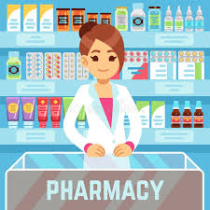
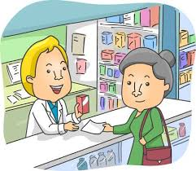
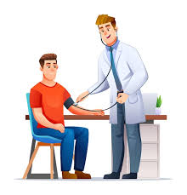
Target
Pharmacists
Patients
Doctors & Hospitals

Slide 8
Next Steps
Design MVP for the project and identify requirements
Collecting and labeling data
Train and Test ML/AI models
Design and implement mobile application / UI
Test the application and get feedback
Any enhancements
Deployment of the app and make it available in the app store

