Slide 1

www.consentguru.com
01 · THE BRIEF
Why Consent. Why DPDP.
Users should know what data is collected and why
Consent provides a clear record of the individual's choice
What is DPDP?
India's Digital Personal Data Protection Act, 2023
Provides a framework for processing digital personal data
Defines responsibilities of organisations processing personal data
Provides rights and protections for individuals
01
02
Users should be able to give, review and withdraw consent
Organisations need mechanisms to demonstrate and manage consent
03
04
DPDP Act specifically recognises the concept of a Consent Manager
India – DPDP Act: Explicitly recognises the Consent Manager concept
CONSENT GURU | Consent Management. Simplified.
www.consentguru.com
01 / 08

Slide 2
www.consentguru.com
02 · THE STAKES
DPDP Penalties: Up to ₹250 Crore
₹250 crore
Failure to implement reasonable security safeguards
₹200 crore
Failure to notify a personal data breach and certain child-data obligations
₹150 crore
Breach of specified Significant Data Fiduciary obligations
₹50 crore
Other specified breaches; ₹10,000 for specified Data Principal duties
Penalty amounts in ₹ crore as specified under the DPDP Act
CONSENT GURU | Consent Management. Simplified.
www.consentguru.com
02 / 08

Slide 3
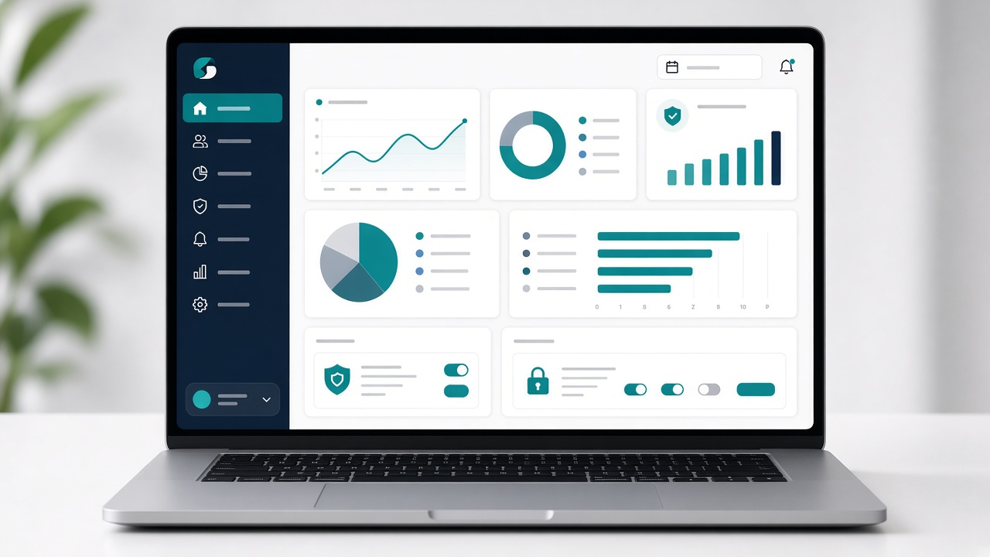
www.consentguru.com
03 · THE PRODUCT
What is Consent Guru?
A Consent Management Platform for organisations
01
Helps collect, record and manage user consent
02
Designed with the Indian privacy and DPDP ecosystem in mind
03
Provides a centralised platform for consent management
04
CONSENT GURU | Consent Management. Simplified.
www.consentguru.com
03 / 08

Slide 4
www.consentguru.com
04 · PRODUCT
Key Features of Consent Guru
Consent banner and preference centre
Consent collection, recording and withdrawal
Consent logs and audit trail
Website, cookie and third-party tracker management
01
02
03
04
Unique Features of Consent Guru
01
India-first consent management
02
Designed around the DPDP ecosystem
03
Centralised management of multiple websites
04
Simple implementation for organisations of different sizes
CONSENT GURU | Consent Management. Simplified.
www.consentguru.com
04 / 08

Slide 5
www.consentguru.com
05 · WHY US
Consent Guru vs other CMPs
Consent Guru differentiates through its India-first and DPDP-focused positioning
Consent Guru
OneTrust
Usercentrics
Cookiebot
Didomi
Consent Guru
India / DPDP-focused consent management
CookieYes
Global / SMB-oriented CMP
Complianz
Website / WordPress-oriented privacy solution
OneTrust and Usercentrics
Global enterprise/privacy platforms
CONSENT GURU | Consent Management. Simplified.
www.consentguru.com
05 / 08

Slide 6

www.consentguru.com
06 · GO LIVE
How to Install Consent Guru
Create your Consent Guru account
01
Add and configure your website
02
Configure consent categories, purposes and preferences
03
Add the Consent Guru script to your website
04
On the website
Clear options to Accept, Reject or Manage Preferences
Multiple websites
Add and manage multiple websites
One dashboard
Centralise consent configurations
CONSENT GURU | Consent Management. Simplified.
www.consentguru.com
06 / 08

Slide 7
www.consentguru.com
07 · OUTCOMES
Why Businesses Need Consent Guru
Simplify consent management
Maintain centralised consent records
01
02
Improve transparency and user control
Support organisational privacy and compliance processes
03
04
Collect
Record
Manage
Communicate
Withdraw
Audit
Collect → Record → Manage → Communicate → Withdraw → Audit · Consent is not simply a one-time checkbox
CONSENT GURU | Consent Management. Simplified.
www.consentguru.com
07 / 08

Slide 8

www.consentguru.com
08 · NEXT STEP
Experience Consent Guru
Your Data.
Your Consent.
Your Choice.
CONSENT GURU
Consent Management. Simplified.
Website: www.consentguru.in
www.consentguru.com
Email / Phone / Address: Add your official details
Questions?
CONSENT GURU | Consent Management. Simplified.
www.consentguru.com
08 / 08

