Slide 1
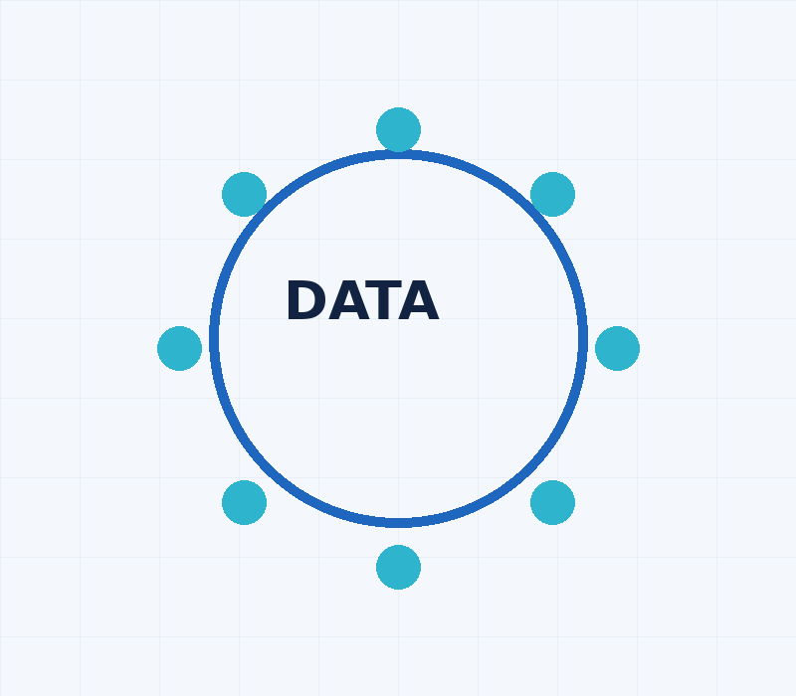
What is Data?
01
• Data is information relating to a person, organisation, device or activity
• It may be collected directly, indirectly or generated through digital activity
• Websites and applications continuously collect and process data
• Data is an important digital and business asset
CONSENT GURU | Consent Management. Simplified.
1/25

Slide 2
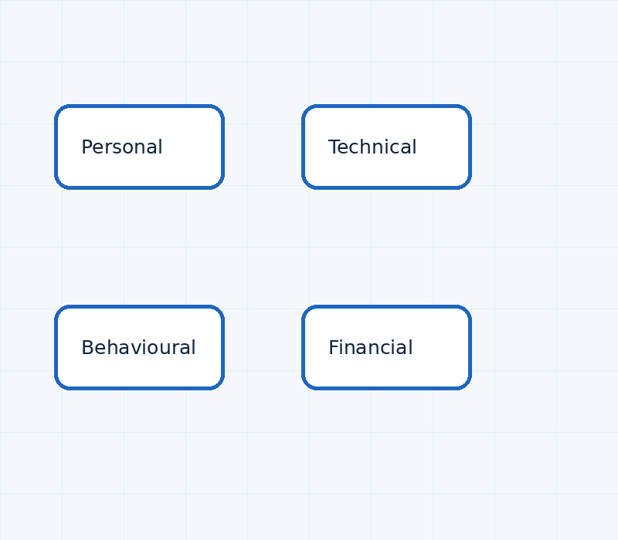
Types of Data
02
• Personal Data: Name, email, phone number, address, identifiers
• Financial / Health / Biometric Data: Higher-risk categories of personal information
• Technical Data: IP address, device, browser, cookies and logs
• Behavioural Data: Preferences, browsing, clicks, searches and interactions
CONSENT GURU | Consent Management. Simplified.
2/25

Slide 3
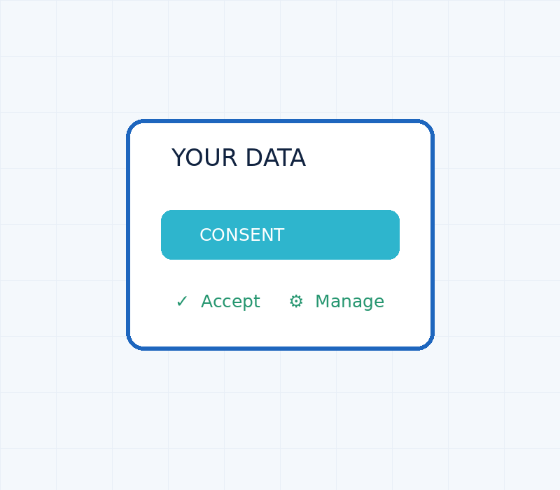
Why is Consent Needed?
03
• Users should know what data is collected and why
• Consent provides a clear record of the individual's choice
• Users should be able to give, review and withdraw consent
• Organisations need mechanisms to demonstrate and manage consent
CONSENT GURU | Consent Management. Simplified.
3/25

Slide 4
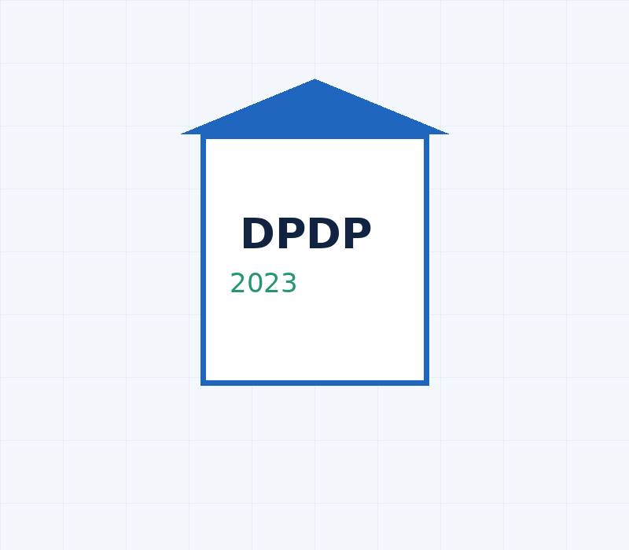
What is DPDP?
04
• India's Digital Personal Data Protection Act, 2023
• Provides a framework for processing digital personal data
• Defines responsibilities of organisations processing personal data
• Provides rights and protections for individuals
CONSENT GURU | Consent Management. Simplified.
4/25

Slide 5
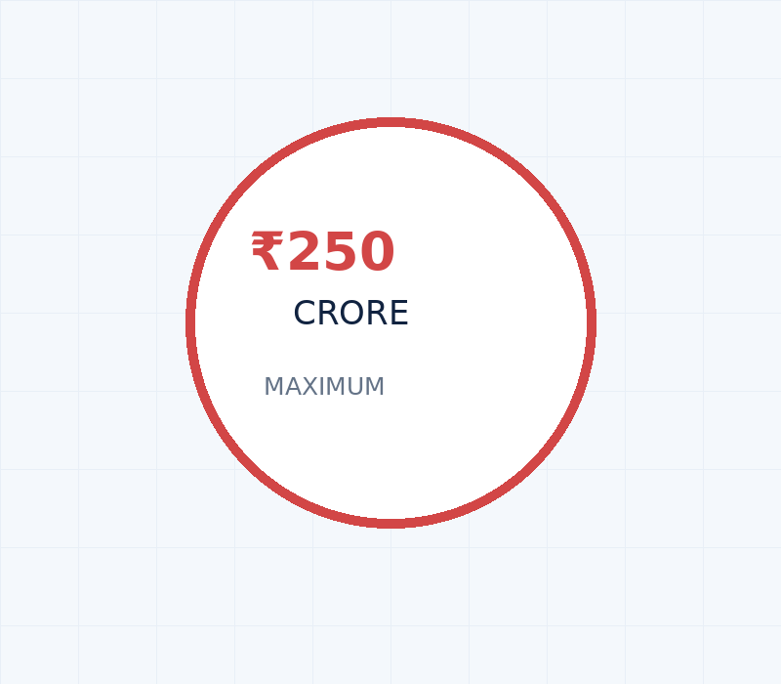
DPDP Penalties: Up to ₹250 Crore
05
• ₹250 crore: Failure to implement reasonable security safeguards
• ₹200 crore: Failure to notify a personal data breach and certain child-data obligations
• ₹150 crore: Breach of specified Significant Data Fiduciary obligations
• ₹50 crore: Other specified breaches; ₹10,000 for specified Data Principal duties
CONSENT GURU | Consent Management. Simplified.
5/25

Slide 6
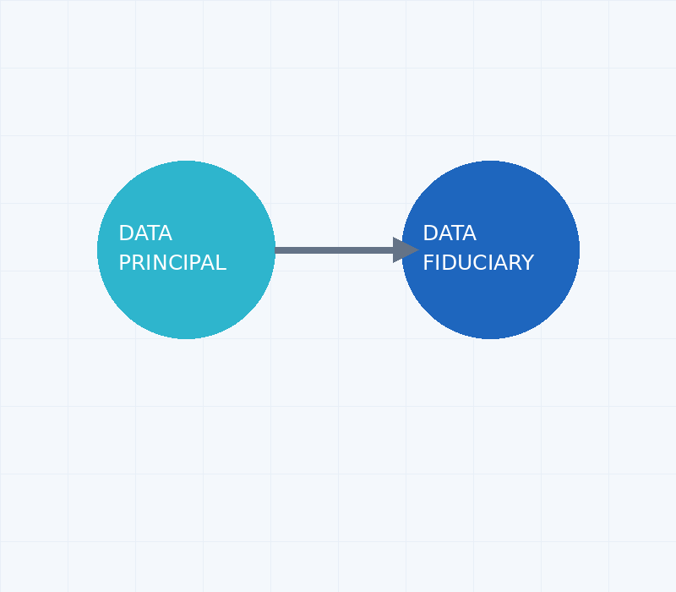
Data Principal & Data Fiduciary
06
• Data Principal: The individual to whom the personal data relates
• Data Fiduciary: The organisation determining the purpose and means of processing
• Example: Customer = Data Principal; e-commerce company = Data Fiduciary
• The Data Fiduciary has obligations under the DPDP Act
CONSENT GURU | Consent Management. Simplified.
6/25

Slide 7
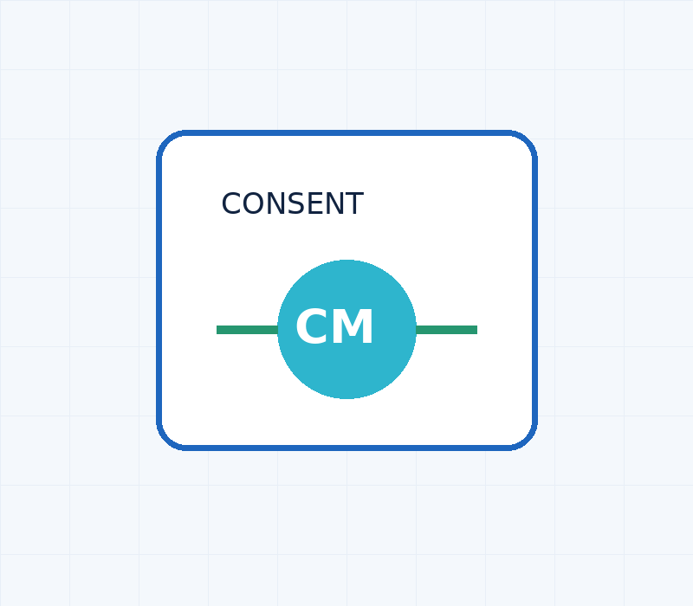
What is a Consent Manager?
07
• A technology layer that helps individuals manage their consent
• Enables users to give, review and withdraw consent
• Maintains records of consent and user preferences
• Helps organisations manage consent-related processes
CONSENT GURU | Consent Management. Simplified.
7/25

Slide 8
What Does DPDP Say About Consent Manager?
08
• DPDP Act specifically recognises the concept of a Consent Manager
• Enables a Data Principal to give, manage, review and withdraw consent
• May act as an intermediary between Data Principal and Data Fiduciary
• Subject to registration and prescribed requirements
CONSENT GURU | Consent Management. Simplified.
8/25

Slide 9
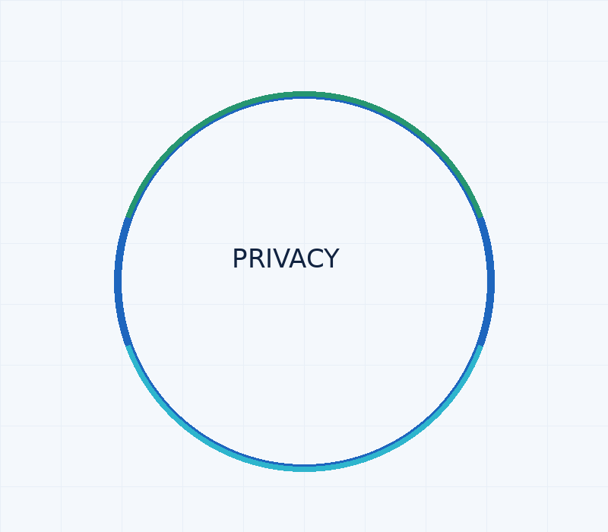
Global Privacy Laws & Consent Management
09
• India – DPDP Act: Explicitly recognises the Consent Manager concept
• EU – GDPR: Requires valid and demonstrable consent where consent is the legal basis
• Brazil – LGPD: Provides requirements concerning consent and withdrawal
• South Africa – POPIA: Establishes consent and lawful-processing requirements
CONSENT GURU | Consent Management. Simplified.
9/25

Slide 10
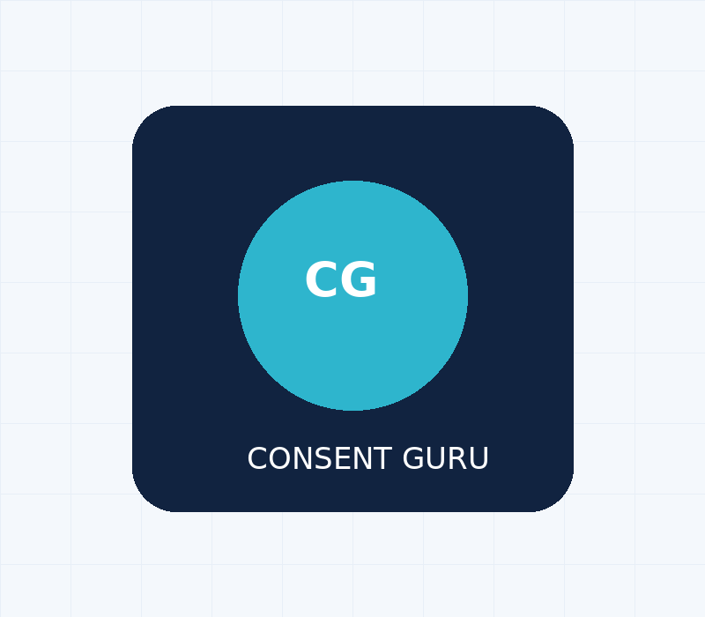
What is Consent Guru?
10
• A Consent Management Platform for organisations
• Helps collect, record and manage user consent
• Designed with the Indian privacy and DPDP ecosystem in mind
• Provides a centralised platform for consent management
CONSENT GURU | Consent Management. Simplified.
10/25

Slide 11
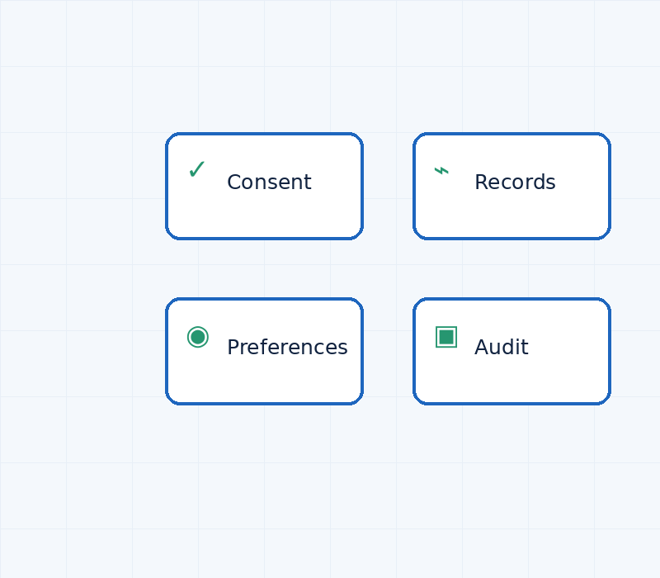
Key Features of Consent Guru
11
• Consent banner and preference centre
• Consent collection, recording and withdrawal
• Consent logs and audit trail
• Website, cookie and third-party tracker management
CONSENT GURU | Consent Management. Simplified.
11/25

Slide 12
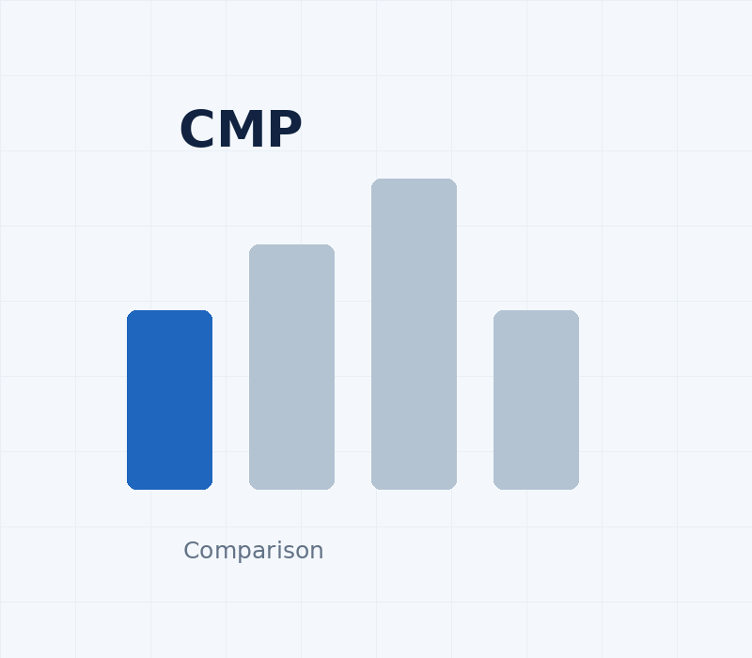
Consent Guru vs Global CMPs
12
• Consent management: Consent Guru, OneTrust, Usercentrics, Cookiebot and Didomi
• Consent records and audit capabilities are common across leading CMPs
• Multi-website management is available across major CMP platforms
• Consent Guru differentiates through its India-first and DPDP-focused positioning
CONSENT GURU | Consent Management. Simplified.
12/25

Slide 13
Consent Guru vs CMPs in India
13
• Consent Guru: India / DPDP-focused consent management
• CookieYes: Global / SMB-oriented CMP
• Complianz: Website / WordPress-oriented privacy solution
• OneTrust and Usercentrics: Global enterprise/privacy platforms
CONSENT GURU | Consent Management. Simplified.
13/25

Slide 14
Unique Features of Consent Guru
14
• India-first consent management
• Designed around the DPDP ecosystem
• Centralised management of multiple websites
• Simple implementation for organisations of different sizes
CONSENT GURU | Consent Management. Simplified.
14/25

Slide 15
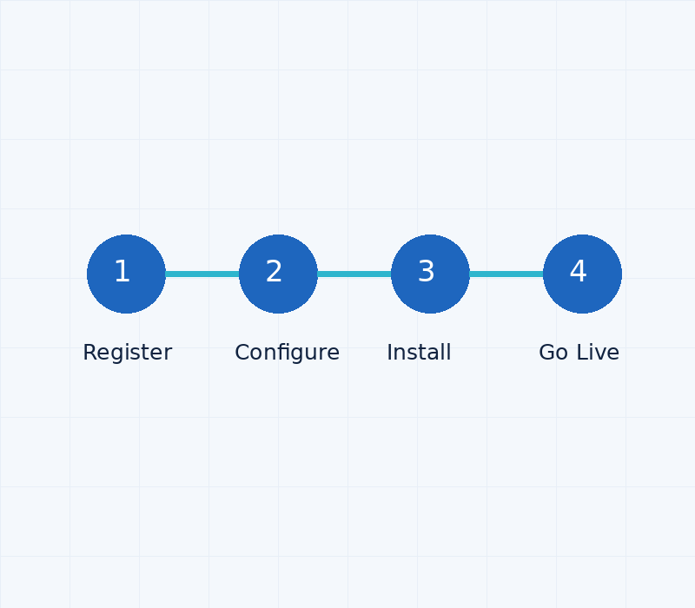
How to Install Consent Guru
15
• Create your Consent Guru account
• Add and configure your website
• Configure consent categories, purposes and preferences
• Add the Consent Guru script to your website
CONSENT GURU | Consent Management. Simplified.
15/25

Slide 16
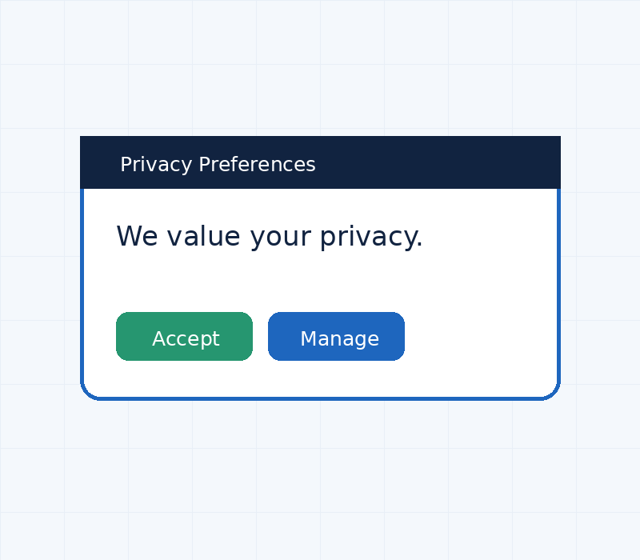
How Does It Look on Your Website?
16
• Privacy / consent notification displayed to website visitors
• Clear options to Accept, Reject or Manage Preferences
• Users can access their preferences again
• Interface can be aligned with website branding
CONSENT GURU | Consent Management. Simplified.
16/25

Slide 17
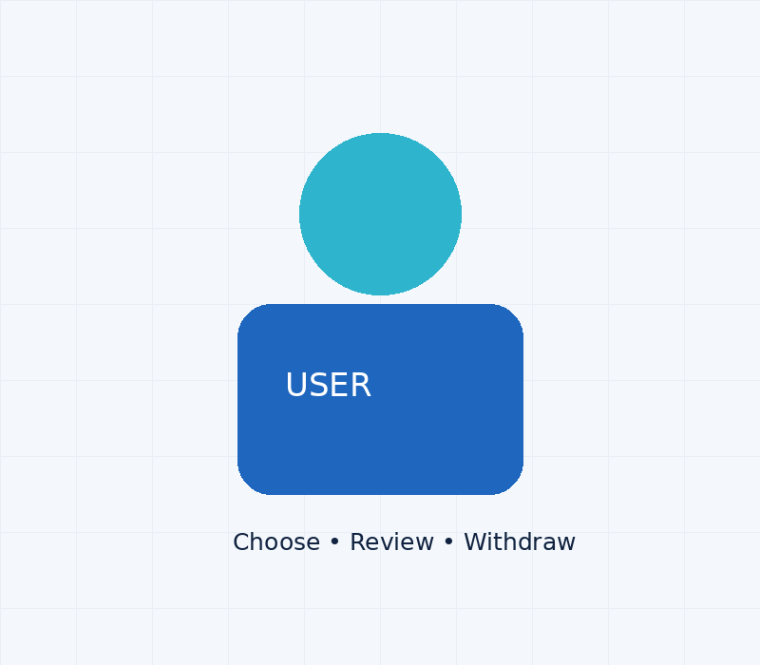
What Can the User Do?
17
• Understand what data and cookies are being used
• Accept or reject applicable categories
• Provide granular consent where applicable
• Review or withdraw consent later
CONSENT GURU | Consent Management. Simplified.
17/25

Slide 18

What Can the Administrator Do?
18
• Configure consent categories and purposes
• Manage websites and consent settings
• View consent records and activity
• Generate reports for compliance and audit
CONSENT GURU | Consent Management. Simplified.
18/25

Slide 19
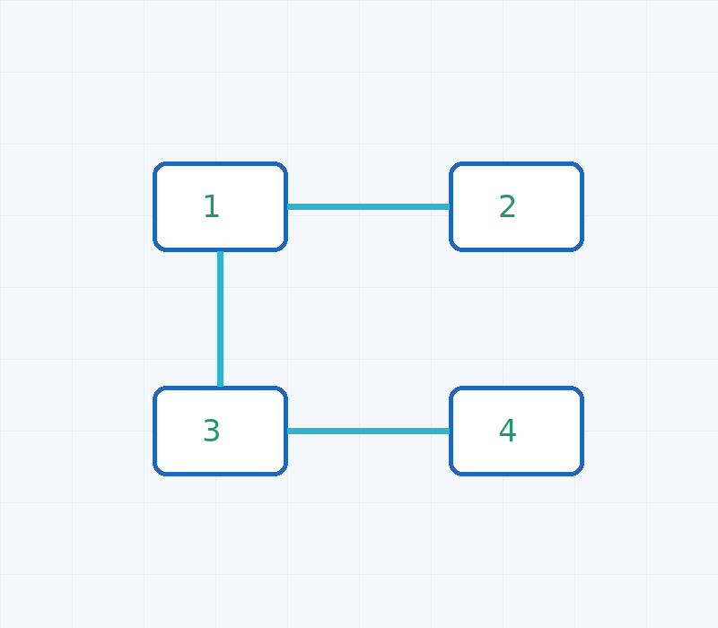
Multiple Websites. One Dashboard.
19
• Add and manage multiple websites
• Centralise consent configurations
• Monitor consent activity across domains
• Suitable for organisations with multiple brands and portals
CONSENT GURU | Consent Management. Simplified.
19/25

Slide 20
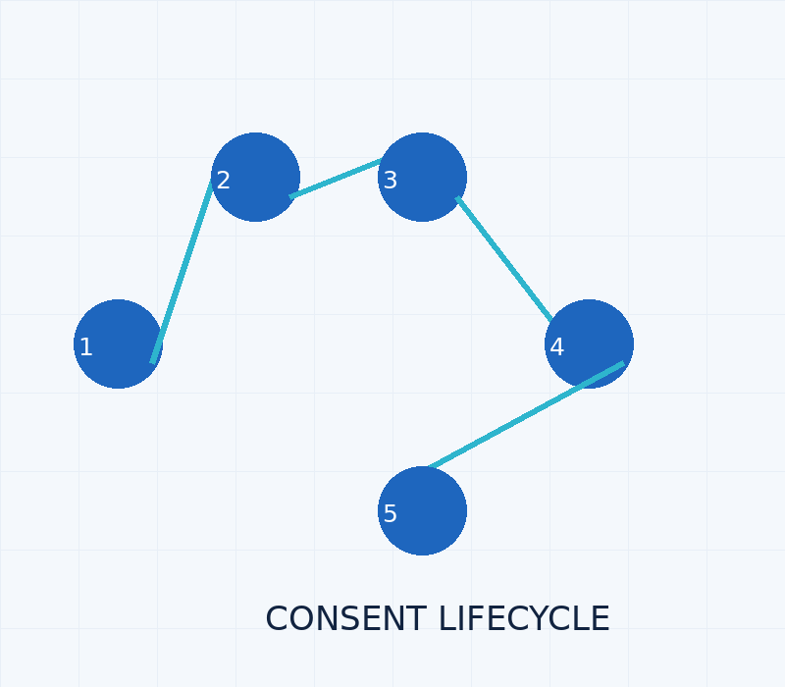
The Consent Lifecycle
20
• Collect → Record → Manage → Communicate → Withdraw → Audit
• Consent is not simply a one-time checkbox
• User preferences can change over time
• Consent events should remain traceable
CONSENT GURU | Consent Management. Simplified.
20/25

Slide 21
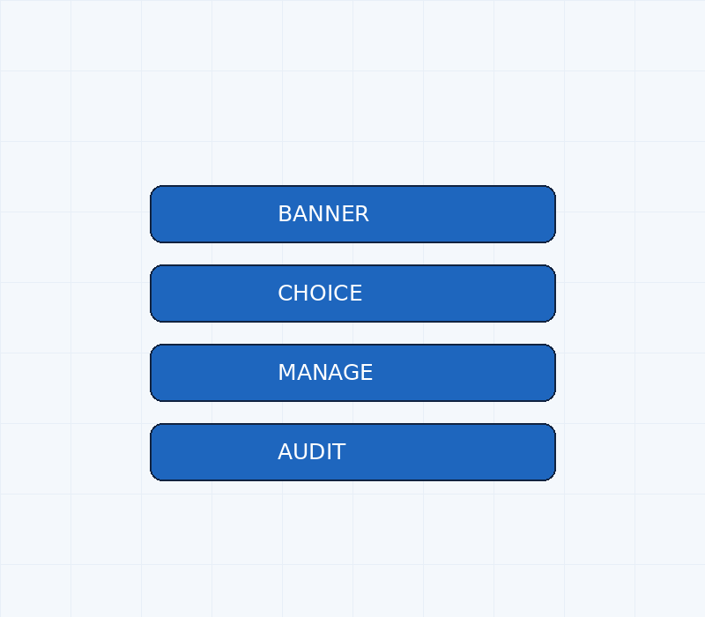
From Cookie Banner to Consent Infrastructure
21
• Traditional approach: Show a banner
• Modern approach: Capture user choice
• Better approach: Respect and manage that choice
• Enterprise approach: Collect → Manage → Enforce → Demonstrate
CONSENT GURU | Consent Management. Simplified.
21/25

Slide 22

Why Businesses Need Consent Guru
22
• Simplify consent management
• Maintain centralised consent records
• Improve transparency and user control
• Support organisational privacy and compliance processes
CONSENT GURU | Consent Management. Simplified.
22/25

Slide 23
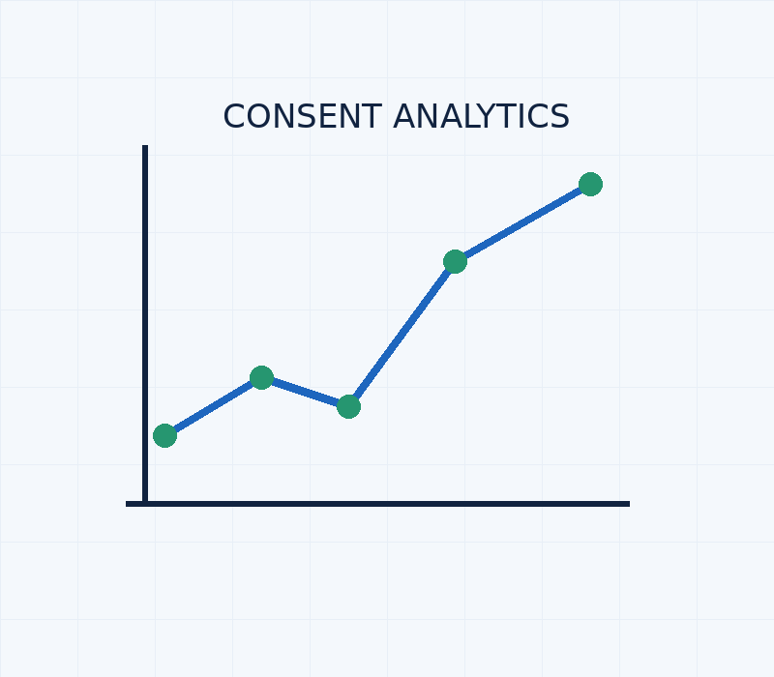
Privacy Centre & Consent Analytics
23
• Privacy notice and consent management
• Cookie and preference management
• Who, when, what purpose and withdrawal history
• Centralised visibility for privacy teams and administrators
CONSENT GURU | Consent Management. Simplified.
23/25

Slide 24
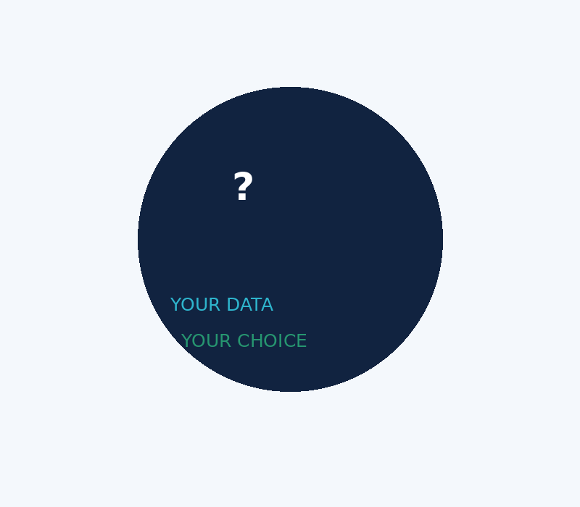
Questions?
24
• Your Data.
• Your Consent.
• Your Choice.
• Experience Consent Guru
CONSENT GURU | Consent Management. Simplified.
24/25

Slide 25
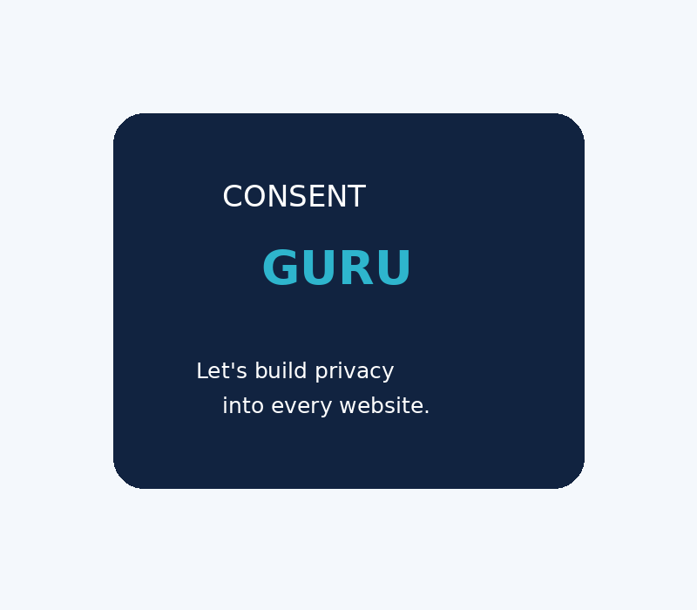
Contact Us
25
• CONSENT GURU
• Consent Management. Simplified.
• Website: www.consentguru.in
• Email / Phone / Address: Add your official details
CONSENT GURU | Consent Management. Simplified.
25/25

