Slide 1

Bitcoin analysis
Optimized Machine Learning To Predict Bitcoin’s Market Value

Slide 2

Can we use the daily weighted average price and volume of trades to predict what the price will be at a certain point in the future?
BUY
SELL
HOLD

Slide 3
Technologies used
Jupyter Notebook

Slide 4
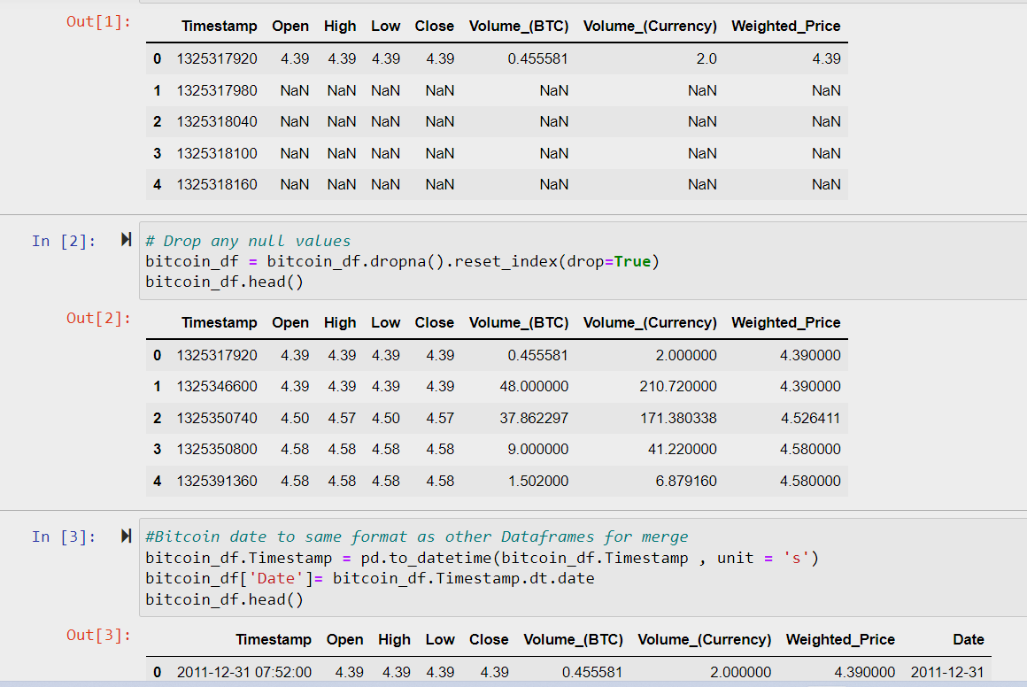
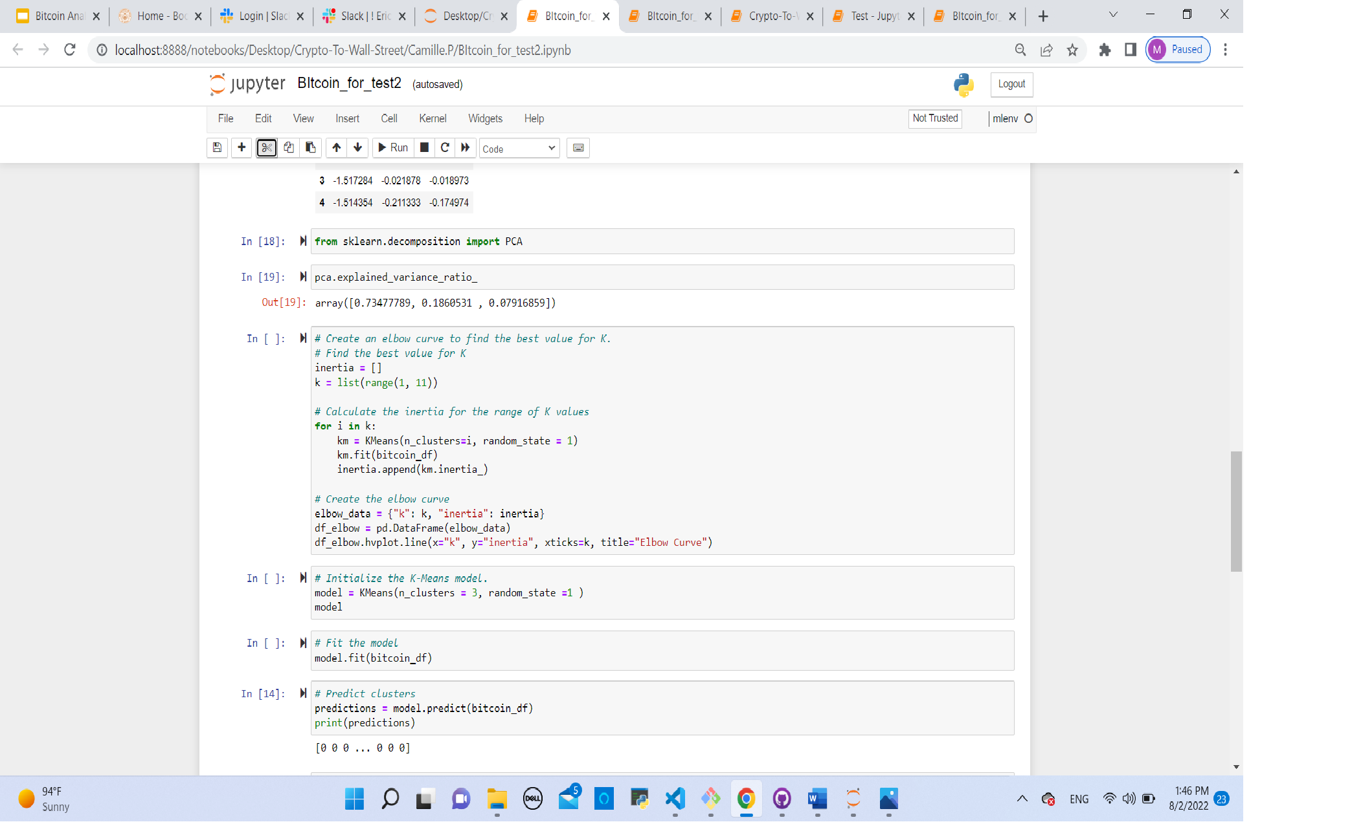
Bitcoin Kaggle data

Slide 5
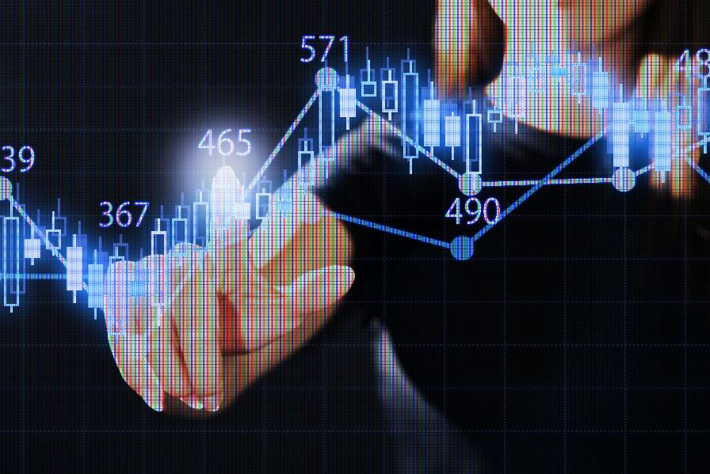
Machine learning models
LinearRegression
K-Means

Slide 7
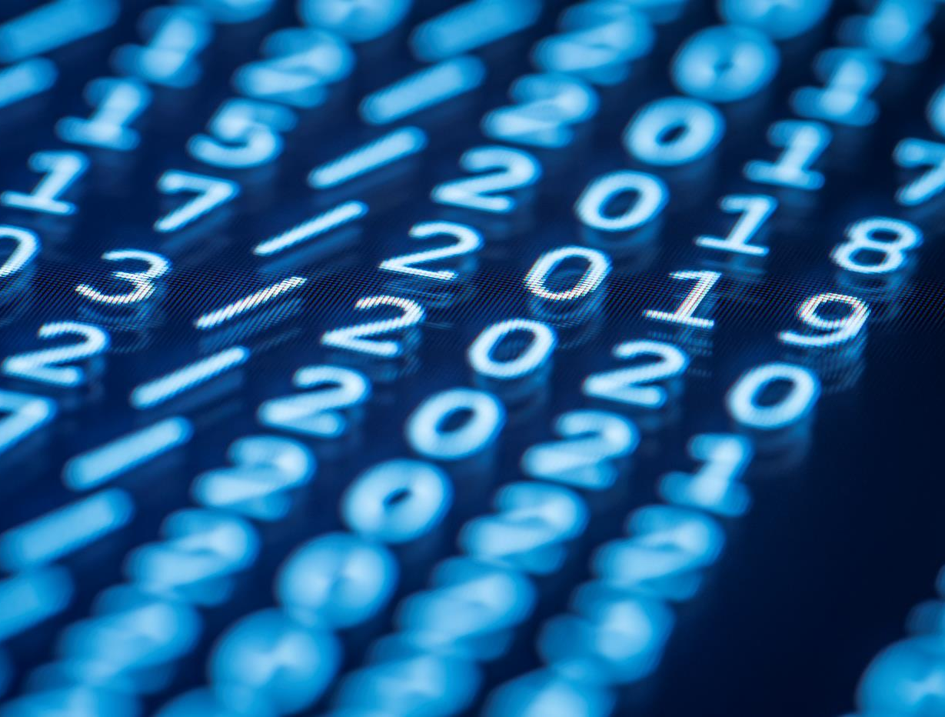
Thank You
Eric bou
Camille pena
Tori Bartley
Kyle kato

Slide 8
Digital Communications
Cloud
Local
Hybrid

Slide 9
OVERVIEW
future?

Slide 10
Thank You
someone@example.com

