Slide 1
Farmers Market App
Presented by: Bradley Bouchard & Kevin Naval

Slide 2
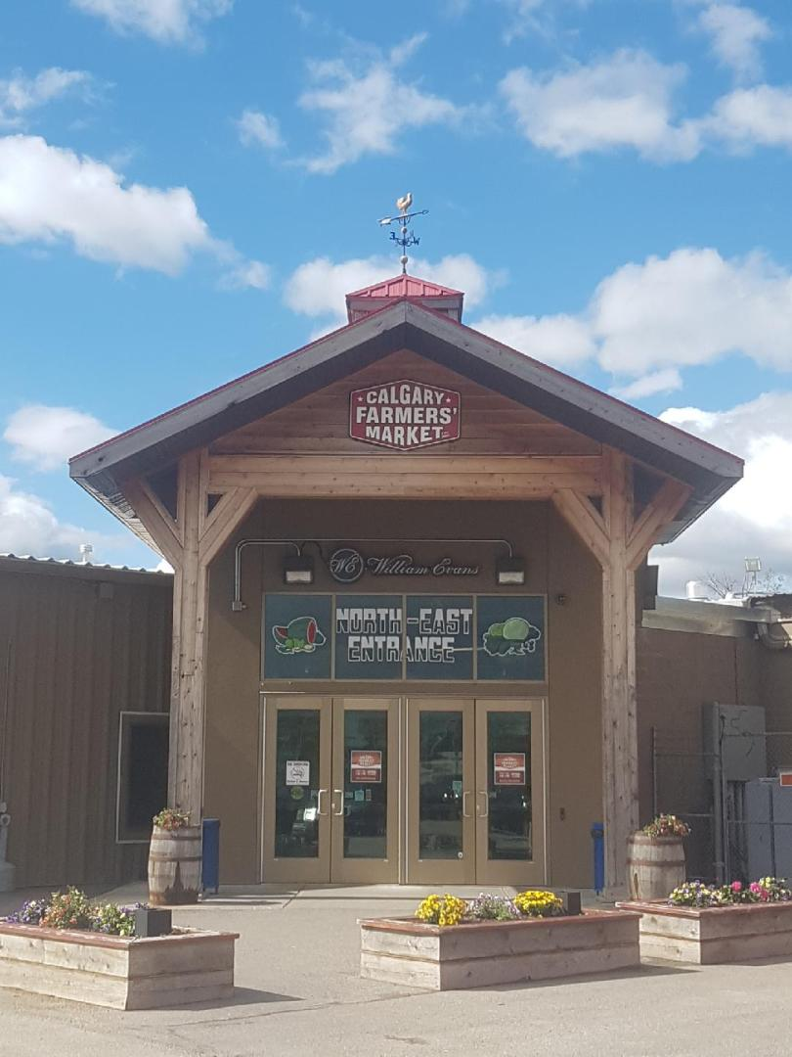
Who is this presentation/project for?
Owner/Operator of the Farmers Market

Slide 3
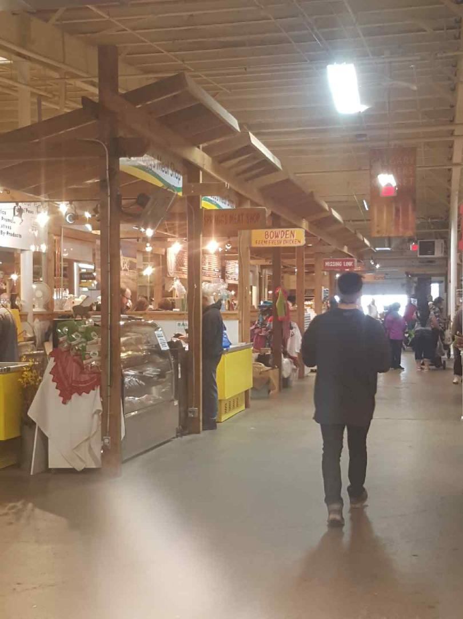
Design Problem
No real layout
Farmers struggle to advertise their location
Cash-only
No stall order

Slide 4
Who are we designing for?
Farmers selling their product
Consumers

Slide 5
User Research
Observation
How consumers and vendors interact at a farmer’s market
Slow process
Consumers often window shop due to lack of information
Try it Yourself
To gain a consumer’s perspective during a transaction
Some strongly prefer cash (unfamiliarity with debit transactions)
Vendors loudly advertise to attract passers-by
Camera Journal
Allows to see the finer details of the environment that memories and notes would have missed

Slide 6
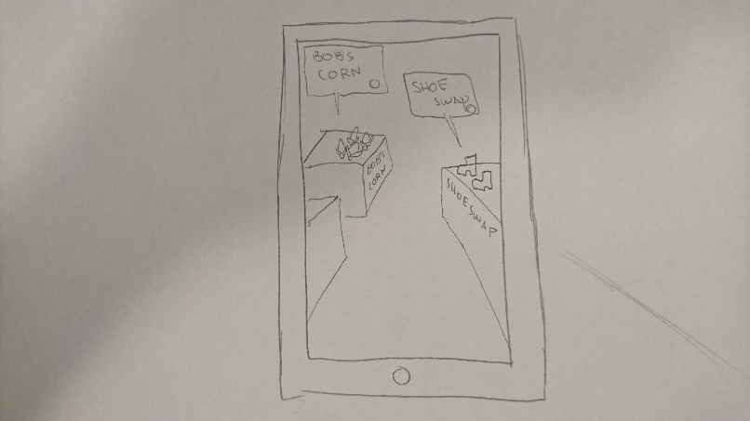
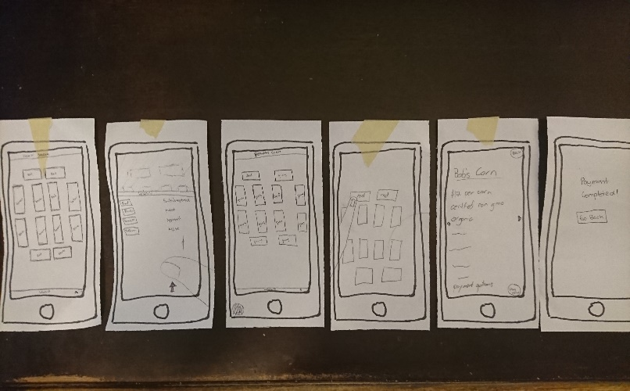
Design Decisions
Paper Prototyping
Market Go!
Unladen Swallow Delivery Service
Trebuchet Delivery
Storyboard
Interactive map
Simply search function
Vendor information/advertising
Vendor Product List
Product information

Slide 7
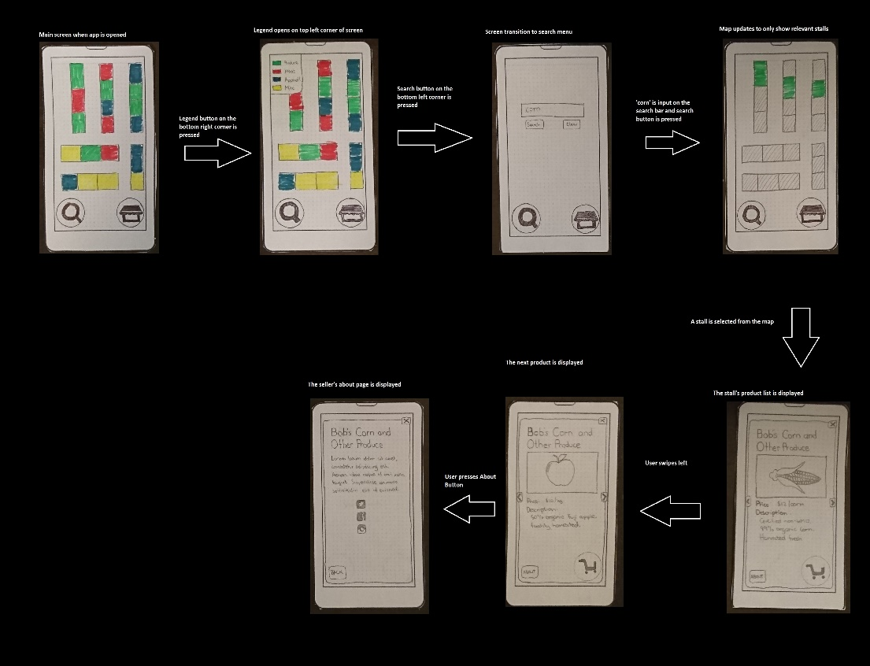
Final System

Slide 8
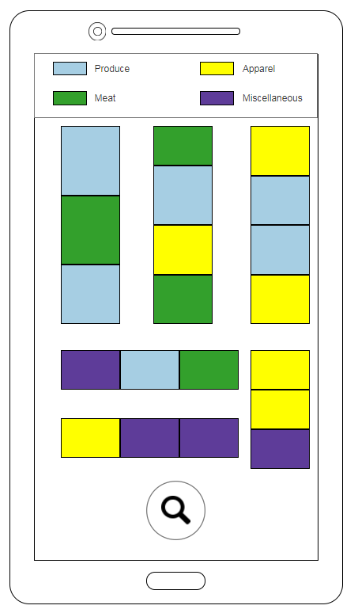
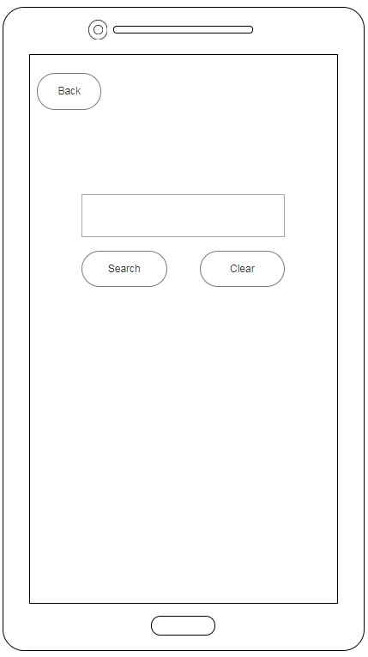
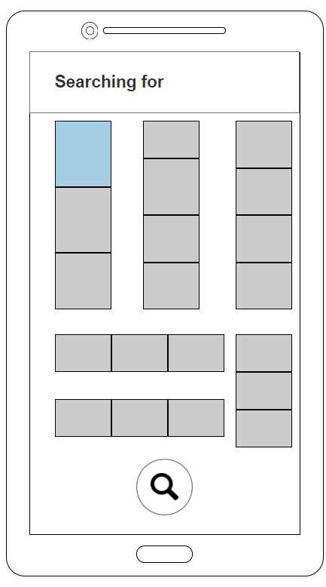
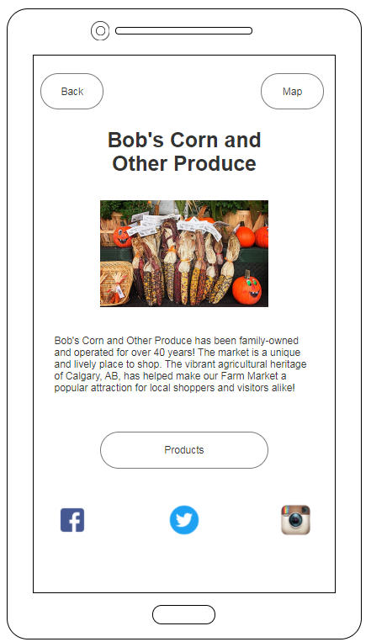
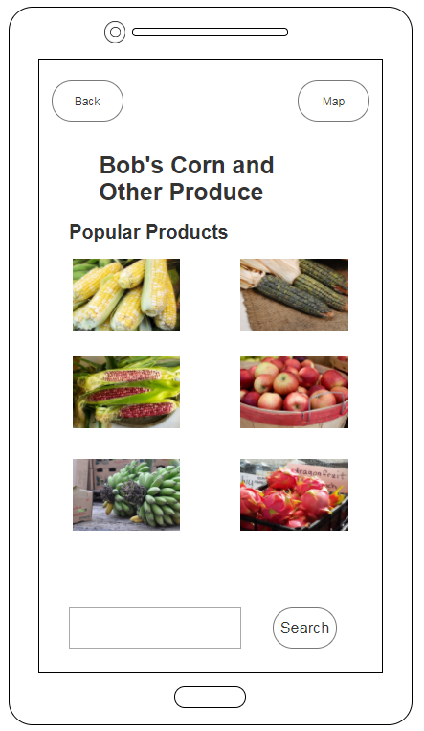
Final System

Slide 9
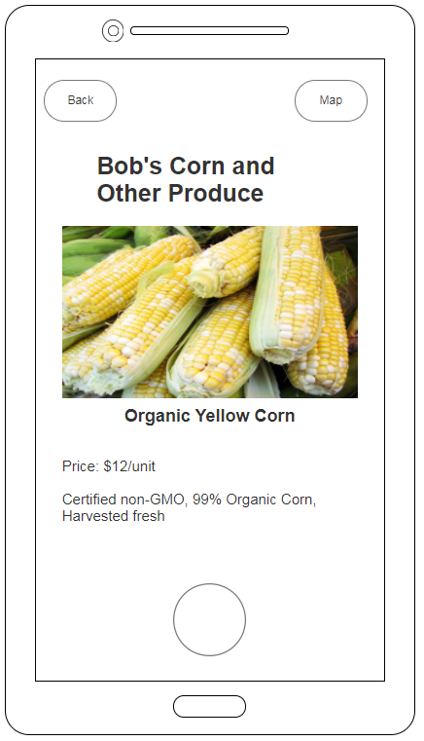
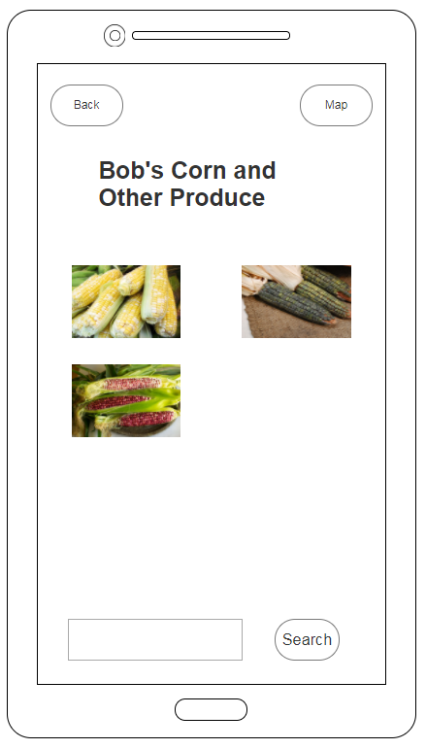
Final System

Slide 10
Heuristic Evaluation
Vague main menu
No markers
No error messages
Does not return appropriate error messages on invalid actions
Weak documentation
No direction

Slide 11
Future Iterations
Add exits, entrances, atm locations in the map (more details)
Implement appropriate error messages
Implement help section/settings

