Slide 1
Open Shortest Path First
(OSPF)
Learning Outcomes:
  Foundation
  Inter Router Communication
  Network Types
  Neighbors
  DR/BDR
  OSPF Configuration
  Verification

Slide 2
1. Foundation
Link State routing protocol, sends link state(up/down) and link metric to neighbors
Non-proprietary IGP
OSPFv2 supports IPv4
OSPFv3 modified original to support IPv6
Administrative Distance (AD) 110
Dijkstra's SPF algorithm

Slide 3
1. Foundation
OSPF floods Link State Advertisements (LSA) to share link state and metric
Every OSPF router builds Link State Database (LSDB) from received LSAs.
LSDB provides complete topology view of the network to the OSPF router.
OSPF routers run Dijkstra Shortest Path First (SPF) algorithm on LSDB to create a shortest path loop free topology.
Such topology is SPF Tree (SPT) with each router as root of the tree.
LSDB is identical for each router, but SPT is different.

Slide 4
1. Foundation
OSPF uses Areas to provide scalability.
Routers in single OSPF Area has identical LSDB.
OSPF Areas are two tier hierarchial architecture
Tier 1/Area 0/ Backbone
Tier 2/ Area non-zero/non-backbone
All non-backbone areas are connected to backbone and inter non-backbone communication is via backbone area.
OSPF runs as a process in routers and is identified with process number.
Each OSPF processes in a router are independent and routing information between processes is only shared if redistributed.
The process identifier from router to router does not need to match.
OSPF processes within the router or between routers are uniquely identified with Router ID (RID)

Slide 5
2. Inter Router Communication
OSPF runs directly over IPv4 with protocol number 89
Multicast traffic to:
  AllSPF Routers: 224.0.0.5 or MAC 01:00:5E:00:00:05
  DR & BDR: 224.0.0.6 or MAC 01:00:5E:00:00:06.
5 Packet Types
Packet Type | Packet Name | Function
1 | HELLO | Used for discovery and reachability of the neighbors (Multicast)
2 | Database Descriptors (DBD) or (DDP) | Contains summary of LSDB content. Exchanged while forming adjacency.
3 | Link-state Request (LSR) | After analyzing DBDs while forming adjacency, Link-state Request packets are sent to request any missing LSA's in LSDB.
4 | Link-state Update (LSU) | Requested LSA's are wrapped in Link-state Update packets and sent.
5 | Link-state ACK | Acknowledgement for LSU. Unlike Seq.no. in TCP Acks, this packet contains header of LSA's that were received in LSU.

Slide 6
3. Network Types
OSPF network types are the logical architecture of the network percieved by OSPF process rather than actual physical architecture.​
Network types can be specified during OSPF configuration and this determines how OSPF routers form adjacency(dynamically or manually specifying neighbors).
The default Dead Interval is 4 times Hello Interval.
Network Types | DR/BDR Election | Hello Interval/Sec | Dynamic Neighbor Discovery | Default For
Point to Point | NO | 10 | YES | Serial, Frame Relay P2P sub-interfaces
Broadcast | YES | 10 | YES | Ethernet
Non-Broadcast Multi Access (NBMA) | YES | 30 | NO | Frame Relay Physical
Point to Multipoint (P2M) | NO | 30 | YES | /32 prefix
P2M Non-Broadcast | NO | 30 | NO | /32 prefix
Loopback | NO | No Hello Sent | Does not form Adj. | /32 prefix only

Slide 7
4. OSPF Neighbors
OSPF neighbor is a router that has common OSPF enabled interface and atleast exchange Hello packets.
Additionally, OSPF routers need to have common parameters as shown in the table.
OSPF adjacency is more specific status of OSPF neighbors that have synchronized LSDB. Ex. DR & DR-OTHERs.
Adjacency States | Description
DOWN | No Hello packets sent/received
ATTEMPT | In NBMA network segments only, router sending Hello. No reply received.
INIT | Hello packet sent OR received (Unidirectional)
2-WAY | Hello packets exchanged(Bi-directional). DR/BDR election if required. DR-OTHERS stay in this state.
EX-START | Identify Master and Slave for LSDB sync.
EXCHANGE | DBD packets exchanged.
LOADING | LSR and LSU packets exchanged
FULL | LSDB synchronized
Parameters | Must Match
Router ID | NO/ Must be unique
Hello/Dead interval | YES
Area ID | YES
Subnet Mask | YES/Broadcast segment only
Authentication | YES
MTU | YES
Stub Area flag | YES

Slide 8
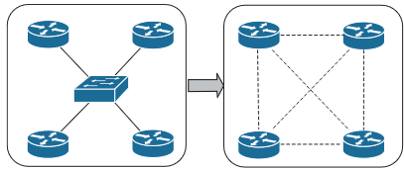
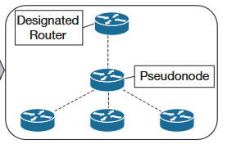
5. DR/BDR
Router ID : 32 bit unique ID that identifies each OSPF processes in an OSPF domain.
Router ID Election Hierarchy:
  Manual configuration
  Highest loopback IP
  Highest active physical interface IP
Designated Router (DR): In a multi access network segment, each router is connected with all other routers in a full mesh fashion as shown in top figure.
With n number of routers/nodes, there will be n(n-1)/2 adjacencies/edges.
To reduce this number of adjacencies formed, a DR/Pseudonode is elected as shown in bottom figure.
Every DR-OTHER router forms FULL adjacency with DR/BDR only in a hub and spoke fashion.
DR-OTHER have 2-way adjacency state among them.
Multi-access network without DR/BDR
Multi-access network with DR/BDR

Slide 9
5. DR/BDR
DR Election: Election of DR is non-preemptive, i.e, once selected it cannot be overthrown even if new routers with higher priority joins the segment later.
During initialization, router waits for WaitTimer set in the interface.
DR Election Hierarchy:
  Highest interface priority, Default 1, range 0 to 65,536
  Highest Router ID.
Interface priority zero (0) means it can only be DR-OTHER.
Router elects itself as BDR first to promote later to DR if eligible after communicating with other routers in the segment.
Backup Designated Router (BDR): In case of DR failure, routers must go through resource intensive process of new DR election and new adjacencies.
To overcome such issue, a BDR is pre-elected in the segment which also forms FULL adjacencies with DR and DR-OTHERs.
In case of DR failure, BDR becomes DR and new BDR from DR-OTHERs is chosen.
BDR election uses same DR Election Hierarchy as above.
DR/BDR Operation:
All OSPF routers (DR,BDR,DROther) form full adjacency with DR & BDR.
As new routes are learned by any router, updated LSA is sent to AllDRouters address (224.0.0.6). Only DR & BDR receive & process those.
DR sends unicast Ack for the received LSA.
DR floods the LSA to all the routers in the segment to AllSPF router address (224.0.0.5)

Slide 10
6. OSPF Configuration
OSPF Network Statement:
Match against primary IP address and mask of the interface
router ospf process-id[vrf vrf-name]
Network ip-address wildcard-mask area area-id
vrf indicates ospf process is being configured for particular VRF
Example: Router(config)# router ospf 1
Router(router-config)# network 10.0.0.1 0.0.0.0 area 0
If two network statements with different area match the interface ip address, the longest match is used to allocate area.
Interface Specific Configuration:
ip ospf process-id area area-id [secondaries none]
Router(config)#interface gigabitethernet0/0
Router(config-if)#ip address 10.0.0.1 255.255.255.255
Router(config-if)#ip ospf 1 area 0
This configuration adds secondary connected networks to ospf process as well. Unless secondaries none option is used.
Recommended to set RID statically as the physical interfaces and loopback details can change.
Command router-id router-id under ospf process assigns static RID.
Command clear ip ospf process resets ospf process in a router that resets RID
A passive interface does not send and process any OSPF Hellos.
Command passive interface-id under the OSPF process makes the interface passive
passive interface default makes all intefaces passive
no passive interface-id is used to make the interface process OSPF Hello.
Notes:
Red : Keyword , Blue : Variable/value

Slide 11
7. Verification
Sequence:
OSPF neighbors
R3#sh ip ospf neigh
Neighbor ID Pri State Dead Time Address Interface
10.1.1.1 1 FULL/DROTHER 00:00:34 192.168.1.1 GigabitEthernet0/0
10.2.2.2 1 FULL/DROTHER 00:00:30 192.168.1.2 GigabitEthernet0/0
192.168.1.254 1 FULL/DR 00:00:36 192.168.1.254 GigabitEthernet0/0
Field | Description
Neighbor ID | RID of the neighbor
Pri | Priority of the neighbor's interface
State | Adjacency-state/DR-BDR-role of neighbor
Dead Time | Time left until the neighbor is declared unreachable
Address | Primary IP address of the neighbor's interface.
Interface | Local OSPF interface the neighbor is discovered.
Notes:
Red : Keyword , Blue : Variable/value

Slide 12
7. Verification
2. OSPF Interfaces
R3#sh ip ospf int b
Interface PID Area IP Address/Mask Cost State Nbrs F/C
Gi0/2 123 0 192.168.40.3/24 1 DR 0/0
Gi0/1 123 0 192.168.30.3/24 1 DR 0/0
Gi0/0 123 0 192.168.1.3/24 1 BDR 3/3
Field | Description
Interface | OSPF enabled interface
PID | OSPF PID the interface is associated with
Area | OSPF area the interface is in.
IP Address/Mask | Primary IP address/mask of the interface
Cost | Cost metric of the interface assigned and used to calculate path metric.
State | State of the interface (DR,BDR,DROTHER,LOOP,DOWN)
Nbrs F | Number of neighbors for the segment that are fully adjacent.
Nbrs C | Numbers of neighbors that are discovered/connected.

Slide 13
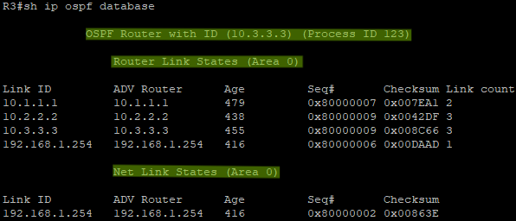
7. Verification
3. OSPF Link State Database (LSDB)
  LSDB groups different Types of LSAs together. In below picture, Router Link LSA (Type 1) and Network Link LSA (Type 2) highlighted below.
  Router LSA (Type 1) are generated by every router in an OSPF area.
  Network LSA (Type 2) are generated by DR on multiaccess network segment.
  Type 2 LSA is showing the network segment 192.168.1.254 advertised by DR 192.168.1.254 in that segment.
  More detailed command 'show ip ospf database router'.
Field | Description
Link ID | LSA ID, usually same as RID of advertising router
ADV Router | RID of the advertising router
Age | LSA age since LSA was generated. Discarded after max age time. 3600 Sec
Seq# | LSA seq# to identify old/stale and new LSA
Checksum | LSA Fletcher checksum
Link Count | Number of links connected to advertising router

Slide 14
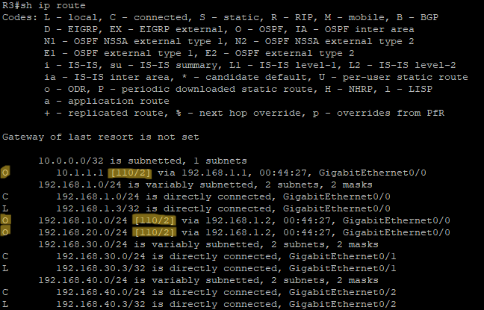
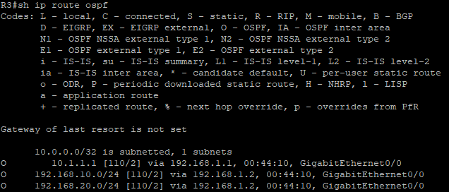
7. Verification
4. Routing Table (RIB)
  First Image below shows the routing table on R3 with all the routes (Connected,Local and OSPF).
  Second picture shows only OSPF routes installed in RIB with 'show ip route ospf' command.
  OSPF routes has 'O' as route types and [AD/cost] value of [110/2].

