Slide 1
Enhanced Interior Gateway Routing Protocol (EIGRP)
Learning Outcomes:
Foundation
Basic Components
Key Terms
Tables
Packet Types
Path Metric Calculation
Load Balancing
Timers
Path Selection
Failure Detection/Path Operation

Slide 2
1. Foundation
Advanced Distance(metric) Vector(direction/egress) (DV) routing protocol
Fast Convergence because of backup routes
Scalable as each router only have to know about it's directly connected routers
Load balance over unequal or equal cost paths
EIGRP routers that are in same Autonomous System (AS) can only participate in same EIGRP process.
Initially Cisco Proprietary
Protocol number 88, Multicast address 224.0.0.10
Administrative Distance (AD) Internal 90, External 170, Summary 5

Slide 3
2. Basic Components
EIGRP has four basic components:
Neighbor Discovery/Recovery: Dynamically learns about routers in a directly attached networks by periodically sending small Hello messages. This messages helps to discover if the neighbors become unreachable or inoperative.
Reliable Transport Protocol(RTP): Guarantees ordered delivery of EIGRP packets to it's neighbor. For efficiency, RTP is only used when necessary. Such as Update packets require Ack while, multicast Hello messages do not.
Diffusion Update Algorithm (DUAL) Finite State Machine(FSM): This acts upon the topology table to compute routes. When topology changes occur and there is no Feasible Successor, DUAL FSM is triggered to compute new successor route.
Protocol dependent modules: Responsible for protocol specific network layer functions. Such as, IP-EIGRP, module which is responsible for sending and receiving EIGRP packets that are encapsulated into IP .

Slide 4
3. Key Terms
Successor route: Least cost loop free path to the destination prefix
Successor: A next hop router to a destination prefix in successor route
Feasible Successor: A next hop router for a backup route to a destination prefix that meets the feasibility condition(FC)
Feasible Distance (FD): Total successor route metric from the EIGRP router to the destination prefix
Reported Distance (RD): Total path metric reported/advertised by next hop routers towards a destination prefix
Feasibility Condition(FC): Feasible Distance (FD) < Reported Distance (RD)

Slide 5
4. Tables
Topology table:
Each table entry holds network prefixes within EIGRP AS, EIGRP neighbors advertising those prefix, metrics from each neighbors, and values used for calculating the metrics.
Entry also contains its metric to reach the prefix. Which is sum of the best advertised metric from all neighbors plus the link cost to the best neighbor.
Prefixes/routes in topology table has one of two states. Passive (P) and Active (A). Routes go into P state when there is FS or Successor and no route re-computation is required. If a route re-computation is required for a prefix, it goes into Active(A) state.
DUAL Finite State Machine (FSM) acts on topology table to recompute routes.
If a neighbor advertises route to a prefix, it is assumed that the neighbor uses that route to reach the prefix.

Slide 6
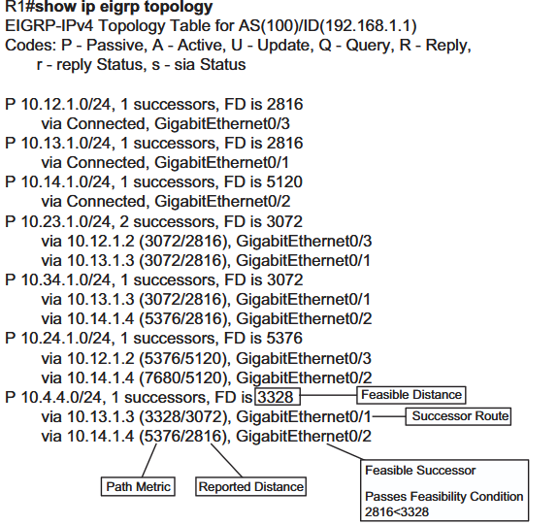
4. Tables
Topology table: Example

Slide 7
4. Tables
Neighbor table:
Records address and interface of each neighbor discovered.
Records HoldTime, which is the time the router waits to receive Hello packet from that neighbor before informing DUAL about it's unreachability.
It holds information required by reliable transport protocol.Such as sequence numbers to detect out of order ACKs, transmission list to queue packets and RTT for optimal retransmission interval.

Slide 8
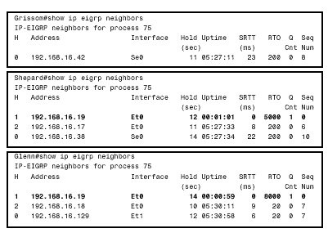
4. Tables
Neighbor Table: Example

Slide 9
5. Packet Types
EIGRP Packet Types:
Packet Type | Packet Name | Function
5 | HELLO | Used for discovery and reachability of the neighbors (Multicast)
2 | REQUEST | Request specific information from one or more neighbors
1 | UPDATE | Reliably transmit routing and reachability information with other neighbors. Neighbor discovery updates are unicast. Link cost change updates are multicast.
3 | QUERY | Used in DUAL during topology changes to recompute routes. Queries are reliable transmission and are always multicast
4 | REPLY | Sent in response to Query packet. Replies are reliable transmission and are always unicast to Query packet originator.

Slide 10
6. Path Metric Calculation
Path Metric Calculation:
Classic metric(IGRP) =
[{K1 * BW+{(K2*BW)/(256-Load)}+k3*Delay}*K5/(k4+Reliability)]
BW is slowest link BW/Kbps in the path scaled to EIGRP_BANDWIDTH of10 Gbps(10⁷ Kbps). Ex. BW = (10⁷ Kbps/100 Kbps) = 10⁵
Delay is the total path delay in tens of µs. Ex . 100 µs = 100/10 = 10
Minimum BW and Total delay of the path is obtained from EIGRP path attribute propagation.
Composite metric(EIGRP) is based on classic IGRP metric above but it is multiplied by 256 to convert it from 24 bits update packet metric field to 32 bits update packet metric field.
Composite EIGRP metric = 256 *[{K1 * Min.BW+{(K2*Min.BW)/(256-Load)}+k3*Total Delay}*K5/(k4+Reliability)]
Values of K can vary from 0 to 128
Default value of K2,K4 and k5 is set to 0
Default value of K1 and K3 is set to 1
Composite EIGRP metric becomes = 256 *[{K1* Min.BW+{(0}+k3*Total Delay}*1] Note: RFC states if K5=0, Reliability part becomes 1.
Applying the BW scaling discussed above and total delay in tens of µs , Composite EIGRP metric becomes:
256 *{(Scaled Min. BW +Scaled Total Delay} = 256 *{(10⁷/ Min. BW⁾ +(Total Delay/10)}

Slide 11
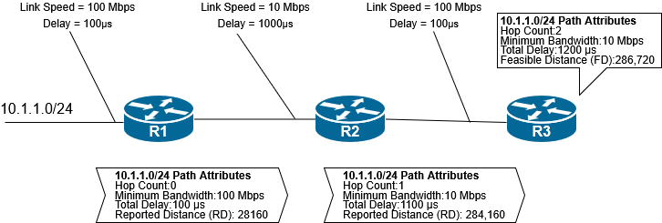
6. Path Metric Calculation
EIGRP Composite Metric calculation example:
EIGRP Path Attribute Propagation
From above figure, calculating EIGRP composite metric at R3 for 10.1.1.0/24 prefix:
Minimum Bandwidth = 10 Mbps = 10 * 1000 Kbps = 10,000 Kbps= 10⁴ Kbps, Total Delay = 1200 µs
Metric = 256 * { (10⁷ /10⁴) + 1200/10} = 256*{10³ + 120} = 256 * 1120 = 286,720

Slide 12
6. Path Metric Calculation
Calculate EIGRP Composite metric for common LAN interfaces:
10 GigabitEthernet
Scaled Bandwidth = 10,000,000/10,000,000
Scaled Delay = 10/10
Composite Metric = 256 *(1+1) = 512
11 GigabitEthernet
Scaled Bandwidth = 10,000,000/11,000,000
Scaled Delay = 10/10
Composite Metric = 256 *(0+1) = 256
20 GigabitEthernet
Scaled Bandwidth = 10,000,000/20,000,000
Scaled Delay = 10/10
Composite Metric = 256 *(0+1) = 256
The composite metrics calculated above for 11G and 20G interfaces are same.Because of this, there will be undesirable equal cost load balancing for higher speed interfaces and etherchannels.Thus, this metric calculation does not scale for higher speed interfaces.Therefore, EIGRP supports second set of metrics known as Wide Metrics.

Slide 13
6. Path Metric Calculation
Wide Metrics:
[{K1 * BW+{(K2*BW)/(256-Load)}+k3*Latency +k6*Extended}*K5/(k4+Reliability)]
Where, Extended adds other future attributes such as jitter and energy.
Latency is measured in picoseconds (10⁻¹² ) instead of microseconds (10⁻⁶ ). 1µs = 10⁶ picoseconds.
To accommodate higher speed interfaces (up to 655 Tbps) wide metrics is multiplied by 65,536 (64 bits).
The default values of K1 and K3 is 1 and 0 for K2,K4,K5 and K6.
Applying these, the EIGRP Wide Metric becomes:
65,536 *{(10⁷/Min. BW) + (Total Latency/10⁶)}
Example: Path with 10G link, delay = 10 µs = 10 *10⁶ picoseconds= 10,000,000 picoseconds
Scaled BW =10,000,000/10,000,000 = 1
Latency = 10,000,000/1,000,000 = 10
Wide Metric = 65,536 * (1+10) = 65,536 + 6,55,360 = 720,896
Cisco RIB can only fit 4 Byte unsigned values. To fit the 64 bits wide metrics into RIB, use metric rib-scale command. This clears the metrics for EIGRP routes in the RIB and sets new metric values.

Slide 14
6. Path Metric Calculation
EIGRP Wide Metric Backward Compatibility:
With the values of K1,K2,K3,K4 and K5 set to same in both Wide Metric and Composite Metric and K6 not set in Wide Metric. Wide Metric is backward compatible with Composite metric.
Mismatched K-values between the peering routers fails to establish EIGRP neighbor relationship .
EIGRP is able to detect when peering with router using Composite metric. It uses below formula to unscale:
Unscaled Bandwidth = (EIGRP_BANDWIDTH *EIGRP classic scale)/Scaled Bandwidth
Example: Scaled BW for classic metric = 1
Unscaled BW = (10,000,000*256)/1 = 2560000000

Slide 15
7. Load Balancing
Equal Cost Multi Pathing (ECMP)
EIGRP allows installation of multiple successor routes (using same metrics) into RIB. Installing multiple paths into RIB for same prefix is called ECMP.
Unequal cost load balancing
EIGRP unequal cost load balancing, which installs both successor and feasible successor into RIB.
Any Feasible Successor's FD below the EIGRP variance value is installed into the RIB.
EIGRP Variance value: It is calculated by multiplying the Successor's FD with EIGRP variance multiplier.
Variance Multiplier : It is calculated by dividing the feasible successor's FD with Successor's FD and rounding up to nearest whole number.
Feasible Successor FD/Successor FD ≤ ||Variance Multiplier||
Where, Feasible Successor FD is the Calculated Distance (CD). I.e Feasible Successor RD + cost to Feasible Successor.

Slide 16
7. Load Balancing
Example: On slide 6, the prefix 10.4.4.0/24 has FD = 3328, Feasible Successor's FD (CD) = 5376
5376/3328 ≤ ||Variance Multiplier||
1.6 ≤ || Variance Multiplier||
Therefore, Variance Multiplier = 2
If Feasible Successor FD (CD) < Successor FD * Variance Multiplier, then the feasible successor route is installed into RIB.
5376 < 3328 * 2 or, 5376 < 6656.
Thus, the route via 10.14.1.4 will also be installed into RIB
Manually changing/setting the Variance Multiplier value will install multiple unequal cost path into RIB.

Slide 17
8. Timers
Hello time : Hello packets between EIGRP neighbors are sent every 5 seconds or 60 seconds for slower interfaces.
HoldTime :
HoldTime is the time the router waits for Hello packets.
HoldTime defaults to 3 times Hello time.
Thus, default value of 15 seconds and 180 seconds.
On receiving Hello packets, the HoldTime resets to default value and starts decrementing.
If the router does not receive any Hello packets from the neighbor before HoldTime reaches 0, it considers the neighbor as down and informs DUAL of topology change.

Slide 18
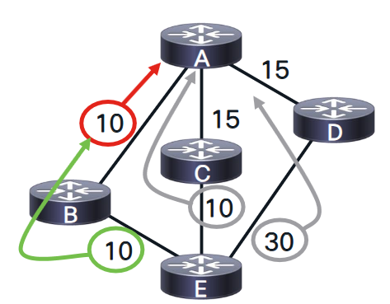
9. Path Selection
For Router-A to reach a prefix connected to Router-E.
RD of B,C and D are 10,10 and 30 respectively.
Calculated Distance (CD) at A will be via B(10+10=20),C(10+15=25) and D(30+15=45).
Least(20,25,45) is 20, thus router B is Successor with FD of 20.
Evaluate Feasibility Condition (FC):
RD of C(10) < FD(20).So, path via C is loop free and is Feasible Successor.
RD of D(30) < FD(20). So, path via D is not loop free and cannot be Feasible Successor.

Slide 19
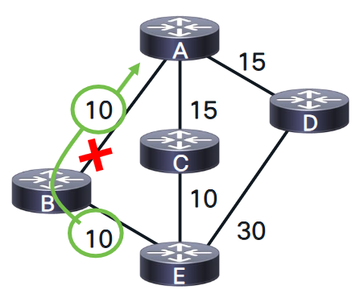
10. Failure Detection
When a link fails between two routers, neighbor goes down and topology changes.
Convergence with Feasible Successor:
When link between A and B fails.
A looses it's successor route and checks topology table for FS for the prefix. EIGRP routers can store up to 6 FS in Topo table.
Since path via C is FS, it instantly installs the FS route into RIB as a Successor route.
A then sends UPDATE packets to it's neighbors about the new Successor route and FD (metric).
A analyses it's topology table and any UPDATE packets received from other neighbors about this prefix to find new FS.
New FD via C(10+15 = 25), which is not smaller than RD of D(30), thus no FS for this prefix.
D's Succesor is E for the prefix with FD of 30, and FS is A with RD of 20.
D analyses it's Topology table and UPDATE received from A to see if any changes for the prefix.
E remains D's Successor.
New updated RD from A is 25, check Feasibility condition, RD of A(25) < 30. A remains FS but RD (metric) changes.
Notes:
Calculate routes for prefix connected to router A for both router B and router E.

Slide 20
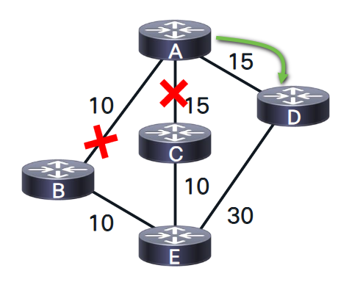
10. Failure Detection
Convergence without Feasible Successor:
Now when both links between A and B, and A and C fails.
A loses it's successor route via C and checks topology table for FS for the prefix.
No FS for the prefix, A puts the prefix in Active state (A)
A sends QUERY with delay set to infinity to notify D that the prefix is gone Active.
D received QUERY packet for a prefix from it's Non-Successor, D sends REPLY with it's route information via E. (QUERY boundary, QUERY does not travel further.)
If the query comes from Successor and it does not have FS for the prefix, it sets the prefix as Active and sends the query to other neighbor routers
A receives REPLY from D, acknowledges it and has no other outstanding replies, calculates new metric for the prefix and sets it as Passive.
A query boundary is established when a router does not mark the prefix as Active. Which happens if the router:
Replies with alternate path attributes (Successor or FS.)
Replies saying it does not have route information which can be because of no downstream routers to query, Route Filtering or Summarization.
Notes:
Calculate routes for prefix connected to router A for both router B and router E.

Slide 21
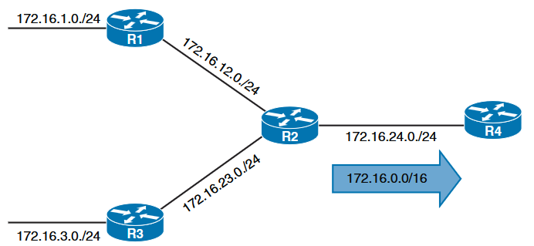
10. Summarization
EIGRP summarizes network prefixes on interface basis.
A summary aggregate is configured on EIGRP interface.
The metric for summary aggregate prefix is calculated from metric attributes of component prefix with least metric.
Change in component prefix's metric will force summary aggregate to recompute the summary aggregate metric.
Latest EIGRP implementation of Cisco allows to define 'summary-metric' attributes.
Without summarization, R2 will advertise 172.16.1.0/24,172.12.0/24,172.16.23.0/24 and 172.16.3.0/24 to R4.
With summarization, R2 will advertise 172.16.0.0/16 to R4.
Summarization reduces the size of Topology table and RIB.
If R2 sends QUERY for 172.16.12.0/24 to R3 and R4, R3 checks it's topology table for alternate route and sends query to downstream routers.
R4 checks it's topology table and has entry only for summarized route 172.16.0.0/16 but has no knowledge of 172.16.12.0/24.
R4 replies immediately to R2 because of no route information for the prefix.
Thus, summarization creates Query boundary.
Notes:
Calculate routes for prefix connected to router A for both router B and router E.

