Slide 1
Multicast
Learning Outcomes:
Multicast Fundamentals
Multicast Addressing
Internet Group Management Protocol (IGMP)
Protocol Independent Messaging (PIM)

Slide 2
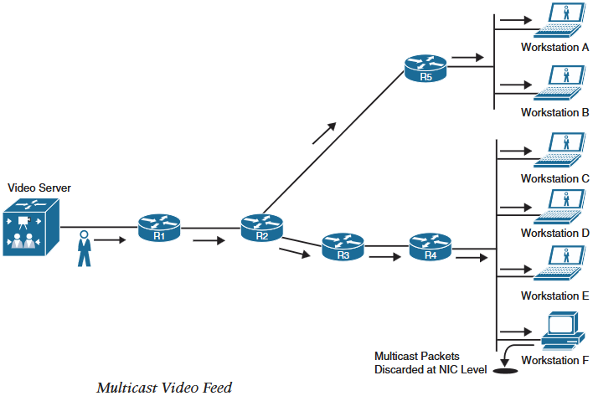
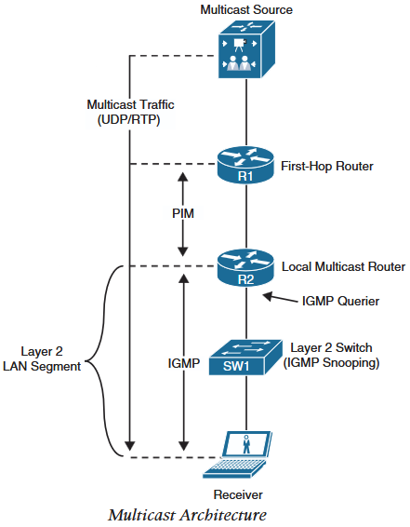
1.Multicast Fundamentals
Multicast: It allows source host to send data packets to group of destination hosts (receivers) to conserve bandwidth and resources.
One to many communication, where a single data packet is sent on a link and is replicated between links as they split(fork) on a network device along the Multicast Distribution Tree (MDT).
Data packets are known as stream that uses a special destination ip address known as group address.
Multicast receivers selectively request to receive the stream.
Application of multicast include Cisco Telepresence, IPTV, Audio/Video conferencing, real-time video, stock tickers, distance learning, music on hold and gaming.
Above picture shows multicast stream that splits at R2.
Workstation F does not process the multicast packets and is discarded as NIC (in contrast broadcast packets would be discarded after processing at CPU).
With IGMP Snooping, multicast packet would not reach Workstation F NIC.

Slide 3
2.Multicast Addressing
Layer 3 Multicast Addressing: IANA reserved multicast addresses are class D network whose first octet starts with 1110 (224.0.0.0/4) to (1111) -1 = 239.255.255.255.
In the multicast address space, multiple blocks are reserved for specific purposes:
224.0.0.0/24 (224.0.0.0 to 224.0.0.255): Local network control block: Protocol control traffic that is not forwarded outside a broadcast domain.
224.0.0.1: All hosts group (in a subnet)
224.0.0.2: All routers group (in a subnet)
224.0.0.5: All OSPF routers
224.0.0.6: All OSPF DRs
224.0.0.9: All RIPv2 routers
224.0.0.10: All EIGRP routers
224.0.0.13: All PIM routers
224.0.0.18: VRRP
224.0.0.22: IGMPv3
224.0.0.102: HSRPv2 and GLBP
Mnemonics: 1st priority-to-Hosts, Routers-pass-traffic-between 2 interfaces, AllOSPF has 5 capital letters,OSPF-Doctors work 6 days a week,RIP after 9 lives, Unlucky 13 caused by PIM splitting traffic, must be 18 to vote for Virtual Representatives (VRRP), 2 and 2 joined to form (IGMP) group 22, 102 Hot Standby Regular Paramedics (HSRP) & Good Looking Bold Paramedics(GLBP).
224.0.1.0/24 (224.0.1.0 to 224.0.1.255): Internetwork control block: Protocol control traffic that may be forwarded throughout the internet.
224.0.1.1: NTP
224.0.1.39: Cisco RP Announce (Auto RP)
224.0.0.40: Cisco RP Discovery(Auto RP)
Mnemonics: Even more 1.1 priority to Time (NTP), ‘39 sign or divine’ announcement is made to the crowd, mid-life crisis at age 40 to discover oneself.
232.0.0.0/8 (232.0.0.0 to 232.255.255.255) Source Specific Multicast(SSM): SSM is PIM extension that forwards traffic only from those multicast source in which the receivers have shown interest.

Slide 4
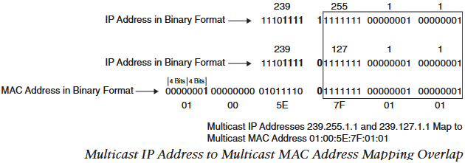
2.Multicast Addressing
Layer 3 Multicast Addressing:
233.0.0.0/8 (233.0.0.0 to 233.255.255.255) GLOP block : Globally scoped statically assigned addresses where 2nd and 3rd octets are mapped to 16 bit domains ASNs.
239.0.0.0/8 (239.0.0.0 to 239.255.255.255) Administratively scoped block: Scope of this block is within the local organization’s administration. These are similar to private ip address ranges and are not routable in the internet. SSM typically assigned ip from this block.
Layer 2 Multicast Addressing:
Every multicast group address (ip address) is mapped to multicast MAC address.
First 24 bits of multicast MAC address always starts with 01:00:5E and 25th bit is always set to 0.
Rest of the LSB bits(23 bits) out of total 48 bits of the MAC address are copied from multicast group address (ip address) LSB.
Example: a group address of 239.255.1.1 would be mapped to multicast MAC address of:
0b 11101111.11111111.00000001.00000001 = 0d 239.255.1.1
0b 0000 0001:0000 0000:0101 1110: = 0x 01:00:5E:
setting 25th bit to 0 of the multicast MAC and copying rest of the LSB from multicast group ip, multicast MAC = 0b 0000 0001:0000 0000:0101 1110:0111 1111:0000 0001:0000 0001 = 0x 01:00:5E:7F:01:01
Out of the remaining 9 MSB of the ip address, 4 MSB are always 1110, remaining 5 bits can vary.
Thus there are 2⁵ = 32 multicast ip addresses that map to same multicast MAC address. (overlapping)
Shortcut to map multicast group address to multicast MAC address:
Fixed 01:00:5E:
copy last two octets of ip address and convert to hex
copy 7 LSB of 2nd octet from ip, add always 0 25th bit as 8th bit and convert to hex.
Example: 239.130.1.1
0b 0000 0001.0000 0001 = 0x 01 01
130 = 10000010
= 0000 0010
239.130.1.1 maps to 01:00:5E:02:01:01

Slide 5
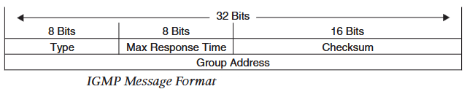
2.IGMP
Internet Group Management Protocol (IGMP):
When a receiver wants to receive multicast traffic from a source it sends a IGMP join (membership report) to it’s router.
IGMP must be supported by the receivers and router interfaces facing the receivers.
Three version of IGMP exist. IGMPv1 is old and rarely used.
IGMPv2 is most common and IGMPv3 is used by Source Specific Multicast.
IGMPv2
IGMPv2 packets are sent encapsulated within ip packet with the IP router alert option set, protocol number 2 and TTL value set to 1.
Router alert option directs the router to closely inspect the packet (de-encapsulation) and since TTL is set to 1, it is discarded at local router.
Below is the IGMP message format:
8 bit Type field describes 5 IGMP message types used by receivers and routers.
Version 2 membership report (type value 0x16): Used by receivers to join multicast group or to respond to local router’s membership query message. This message is commonly referred as IGMP join.
Version 1 membership report (type value 0x12): Used by receivers for backward compatibility to IGMPv1
Version 2 leave group(type value 0x17): Used by receiver to indicate they want to stop receiving multicast traffic for the group they joined.
General membership query(type value 0x11): Periodically sent to all hosts address 224.0.0.1 to check whether there are any receivers in the attached subnet. It sets the group address field to 0.0.0.0
Group specific query(type value 0x11): Sent in response to the leave group message. The group address is the destination IP address of the packet and the group address field of leave group message.

Slide 6
2.IGMP
IGMPv2
Max Response Time: It is set only in general and group specific query messages (type value 0x11).In all other messages it is set to 0x 00 and is ignored.
Checksum: Message checksum calculated same as TCP/IP checksum.That is 16-bit 1’s complement of the 1’s complement sum of the IGMP message.
Group Address: Set to 0.0.0.0 in general query message. And is set to group ip address receiver wants to join and leave in membership report, group specific query and leave group messages.
IGMPv2 Operation
Receiver sends an unsolicited membership report message for the group it wants to join (such as 239.1.1.1) to local router.
Local router sends PIM join message upstream towards the source of the group.
When local router starts receiving multicast traffic it forwards to the subnet where the receiver resides.
Local router then periodically sends general query message with max response time of 10 seconds to all host address 224.0.0.1 to check if any receivers in the subnet.
In response to the general query message, receivers set a timer equal to max response time before sending a membership report message for the group.
To prevent duplicate membership report message from a subnet, while the max response timer is running, if receivers receive any membership report message from any other receiver, it stops it’s timer and does not send membership report message.
To leave a group, if the receiver is the last one to respond to the general query message, it sends the leave group message. If it’s not then it leaves the group quietly assuming there are other receivers for the group in the subnet.
On receiving leave group message, local router sends group specific message to check if any receivers for the group left in the subnet.

Slide 7
2.IGMP
IGMPv2 Operation
If no receivers left in the group, the local router removes the IGMP state for the group.
If there are more than one router in a LAN segment, IGMP querier election takes place.
Local routers send general query message to all hosts address 224.0.0.1 with their interface ip address as source address.
Routers in a LAN segment receive each other’s general query message and compare the source ip address of the message.
Router with lower interface ip address is elected as IGMP querier for the group in the LAN segment.
All the non-querier routers start a timer that resets when they receive a general query message from the querier.
If the querier router stops sending general query, routers wait for twice the query interval (60 seconds) before triggering new querier election.
IGMPv3
IGMPv3 is backward compatible and supports all the IGMPv2 message types.
IGMPv3 has new message type called version 3 membership report to support source filtering for source specific multicast (SSM).
The receiver can specify the source it is interested in for the group in version 3 membership report message.
IGMPv3 membership report message can operate in two modes:
Include mode: Contains include list of the group source addresses the receiver wants to receive traffic from.
Exclude mode: Contains exclude list of the group sources addresses the receiver does not want to receive traffic from. Empty exclude list operates same as IGMPv2 and receives traffic from all sources.

Slide 8
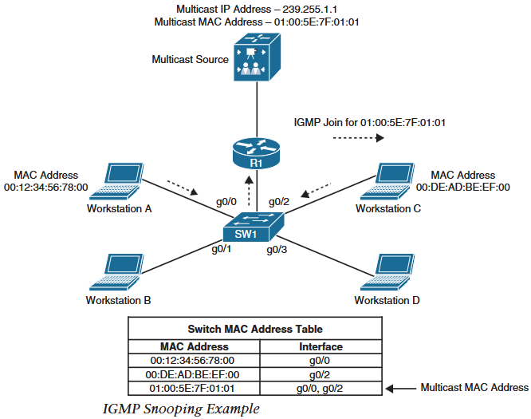
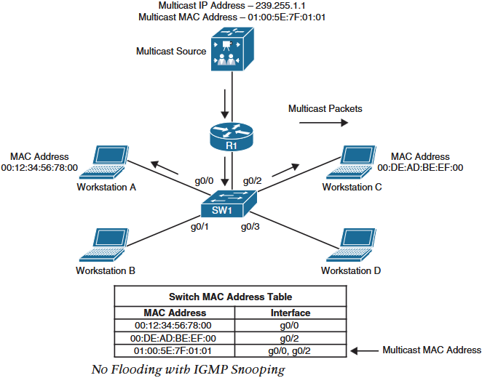
2.IGMP
IGMP Snooping
To stop multicast traffic flooding in a LAN segment, switches can either use IGMP snooping or they can be configured with static MAC address entries.
Static MAC address entry is not scalable and is rarely used.
Switches enabled with IGMP snooping, dynamically populate their MAC address table to forward multicast traffic only to the receivers that have joined the group.
First picture shows Workstation A and C sending IGMP join message for group address 239.255.1.1 mapped to multicast MAC 01:00:5E:7F:01:01.
SW1 populates it’s MAC address table with Multicast MAC address mapped to workstation A and C interfaces.
In second picture, when SW1 receives multicast traffic for the group, it performs a MAC address lookup for the multicast group address to forward traffic only out the interfaces where it received join messages for the group.
So SW1 forwards the multicast traffic out interface gi0/0 (workstation A) and gi0/2(workstation C).

Slide 9
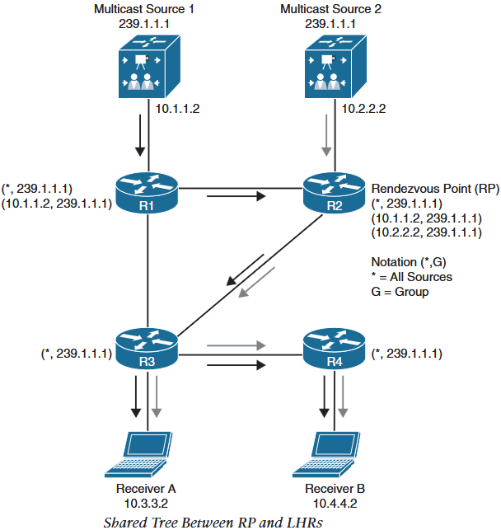
3.PIM
Protocol Independent Multicast (PIM)
For multicast architecture where source and receivers are not connected to same router, a multicast routing protocol is required.
Cisco fully only supports PIM as a multicast routing protocol that is unicast routing protocol independent but depends on unicast routing to identify path between source and receivers.
PIM Distribution Trees
Two basic types of Multicast Distribution Trees(MDT):
Source Tree
A MDT with source as root and branches through the multicast network upto the receivers.
The tree is built as a shortest path from root to the leaves thus it is also known as Shortest Path Tree (SPT).
Forwarding state of the source tree is known by the notation S comma G (S,G) where S is the multicast source and G is the group address.
Shared Tree
A MDT where root of the tree is not multicast source but a designated router known as Rendezvous Point (RP).
Thus shared tree is also known as RP Tree (RPT).
Regardless of the multicast source, traffic is forwarded down the tree using the shared tree forwarding state ‘star comma G’ (*,G).
One of the benefits of shared tree is that it requires fewer forwarding states as any number of source can be represented with * in (*,G).
In below figure, * is 10.1.1.2 and 10.2.2.2, and G is 239.1.1.1.
One of the drawbacks of shared tree is that multiple(one from each source) multicast stream flow in the network consuming bandwidth and receiver resources.
Security is another drawbacks as unwanted source can be introduced to the shared tree.

Slide 10
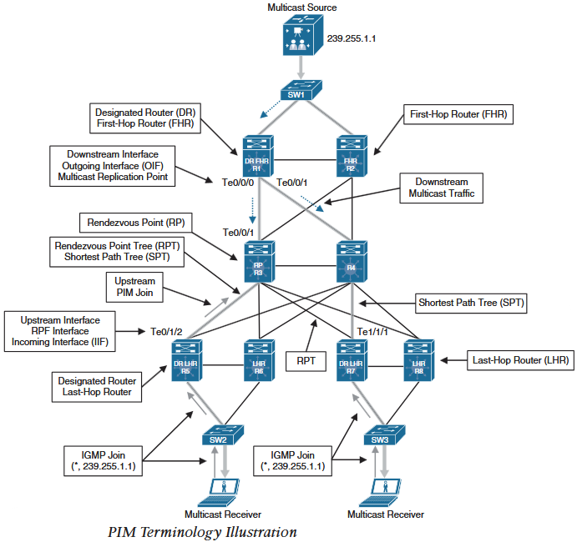
3.PIM
PIM Terminology
Reverse Path Forwarding (RPF) Interface: Interface with lowest cost path to the root of SPT or RPT. For multiple interfaces with equal cost, interface with highest ip address is used as tiebreaker.Te0/1/2 of R5 and Te1/1/1 of R7 are the example of reverse path forwarding interface.
RPF Neighbor: PIM neighbor on RPF interface. Example: If R7 is using SPT, RPF neighbor would be R4 and if it is using RPT, RPF neighbor would be R3.
Upstream: Toward the root of the tree, RP in RPT and Source in SPT where PIM join message travels.
Upstream Interface: Interface towards source of the tree which is also known as RPF interface or Incoming Interface.
Downstream: Away from the source of the tree and towards the receiver.
Downstream Interface: Any interface that is used to forward multicast traffic down the tree, also known as Outgoing Interface.
Incoming Interface (IIF): Only interface that can accept multicast traffic coming from the source. Same as RPF interface. Example R3 Te0/0/1.
Outgoing Interface(OIF): Any interface that is used to forward traffic down the tree, also known as downstream interface.
Outgoing Interface List (OIL): List of outgoing interfaces that forwards traffic downstream. Example: R1’s Te0/0/0 and Te0/0/1.
Last Hop Router (LHR): Also known as leaf router which is directly attached to receivers. It is responsible for sending PIM joins upstream towards the source.

Slide 11
3.PIM
PIM Terminology
First Hop Router (FHR): Router that is directly attached to the multicast source also known as root router. It is responsible for sending register messages to RP.
Multicast Routing Information Base (MRIB): Similar to unicast RIB, it is a topology table also known as multicast route table (mroute), that is derived from unicast routing table and PIM.MRIB contains Source(S), Group (G), IIF, OIF, and RPF neighbor for each multicast route.
Multicast Forwarding Information Base (MFIB): A forwarding table that uses MRIB to program multicast forwarding information in hardware for faster forwarding.
Multicast State: Forwarding state used by router to forward multicast traffic. It is composed of entries found in mroute table (S,G,IIF,OIF and so on).
PIM Modes:
PIM Dense Mode (PIM DM)
PIM Sparse Mode (PIM SM)
PIM Sparse Dense Mode
PIM Source Specific Multicast (PIM SSM)
PIM Bidirectional Mode (Bidir PIM)
PIM Dense Mode and Sparse Mode commonly known as Any Source Multicast (ASM)

Slide 12
3.PIM
PIM Control Messages
All PIM control messages use IP protocol number 103 and they are either unicast (register and register stop) or multicast to All PIM address 224.0.0.13.
PIM Hello messages are sent every 30 seconds by default.
PIM Dense Mode (PIM-DM)
PIM-DM is used on a multicast network architecture where receivers are densely populated or are located on every subnet.
MDT is built by initially flooding multicast traffic on every interface of PIM-DM router and later pruning off branches with no receivers.
On receiving multicast traffic on PIM-DM router, it must check if any active receivers are located on it.
If so, the router quietly lets the traffic flow through it.
If no receivers have requested the multicast traffic on LHR, it sends a prune message towards the source.
The branch of the tree is then pruned off to create a unique source tree.
Type | Messages | Destination | PIM Modes
0 | Hello | 224.0.0.13 (all PIM routers) | SM,DM Bidir and SSM
1 | Register | RP address (unicast) | PIM-SM
2 | Register stop | First Hop Router (Unicast) | PIM-SM
3 | join/prune | 224.0.0.13(all PIM routers) | PIM-SM,Bidir-PIM and SSM
4 | Bootstrap | 224.0.0.13(all PIM routers) | PIM-SM and Bidir-PIM
5 | Assert | 224.0.0.13 (all PIM routers) | SM,DM and Bidir-PIM
8 | Candidate RP Advertisement | Bootstrap Router Address (unicast to BSR) | PIM-SM and Bidir-PIM
9 | State refresh | 224.0.0.13 (all PIM routers) | PIM-DM
10 | DF election | 224.0.0.13 (all PIM routers) | Bidir-PIM

Slide 13
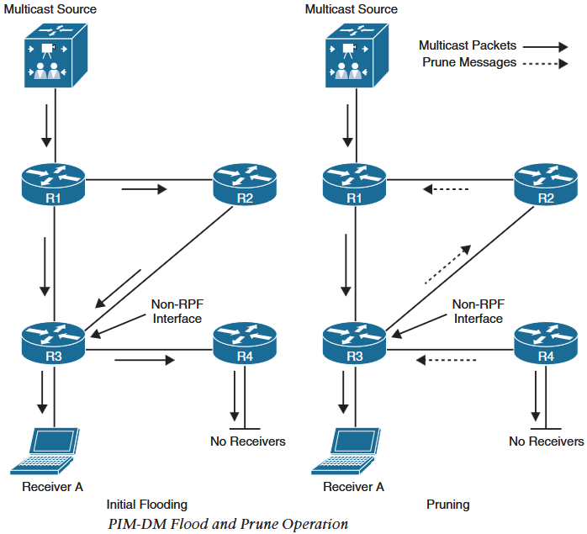
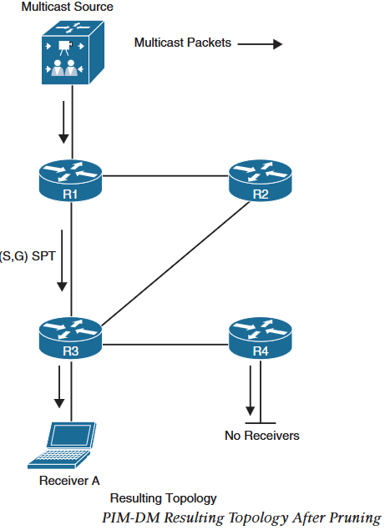
3.PIM
PIM Dense Mode (PIM-DM): Below picture on left shows initial flooding and pruning mechanism of PIM-DM and resulting SPT.
Eventhough multicast traffic is not reaching all the routers, (S,G) state still remains on all the routers (R2 and R4 as well).
Prune messages are sent out of RPF interface if there are no downstream receivers as is the case with R4.
And are also sent out of non-RPF interface to stop multicast traffic flow through non-RPF interfaces as is the case for R3.
PIM-DM prune messages expire after 3 minutes, which causes periodic initial flooding and pruning operation every 3 minutes.
Thus PIM-DM is good for small networks with dense receivers.
PIM Sparse Mode
It works well with both densely or sparsely populated receivers but assumes that no receivers are interested in multicast traffic unless they explicitly join the group.
Source and Shared Path Tree
Receivers send IGMP join to the local router (PIM LHR).
LHR sends a PIM join message towards the root of the source path tree (FHR) or shared path tree(RP).
Unlike PIM-DM where arrival of multicast traffic on a router creates forwarding state, these explicit PIM join messages create forwarding state in PIM-SM.

Slide 14
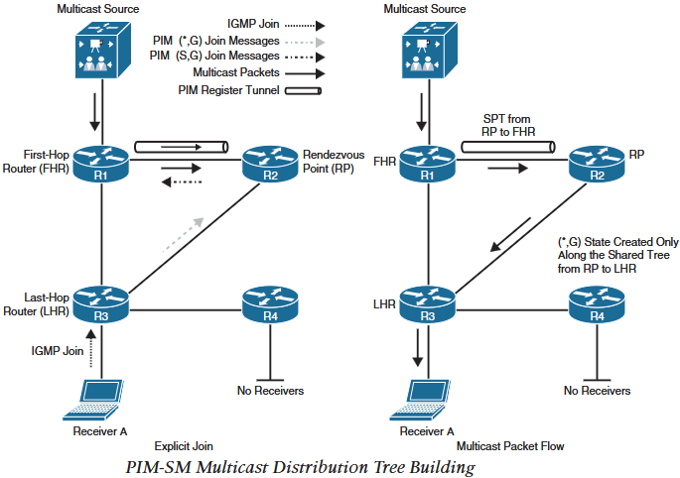
3.PIM
Explicit join from receiver makes LHR to send PIM join (*,G) message towards RP, which travels hop by hop creating a Shared Path Tree (RPT) between RP and LHR.
PIM-SM builds a Source Path Tree (SPT) between FHR and RP using source registration.
As the source sends multicast traffic towards FHR, it encapsulate the data with PIM Register message and sends through an unidirectional PIM tunnel.
RP decapsulates the multicast traffic received on Register message and checks if there is any existing shared tree (RPT) because of any PIM join message for the group.
If none, it sends unicast Register Stop message to FHR without traversing the Register tunnel.
If there is an active shared tree, RP forwards traffic downstream the shared tree and sends back a (S,G) join message towards the source to create a (S,G) SPT.
If RP and FHR are multi-hop away, a (S,G) state is created on all the routers inbetween,RP and FHR to create SPT.
The FHR, routers inbeetwen and RP also has (*,G) state.
Once SPT is created, multicast traffic start to flow natively using the SPT between RP and FHR and RP sends a Register stop message to FHR to stop the Register messages.
Multicast traffic now flows natively using SPT between FHR and RP, and RPT between RP and LHR.
The Register tunnel stays in up/up state even if there is no active multicast stream between FHR and RP until RP has valid RFP for the group.

Slide 15
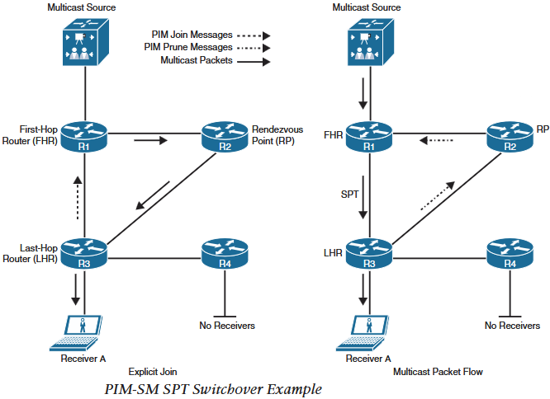
3.PIM
PIM SPT Switchover
PIM-SM allows SPT switchover for a specific group and in Cisco routers it is the default behavior that can be disabled on per group basis.
LHR switches from shared tree to SPT after it receives the first multicast packet from the RP through a shared tree even if the SPT is through RP.
After receiving first packet, LHR becomes aware of Source ip address and checks unicast routing table to check which is the shortest path to the source.
It then sends a (S,G) towards the FHR hop by hop to create a SPT.
Once LHR receives multicast packets from SPT, it switches RPF inteface if necessary.
LHR then sends PIM prune message towards RP to shut off the shared tree and block duplicate multicast traffic.
In this topology the shortest path is via R1, thus R3 sends PIM join message to R1 and PIM prune message to R2.
If RP (R2) does not have any other outgoing interfaces for the shared tree (group), it sends PIM prune message to FHR.

Slide 16
3.PIM
Designated routers
If multiple PIM routers exist in a LAN segment, a PIM designated router(DR) needs to be elected using PIM Hello messages to prevent duplicate multicast traffic.
By default DR priority value of all PIM routers is 1 and can be changed to force DR, where higher priority becomes DR.
If priority can’t be changed and all routers have same priority, higher interface ip address is elected as DR.
On FHR LAN segment, DR is responsible for sending unicast register message towards RP and without DR, duplication would occur.
On LHR LAN segment, DR is responsible for sending PIM join and PIM prune messages towards RP and perform SPT switchover.
Default DR hold time is 3.5 times Hello time (105 seconds) and can be changed to speed up DR re-election.
Reverse Path Forwarding (RPF)
RPF is an algorithm that prevents loops and ensures multicast traffic arrives on correct interface.
RPF functions as follows:
If a router receives multicast traffic on an interface it uses to forward unicast traffic, the packet has arrived on RPF interface.
If a packet arrives on RPF interface, the router forwards it out the interfaces on outgoing interface list (OIL) of the mroute table entry.
If the packet does not arrive on RPF interface the packet is discarded to prevent loops.

Slide 17
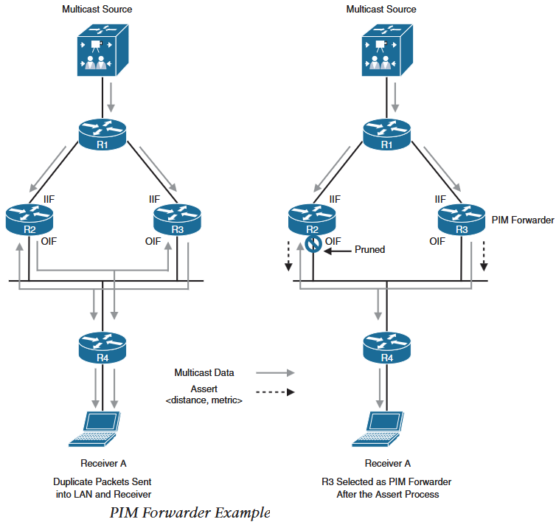
3.PIM
Reverse Path Forwarding (RPF)
PIM-SM forwards traffic using Source Path Tree (SPT) between FHR and RP,and between source and LHR. It also uses Shared Path Tree (RPT) between LHR and RP.
Based on the MDT used, following RPF check is performed:
If PIM router has (S,G) state, it performs RPF check against the ip address of the source.
If PIM router has (*,G) state, it performs RPF check against the ip address of the RP.
PIM Forwarder
In cases where duplicate multicast traffic can flow in multi-access network, PIM Assert messages stops such duplicate traffic.
In the figure, R2 and R3 receive same (S,G) traffic and forward onto their outgoing interfaces.
Thus R2, and R3 receive same (S,G) traffic on their downstream interfaces through which they are sending out the same (S,G) traffic.
This situation triggers Assert mechanism in PIM, where R2 and R3 send assert message on their outgoing interfaces (into LAN).
Assert messages contain their AD and route metrics to the source to determine which router should forward the traffic for that LAN segment.
The router with lower AD, then lower route metrics then higher interface ip address becomes PIM forwarder for the segment.
Loosing router prunes it’s interface as if it has received a prun message on it.

Slide 18
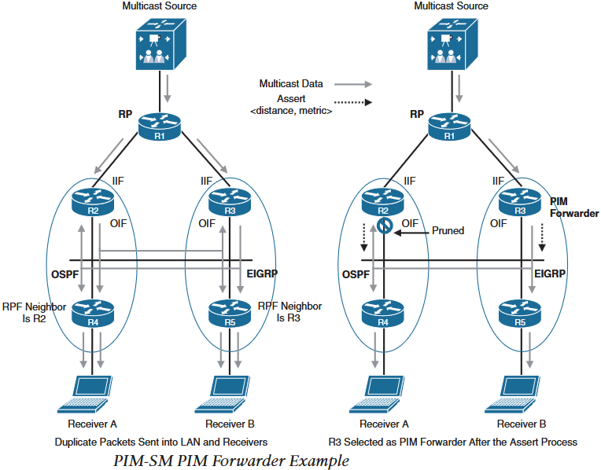
3.PIM
PIM Forwarder
Prune times out after 3 minutes and assert mechanism is repeated ever 3 minutes.
PIM forwarder is used mostly in PIM-DM and rarely in PIM-SM.
PIM-SM eliminates use of assert mechanism
In the PIM Forwarder example topology, PIM-SM would not use assert mechanism because of the PIM-SM operation procedure.
PIM-SM routers identify their RPF neighbor and send PIM join messages with RPF neighbor ip field set (ex.R3’s ip).
Assuming R1 is the RP, R2 would ignore the PIM join message because of the RPF neighbor ip set to R3, and only R3 sends PIM join message towards R1.
This creates a shared tree between R1,R3 and R4 that eliminates the possibility of traffic duplication.
PIM-SM cannot avoid assert mechanism
In PIM-SM PIM Forward Example topology, R2 & R4 is using OSPF and R3 & R5 is using EIGRP.
R4 learns about RP (R1) via R2 and R5 via R3, thus R4’s RPF neigbor is R2 and R5’s RPF neighbor is R3.
Assuming both Receiver A and B wants to join a group, R4 and R5 send PIM join upstream and create RPT through their RPF neigbor.
R2 and R3 forward same multicast traffic via their outgoing interface. Which triggers assert mechanism.
R2 prunes it’s downstream interface and R3 becomes PIM Forwarder for the LAN segment.

Slide 19
3.PIM
Rendezvous Points (RP)
In PIM-SM, it is mandatory to choose one or more routers as root of shared tree known as Rendezvous Points.
RP can be selected in following ways:
Static: Statically configure RP on all routers of the multicast domain with global config command ip pim rp-address rp-address.
Statically configuring RP in large networks is not scalable and is not a viable solution for a network where RP can change frequently and requires failover.
Auto RP: Cisco proprietary solution that automatically distributes PIM group to RP and has following benefits.
Easy to use multiple RPs for different PIM groups.
Allows load balancing between different Rps.
Simplifies RP placement according to the location of group participants.
Prevents inconsistent manual RP configuration.
RPs of one group can be configured as backup for another group.
Auto RP has two basic components, Candidate RP (C-RP) and RP Mapping Agents (MAs).
Candidate RPs (C-RP) :
C-RP announce it’s willingness to become RP to a well known RP-announce address 224.0.1.39 using RP announcement message every RP announce interval of 60 seconds by default.
RP announcement message contains default group range 224.0.0.0/4, C-RP ip address and hold time of 3 times RP-announce interval.
C-RP with highest ip address is selected as RP.
RP Mapping Agents (MAs):
Primary role of RP MAs is to store RP to group mapping and hold times in their RP to group mapping cache.
RP MAs join group 224.0.1.39 to receive RP announcements.

Slide 20
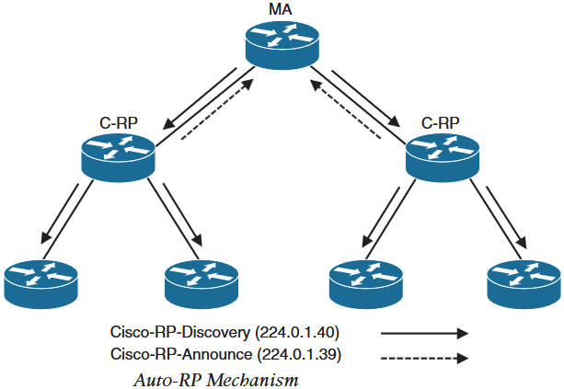
3.PIM
RP Mapping Agents (MAs)
RP MAs advertise RP-to-Group mapping and elected RPs to well known (Cisco-RP-Discovery) address 224.0.1.40 every 60 seconds by default or when any change is detected.
All PIM enabled routers join RP-Discovery group and store the RP mappings in their private cache.
RP MAs act independently and for redundancy multiple MAs can be configured in a network which advertise and store identical RP-to-Group mappings in their cache.
In the figure, MA periodically receive RP-Announce messages from C-RP and periodically advertise RP-to-Group mappings to all PIM routers using Cisco-RP-Discovery address 224.0.1.40.
PIM BootStrap Router (BSR)
Another method to dynamically discover and distribute fault tolerant RP is by using BootStrap Router.
Similar to Auto-RP ,PIM uses non-proprietary BSR mechanism to announce and discover RP set information for each group prefix to all PIM routers in the domain.
RP set is Group-to-RP mapping with below information:
Multicast group range
RP priority
RP address
Hash mask length
SM/Bidir flag

Slide 21
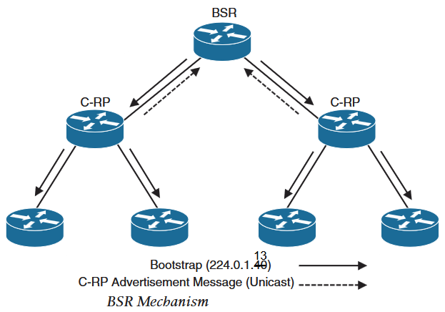
3.PIM
PIM BootStrap Router (BSR)
BSR messages originate in BSR routers and is flooded into the multicast domain hop by hop using allPIM router address 224.0.0.13 with TTL of 1.
For redundancy multiple candidate BSRs (C-BSR) can be deployed but a single BSR is elected among C-BSR using C-BSR priority. And highest C-BSR ip address as a tiebreaker.
Candidate RPs (C-RPs)
PIM routers are configured as C-RP which receive BSR messages that contains current BSR’s ip address.
C-RP can then send unicast Candidate RP Advertisement (C-RP-Adv) messages to BSR directly.
C-RP-Adv messages contain list of group address and group mask field pairs for the group it is willing to become RP.
BSR store incoming C-RP-Adv into it’s local group-to-RP mapping cache and advertise same to all PIM routers in the domain through BSR messages every 60 seconds.
BSR does not elect RP for the group and leave this task for individual PIM routers.
Each PIM router use same well-known hashing algorithm against the same list of C-RP for a group to elect same RP for the group.
In below figure, BSR messages are sent to All PIM routers on 224.0.0.13 and C-RP-Adv messages are unicast to BSR.

