Slide 1
Spanning Tree Protocol
Learning Outcomes:
Spanning Tree Protocol (STP)
Rapid STP (RSTP)
Advanced STP Tuning
STP Protection Mechanisms
Multiple Spanning Tree (MST)

Slide 2
1.STP
Spanning Tree Protocol iterations:
802.1D, Original Spanning Tree Protocol specification
Per VLAN Spanning Tree (PVST)
Per VLAN Spanning Tree Plus (PVST+)
802.1W, Rapid Spanning Tree Protocol (RSTP)
802.1S,Multiple Spanning Tree (MST)
802.1D is the basis of all iterations and creates single spanning tree topology.
Every 802.1D port transitions through below Port States:
802.1D Port Roles
Root Port (RP) : A port that is connected to root switch or upstream switch in spanning tree topology.
There should be only one root port per VLAN in a switch.
Designated Port (Desg/DP) : A port that receives and forwards BPDU to other switches.
There should be only one Active DP per link.
It provides connectivity to downstream switches and devices.
Blocking Port: A port that is not forwarding traffic because of STP calculation.
Port States | Description
Disabled | Administratively Shutdown
Blocking | Port is enabled but is not forwarding any traffic to prevent loops. The switch does not modify MAC address table and can only receive BPDU from other switch.
Listening | Transitioned from Blocking state and now can send or receive BPDU. Duration of this state correlates to STP forwarding time.
Learning | Can modify MAC address table with received traffic. It cannot forward network traffic other than BPDU. Duration of this state correlates to STP forwarding time.
Forwarding | Can forward network traffic and update MAC address table.
Broken | Switch detected configuration or operational problem and is discarding packets until the problem exist.

Slide 3
1.STP
STP Key Terminology:
Root Bridge: Root of the spanning tree that has all ports in designated forwarding state.
Bridge Protocol Data Unit (BPDU): Hello packets of STP that are used to notify topology change and identify hierarchy in Spanning tree topology. Sent to MAC 01:80:c2:00:00:00 (Nearest-Customer-Bridge).Two types of BPDU:
Configuration BPDU: Used to identify root bridge and port roles. It contains STP type, root path cost, root bridge identifier, local bridge identifier, max age, hello time and forward delay.
Topology Change Notification (TCN) BPDU : Used to communicate changes in layer 2 topology.
Root path cost: Combined cost for a specific path towards the root bridge.
System priority: 4-bit value (4 MSB of 16 bit ) that indicates the preference of a switch to be root switch. Default is 32,768.
System ID extension: 12-bit value that indicates the VLAN the BPDU correlates to. VLAN 1 will have sysid 1.
Root bridge identifier: This is the combination of System priority, sysid and MAC address of the root bridge.
Local bridge identifier: This is the combination of System priority, sysid and MAC address of the switch (root or non-root).
Max age: Maximum time the received BPDU is valid for. Default is 20 seconds and can be modified with spanning-tree vlan vlan-id max-age maxage.
Hello time: Time interval that BPDU is advertised. Default 2 seconds and can be modified with spanning-tree vlan vlan-id hello-time hello-time.
Forward delay: Time the port stays in listening and learning state. Default 15 seconds and can be modified with spanning-tree vlan vlan-id forward-time forward-time.

Slide 4
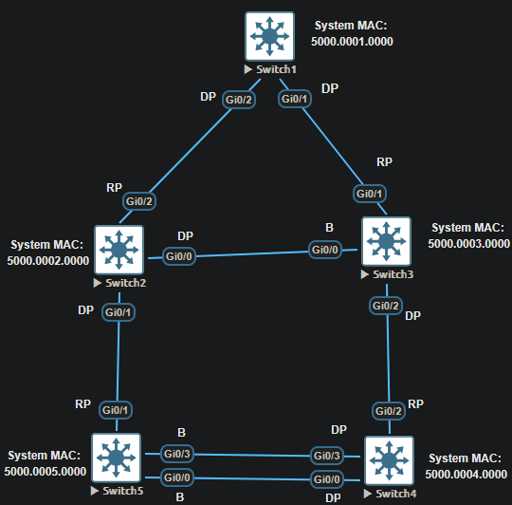

1.STP
Building STP Topology
Root Bridge Election: On initialization, a switch assumes itself as a root switch and uses local bridge identifier as root bridge identifier. Then it listens for neighbors configuration BPDU.
Switch with lower System priority is preferred as root switch and if the system priority is same then switch with lower MAC address is preferred.
On receiving configuration BPDU from neighbor, it does following:
If neighbor’s configuration BPDU is inferior to it’s own BPDU, then it ignores the neighbor’s BPDU.
If not then it updates it’s BPDU with new root bridge identifier and new root path cost.
This process continues until all the switches in topology identifies root switch.
Root bridge in a topology can be verified with show spanning tree root
As SW1 is the root switch in the topology, root port is empty on show spanning-tree root output.
The root ID is the default system priority + sys id extension(Vlan1) MAC address = 32768+1 5000.0001.0000
Advertised root path cost is always calculated on local switch.

Slide 5
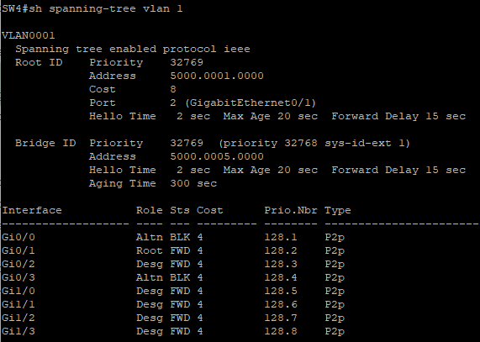
1.STP
Building STP Topology
Locating root port (RP): Root port is selected using below criteria. On tie, next criteria is used as tie-breaker.
Interface associated to lowest root path cost is preferred.
The interface associated to lowest system priority.
Interface associated to lowest system MAC.
For multiple links associated to same switch, lowest port priority is preferred.
For multiple links associated to same switch, lowest port number is preferred next.
Locating Blocked designated port (B): The logic to calculate which port to block in a link between two non-root switch is as follows:
The interface must be DP and not RP.
Switch with lower root path cost forwards(DP) and one with higher root path cost blocks(B) it’s port in a link between switches.
If root path cost ties, then switch with lower system priority forwards(DP) and higher system priority blocks(B).
If system priority is same then switch with lower MAC address forwards(DP) and switch with higher MAC address blocks(B).
In the topology in previous slide, for link between SW2 and SW3, and for link between SW4 and SW5, they use above step 4 to put their ports in DP and B state.

Slide 6
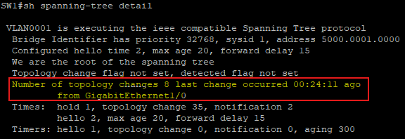
1.STP
STP Topology Changes : In a stable STP topology, configuration BPDU always flow from root switch to edge switches.
In an event that causes topology change such as switch failure, link failure or link coming up (becoming active) all the switches in STP topology are impacted.
The switch that detects such event sends a Topology Change Notification (TCN) BPDU towards the root switch.
If an upstream (non-root) switch receives such BPDU, it sends an acknowledgment to downstream switch and forwards the TCN BPDU out it’s RP to the root switch.
Upon receiving TCN, root switch creates and floods new configuration BPDU with TCN flag set.
Upon receiving configuration BPDU with TCN flag set, the non root switch sets it’s MAC address table timer to forward delay timer (default 15 sec).
This causes flushing of MAC address table for hosts that are not actively communicating (within forward delay timer interval).
MAC address table flush during the topology change causes temporary increase in unknown unicast flooding until the STP topology stabilizes.
MAC address table timer is reset to default value of 300 seconds upon receipt of second configuration BPDU.
TCN is generated per VLAN basis, thus number of hosts in a VLAN directly correlates to number of TCN and scale of unknown unicast flooding during topology change.
Number of TCN can be viewed with show spanning-tree [vlan vlan-id] detail and is important STP troubleshooting command.

Slide 7
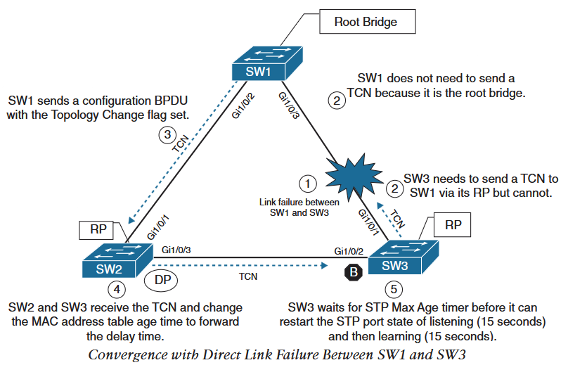
1.STP
Convergence with Direct Link Failure: When switch loses power or reboots or link is removed, layer 1 signaling places the port in down state can notify processes such as STP.
Such situation is know as direct link failure to STP and converges depending on below three scenarios:
Scenario 1: Link between SW2: gi0/0 (DP) and SW3:gi0/0 (B) fails.
Since SW3:gi0/0 is in blocking state, there is no impact on network traffic between SW2 and SW3. As it is transmitted via SW1.
SW2 and SW3 however will send TCN out their RP to root switch.
SW1 sends TCN BPDU to all connected switches, SW@ and SW3 in this case.
SW2 and SW3 will change their MAC address table timer and flush it.
Scenario 2: Link between SW1 and SW3 fails.
SW1 does not need to send a TCN because it is the root switch. SW3 needs to send TCN to SW1 via it’s RP but cannot send it.
SW1 sends configuration BPDU with TCN flag set to SW2.
SW2 and SW3 receives the BPDU with TCN flag set and set their MAC address table timer to forward delay timer.
SW3 waits for STP max age timer before it can restart the port state of listening (15 seconds) and then learning (15 seconds).
Total convergence time of 30 seconds with 15 seconds in listening state and 15 seconds in learning state.

Slide 8
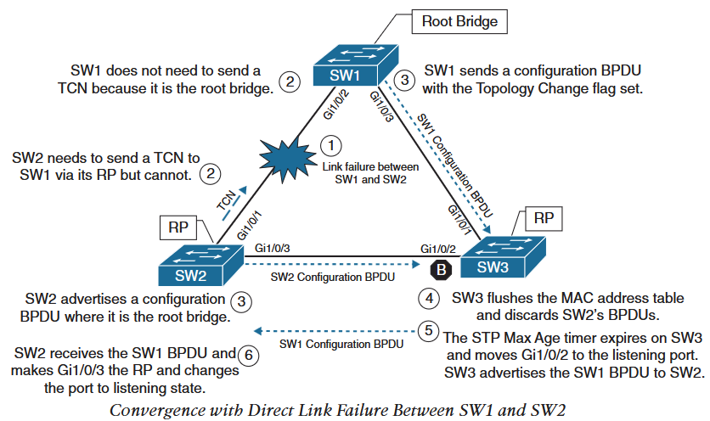
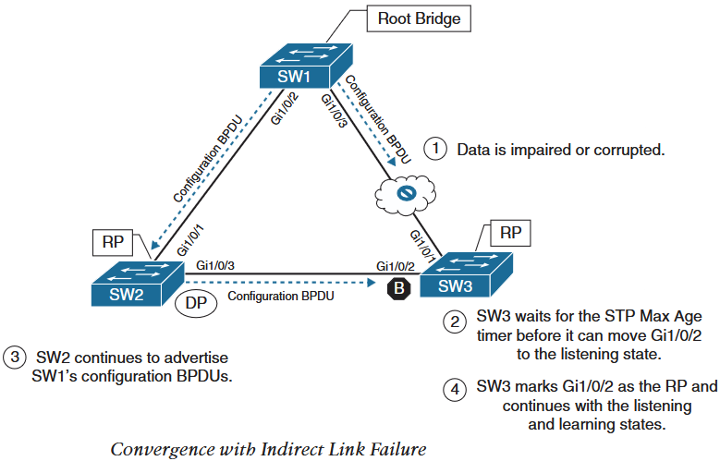
1.STP
Scenario 3: Link between SW1 and SW2 fails.
SW2 needs to send TCN via it’s RP to SW1 but it cannot.
SW1 sends configuration BPDU with TCN flag set to SW3.It cannot relay SW1’s BPDU to SW3 as it’s Gi1/0/2 is in Blocking state. SW2 sends a configuration BPDU with it’s own system ID as root ID.
SW3 flushes the MAC address table and discards SW2’s BPDU as it is inferior to one received from SW1.
Max age timer expires on SW3 Gi1/0/2 and it moves the port to listening state and advertises SW1’s BPDU to SW2.
SW2 receives SW1’s configuration BPDU via SW3 and finds it superior to it’s own BPDU. It then changes it’s Gi1/0/3 to RP.
Total convergence time of 52 seconds: 20 seconds max age , 15 seconds listening state, 15 seconds learning state for SW3 Gi1/0/2 port. And 2 seconds for hello time in SW2.
Convergence with Indirect Link Failure:
Indirect link failure scenario is when the STP BPDU is impaired or blocked but the link is still up.
In such case, STP have to rely on timers to stabilize the topology.

Slide 9
1.STP
Scenario 3: Link between SW1 and SW2 fails.
SW2 needs to send TCN via it’s RP to SW1 but it cannot.
SW1 sends configuration BPDU with TCN flag set to SW3.It cannot relay SW1’s BPDU to SW3 as it’s Gi1/0/2 is in Blocking state. SW2 sends a configuration BPDU with it’s own system ID as root ID.
SW3 flushes the MAC address table and discards SW2’s BPDU as it is inferior to one received from SW1.
Max age timer expires on SW3 Gi1/0/2 and it moves the port to listening state and advertises SW1’s BPDU to SW2.
SW2 receives SW1’s configuration BPDU via SW3 and finds it superior to it’s own BPDU. It then changes it’s Gi1/0/3 to RP.
Total convergence time of 52 seconds: 20 seconds max age , 15 seconds listening state, 15 seconds learning state for SW3 Gi1/0/2 port. And 2 seconds for hello time in SW2.
Convergence with Indirect Link Failure:
Indirect link failure scenario is when the STP BPDU is impaired or blocked but the link is still up.
In such case, STP have to rely on timers to stabilize the topology.
Total convergence time is 52 seconds, 20 max age on SW3, 2 SW2 BPDU advertisement, 15 listening and 15 learning on SW3.

Slide 10
2.RSTP
Rapid Spanning Tree: PVST and PVST+ provides STP topology for each VLAN. These feature was incorporated into with faster convergence to create 802.1 W specification known as RSTP.
RSTP Port States
Discarding: Port is enabled but it is not forwarding any traffic to prevent loops. It is combination of disabled, blocking and listening port states of 802.1D.
Learning: Does not forward any network traffic. It can receive and send BPDU. And can modify MAC address table.
Forwarding: Forwards network traffic and updates MAC address table as normally.
RSTP Port Roles
Root port (RP) : A port that connects to root switch or an upstream switch in spanning tree topology. There can be only one RP per VLAN on a switch.
Designated port (DP): A port that provides connectivity to other switches or devices and receives and sends network traffic. There can be only one DP in a link.
Alternate port: A port that provides alternate connectivity towards the root through different switch.
Backup port: A port that provides link redundancy towards the root switch. As it is mainly for link redundancy, it cannot provide root switch connectivity when upstream switch fails. This port is present when there is two links between same switches.
RSTP Port Types
Edge port : A port that connects to hosts. This type of ports should be enabled with STP portfast.
Root port : A port that connects to/towards root switch and has best root path cost.
Point-to-Point port : Any port that connects to another RSTP switch. P2P port is full duplex and does not connect to half duplex devices (multi-access) such as hub. By determining a port as P2P, switches form RSTP neighborship quickly.
A switch tries to establish RSTP handshake with device on other end of the link. If the device is non-RSTP, it falls back to 802.1D. This can delay RSTP stability with end devices connected on a RSTP switch.

Slide 11
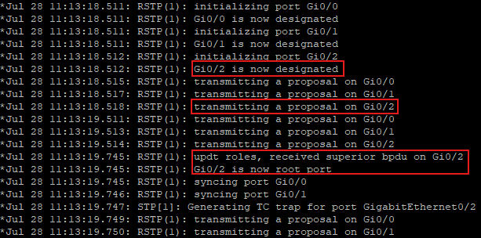
2.RSTP
Building RSTP Topology: When two RSTP switches first connect, they establish a bidirectional RSTP handshake across the shared link to identify a root switch.
This is known as synchronization process and applies to a scenario when a new switch is added to a stabilized RSTP topology as well.
Synchronization process:
As two switches connect, they verify that they are connected with P2P link by checking full duplex status.
They establish a handshake with each other by sending a RSTP proposal that contains itself as root identifier and it’s link as DP.
Each switch evaluates the proposal of other switch to find superior proposal. Preference is same as 802.1D logic.
The inferior switch moves it’s port as RP and concurrently moves all it’s non-edge port to discarding. Therefore it has stopped all local switching for non-edge ports.
The inferior switch sends an agreement to root switch to signify that synchronization is happening in that switch.
Both the inferior and superior switch move their RP and DP to forwarding state.
Inferior switch repeats the process for any downstream switch connected to it.
Below is the spanning-tree event debug on SW2 connected to SW1 on port Gi0/2. Ports Gi0/1 and Gi0/0 are connected to powered off devices.

Slide 12
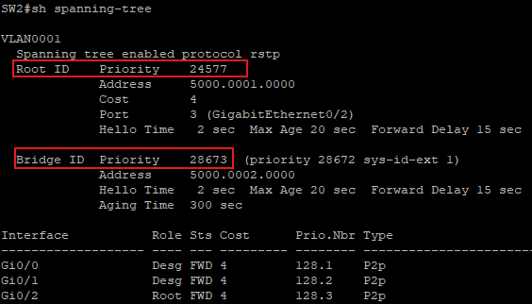
3.Advanced STP Tuning
Root Bridge Placement: Ideally root switch is placed on core switch and secondary root switch is designated for redundancy.
Root bridge can be selected by setting the system priority to lower value.
Priority can be set with either of the following commands:
spanning-tree vlan vlan-id priority priority
spanning-tree vlan 10 priority 24,576
Priority value is between 0 and 61,440 and should be multiple of 4096.
spanning-tree vlan vlan-id root {primary|secondary} [diameter diameter]
spanning-tree vlan 10 root primary
This command executes a script to sets primary root’s system priority to 24,576 and secondary root’s priority to 28,672.
The optional diameter command should reference the maximum number of layer 2 hops between the root bridge and STP topology boundary/edge switch.
This command tunes STP convergence and timers, which are carried in BPDU from root switch throughout the topology.
Below picture shows output of show spanning-tree on SW2 after issuing spanning-tree vlan 1 root primary on SW1 and spanning-tree vlan 1 root secondary on SW2.
Generally, root switch are placed at layer2/layer3 boundary.
Best approach to set primary root is to set system priority to 0 and secondary root system priority to 4096.

Slide 13
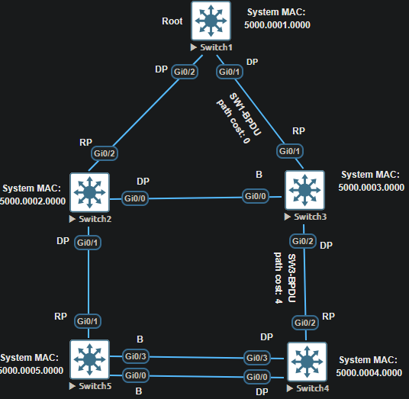
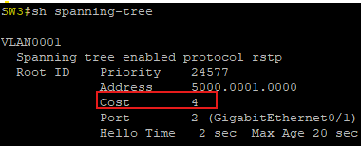
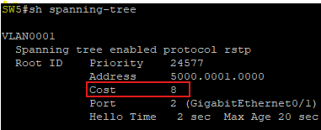
3.Advanced STP Tuning
Modifying STP root port and blocked port locations:
When switch generates BPDUs, the path cost is the total cost to reach the root switch and does not include the port cost out which the BPDU is advertised.
The receiving switch adds the cost of the port on which the BPDU is received.
As shown in the topology in left:
SW1 sends BPDU with path cost of 0.
SW3 relays that BPDU with path cost of 4 by adding path cost of it’s RP (Gi0/1).
SW5 receives BPDU from SW3 with path cost of 4 on it’s RP.
The root path cost on SW5 is 8 after adding the port cost of it’s RP (Gi0/2).
Modifying the port cost with spanning-tree [vlan vlan-id] cost cost command under interface configuration mode will change the STP forwarding path and topology.
Unless the optional vlan keyword is used, STP modifies the cost for all VLAN.

Slide 14
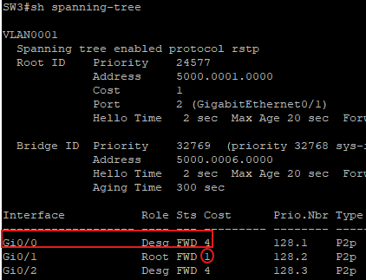
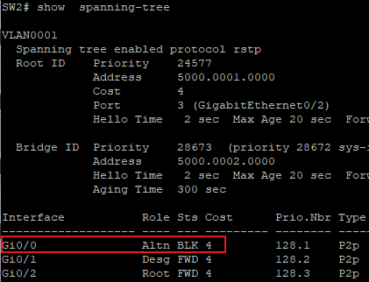
3.Advanced STP Tuning
By changing the port cost of SW3 Gi0/1 to 1, we can influence the port roles in the link between SW2 and SW3.
SW3 Gi0/0 now becomes DP as SW3 has lower root path cost of 1 and SW2 Gi0/0 becomes blocked as it has higher root path cost of 4.
In a link between two switches where both are DP and one needs to be blocked to prevent loops, ports local cost is irrelevant and which port in the link is blocked depends on the switch’s root path cost.
For example, changing port cost of SW3’s Gi0/0 to 1 would not change the port role in the link between SW2 and SW3.
Switch with low root path cost stays DP and switch with higher root path cost blocks it’s port.
Same root path cost goes through the tie-breaker process.
Modifying port priority: In a scenario where the root path cost and system priority remains same, modifying port priority can influence the port role.
In SW4, if we change cost of Gi0/2 to 8 or shut it down. Gi0/0 becomes RP.
As both root path cost and system priority are same on all ports (Gi0/2,Gi0/3 and Gi0/0), next check isport priority followed by port number.
All the ports have same port priority of 128 thus port Gi0/0 with priority.number of 128.1 becomes the root port.
As both port priority and number is controlled by upstream switch, changing port priority of SW5’s Gi0/3’s priority can make SW4’s Gi0/3 a RP.

Slide 15
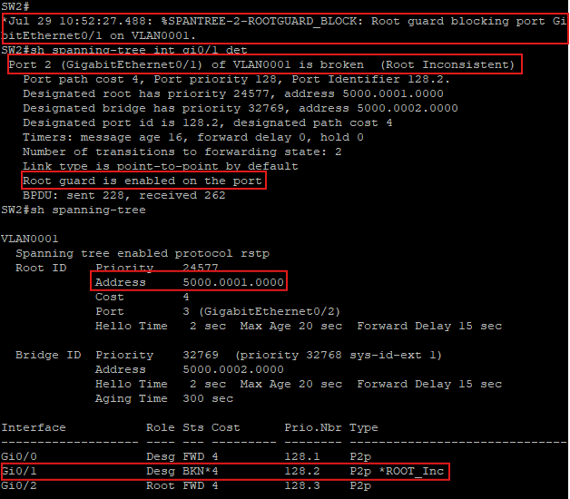
4.STP Protection Mechanism
Unlike layer 3 Time-to-Live (TTL) mechanism to protect loops, there is no such mechanism to prevent layer 2 loops.
In layer 2 loops, in addition to consuming bandwidth the CPU spikes as the frame needs to be processed constantly from incoming to outgoing interface.
Root Guard
Configuring root guard in a switchport puts the port in ErrDisable state if superior BPDU is received and prevents it from becoming a root port.
Therefore, any switch that is connected to a port with root guard configured cannot become root switch.
Root guard is configured on a port by port basis and prevents a rouge switch to become root in STP topology.
In our topology, root guard can be configured on SW2’s interface connected to SW5 and SW3’s interface connected to SW4 can to prevent SW5 and SW4 from ever becoming root.
SW2 and SW3 can still reach root SW1 via link between them if one of their current RP fails.
Root guard can be configured with spanning-tree guard root command under interface configuration mode.
Syslog message shows root guard is blocking the port when SW5 sends superior BPDU.
Gi0/1 is reported as broken due to root inconsistency while still keeping the original root (SW1) details intact.
In this topology, configuring root guard only in SW2’s Gi0/1 and not in SW3’s Gi0/2 will only block SW2’s Gi0/1 but will not prevent SW5 from becoming root as it’s superior BPDU can still reach SW2 via SW3.

Slide 16
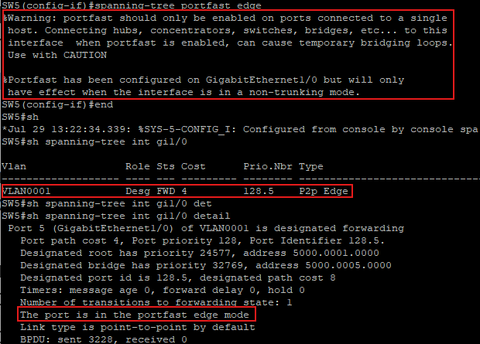
4.STP Protection Mechanism
STP Portfast
STP portfast feature disables TCN generation for access ports that are connected to end hosts to provide layer 2 stability.
If a BPDU is received on portfast enabled port, portfast is removed and function as normal RSTP enabled port.
Portfast can be enabled in port by port basis with command spanning-tree portfast or globally on all access ports with spanning-tree portfast default.
To disable portfast on a port, spanning-tree porfast disable command is used under interface configuration mode.
To enable portfast on trunk port that is connected to end hosts such as VM or Server, spanning-tree portfast trunk can be used under the interface configuration mode.
Enabling portfast globally, shows below warning;
SW5(config)#spanning-tree portfast edge default
%Warning: this command enables portfast by default on all interfaces. You should now disable portfast explicitly on switched ports leading to hubs, switches and bridges as they may create temporary bridging loops.
In our topology, connecting a PC on Gi1/0 interface of SW5 and enabling portfast on that port only will show below warning. The port type is shown as P2p edge port.

Slide 17
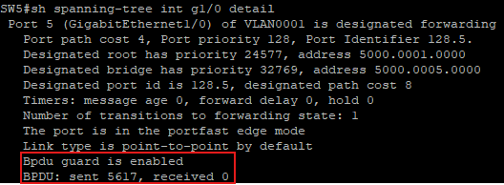
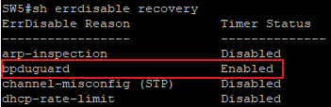
4.STP Protection Mechanism
BPDU Guard
STP BPDU guard feature disables the port if any BPDU are received on the port enabled with portfast.
BPDU guard is enabled on all access switch with portfast enabled with command spanning-tree portfast bpduguard default
BPDU guard can be enabled or disabled on individual port with spanning-tree bpduguard {enable | disable}
If any BPDU is received on BPDU guard enabled port, the port is put in ErrDisable state and do not recover automatically.
To recover ErrDisabled port due to BPDU guard violation, Error Recovery service must be used.
To use Error Recovery service to recover port that were ErrDisabled due to BPDU guard, use errdisable recovery cause bpduguard in global config mode.
The period that the Error Recovery service checks for the errors in the port is configured with errdisable recovery interval time-seconds
Default interval is 300 seconds (5 min) and range can vary from 5 to 86,400 seconds (24 hrs)
In our topology, Gi1/0 interface of SW5 is enabled with portfast and enable it with bpduguard as well.
Enabling portfast and bpdu guard with default command will show ‘Portfast/Bpdu guard is enabled by default’
Configuration of Error Recovery service can be verified with show errdisable recovery command.
There are other cause of error recovery service and timer details, below output is cut short.

Slide 18
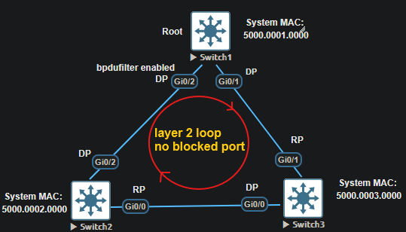
4.STP Protection Mechanism
BPDU Filter
BPDU filter simply filters BPDU being transmitted out of the port.
As with portfast and BPDU guard, BPDU filter can be enabled globally or on a port by port basis. But the behaviour of the BPDU filter enabled port differs by the way it is enabled.
If enabled globally with spanning-tree portfast bpdufilter default command, it sends series of 10 to 12 BPDUs at the start of link up.Then it start to filter (stop sending) BPDUs. When BPDU is received, it checks the switch preference and does below:
If it is the preferred switch, it does not process any BPDUs and only transmits BPDUs to downstream switch.
If it is inferior switch then it processes received BPDUs but do not send BPDUs to upstream superior switch.
If enabled on interface with spanning-tree bpdufilter enable command, the port does not send any BPDU. And if remote port has bpdufilter enabled then it shuts the port down to prevent loops.
Enabling bpdufilter on an interface can put the ports in a link between switches in both designated forwarding state and create loops.
In our topology, enabling bpdufilter on SW1’s Gi0/2 interface will force SW2’s Gi0/0 to be RP as it receives SW1’s BPDU via SW3.
This leaves both side ports in link between SW1 and SW2 as DP. Thus creating a layer 2 loop.

Slide 19
4.STP Protection Mechanism
Unidirectional Link Problems
Fibre optic cables consists two strands of glass/strand, one for transmit and another for receive.
The order of transmit and receive is opposite at two ends of the fibre optic cable link.
Problem with one link will create a unidirectional link while keeping the link in up state.
This prevents BPDUs reaching the downstream switch via unidirectional link (similar behavior as enabling bpdufilter on the interface.)
This forces the switch to choose new RP and receives traffic via new RP and transmits via the unidirectional link creating a loop.
STP Loop Guard: One of the solution to solve unidirectional link problem which prevents any Alternate or RP from becoming designated port due to loss of BPDUs in RP.
Loop guard places the original port in ErrDisabled state while BPDUs are not received and recovers and goes through normal STP states when it starts receiving BPDUs.
Loop guard should not be enabled on portfast enabled ports.
Loop guard can be enabled globally with spanning-tree loopguard default or on an individual interface with spanning-tree guard loop command.
In general enabling loop guard throughout the layer 2 switch network is best practice.
In our topology enabling loop guard on SW2’s Gi0/2 (RP) will prevent creating loops if no BPDU is received on that port due to unidirectional link or BPDU filter.
SW2# *Jul 29 18:51:29.743: %SPANTREE-2-LOOPGUARD_BLOCK: Loop guard GigabitEthernet0/2 on VLAN0001. SW2#sh run int gi0/2 interface GigabitEthernet0/2 negotiation auto spanning-tree bpdufilter enable spanning-tree guard loop SW2#sh spanning-tree Interface Role Sts Cost Prio.Nbr Type ------------------- ---- --- --------- -------- ----------------- Gi0/0 Root FWD 4 128.1 P2p Gi0/1 Desg FWD 4 128.2 P2p Gi0/2 Root BKN*4 128.3 P2p *LOOP_Inc

Slide 20
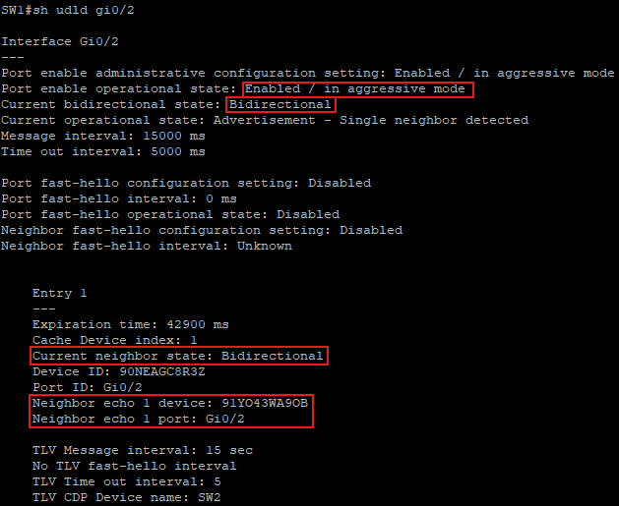
4.STP Protection Mechanism
Unidirection Link Detection (UDLD): This is another solution to unidirectional link problem that monitors the fiber-optic cables.
UDLD should be enabled on both end of the link, which forms UDLD neighborship.
UDLD neighbors send their System ID and port ID continuously to each other to verify if the link is bidirectional.
It can operate in two modes:
Normal mode: If the frames are not acknowledged, link is considered undetermined and port remains active.
Aggressive mode: If frames are not acknowledged, it sends another 8 frames in 1 second interval. If those are not acknowledged as well then the port is place into error state.
UDLD can be enabled globally on any SFP ports with udld enable [aggressive] command.
It can be enabled on specific port (fibre or copper) with udld port [aggressive] and can be disabled on specific port with udld port disable command.
UDLD recovery can be used with udld recovery [interval time-seconds] command.
UDLD can be verified with show udld neighbors
SW1#sh udld neighbors
Port Device Name Device ID Port ID Neighbor State
---- ----------- --------- ------- --------------
Gi0/2 90NEAGC8R3Z 1 Gi0/2 Bidirectional
More detailed info can be verifed with show udld interface-id command

Slide 21
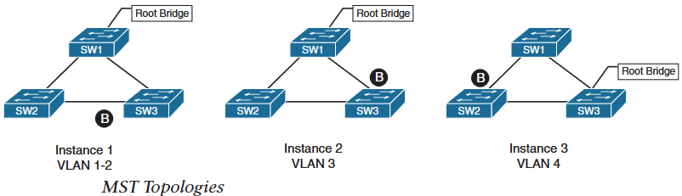
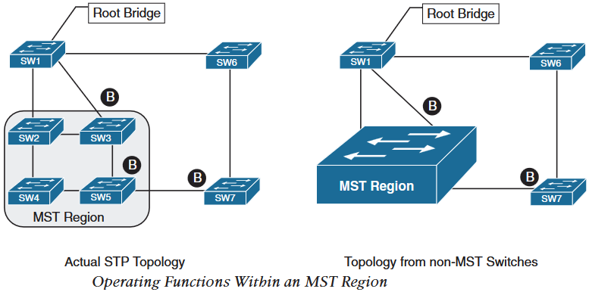
4.MST
Multiple Spanning Tree (MST): With PVST, PVST+ and RSTP, load sharing can be done by blocking alternate ports in alternate or different VLANs and root bridge can be placed in different switch per VLAN.
But with 802.1D load sharing was not possible as it used single STP topology for all VLANs known as Common Spanning Tree (CST).
With per VLAN based STP, switches must process large amount of STP BPDUs proportional to the number of VLANs. Convergence due to large trunk link failure forces switches to recompute STP topology for large number of VLANs.
MST provides a blended approach by mapping one or more VLANs in to single spanning tree instances called Multiple Spanning Tree Intstance (MSTI).
As shown in the figure, VLANs 1 & 2 are mapped to Instance 1, VLAN 3 is mapped to Instance 2 and VLAN 4 is mapped to Instance 3.
Adding more VLANs can be mapped to one of these instances.
MST Region
Grouping two or more switches that has same high level STP configuration is known as MST region.
MST incorporates a mechanism that makes MST region appear as a single virtual switch to other switches outside the MST region.

Slide 22
4.MST
MST Instances (MSTI): Each switch in MST runs a special instance 0 known as Internal Spanning Tree (IST).
IST runs on all switch interfaces in MST region regardless of the VLANs associated to the ports.
To minimize the number of BPDUs, information about other MSTIs is nested in the IST BPDUs and transmitted throughout the MST region.
Cisco supports upto 16 MSTIs by default, Instance 0 is known as IST and instances from 1 to 15 can be used for other MST instances.
MST Configuration Steps:
Define MST as spanning tree protocol with command spanning-tree mode mst.
(Optional) Define MST instance priority (root placement) with either of the following methods:
spanning-tree mst instance number priority priority
Priority range from 0 to 61,440, in increment of 4096.
spanning-tree mst instance number root {primary | secondary} [diameter diameter]
Associate vlans to MST Instance by entering MST configuration submode with command spanning-tree mst configuration. Under configuration submode, assign vlans to MSTI with command instance instance-number vlan vlan-id.
MST version number must match on all switches in same MST region. Specify MST version number under configuration submode with command revision version.
(Optional) define MST region name under configuration submode with command name mst-region-name.
By default MST region name is an empty string.

Slide 23
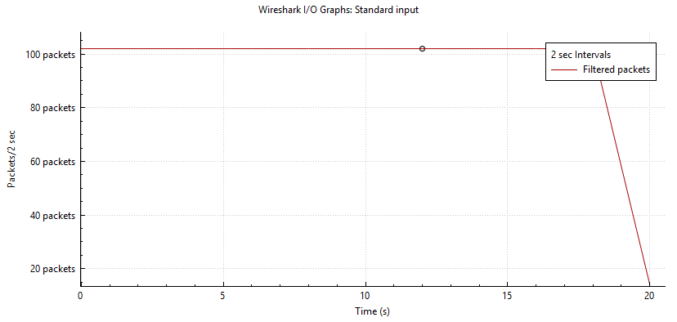
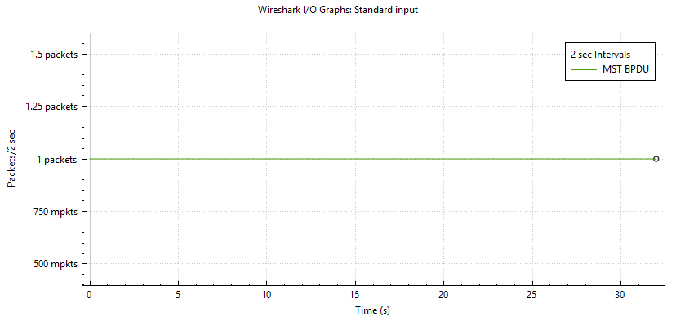
4.MST
PVST+ and MST Traffic comparison: Three switch topology with 105 total vlans. In first figure, about 105 (1 per vlan) packets/BPDUs every 2 seconds are transmitted. Whereas, in the second figure, MST generates 1 single instance 0 BPDU for all 105 vlans per 2 seconds.
MST configuration Example:
SW1(config)#spanning-tree mode mst
SW1(config)#spanning-tree mst configuration
SW1(config-mst)#instance 1 vlan 1-50
SW1(config-mst)#instance 2 vlan 51-100
SW1(config-mst)#revision 1
SW1(config-mst)#name main-region
SW1(config-mst)#exit
SW1(config)#spanning-tree mst 1 root primary
SW1(config)#spanning-tree mst 2 root secondary
MST Verification:
SW1#sh spanning-tree mst configuration
Name [main-region]
Revision 1 Instances configured 3
Instance Vlans mapped --------------------------------------------
0 101-4094
1 1-50
2 51-100
-------------------------------------------
SW1#show spanning-tree mst 1
##### MST1 vlans mapped: 1-50
Bridge address 5000.0001.0000 priority 24577 (24576 sysid 1)
Root this switch for MST1
Interface Role Sts Cost Prio.Nbr Type
Gi0/0 Desg FWD 20000 128.1 P2p
Gi0/1 Desg FWD 20000 128.2 P2p
Gi0/2 Desg FWD 20000 128.3 P2p
Gi0/3 Desg FWD 20000 128.4 P2p
Gi1/0 Desg FWD 20000 128.5 P2p
Gi1/1 Desg FWD 20000 128.6 P2p
Gi1/2 Desg FWD 20000 128.7 P2p
Gi1/3 Desg FWD 20000 128.8 P2p

Slide 24
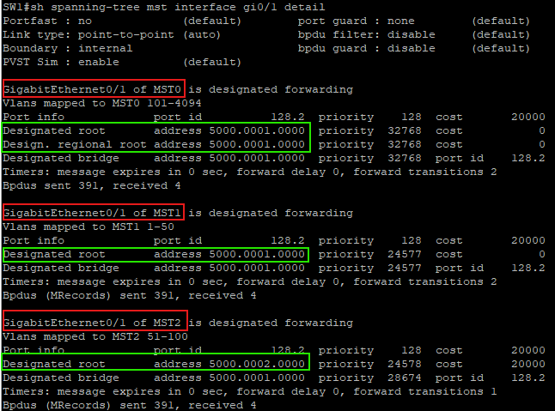
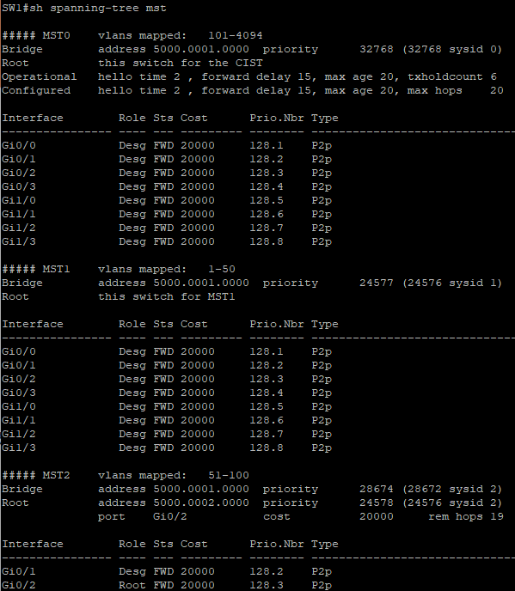
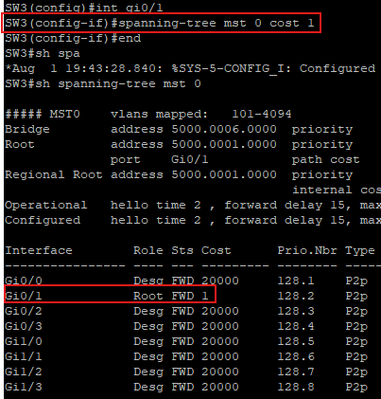
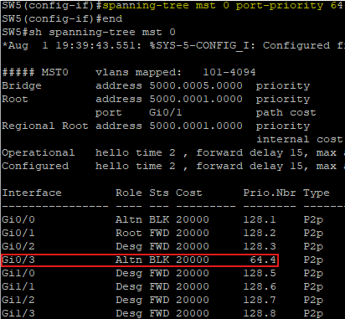
4.MST
MST Verification:
The priority value for an MST switch is system priority plus the instance id.
show spanning-tree mst
show spaninng-tree mst interface interface-id [detail]
All interface belongs to MST 0 by default, vlan 1 is included in MST 1 thus all interfaces are shown under MST 1.
Interface Gi0/1 and Gi0/2 are trunk link that allows all vlans from 1 to 100, thus these interfaces appear in all three MST instances.
MST Tuning: MST supports the tuning of port cost and port priority.
Port cost: Under interface configuration command use spanning-tree mst instance-number cost cost
Port Priority: Under interface configuration command use spanning-tree mst instance-number port-priority priority

Slide 25
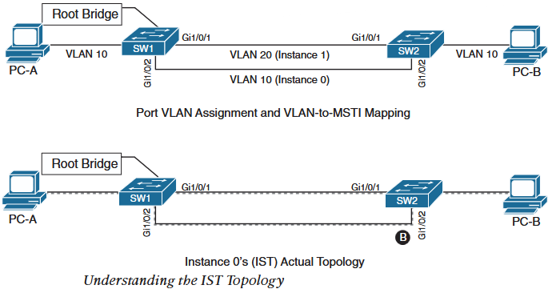
4.MST
Common MST Misconfigurations:
VLAN assignment to IST
PC-A, PC-B and interface Gi1/0/2 of both SW1 and SW2 belong to vlan 10. Vlan 10 is mapped to IST and vlan 20 is mapped to MSTI 1. It would appear that the traffic can flow between PC-A and PC-B via Gi1/0/2 link between SW1 and SW2.
By default all the access interface belong to IST. For the link between SW1 and SW2, G1/0/1 of both switch will by default belong to IST as well. Thus, for IST, SW1 being root switch and both of its port are designated port, SW2 will have to block one of it’s port for the link.
SW2 blocks Gi1/0/2 based on port number as shown in second picture.
So the traffic for vlan 10 unintentionally flows through Gi1/0/1 interface instead of Gi1/0/2.
To solve this either map vlan 10 to different MSTI other than IST or allow all vlans on trunk link between switches.
VLAN pruning on trunk link
While pruning vlans on trunk link of a MSTI topology, every vlans of MSTI must be pruned.
Leaving one VLAN active while pruning another from the same instance on a link can cause MST to place the active VLAN's traffic on a port that the logical instance has blocked, resulting in dropped packets.

Slide 26
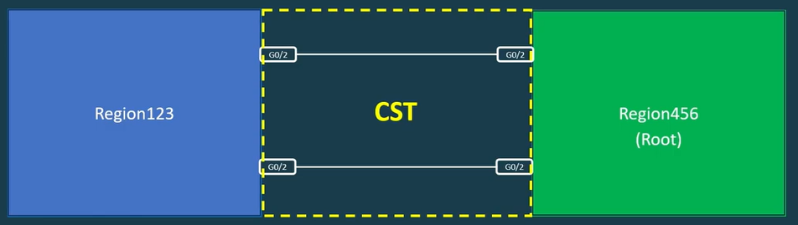
4.MST
MST Region Boundary
MST region boundary is any port that connects a MST region to different MST region or 802.1D or 802.1W switch.
MST instances are contained within the IST.
Each MST region is represented as a single logical switch to another MST region or non-MSTP switch.
A Common Spanning Tree (CST) is a spanning tree for connection between MST regions or connection between MST region and non-MSTP swtiches.
Propagating CST at the region boundary involves feature called PVST simulation mechanism.
PVST simulation mechanism at the region boundary is to map region’s IST to vlans and transmit PVST+/RSTP BPDUs.
This is required because the PVST+/RSTP switches do not understand IST BPDU structure.
On receiving PVST+/RSTP BPDU on region boundary, it is not mapped to vlans in MSTI.
Instead vlan 1 BPDU of PVST+/RSTP switches are mapped to IST of the MST region.
A common spanning tree that represents whole LAN (MST region’s IST, CST and PVST+ switches) is known as Common Internal Spanning Tree (CIST).

Slide 27
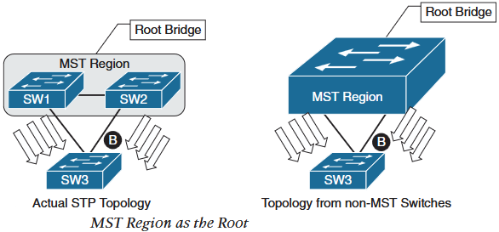
4.MST
There are two scenarios while interconnecting MST region with non-MSTP switches:
MST region as the root bridge (CIST root bridge in MST region)
This scenario makes region boundary port to flood same IST BPDU to all VLANs in the PVST switches.
The MST region appears as a single logical switch and PVST switches detect alternate links and place them in Blocking state.
SW1 and SW2 transmit superior BPDUs for each VLAN towards SW3.
SW3 is responsible for blocking ports towards MST region.
MST region not a root bridge for any VLAN (CIST root bridge in PVST+ region)
Since IST BPDU is a one to many translation of all vlans PVST BPDU, MST region port can only block or forward for all vlans.
If superior BPDU is received for any VLAN from PVST switch, the MST region boundary port uses bpdu guard to block the port to create a loop free topology.
This mechanism is called PVST simulation check.

