Slide 1
Virtualization
Learning Outcomes:
Server Virtualization
Network Function Virtualization (NFV) ETSI
Cisco Enterprise Network Function Virtualization (ENFV)

Slide 2
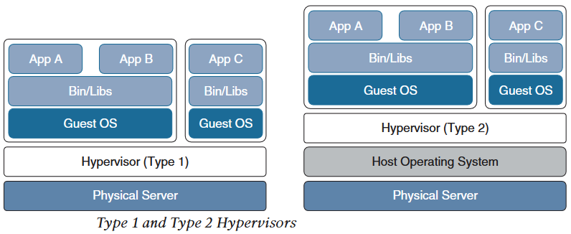
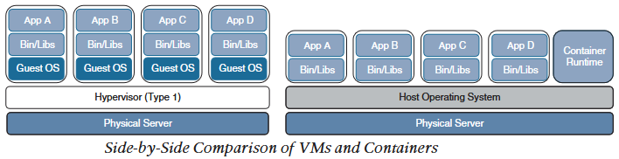
1.Server Virtualization
A physical server that uses software (hypervisor) to share it’s resources with multiple virtual machines (Vms) running on it is known as virtualized server.
Virtual Machines
A software emulation of physical server with an operating system is known as Virtual Machine.
From application point of view, VMs provide the look and feel of real physical server with CPU,memory,and NICs.
Some advantages of VMs is that they can be easily migrated and can be used to provide high availability during primary server failure.
Hypervisors
The software that creates VMs and performs hardware abstraction that allows multiple VMs run concurrently is known as Hypervisor.
Two types of hypervisor:
Type 1: Commonly referred as ‘bare metal’ or ‘native’, they run directly on hardware.
Type 2: Typically used by client devices, they run on host OS. VMware Fusion is an example.
Containers
Container is an isolated environment where a containerised application run.
A containerised application is an application with all it’s dependencies packed together.
A VM includes guest OS, that comes with large number of components that are not require for an application to run.
Whereas, containers share the underlying resources of the host operating system and does not include guest OS.
An application running on VM is dependent on states of guest OS (bootup and initialisation) whereas, containers run direclty on already up and running host OS.

Slide 3
1.Server Virtualization
A physical server that uses software (hypervisor) to share it’s resources with multiple virtual machines (Vms) running on it is known as virtualized server.
Virtual Machines
A software emulation of physical server with an operating system is known as Virtual Machine.
From application point of view, VMs provide the look and feel of real physical server with CPU,memory,and NICs.
Some advantages of VMs is that they can be easily migrated and can be used to provide high availability during primary server failure.
Hypervisors
The software that creates VMs and performs hardware abstraction that allows multiple VMs run concurrently is known as Hypervisor.
Two types of hypervisor:
Type 1: Commonly referred as ‘bare metal’ or ‘native’, they run directly on hardware.
Type 2: Typically used by client devices, they run on host OS. VMware Fusion is an example.
Containers
Container is an isolated environment where a containerised application run.
A containerised application is an application with all it’s dependencies packed together.
A VM includes guest OS, that comes with large number of components that are not require for an application to run.
Whereas, containers share the underlying resources of the host operating system and does not include guest OS.
An application running on VM is dependent on states of guest OS (bootup and initialisation) whereas, containers run direclty on already up and running host OS.

Slide 4
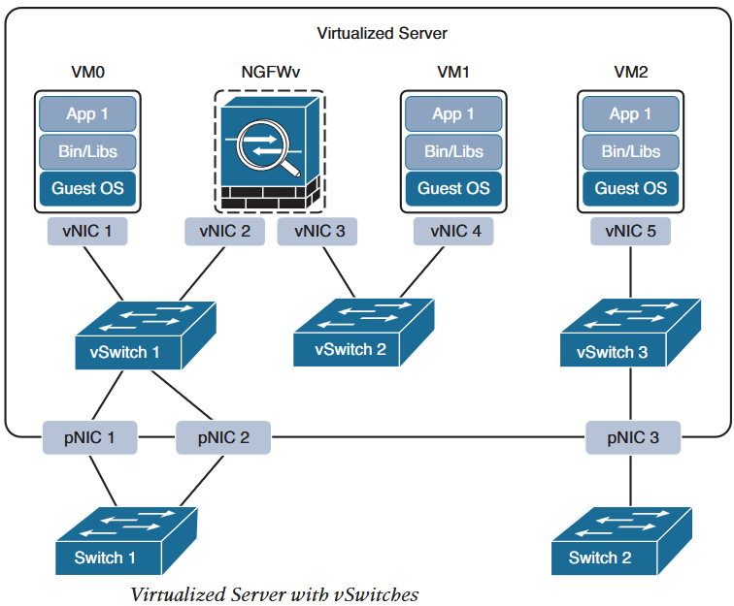
1.Server Virtualization
Containers
A container image is the file created by container engine that includes application code and all it’s related dependencies only.
A container engine is a software that creates, manages and runs containers in an isolated envirnoment.
Docker engine is the most popular container engine and some other container engines available are :
rkt (pronounced ‘rocket’)
Open Container Initiative
LXD (pronounced ‘lexdi’) from Canonical Ltd.
Linux-Vserver
Windows Containers
Virtual Switching
A virtual switch (vSwitch) is a software emulation of layer 2 switch.
vSwitch enables VMs on a virtualized server to communicate with each other and outside physical network through physical NIC (pNIC).
Multiple vSwitches can be created within a virtualized server but they cannot communicate with each other directly and cannot share pNIC.
In above figure, vSwitch1 is linked to pNIC 1 & 2 and vSwitch3 is linked to pNIC3.
VSwitch2 is not linked to any pNIC, therefore hosts connected to it (VM1) must communicate with outside network and VM0 via NGFWv.
Some of the popular virtual switches are Cisco Nexus 1000VE series, Cisco Application Virtual Switch (AVS), Open vSwitch (OVS) and vSphere Switch.

Slide 5
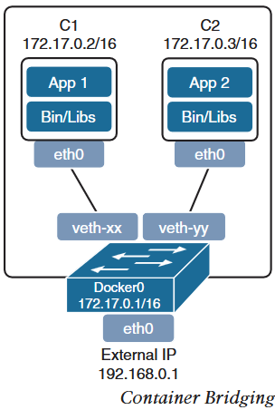
1.Server Virtualization
Virtual Switching
A virtual switch (vSwitch) is a software emulation of layer 2 switch.
vSwitch enables VMs on a virtualized server to communicate with each other and outside physical network through physical NIC (pNIC).
Multiple vSwitches can be created within a virtualized server but they cannot communicate with each other directly and cannot share pNIC.
Aggregation of vswitches from cluster of virtualized servers into a single Distributed Virtual Switch (DVS) for easier management and configuration.
Virtual switches for containers is known as virtual bridges that enable inter container (within a node) and outside network communication.
Docker engine creates a virtual bridge named docker0 with 172.16.0.1/16 subnet assigned to it.
Every container created by docker is assigned a virtual ethernet (veth) interface with ip address from 172.16.0.0/16.
The virtual ethernet interface (veth) appears as eth0 to the container.
Containers in different nodes are not reachable by default, and needs to be linked using OS level routing or overlay networking.
Containers in different nodes with default configuration end up with same subnet and ip addresses.
Container orchestrator such as Kubernetes is a better option to manage connectivity between containers deployed in same or different node.

Slide 6
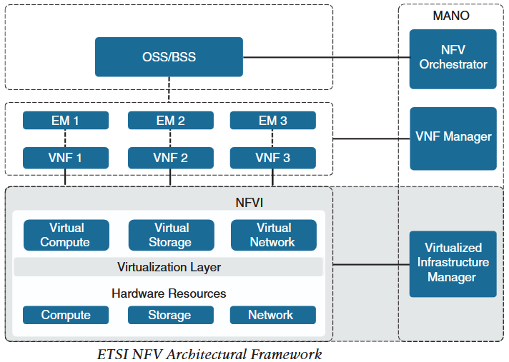
2.Network Function Virtualization
Network Function Virtualization (NFV)
NFV is an architectural framework created by European Telecommunication Standard Institute (ETSI) that defines standard to decouple network functions from hardward based appliances and have them run on standard x86 based server.
It also defines standard to manage and orchestrate network functions.
Network Functions (NF) are the functions performed by physical appliances such as firewall and router.
Some of the benefits of NFV are :
Reduced capital (capex) and operational expenditure (opex) through reduced equipment costs and efficiency through power, storage and cooling.
Faster time to market (TTM) because of simplified deployement.
Improved return on investment (ROI).
Ability to scale up/down and in/out (elasticity).
Opportunities to test and deploy new services virtually with lower risk.
NFV Infrastructure (NFVI)
Hardware and software components that comprise platform environment to deploy virtualized network functions.
Element Managers (EM)
Also known as element management systems (EMSs) are responsible for functional management (Fault,Config,Accounting,Performance and Security) of VNFs.

Slide 7
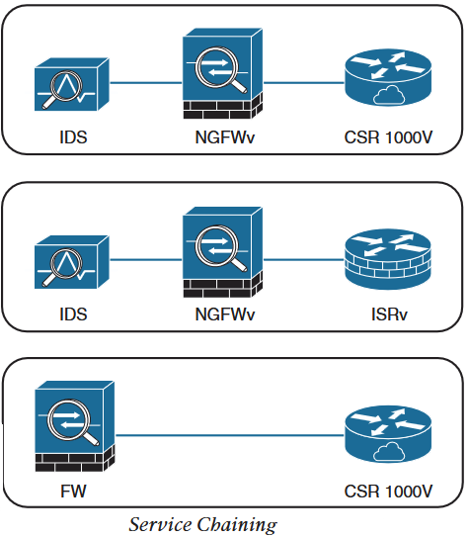
2.Network Function Virtualization
Virtual Network Functions (VNF)
VNFs are software version of NF that typically runs on hypervisor as a VM.
VNFs are Commonly used for layer 4 to layer 7 functions such as load balancers, firewalls, Intrusion Detection Systems (IDSs), Application Delivery Controllers (ADC) and WAN optimization appliances.
Some VNFs can however perform layer 2 and layer 3 functions as well.
Some of the available Cisco VNFs are :
Cloud Services Router (CSR) 1000v
Cloud Services Platform (CSP) 2100
Integrated Services Virtual Router (ISRv)
NextGen Firewall Virtual Appliance (NGFWv)
Adaptive Security Virtual Appliance (ASAv)
Virtualized Infrastructure Manager (VIM)
NFVI VIM is responsible for management of hardware resources and virtualized resources.
It is also responsible for collection of performance measurement and fault information.
In addition it performs lifecycle management (setup,maintenance and teardown) of NFVI and service chaining.
Service chaining is chaining one or more VNFs to provide NFV service or solution.

Slide 8
2.Network Function Virtualization
Management and Orchestration (MANO)
NFV orchestrator is responsible for the setup, maintenance and tearing down of the VNFs.
If multiple VNFs are part of network service, VNF orchestrator is responsible for end to end management of the network service over multiple VNFs.
VNF manager manages lifecycle of VNFs and is responsible for FCAPS of the VNFs.
VNF orchestrator and VNF manager together is know as MANO.
Operation Support System (OSS)/Business Support System (BSS)
OSS is a platform typically used by service providers and large enterprises to manage network services.
It is used to manage the network inventory, provisioning new services,device configuration and resolve network issue.
BSS is a combination of product management, customer management, revenue management (billing) and order management.
VNF Performance
In NFV solution, data traffic enter through pNIC and reach the VNF and then can exit through pNIC, this type of traffic is known as North-South traffic.
Similarly, traffic can be East-West where it enters via pNIC reaches VNF and travels between VNFs (service chaining) and then exit through pNIC.
VNF traffic can be combination of two as well where data traffic is North-South and performance metrics traffic is East-West.
NFV solution terminology
Input/Output (I/O) : Communication between computing system and outside network/devices.
I/O device: Peripheral device such as mouse, keyboard, monitor or NIC.
Device driver: A computer program that controls the I/O device and allows communication with CPU. Ex. NIC driver.

Slide 9
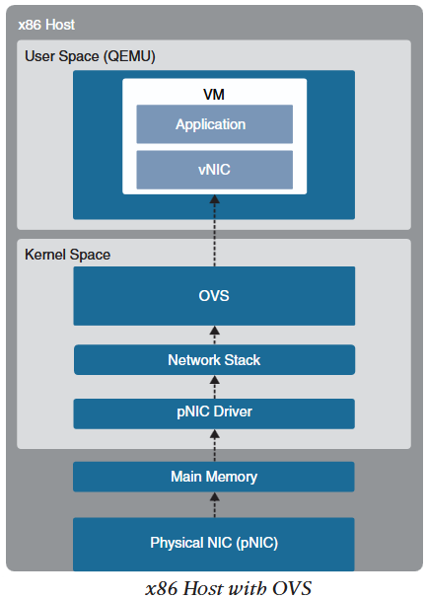
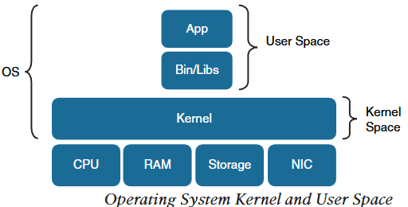
2.Network Function Virtualization
NFV solution terminology
Interrupt request (IRQ): A hardware signal sent by I/O device to the CPU to notify data transfer. On receiving IRQ, CPU halts its current task and runs associated interrupt handler.
Interrupt handler: Each device driver has it’s own interrupt handler. It determines the cause of the interrupt, performs necessary processing, performs CPU state restore, and issues a return-from- interrupt instruction to return control to CPU.
Direct memory access (DMA): Memory access method that allows I/O device to access main memory directly by passing CPU.
Kernel and User space: Kernel (core in German) is a core part of the OS and memory where applications and associated libraries reside. Kernel directly manages hardware components and provides system services to applications. Kernel is executed in protected area of main memory known as kernel space to prevent other process from affecting it. Non-kernel processes are executed in memory area called user space where applications and their libraries reside.
In Operating System Kernel and User Space figure, data destined for application travel through kernel space in a non virtualized environment.
But in virtualized environment as shown on above right figure, there are hypervisor and vswitch in between which are responsible for taking data from pNIC and sending it to vNIC.
Virtualization introduces new packet processing points and can create bottlenecks in input/output.

Slide 10
2.Network Function Virtualization
High level packet flow in virtualized server
Data traffic is received by pNIC and is placed on Rx queue (ring buffers) within pNIC.
pNIC sends packet and packet descriptor to main memory buffer through DMA. Packet descriptor contains only it’s size and memory location.
pNIC sends IRQ to CPU.
CPU transfers control to pNIC driver that services the IRQ by receiving and placing the packets into network stack and into socket receive buffer.
Then the packet is copied from socket receive buffer to OVS virtual switch.
OVS processes and moves the packet to vNIC which is expensive in terms of CPU cycle as the packet is moved from kernel space to user space.
Packet arrives at vNIC of VM and is placed on receive buffer of vNIC.
vNIC sends packet and packet descriptor to virtual memory (VM memory) buffer through DMA.
VNIC sends IRQ to vCPU.
VCPU transfers control to vNIC driver, which serves the IRQ by receiving and placing the packet into network stack and into socket receive buffer.
The packet is finally delivered to the application running on VM.
With high numebr of data received on high speed links (40Gbps), CPU is interrupted frequently and reduces the throughput.
To increase throughput and solve the problem of frequent CPU interruption, many I/O technologies have been created.
Most prevalent I/O technologies are:
OVS Data Plane Development Kit (OVS-DPDK)
PCI Passthrough
Single-root Input/Output Virtualization (SR-IOV)
To implement these technologies, pNIC that supports them is required.

Slide 11
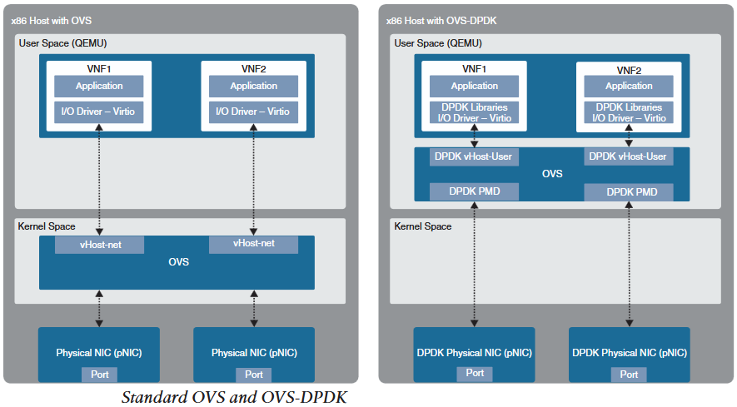
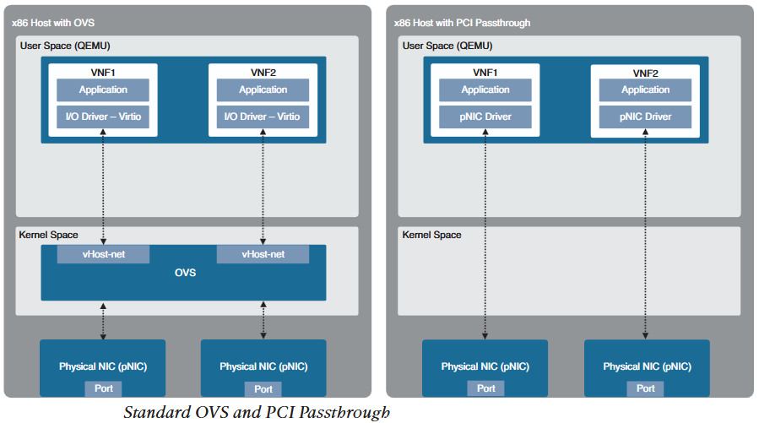
2.Network Function Virtualization
OVS-DPDK
Enhancement to OVS with DPDK libraries that operates entirely in user space.
OVS-DPDK includes Poll Mode Driver (DPDK-PMD) that polls and handles data arrived on pNIC bypassing the kernel space entirley.
But for DPDK-PMD to function it requires one or more CPU cores dedicated to it.
PCI Passthrough
PCI passthrough allows VMs (VNFs) to have direct access (one-to-one mapping) to physical PCI devices as if they are directly attached to them.
Downside of PCI passthrough is that, entire pNIC is dedicated to single VNF and cannot be shared between VNFs.

Slide 12
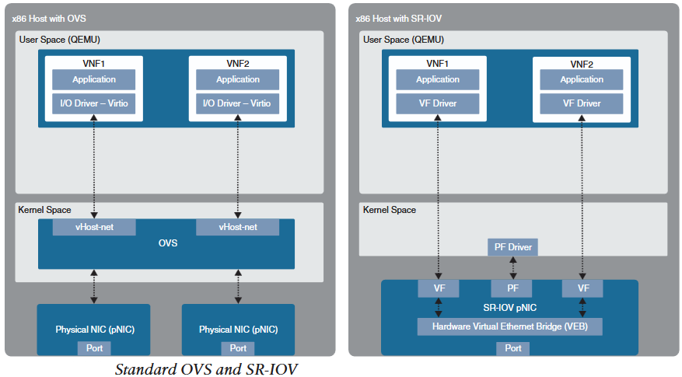
2.Network Function Virtualization
Single-root I/O Virtual Switch (SR-IOV)
Enhancement to PCI passthrough that allows single pNIC to be shared by VNFs.
SR-IOV emulates (imitate behavior) single PCI express (PCIe) devices (pNIC) as multiple PCIe devices.
Emulated PCIe devices are called Virtual Functions (VFs) and physical PCIe devices are called Physical Funtions (PFs).
VNFs have direct access to VFs using PCI passthrough technology.
SR-IOV enabled pNIC supports two different modes for switching traffic between VNFs:
Virtual Ethernet Bridge (VEB): As shown in the figure above, data traffic between VNFs attached to same pNIC is hardware switched directly by pNIC.
Virtual Ethernet Port Aggregator (VEPA): Data traffic between VNFs attached to same pNIC is switched by an external switch.

Slide 13
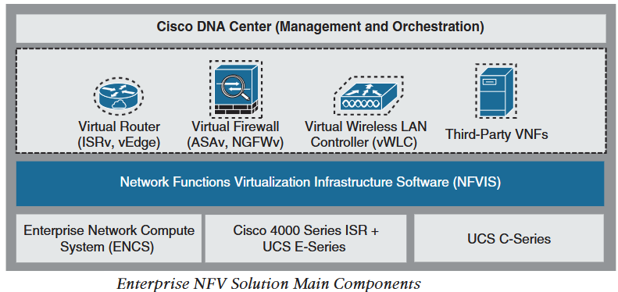
3.Cisco Enterprise Network Function Virtualization (ENFV)
Cisco Enterprise Network Function Virtualization (ENFV)
Cisco ENFV is a solution based on ETSI NFV architectural framework.
It reduces the operational complexity of enterprise branch networks by running network services (firewalls,routers, load balancer, WLC, IDS) as VNFs on standard x86 host.
Cisco ENFV provides added benefits to the ETSI NFV benefits.
Cisco ENFV solution architecture
Based on ETSI NFV architecture, it has four main components
Management and Orchestration
Cisco Catalyst Centre (formerly DNA centre) provides MANO functionality to ENFV.
It includes centralized dashboard and tools to design, provision manage and monitor all branch sites across enterprise.
Two of the main functions of Catalyst centre are to roll out new branch sites and deploy VNFs and network services.
It also provides a centralized policy management by creating network profiles that can be applied to branch sites.
Network profiles include:
Configuration for LAN and WAN virtual interfaces.
Services or VNFs and their system settings (CPU,memory etc) including service chaining.
Device configuration for VNFs through configuration templates created through template editor tool.
Plug and Play allows new branch sites/ENFV to register and provision according to the network profiles assigned to the site.

Slide 14
3.Cisco Enterprise Network Function Virtualization (ENFV)
Virtual Network Functions and Applications
Cisco and third party VNFs can be onboarded on the ENFV solution.
Cisco supported VNFs are:
Cisco Integrated Services Virtual Router (ISRv) for virtual routing
Cisco ASAv for virtual firewall
Cisco NGFWv for integrated firewall and Intrusion prevention and detection
Viptela vEdge
cEdge
Cisco virtual Wide Area Application Services (vWAAS) for virtualized WAN optimization
Cisco vWLCs
Third party VNFs supported by ENFV are:
ThousandEyes
Fortinet
PaloAlto
InfoVista
CTERA
Windows Server and Linux Server
x86 based hardware resources
Cisco ENFV is supported on following x86 hosting platforms:
Cisco Enterprise Network Compute System (ENCS)
Cisco Cloud Services Platform
Cisco 4000 series ISRs with a Cisco UCS E-Series blade
UCS C-Series
Which platform to choose depends on the features such as:
VoIP
Non-Ethernet based Interfaces (T1 or DSL)
4G-LTE
I/O technology such SR-IOV
Number of cores needed

Slide 15
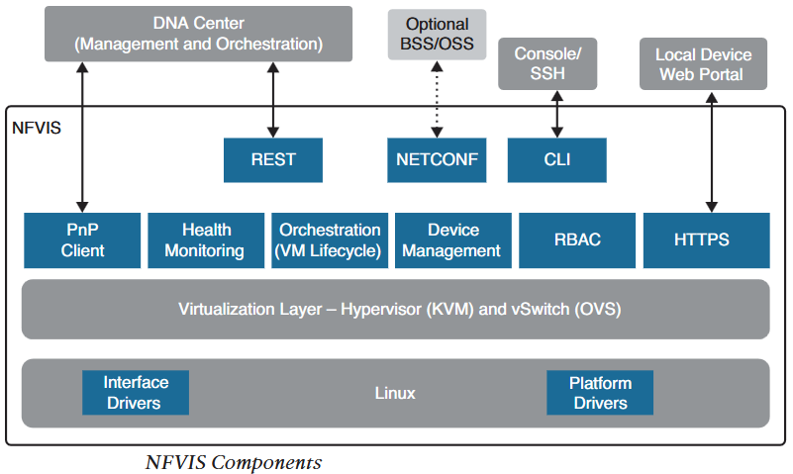
3.Cisco Enterprise Network Function Virtualization (ENFV)
Network Function Virtualization Infrastructure Software (NFVIS)
NFVIS is based on standard Linux packaged with additional functions for virtualization, VNF lifecycle management, monitoring, device programmability and hardware acceleration.
Components of NFVIS are shown in the figure:
Linux: Drives the underlying x86 hosting platform and hosts virtualization for VNFs, vSwitch API, interface drivers, platform drivers and management.
Hypervisor : Based on Kernel-based Virtual Machine (KVM) and include Quick Emulator (QEMU), LibVirt and other associated libraries.
Vswitch: It is Open vSwitch (OVS) and it enables communication between VNFs and outside network.
VM Lifecycle Maangement: Provides VIM functionality of NFV framework through ENFV embedded Elastic Services Controller (ECS) lite. ECS lite supports dynamic bringup of VNFs-creating and deleting VNFs, addinf CPU core, memory and storage. It also supports monitoring of VNF with auto restart of VNFs and send alarm to SNMP or Syslog.
PnP Client: Enables bring up of new hosting platform. It communicates with PnP Server on Catalyst Center to provision and zero touch deployment of x86 hosts.
RBAC: Users accessing the platform are authenticated using RBAC.
Orchestration: REST, CLI, HTTPS and NETCONF/YANG data models are supported for orchestration and management.
HTTPS Web Server: Provides connectivity to local platform for task such as VNF code uploading, start/stop VNFs/services, connect to VNFs and monitor services.

