Slide 1
CPSC 5021 Database Systems Group Project —Team 3
Torben Bernhard
Lei Meng
Uchenna Nwoke

Slide 2

Online Vehicle Sales Platform
Simplify car buying process
Find the right vehicle for customer's budget and needs
Track demand, reach potential customers, and maintain inventory
Notes:
Our mission is to simplify the car buying process for buyers and sellers alike.
Customers face difficulties finding a vehicle available in their price range, in their area, and that meets their needs.
Vendors on the other hand struggle to reach potential customers, track and meet demand, and maintain their inventory.
Our platform uses data provided by vendors and customers to provide both parties with the information they need to make informed, data-driven decisions and reduce wasted time, effort, and money.

Slide 3
Problems
Vendors: How to maintain inventory? How to set price and find the price per vendor competitors?
Customers: How to find vehicles meet their needs? How to compare price trends?
User experience: How to gather valuable and understandable information to inform decisions?
Notes:
The main problem vendors and customers face is the lack of valuable and understandable information they can use to inform their decisions.
One major pain point for the buying process for vendors and customers is location.
Vendors struggle with inventory maintenance, customers struggle to find vehicles that meet their needs.
Another challenge faced is vehicle pricing. Setting price and finding the price per vendor competitors. Lastly considering the user experience, we identified the struggle vendors faces to organize listing, and inventory, and for customers, the simple yet not so over flowing information.
Our platform will facilitate the vehicle transaction process for both parties and use data gathered from each transaction to inform the decisions of future vendors and customers.

Slide 4
Solutions
We have provided multiple suggestions for user and vendors to better understand each other:
For the makes and models of vehicles frequently sold within a specific location, these details are provided to vendors amongst other suggestive makes and models.
For the customers, we have provided suggestive searches, that give an idea of what’s in the market and how it may fit their needs.
We are addressing pricing, by comparing the vehicle listing of competitors and give a range of possible values to consider.
Notes:
We have provide multiple suggestions for user and vendors to better understand each other:
For the makes and models of vehicles frequently sold within a specific location, this details are provided to the vendors amongst other suggestive makes and models.
For the customers, we have provided suggestive searches, that give an idea of what’s in the market and how it may fit their needs.
We are addressing pricing,by comparing the vehicle listing of competitors and give a range of possible values to consider.

Slide 5
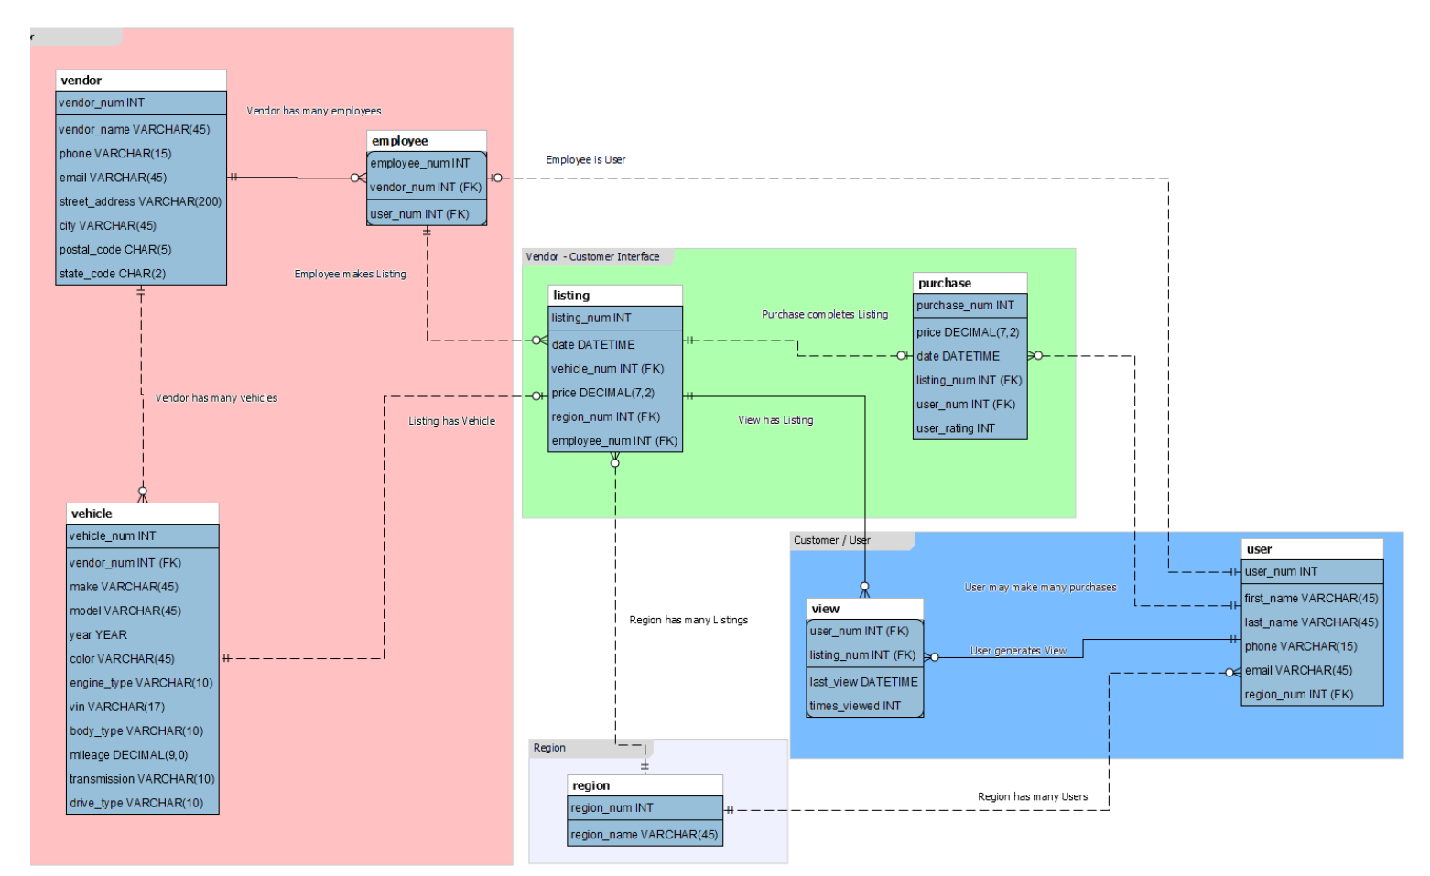

Slide 6
Team 3
Application Demo

