Slide 1
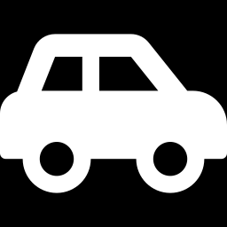
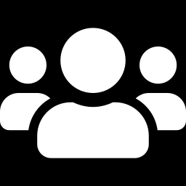
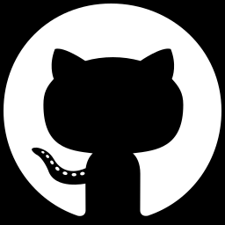



Vehicle Silhouette
Classification using
K-Nearest Neighbors
(K-NN)
Team Members
Name | Roll No.
Raunit Sinha | 241001001252
Anubhab Pal | 241001001194
Sk Sohel Hossain | 241001001206
Pushpesh Kant Ojha | 241001001233
Assignment : K-means or K-NN Algorithm Implementation
GitHub repository
Introduction to Machine Learning
Instructor: Kalpita Dutta
github.com/torchowl/vehicle-knn-classification
7 November 2026
Notes:
Hello everyone, we are presenting our Assignment 1 project: classifying vehicle types from silhouette measurements using the K-Nearest Neighbors algorithm. This is for Introduction to Machine Learning with Professor Kalpita Dutta. The code is public on GitHub and the full notebook is on Colab.

Slide 2


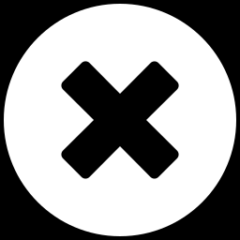
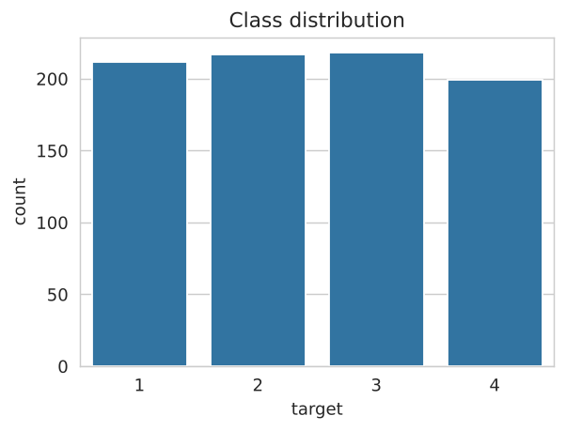
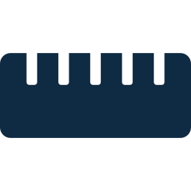



Problem, Dataset and Why K-NN
Goal: predict 1 of 4 vehicle types from 18 silhouette measurements
Why K-NN and not K-means?
K-NN
K-means
Statlog Vehicle Silhouettes (UCI, via Kaggle)
Supervised: learns from labels. Our data has labels.
Unsupervised: finds groups and ignores labels.
846
18
samples
features
How K-NN works
4
0
1
Measure the distance to all training points
classes
missing values
Balanced: about 200 to 218 per class
2
Pick the K closest neighbors
Feature ranges differ hugely: MINORVARIANCE up to 1018 vs. MINORSKEWNESS up to 22. Scaling is essential.
3
The neighbors vote on the class
Notes:
Our goal is to predict one of four vehicle types from 18 numbers measured on the vehicle's silhouette. The dataset has 846 samples with balanced classes and no missing values. Because the data has labels, we use K-NN, which is supervised, instead of K-means. Also, feature ranges differ a lot, so we must scale them before using distances.

Slide 3
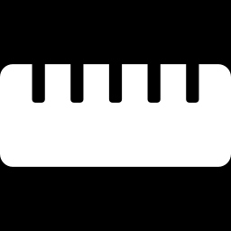


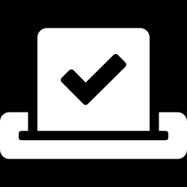

Methodology and Key Concepts
1
2
3
4
5
6
7
8
Load data
Stratified 80/20 split (676 / 170)
Baseline K-NN (K=5, no scaling)
StandardScaler inside a Pipeline
Choose K with 5-fold CV
GridSearchCV tuning
Extras: PCA and data augmentation
Final evaluation on the test set
Feature scaling
Pipeline
Core code
Puts all features on a similar range so none dominates the distance.
Scaling happens inside each fold, which prevents data leakage.
pipe = Pipeline([("scaler", StandardScaler()),
("knn", KNeighborsClassifier())])
grid = GridSearchCV(pipe, {
"knn__n_neighbors": range(1, 31),
"knn__weights": ["uniform", "distance"],
"knn__metric": ["euclidean", "manhattan",
"minkowski"]}, cv=5)
grid.fit(X_train, y_train)
Cross-validation
Hyperparameters
Tests each K on 5 different train and validation folds.
Settings we choose: K, weights and distance metric.
Tries every combination of K, weights and metric, scored with 5-fold CV.
Notes:
This is our pipeline from start to finish. We split the data 80/20, trained a simple baseline, then added scaling inside a Pipeline so the test data never leaks into training. We chose K with 5-fold cross-validation and used GridSearchCV to tune K, the weights and the distance metric. PCA and noise augmentation were extra experiments, and everything was judged on the untouched test set.

Slide 4
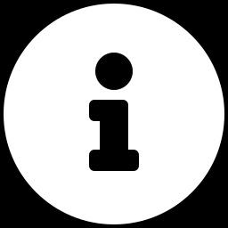
Optimization Techniques and Results
+5.29
points from scaling: the biggest gain
+1.17
points from tuning. Best: K=9, Manhattan, distance-weighted voting
18 to 7
features with PCA, almost no accuracy loss
68.24%
with noise augmentation: it HURT accuracy
Amber = best model (71.76%). Chart axis starts at 60%.
Note: Optimizers and activation functions do not apply to K-NN. It has no learnable weights or gradient descent.
Notes:
Each technique was tested on the same held-out test set. Scaling gave the biggest jump, from 65.29 to 70.59 percent, and tuning with GridSearchCV reached our best result of 71.76 percent with K=9, Manhattan distance and distance-weighted voting. PCA kept almost the same accuracy with only 7 features, but noise augmentation made things worse, and we report that honestly. Optimizers and activation functions do not apply here because K-NN has no weights to learn.

Slide 5
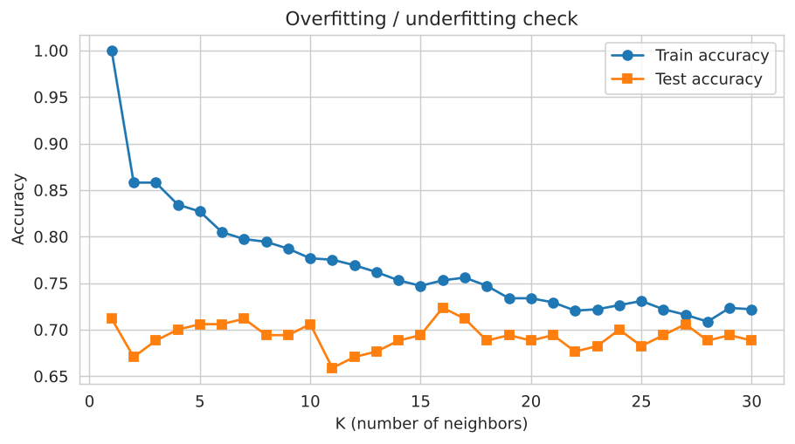
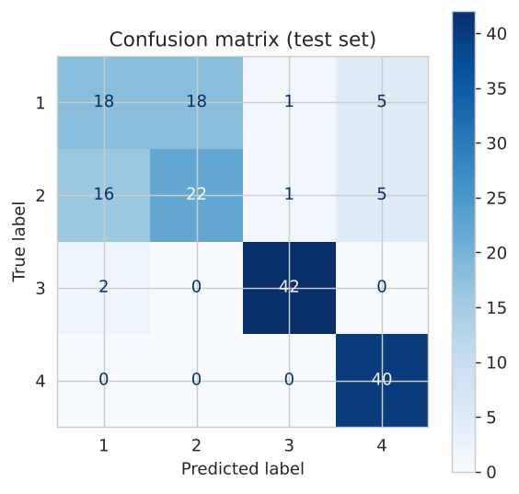
Analysis and Insights
Overfitting check: train vs. test accuracy
Confusion matrix (test set)
At K=1 training accuracy is 100% but test accuracy is about 71% (overfitting). The gap shrinks as K grows, with no clear underfitting up to K=30.
Classes 3 and 4 are recognized very well (F1 0.95 and 0.89). Most errors are classes 1 and 2 confused with each other (34 of 48 mistakes).
Final test accuracy: 71.76%
Notes:
On the left, with K=1 the model memorizes the training data (100 percent) but only gets about 71 percent on the test set, which is overfitting. As K grows the gap shrinks and we see no clear underfitting. On the right, classes 3 and 4 are easy, while classes 1 and 2 look alike and cause 34 of the 48 mistakes.

Slide 6


Conclusion, Limitations and Future Work
Key takeaways
Limitations
1
Scaling is essential for distance-based models
Single 80/20 split. Small test set: 170 samples, so one sample is worth about 0.6 points.
2
Tuning gives modest gains
3
More complex preprocessing does not always help
Future work
Compare with Random Forest and SVM, try feature selection, and use multiple random splits.
4
Classes 1 and 2 overlap strongly
https://github.com/torchowl/vehicle-knn-classification
Thank you!
GitHub repository
https://colab.research.google.com/drive/1TrjFU_hu8jOK9p4syHejX0WG6ULTLTzy
Colab notebook
Notes:
To sum up: scaling matters most for K-NN, tuning helps a little, and fancier preprocessing like noise augmentation does not always help. Classes 1 and 2 overlap strongly, which limits accuracy. Our test set is small, so one sample is worth about 0.6 points, and next we would compare with Random Forest and SVM. Thank you, we are happy to take questions.

