Slide 1
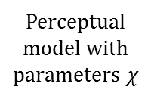






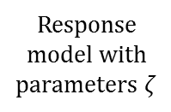
Agent
World
Sensory input
Perceptual
model with
parameters $χ$
$$χ$$
$$u$$
Inferred
hidden states
$$λ$$
$$x$$
True
hidden states
Response
model with
parameters $ζ$
$$ζ$$
$$y$$
Response

Slide 2






Agent
World
Sensory input
(given)
Perceptual
model
?
$$u$$
Perceptual
parameters
Parameter
estimation
$$χ$$
$$λ$$
True hidden
states
Inferred
hidden states
?
$$x$$
Implied trajectories
of beliefs about
hidden states
$$ζ$$
Response
model
?
$$y$$
Response
parameters
Response
(observed)

Slide 3




Agent
World
Perceptual
model
(parameters
given)
Sensory input
(given)
Implied trajectories
of beliefs about
hidden states
$$χ$$
$$u$$
Simulation
$$λ$$
True hidden
states
Inferred
hidden states
?
$$x$$
$$y$$
Response
model
(parameters
given)
$$ζ$$
?
Responses
Response

Slide 4

Agent
World
Perceptual
model
(parameters
given)
Sensory input
(given)
$$χ$$
$$u$$
Implied trajectories
of beliefs about
hidden states
Simulation
True hidden
states
Inferred
hidden states
?
$$x$$
$$λ$$

Slide 5
Agent
World
Sensory input
(given)
Perceptual
model
?
$$u$$
Inferred
hidden states
?
$$x$$
True
hidden states
Response
model
?
$$y$$
Response
(observed)

