Slide 1

PRIORITY QUEUES AND FAIR SHARING
WITH SQS AND LAMBDA
Salvatore Caputi
AWS User Group Venice – 2026-09-24

Slide 2





WHO AM I?
Solutions Architect
@Pixartprinting
Kenjutsu practitioner
@Bushido Dojo Venezia
Bojutsu practitioner
@Bushido Dojo Venezia
Iaido practitioner
@Bushido Dojo Venezia

Slide 3

WHO AM I?
Solutions Architect
@Pixartprinting
Kenjutsu practitioner
@Bushido Dojo Venezia
Bojutsu practitioner
@Bushido Dojo Venezia
Iaido practitioner
@Bushido Dojo Venezia

Slide 4
THE CONTEXT
Service that manipulates pdf files running on Batch
~15k execution per day
Execution duration from few seconds to 50 minutes
Cap to concurrent executions

Slide 5
THE NEED
Give precedence to high priority jobs (e.g. order that must be delivery today).
Resources equally shared among several value streams.

Slide 6
WHY NOT BATCH?
In 2022 we tested priority jobs and fair sharing features.
It didn’t work.

Slide 7
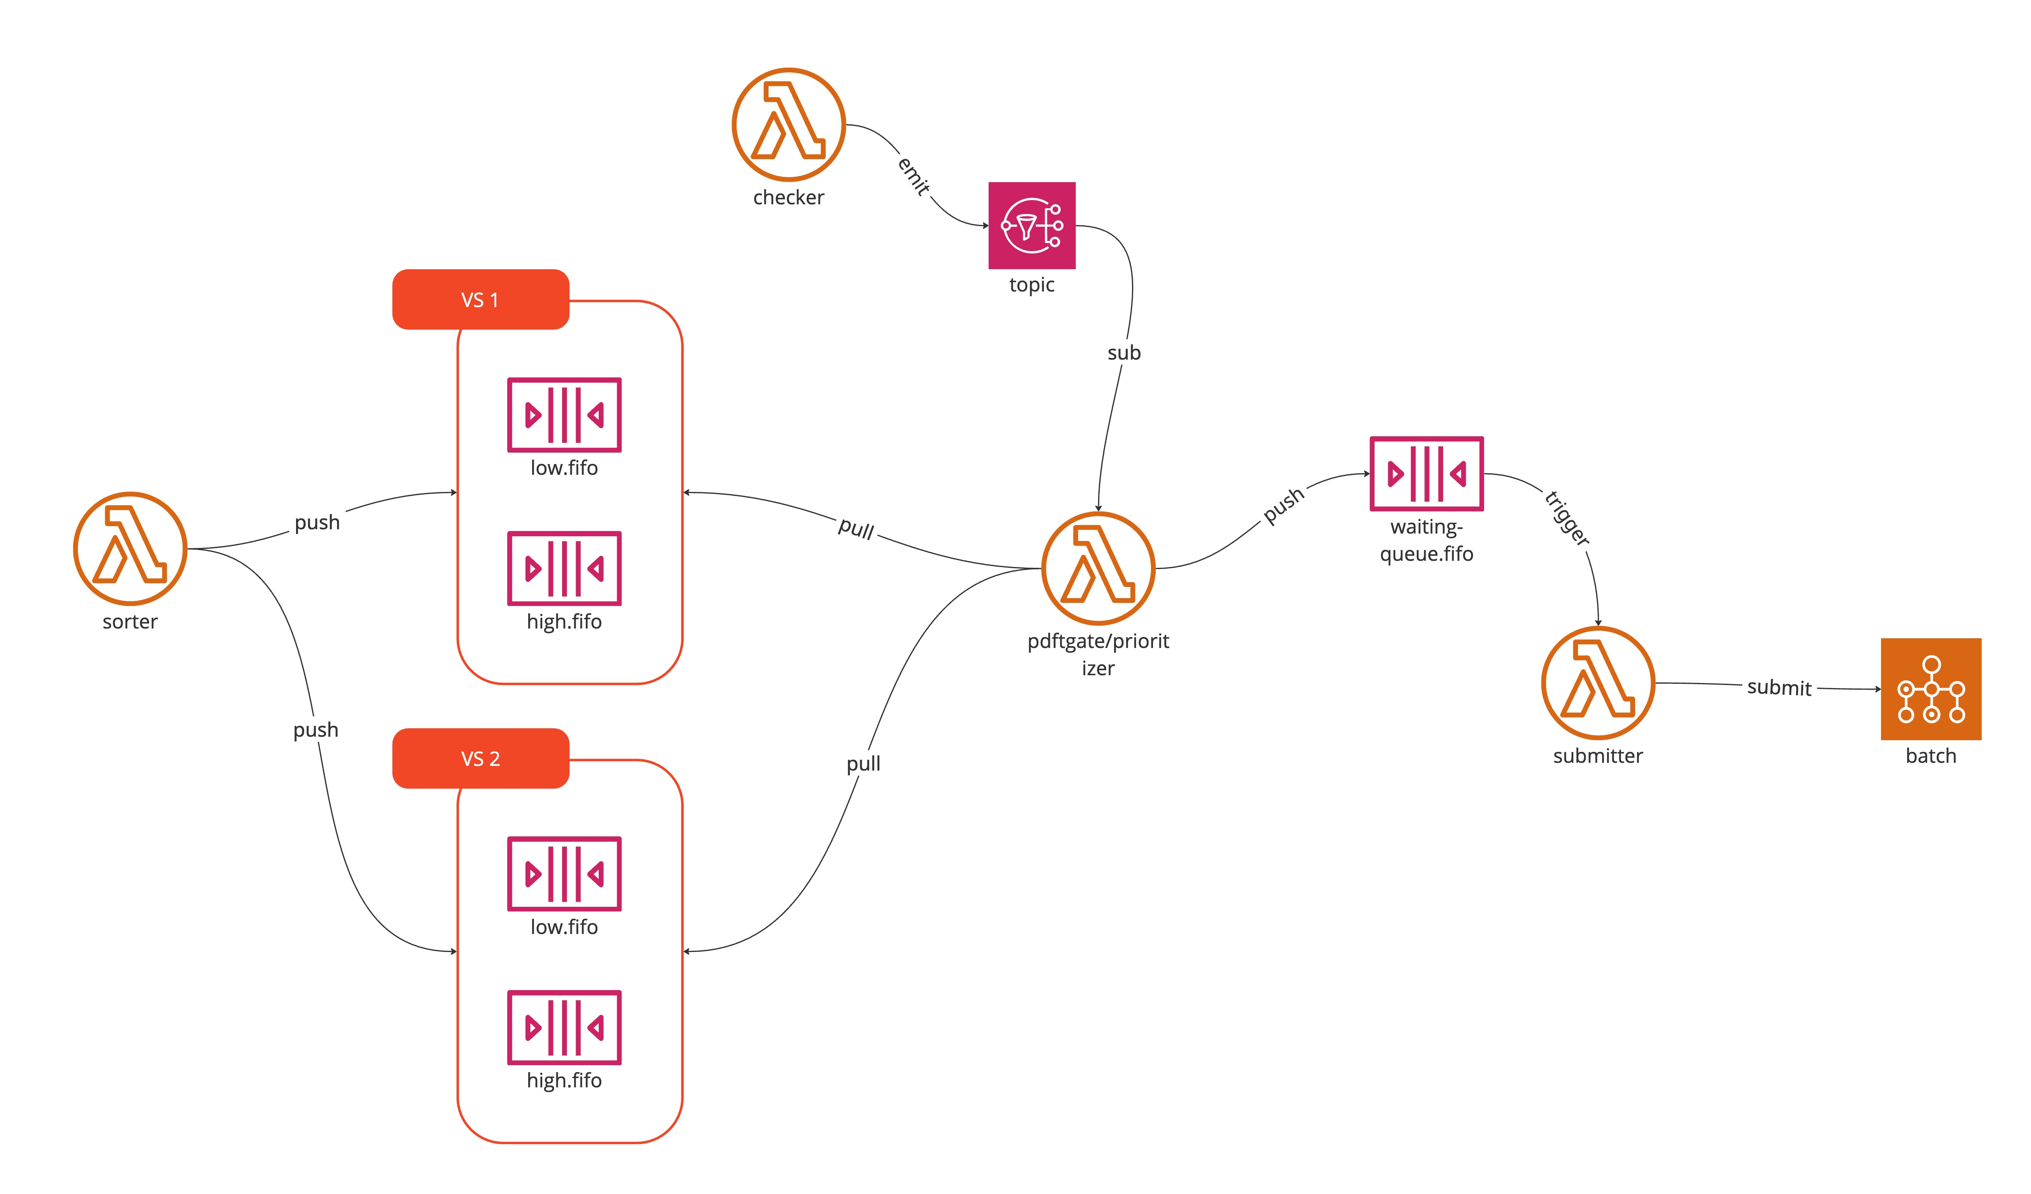
INFRASTRUCTURE

Slide 8
SORTER
Extract tag and priority from message
Sort the message to proper queue
If tag doesn’t match any queue, use a default queue

Slide 9
CHECKER
Count the total of pending jobs in Batch queue
Count the size of messages into waiting queue
Sum them and compare with a given threshold
If sum is lower, send an event to Prioritizer

Slide 10
PRIORITIZER
Check if the message is recent
Loop over all active high-priority queues until batchSize or maxAttempts has been reached
If the batch has still room, loop over all active low-priority queues until batchSize or maxAttempts has been reached

Slide 11
PRIORITIZER
Queues are weighted, so a value stream may have more resources than other
A single loop, either high or low priority, reaches all active queues, this guarantee a fair-sharing among all value streams. This could result in a batch size greater than batchSize value.

Slide 12
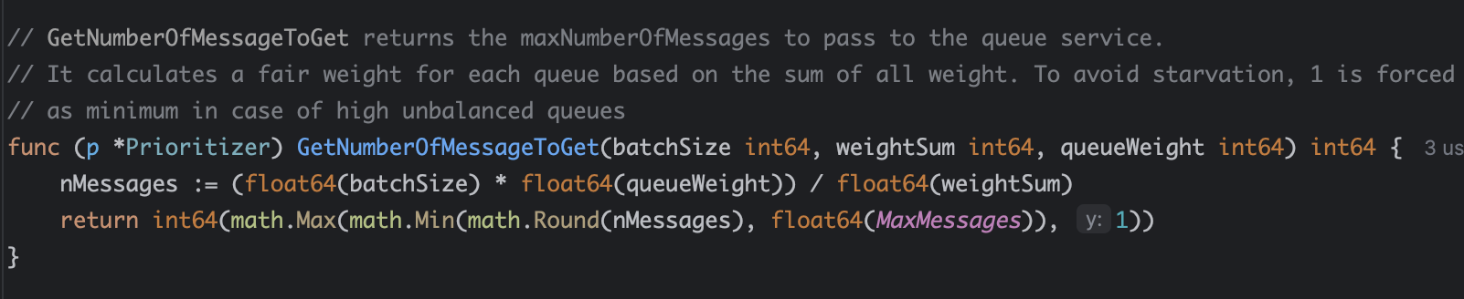
PRIORITIZER

Slide 13
case | batch size | q | weight | weightSum | available in queue | requested | fetched | notes
one 3/2 | 3 | q1 | 1 | 1 | 2 | 3 | 2 | single queue
one 3/3 | 3 | q1 | 1 | 1 | 3 | 3 | 3 | single queue
two 4/4 | 4 | q1 | 1 | 2 | 2 | 2 | 2 | two equal queues equal availability
two 4/4 | 4 | q2 | 1 | 2 | 2 | 2 | 2 | two equal queues equal availability
two unbalanced | 8 | q1 | 1 | 2 | 10 | 4 | 4 | q1 has plenty of messages
two unbalanced | 8 | q2 | 1 | 2 | 2 | 4 | 2 | q2 requests 4 but only 2 available -> fetched capped by availability
two different weight | 12 | q1 | 2 | 3 | 10 | 8 | 8 | double weight -> double share
two different weight | 12 | q2 | 1 | 3 | 10 | 4 | 4
Notes:
requested = GetNumberOfMessageToGet
fetched = min(requested, available)

Slide 14
case | batch size | q | weight | weightSum | available in queue | requested | fetched | notes
many queues small batch - overshoot | 3 | q1 | 1 | 5 | 10 | 1 | 1 | anti-starvation floor: 5 equal queues x 1 = 5 total > batchSize 3
many queues small batch - overshoot | 3 | q2 | 1 | 5 | 10 | 1 | 1 | anti-starvation floor: 5 equal queues x 1 = 5 total > batchSize 3
many queues small batch - overshoot | 3 | q3 | 1 | 5 | 10 | 1 | 1 | anti-starvation floor: 5 equal queues x 1 = 5 total > batchSize 3
many queues small batch - overshoot | 3 | q4 | 1 | 5 | 10 | 1 | 1 | anti-starvation floor: 5 equal queues x 1 = 5 total > batchSize 3
many queues small batch - overshoot | 3 | q5 | 1 | 5 | 10 | 1 | 1 | anti-starvation floor: 5 equal queues x 1 = 5 total > batchSize 3
two high unbalanced | 10 | q1 | 200 | 201 | 10 | 10 | 10 | dominant queue capped at MaxMessages (10)
two high unbalanced | 10 | q2 | 1 | 201 | 10 | 1 | 1 | anti-starvation floor: near-zero share still gets 1 -> total 11 > batchSize 10
Notes:
requested = GetNumberOfMessageToGet
fetched = min(requested, available)

Slide 15
WHAT IF…
A VS has corrupted messages | Disable polling from VS queues
A VS has huge number of messages | Increase weight / Disable other queues
Batch max concurrency has been increased | Increase batchSize
Batch needs to be stopped | Stop the prioritizer, messages are still enqueued
A request has been cancelled | Yet to be implemented ☺

Slide 16


