Slide 1
Subnetting

Slide 2
Subnet Mask
Designates which part of the IP address is for network or host use
Subnetting is the manipulation of the subnet mask to get more addresses
Network is identified by the first or first few octets
Identified by the mask written in dotted decimal or CIDR notation
Match the physical layout of the organization
Match the administrative structure of an organization
Reduce network traffic

Slide 3
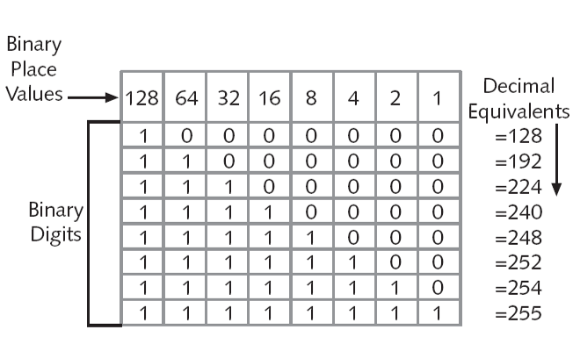
Notes:
An IP address has 32 bits divided into four octets
Each octet has one byte which is equal to eight bits

Slide 4
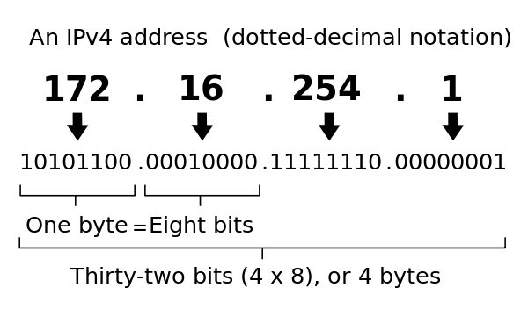
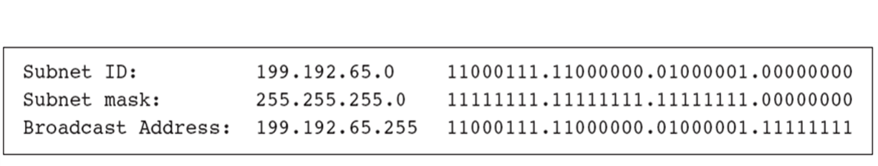
Dotted Decimal Notation

Slide 5
Classless Inter-Domain Routing (CIDR)
Developed to slow the exhaustion of IP addresses
Based on assigning IP Addresses on criteria other than octet boundaries
CIDR addressing method allows the use of a prefix to designate the number of network bits in a mask
Example: 200.16.1.48/25
The first 25 bits are the network bits and will be “on” for all subnets within this network

Slide 6
Classes
Class A: Reserved for governments and large corporations (16,777,214)
Class B: Large and medium sized companies (65,534)
Class C: Groups that do not meet the above criteria (254)
Class D: Reserved for multicast, one to many. (Streaming audio and video)
Class E: Research, testing and experimentation.
Private IP Ranges: Internal use only. They must route through a gateway device before going out to the internet.

Slide 7
Broadcast
Broadcast address
When the entire host portion of an IP address is all binary ones
Examples: 190.55.255.255 and 199.192.65.63
Flooded broadcasts
Broadcasts for any subnet
Use the IP address 255.255.255.255
A router does not propagate flooded broadcasts because they are considered local
Directed broadcasts are for a specific subnet
Routers can forward directed broadcasts
For example, a packet sent to the Class B address 129.30.255.255 would be a broadcast for network 129.30.0.0

Slide 8
The most important thing to know about subnetting.
There are a plethora of calculators available!
https://mxtoolbox.com/subnetcalculator.aspx

