Slide 1
EDES 301
Drink Dispenser Proposal
10/2/2026
Tori Barrera

Slide 2
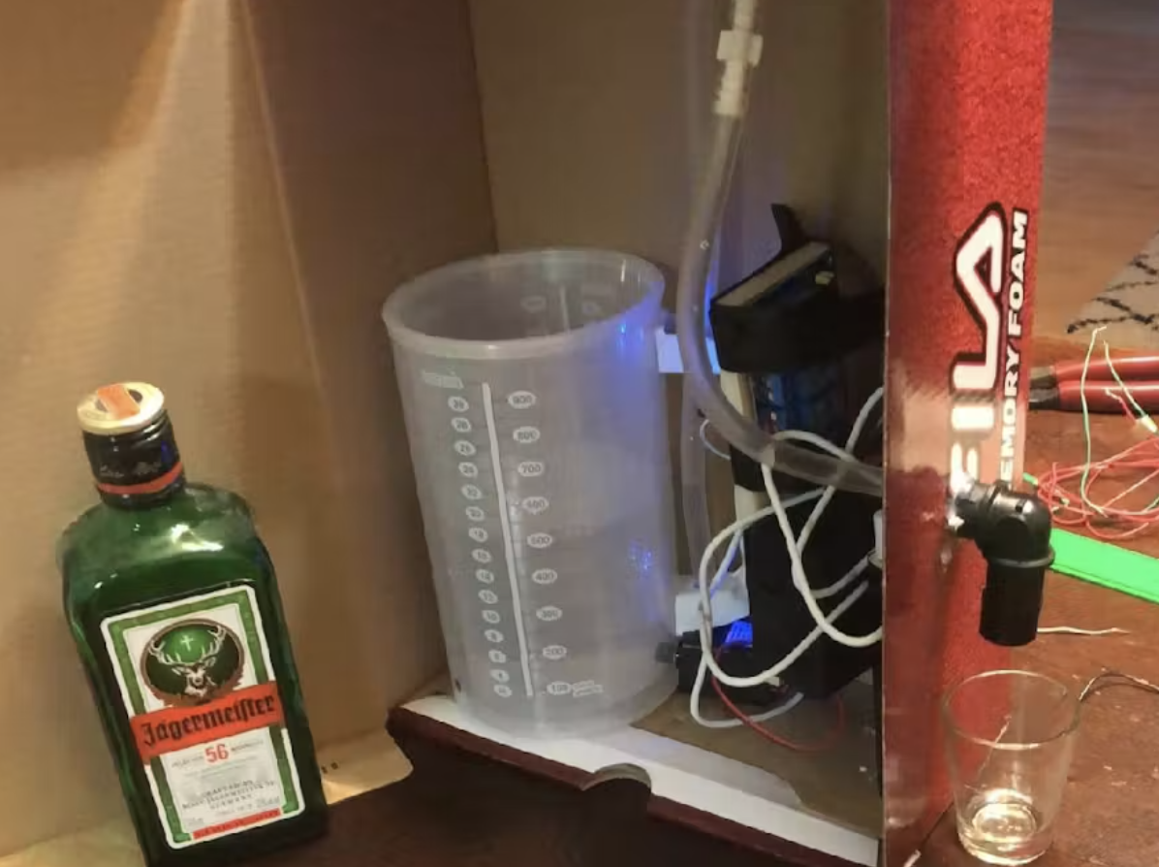
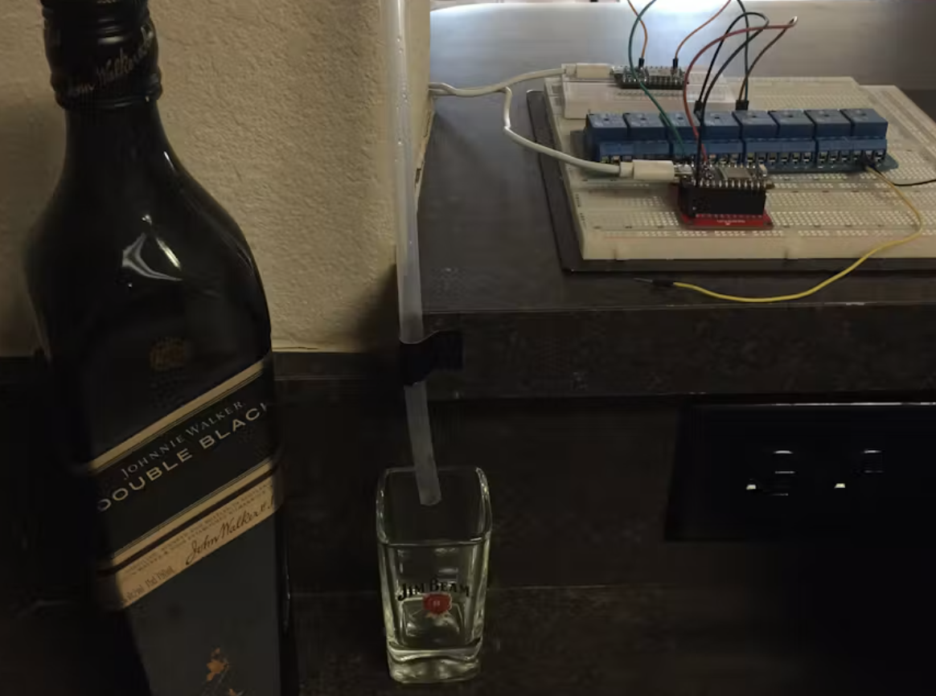
Background Information
Device Function
  Drink dispenser
  Buttons dispense different drinks
  Mix & pour drinks easily with no mess
Project Inspiration
  2 photon wireless shot dispensers
    Shotomatic
    Automatic Shot Dispenser
  Timed drink dispenser w/ air pump
    Automatic Soda Dispenser
Device Improvements
  Previous versions only dispense for a set time/volume
  My device will dispense for as long as the button is pushed
    Works for different drink volumes
  My device will dispense multiple drinks
    Works for mixing drinks
  My device will have a set button that mixes your favorite drink

Slide 3
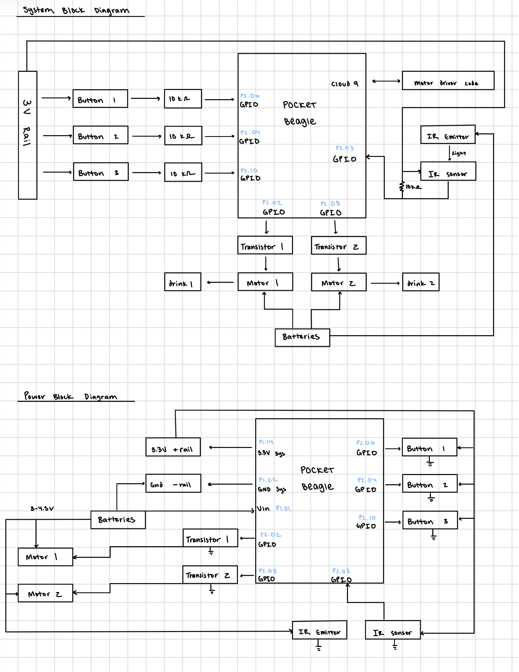
System Block Diagram

Slide 4
Power Block Diagram

Slide 5
Components / Budget
Component | EDES301 to Buy? | Cost
Submersible mini DC motors (4pk) | Yes (Amazon) | 9.96
Food safe silicone tubing | Yes (Amazon) | 5.98
IR break beam sensor (1x) | Yes (Amazon) | 7.99
TOTAL COST |  | 23.93
Additional Materials (no purchase necessary)
OEDK provided: Hot glue gun, resistors (4x 10 kΩ), wires, beagle board, scissors, buttons (3x), USB A to USB C converter, NPN transistors (2x PN2222), diodes (2x 1N4001), batteries (3x AA)
Servery provided: Cup, drinks, drink containers

