Slide 1


FLASH
STUDY
Senior Project 2023

Slide 2
App Quick Facts
Written in Swift using xCode
Designed to be application similar to Quizlet
Flashcards
Multiple Choice
Writing Definitions from memory
Uses JSON files to read in data

Slide 3
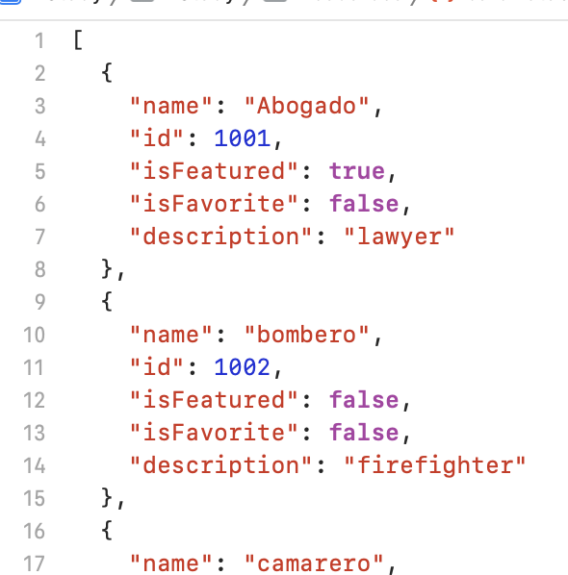

JSON File example
Broken into structs
struct Cardset: Hashable, Codable, Identifiable {
var id: Int
var name: String
var description: String
var isFavorite: Bool
}

Slide 4
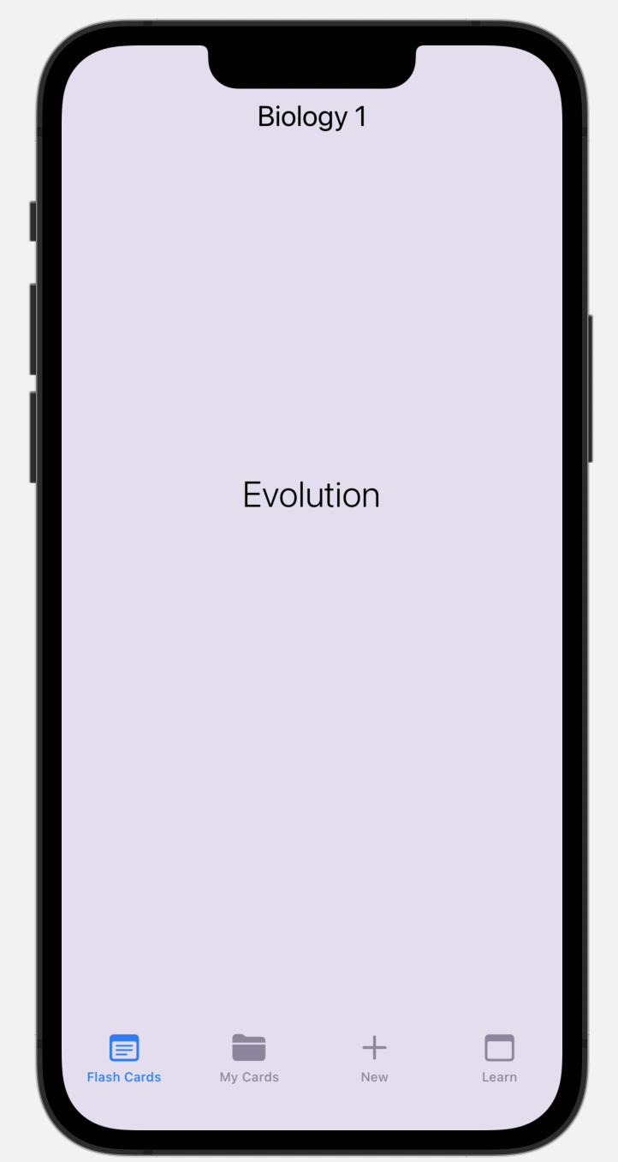
Home Screen
Tab View on the bottom
Menu screen on top to switch between sets
Swipe left and right to switch words
Tab word to see definition

Slide 5
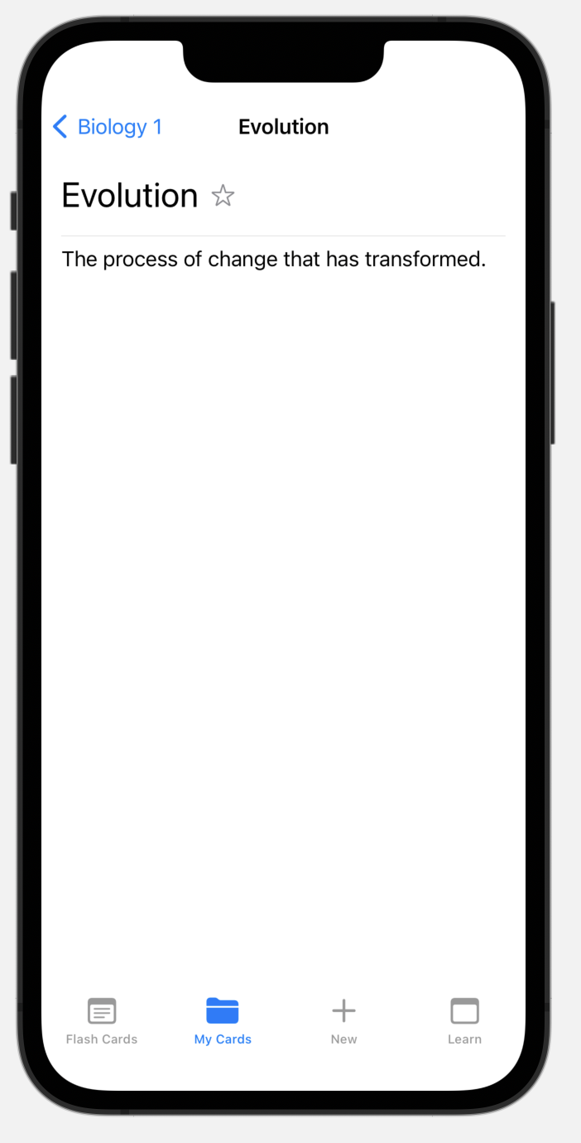

View Word and its definition
Favorite or unfavorite the item

Slide 6
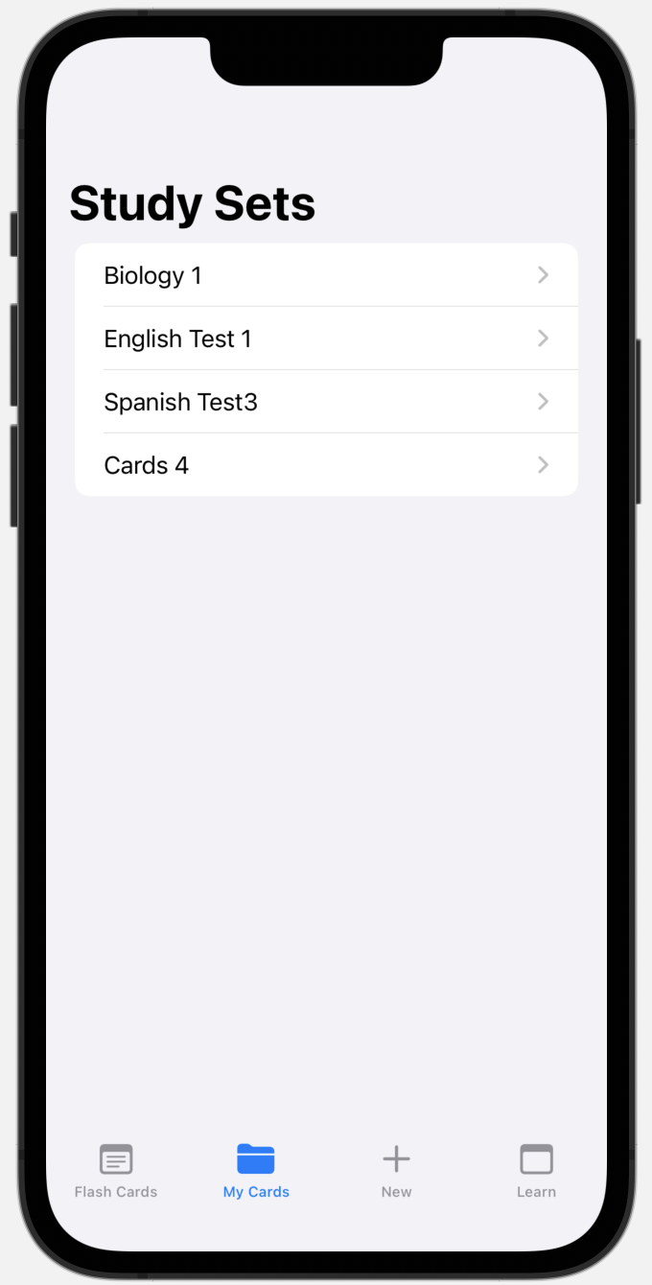
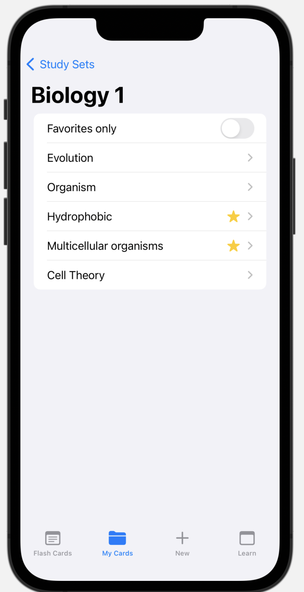
Navigate through your to study sets
Delete Study sets by swiping
See a list of words to study and filter by favorites

Slide 7
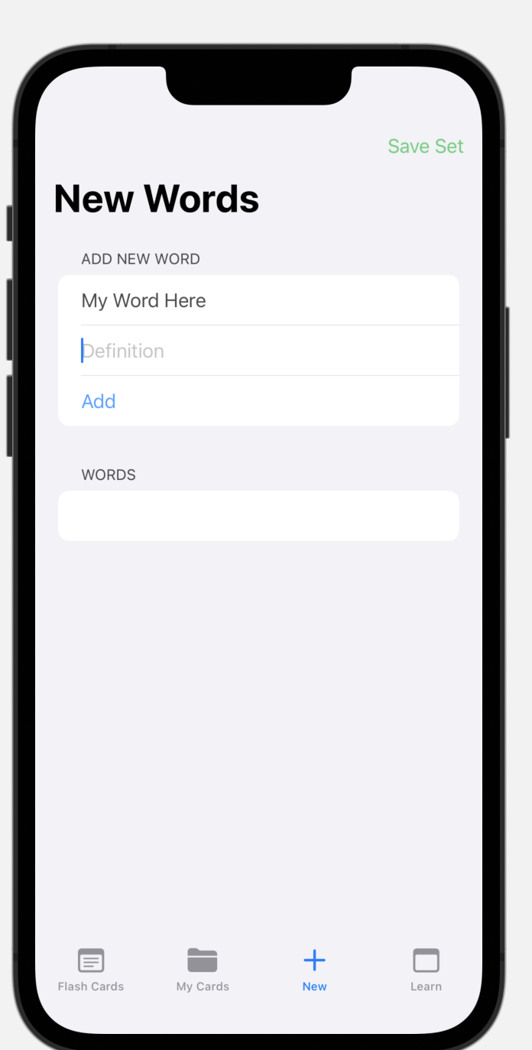

Create New Study Sets
Input your words and matching definitions
Save to study later

Slide 8
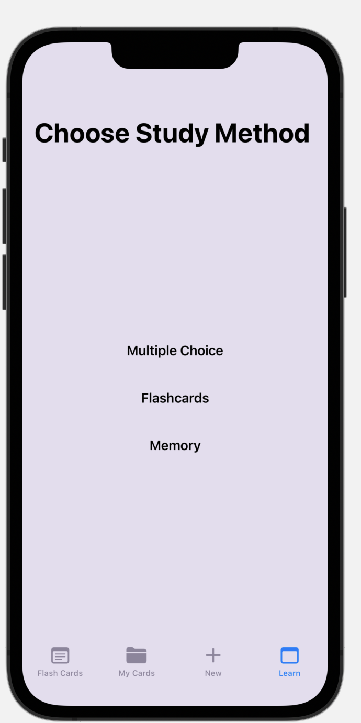
Go Beyond flashcards with other study methods

Slide 9
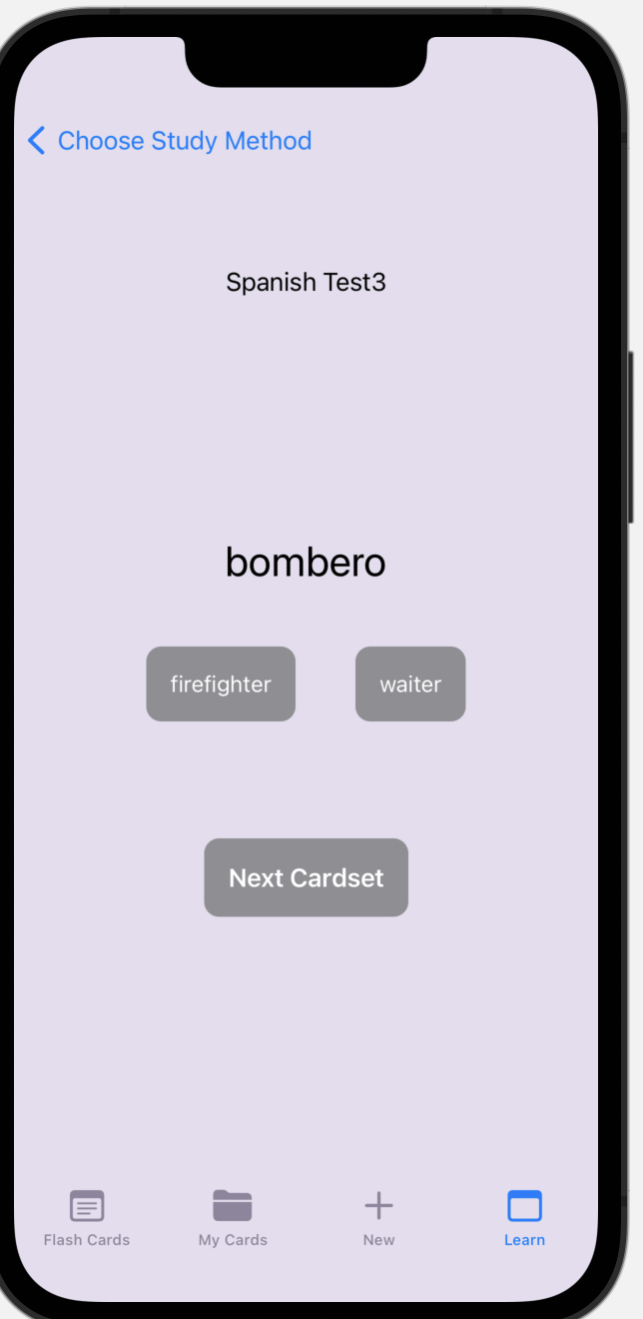
Multiple Choice
Click on study set name to change the selected study set
Choose between answers as means to study

Slide 10
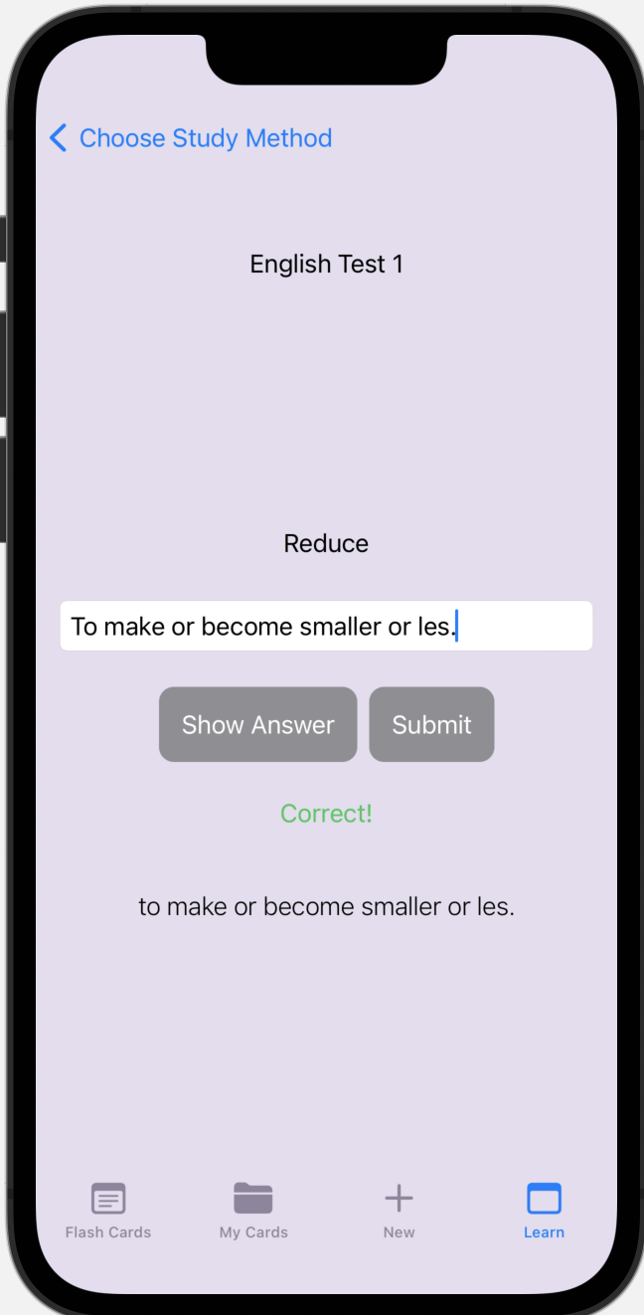
Type Answer
Click on study set name to switch sets
Swipe left and right to switch words
Type answer and press submit to check
If you can’t figure out answer you can click show answer

Slide 11
DEMO

