Slide 1
Propensity Score Matching to Determine the Effectiveness of ALEKS
Torina Lewis, Ph.D
Clark Atlanta University

Slide 2
Introduction -- Blog Post
Just in from education guru & ReSeArChEr!!!!!!!!!!!!!!! Dr. Torina Lewis, a professor in the department of mathematical science at Clark Atlanta University, has begun an analysis of Assesment in Learning and Knowledge Spaces (ALEKS). The company claims high educational gains for a nominal fee of $97. Some users state that their growth in mathematical knowledge is upward of 2.5 years for every year using ALEKS. Could it be that the company is fabricating their story, or can the courseware company ALEKS deliver? In a study of approximately 350 African American students at a Historically Black College and University, evidence shows that ALEKS may not be all that it is cracked up to be. Dr. Lewis performed a propensity score matching experiment. Propensity score matching is a statistical technique in which a treatment case is matched with one or more control cases based on each case’s propensity score. The results show... you will have to tune in next week. Stay tuned and woke….

Slide 3
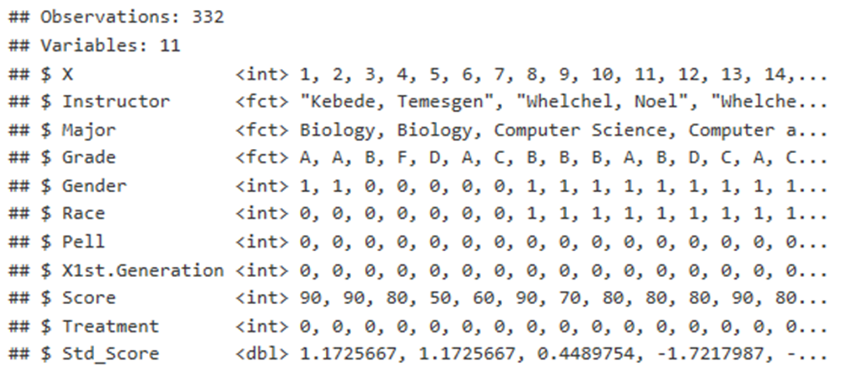

Data Set
The data set was provided in a nearly cleaned manner. However, multiple data wrangling techniques were performed on the data frame to transom it into a document that can be analyzed. These techniques include removing unnecessary variables, changing the names of some columns, adding variables, and including functions for calculation. As expected, there are 332 rows with 11 variables inside of the data set. Additionally, the type of variables is apparent from this view. It is more beneficial to change the treatment variable from a number to a factor since it determines whether a student received the treatment or not. This change was completed.

Slide 4
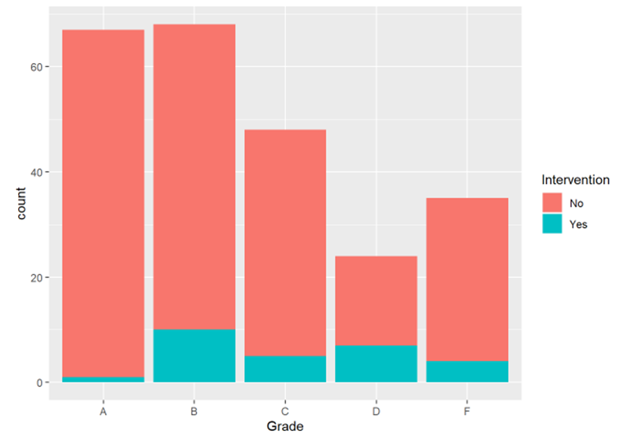
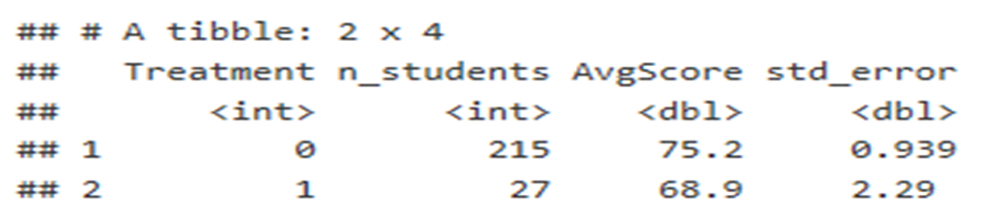
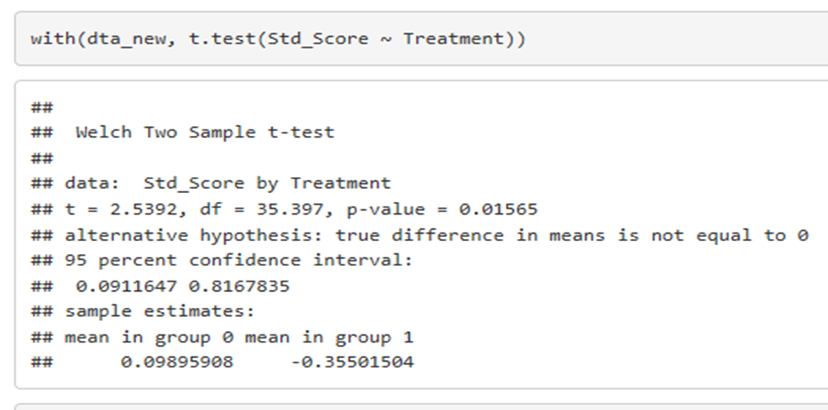
Methodology - Statistical
Figure 1: shows a visual interpretation of the grades the students earned in the treatment and the control groups. Figure 2: displays the mean for the control and treatment groups. In figures 1 and 2 there is definitely a difference in mean. A t-test can provide further analysis. The code and results for the t-test is annotated in figure 3..

Slide 5
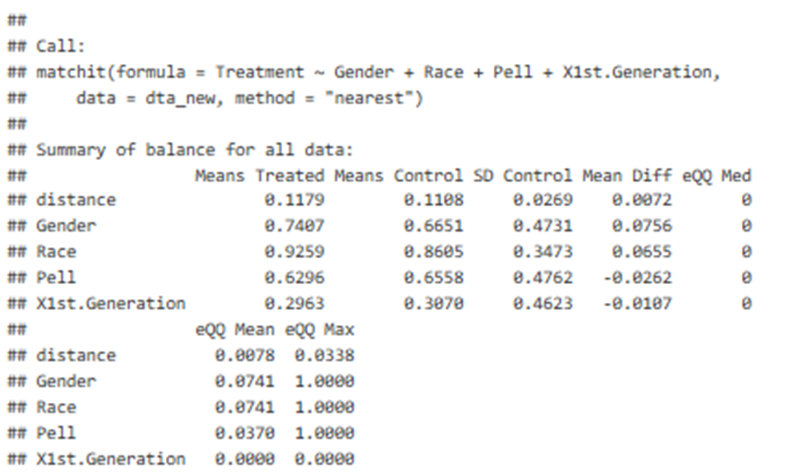
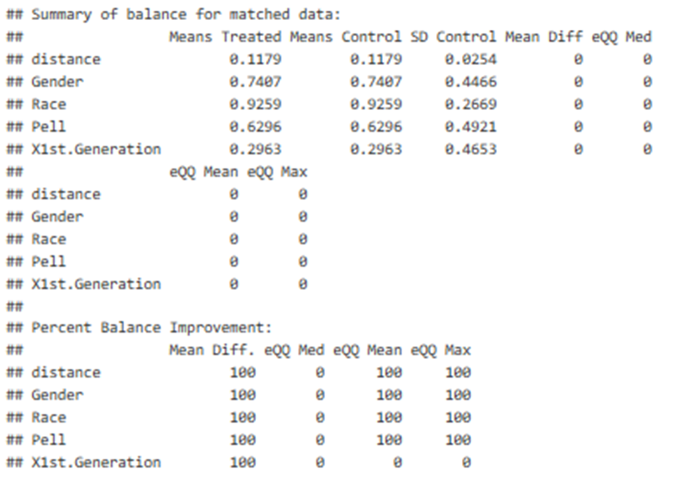
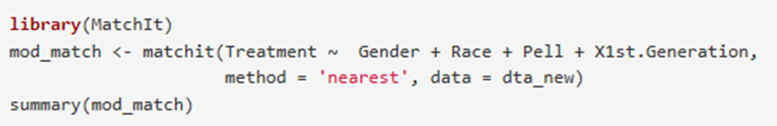
Methodology - MatchIt
Just as anticipated, p < 0.05 in the t-test, and the null hypothesis is rejected. That is, there is a difference in the means. We continue to mathch the data using the “MatchIt” package in rStudio to complete the propensity score matching. Propensity score matching is a statistical technique in which a treatment case is matched with one or more control cases based on each case’s propensity score. This matching can help strengthen causal arguments in quasi-experimental and observational studies by reducing selection bias.

Slide 6
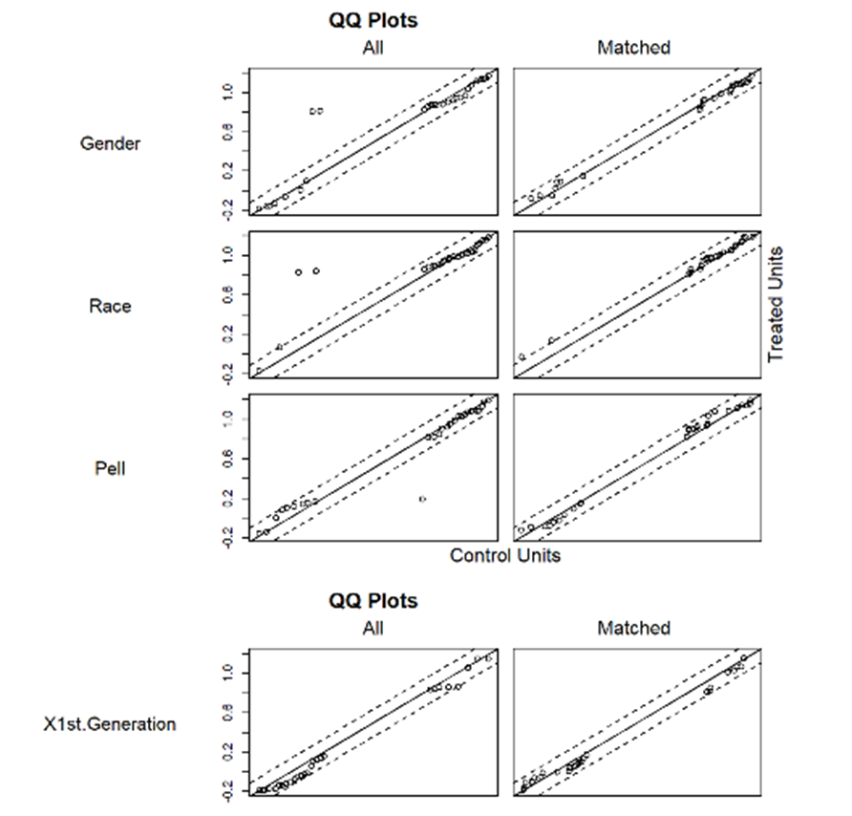
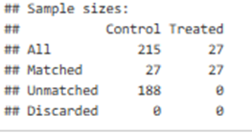
Figure 5c: The propensity score visual matching

Slide 7
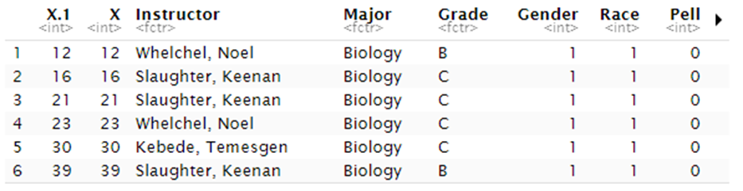
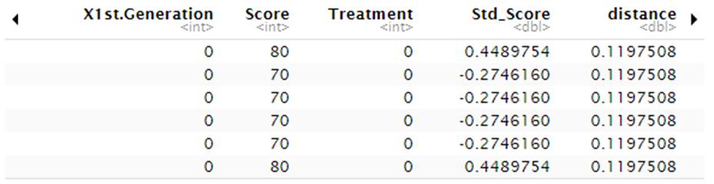
Results & Future Work
The results show that the matching worked well with the data set as all of the students in the treatment group were matched to a student in the control group. In the summary of balance for all data section of the table, before matching, there were slight differences in treated and control means. After matching, there was no difference in the means. The quartile (QQ) columns in these summary data show the median, mean, and maximum quartile between the treated and control data; smaller QQ values indicates better matching. Note that the QQ values were 0 after matching. We are interested in whether the control or treatment group performed better in Calculus I in terms of achievement. That data has been matched, and the next steps are to analyze the matched data. Since score is a continuous variable, linear regression would be a tool to explore. The matched data is shown in figure ???.

