Slide 1
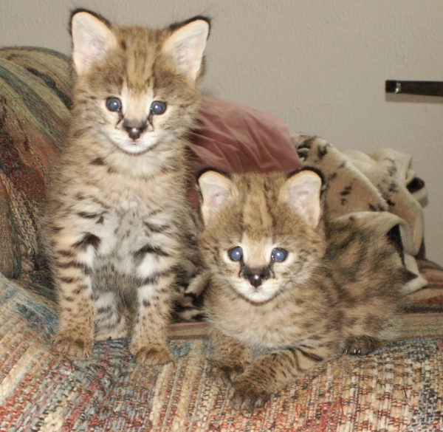
Designing a Multipath Transport Protocol for Serval
Torin Rudeen
Princeton University
IW Presentation
19-Feb-2013

Slide 2
What is Serval?
The problem:
  Internet in 1980 vs. internet in 2013
  Hosts vs. Services
Major features
  Service IDs instead of IP addresses
  Seamless migration
  Multipath?

Slide 3
The Serval Network Stack
Serval Network Stack
Traditonal Network Stack
Application Layer
Application Layer
Transport Layer
Transport Layer
Service Access Layer
Network Layer
Network Layer
Link Layer
Link Layer

Slide 4

Multipath TCP (MPTCP)
Functioning multipath version of TCP
Open source implementation for Linux
Undergoing standardization process

Slide 5
MPTCP
“How can we make multipath
deployable in today's internet?”
Incremental
Multipath only
Achieve backwards compatibility via additional complexity
Serval
“How can we reimagine the network stack for today's internet?”
Transformative
Multipath, migration, service names, etc.
Find simplest design without worrying about backwards compatibility.
MPTCP and Serval have different (but partially overlapping)
design goals and contexts. Multipath for Serval should borrow
from MPTCP where applicable, but find different solutions where
requirements differ.

Slide 6
Anatomy of TCP
TCP does five things: [1]
Connection establishment
Flow control
Congestion control
Acknowledgements and reliable delivery
Connection teardown

Slide 7
Classic Network Stack
Serval Stack
User-space
Controller
Application
Transport
Application
Transport
Flow control
Congestion control
Reliable delivery
Connection establishment
Flow control
Congestion control
Reliable delivery
Connection teardown
Transport
Service Access
Connection
establishment
Connection
teardown
Transport
Network
Service Access
Network

Slide 8
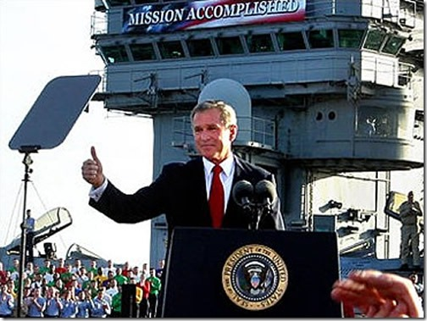
Connection Establishment/Teardown
Handled in the Service Access Layer
Implemented this summer

Slide 9
Congestion Control
Multipath congestion control algorithm should improve throughput for the end hosts, while satisfying fairness constraints.
In other words, make things better for me without making them worse for everyone else.
Researchers working on MPTCP congestion control have translated this principle into three goals for any multipath congestion control algorithm: [4]
  Do no harm
  Improve throughput
  Balance congestion

Slide 10
Do No Harm
Not fair
A multipath connection should not use up more bandwidth at a shared bottleneck than a single path connection.
Strawman #1:
Run single path TCP on each flow independently.
Fair
If it weren't for this criterion, we would trigger a flow “arms race,” where whichever host created the most flows would control the largest share of the resource.
Example from [3]

Slide 11
Improve Throughput
2 Mb/s 3G
A multipath connection should provide at least as much aggregate bandwidth as a single path connection on the best of the available links.
10 Mb/s WiFi
Strawman #2:
Run single path TCP on each flow independently, scaling aggressiveness by 1/n, where n is the number of flows.
1 Mb/s 3G
5 Mb/s WiFi
Example from [3]

Slide 12
Balance Congestion
12 Mb/s
12 Mb/s
12 Mb/s
Example from [3]

Slide 13
Flow Control
Per subflow, or per connection?
Congestion control is per subflow
Per subflow simpler
Unfortunately, per subflow flow control leads to deadlock!

Slide 14
Per subflow flow control allows deadlock [1]
Recieve
window A
Subflow A
Recieve
window B
Subflow B

Slide 15
Reliable Delivery and Acknowledgements
Reordering, retransmission, ACKs, and more.
We have to decide on a sequence number scheme.
  Per connection sequence nums?
  Per subflow and per connection sequence nums?
This is a tradeoff between connection-level complexity and subflow-level complexity.
Choice will influence implementation of flow control and congestion control.

Slide 16
MPTCP's Solution
Separate sequence spaces—per subflow and per connection
Use TCP sequence nums for per subflow sequence nums
Use TCP options for per connection sequence nums
Send special connection-level ACKs using TCP options
Mainly motivated by backwards compatability concerns:
  Middleboxes don't like discontinuous sequence nums
  “Disguise” subflow as a single path TCP connection

Slide 17
Our Solution
?

Slide 18
Dumb Subflows, Smart Connection
As compared to MPTCP's “Smart Subflows, Smart Connection”
Manage everything at the connection level. One connection-level sequence number space.
Subflows have little state.
Everytime a packet needs to be sent, just pick a subflow.
ACKs and retransmitted packets don't need to be on the same subflow as the original packet.
Flow control and acknowledgements become very simple

Slide 19
Issue: Congestion Control
If we use a single sequence number space, how can we implement congestion control on a per subflow basis?
Approach #1: SACK accounting
Remember which packets we sent over which interface, use SACKs to deduce which have been received and which are in flight.
Possibly complicated.
Approach #2: Approximate congestion control
Remember how many packets have been sent over the subflow recently.
Use estimated RTT to estimate how many packets are in flight.
Use this value instead of a congestion window.
Still need to calculate RTT and bandwidth.

Slide 20
Issue: Some Subflow State Needed
For congestion control, we need to know:
  When a packet is lost, which subflow was it sent on?
  When an ACK is received, which subflow was the packet sent on?
MPTCP keeps entire TCP state for each subflow.
Is there some sort of lightweight state we can keep that meets these needs?

Slide 21
Issue: Excessive Reordering
Varying RTTs mean massive reordering, requiring large buffers and lots of CPU time to correct.
Optimization 1: Allocate packets to interfaces in large chunks.
Potential issues if one interface is much slower or fails before it sends its entire chunk.
Requires per subflow state to assemble the chunks on the receiver end.
Optimization 2: Predictive transmission
Don't send packets in order, send so that they'll arrive in order, based on estimated delay-bandwidth product.

Slide 22
Other Issues
Userspace controller—controls what?
  Subflow creation/termination?
  Traffic allocation between subflows?
  How?

Slide 23
Thank you!

Slide 24
References
1. Raiciu et al. "How Hard Can It Be? Designing and Implementing a Deployable
Multipath TCP"
2. Arye, Matvey. "A Formally-Verified Migration Protocol For Mobile,
Multi-Homed Hosts"
3. Wischik et al. "Design, Implementation, and evaluation of congestion
control for multipath TCP"
4. Raiciu et al. "Practical Congestion Control for Multipath Transport
Protocols"
5. Wischik et al. "Control of multipath TCP and optimiziation of multipath
routing in the Internet"
6. Nordstom et al. "Serval: An End-Host Stack for Service-Centric Networking"
7. Podmayersky, Brandon. "An Incremental Deployment Strategy for Serval"
8. Raiciu et al. "Coupled Congestion Control for Multipath Transport
Protocols" (RFC)

